Slide 1

Structured-Depth Image Based Rendering & Depth Enhancement Tool
Pravin Kumar Rana
Sound and Image Processing Lab.(SIP)
KTH - Royal Institute of Technology
SE-10044 Stockholm, Sweden

Slide 2
Outline
Structured-Depth Image Based Rendering
Depth Enhancement Tool: Updates
Depth Pixel Cluster Based Thresholding

Slide 3
Structured-Depth Image Based Rendering (SDIBR)

Slide 4
Connection & Principal Depth Map Extraction

Slide 5
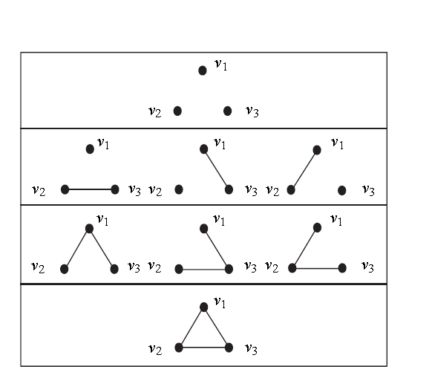
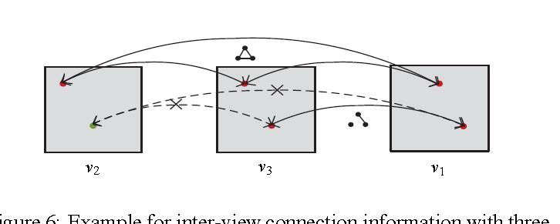
Inter-View Connection Information

Slide 6
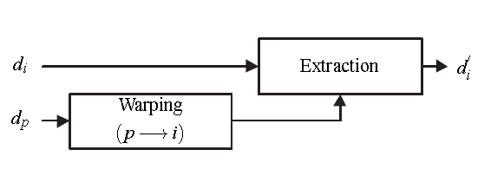
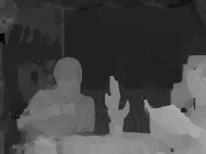

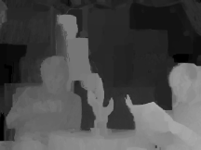
Extraction of Auxiliary Depth Information

Slide 7





Structured Depth Maps
Principal Depth Map
Auxiliary Depth Information

Slide 8
SDIBR Experiments
Multiview Video
Inter-view Connection
Connection Masking
Multiple Depth Maps
Depth Consistency Testing
3D Warping
&
Hole Filling
Multiview Virtual Video
Principal
Depth Map
Auxiliary Depth Info.

Slide 9
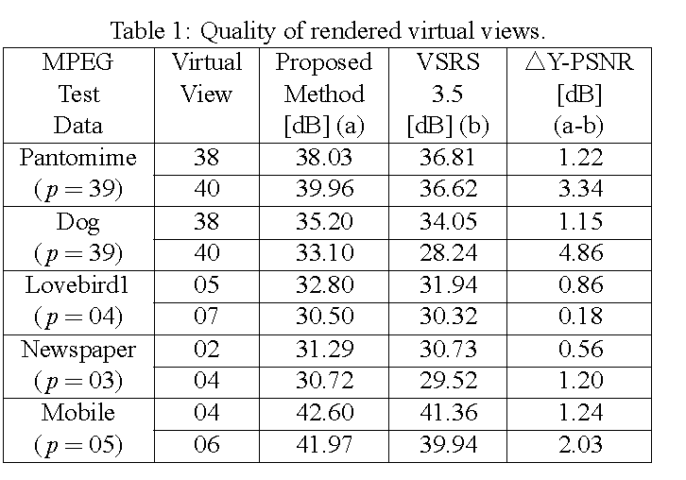
Experimental Results
Quality of Rendered Virtual Views

Slide 10
Conclusions
It exploits the inter-view connectivity information among multiview video and takes advantage of a consistent depth map.
It addresses the problems of inter-view depth inconsistencies and varying illumination conditions.
It permit an appealing 3D scene representation on the encoder side by avoiding depth consistency testing for each interpolated pixel on the decoder side.
It improves the subjective visual quality as well as the objective quality of rendered views

Slide 11
Depth Enhancement Tool
Depth Consistency Testing Algorithm
(DCTA)
Multi-DCTA
Testing pixels in 2
Testing pixels in 1, 2, and 3

Slide 12
Depth Enhancement Tool
Motion
Estimation
Motion
Estimation
Motion
Estimation
Multi-Depth Consistency Testing
Algorithm (MDCTA)

Slide 13
Sub-pel DET Results
Test Sequences | Virtual View | VSRS 3.5 [dB]
 |  | Integer-pel | Half-pel
Kendo | 02 | 37.52 | 37.57
Balloons | 04 | 35.44 | 35.50
Lovebird1 | 05 | 33.00 | 33.03
Newspaper | 05 | 32.00 | 32.01

Slide 14

Depth Pixel Cluster-Based Thresholding
Cluster A
Cluster B
Cluster C
Kendo

Slide 15
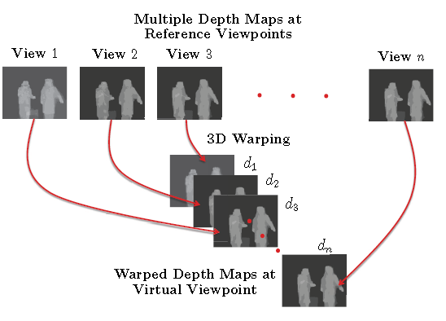
Connection Threshold

Slide 16
Cluster Approach Based Connection Thresholding
Cluster A
Cluster B
Cluster C

Slide 17
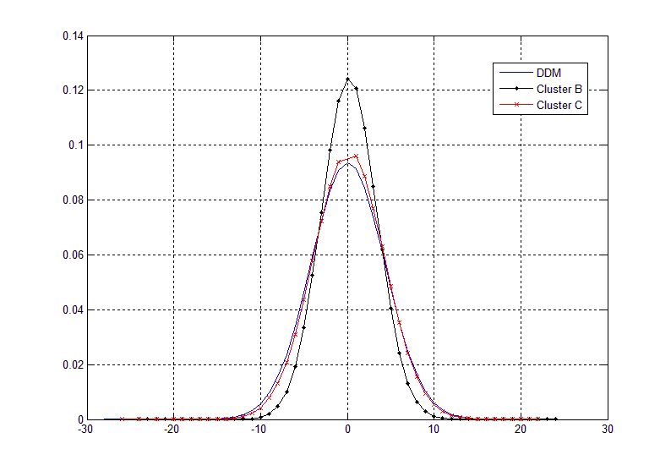
Cluster Distribution
3 Reference-view Scenario

Slide 18
Relative Distance Sub-cluster Classification

Slide 19
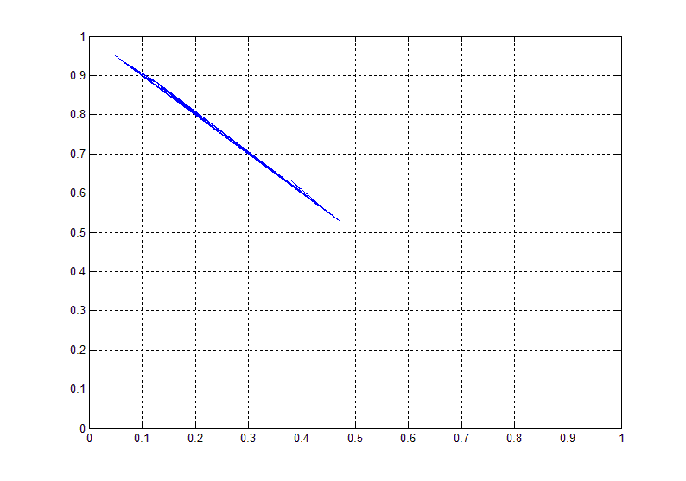
Relative Distance Sub-cluster Classification
3 Reference-view Scenario
C₂
C₁

Slide 20
Connection Threshold
Class A Cluster
Class B Cluster
Class C₁ Cluster
Class C Cluster
Class C₂ Cluster
Class C_{i} Cluster

Slide 21
Experimental Results
4-view Depth Consistency Testing Supported View Synthesis Algorithm
Test Data (50 frames) | Virtual View | T<(μ+λσ) [dB] | Cluster Based Threshold [dB]
Lovebird1 | 05 | 32.0 | 32.3
 | 06 | 29.2 | 29.3
Newspaper | 04 | 30.0 | 30.5
 | 05 | 32.6 | 32.8

