Slide 1

A presentation on…
Prediction of Antarctic Sea Ice Edge Using Active Contour Model
By
PRAVIN KUMAR RANA
(06CL6003)
Under the guidance of
Dr. A. ROUTRAY Dr. MIHIR K. DASH
Centre for Ocean, Rivers, Atmosphere and Land Sciences
Indian Institute of Technology
Kharagpur-721302
India

Slide 2
Outline
Problem
Approach
Prediction Model
Result & Error Analysis
Concluding Remarks

Slide 3
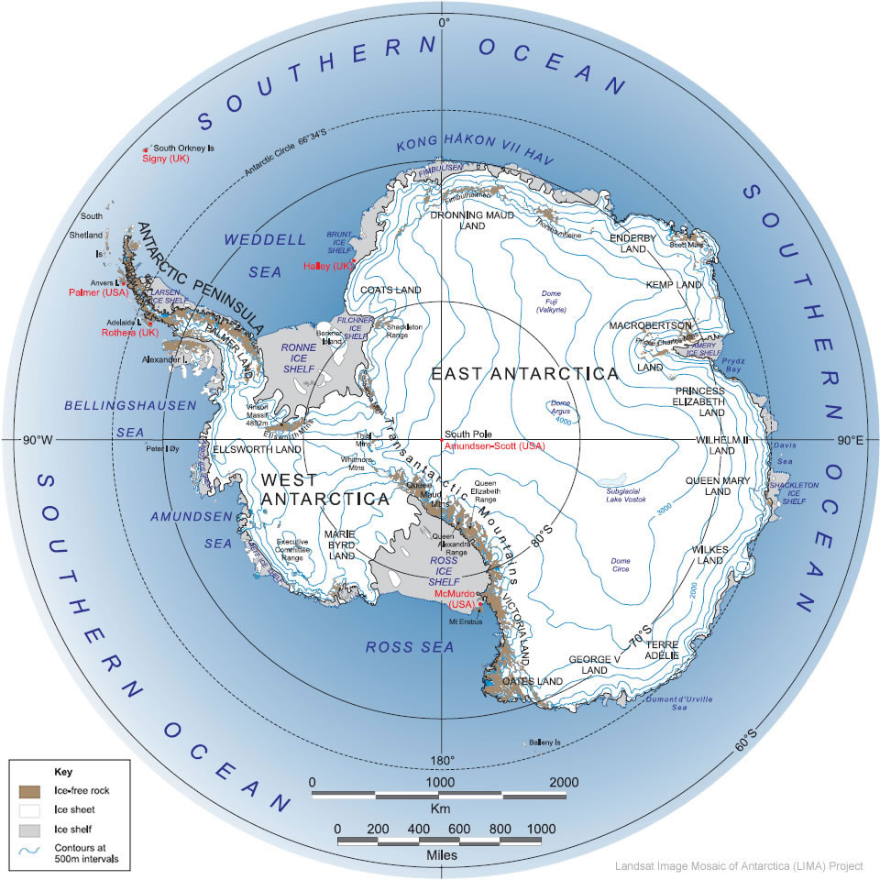
Antarctica: An Introduction
The southern most icy continent of the world surrounding the south pole.
Located between the latitudes of approximately 65⁰ S and 90⁰ S
The pulsating continent

Slide 4
Salient Features of Antarctica
Fifth largest continent about 14X10⁶ km²
Mean Surface elevation is over 2000m
Lowest temperature recorded -89 ⁰C
Wind velocity up to 200 km/h
The driest continent in the world
The highest point in the continent is Vinson Massif with height of 5140 m
The thickness of ice on the remaining 90% of the continent is 0.6-4.5 km
Antarctica started forming at least 50X10⁶ years ago

Slide 5
Problem
Prediction of pulsating nature of Sea Ice Edge over the Antarctica

Slide 6
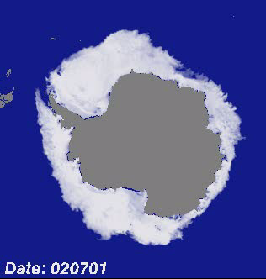
Pulsating Continent : Antarctica
Seasonal Variation of Antarctica Sea Ice Edge: 1st July 2002 to 1st July 2005

Slide 7
Why Antarctica Sea Ice Edge?
Earth Climate System
  Earth Radiation Budget
  Global Ocean Circulation
Marine Biota
Climate Modeling
Military Operations
Navigation

Slide 8
Approach
Active contour Model
Polynomial Statistical Method

Slide 9
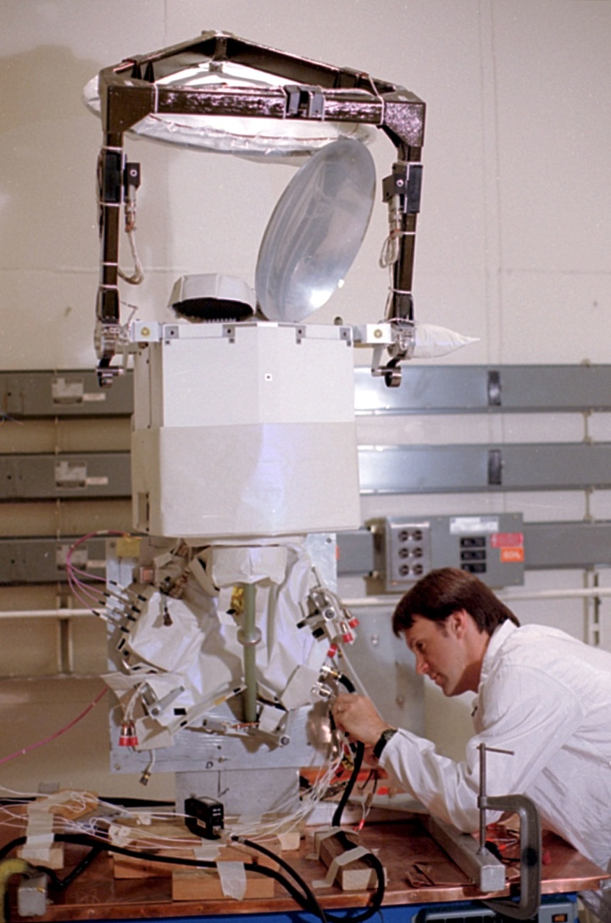
Sea Ice Concentration Data
Special Sensor Microwave/Imager
Derived from the Special Sensor Microwave/Imager (SSM/I) using Bootstrap Algorithm with daily varying tie-points
Gridded on polar stereographic projection with 25km x 25 km resolution
Format :Binary two-byte integer.
Spatial Coverage:
Temporal Coverage: 1987 to till date, (Daily and monthly)
Bootstrap Algorithm: http://nsidc.org/data/docs/
daac/bootstrap/index.html
Data Source :The National Snow and Ice Data Center
(http://www.nsidc.org)

Slide 10
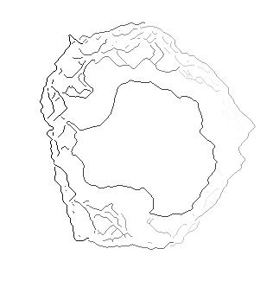

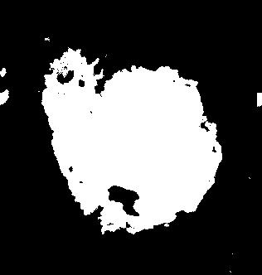

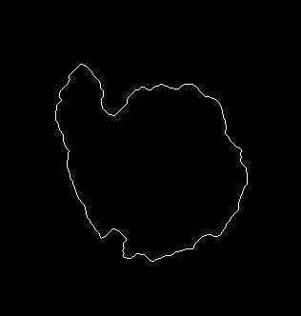
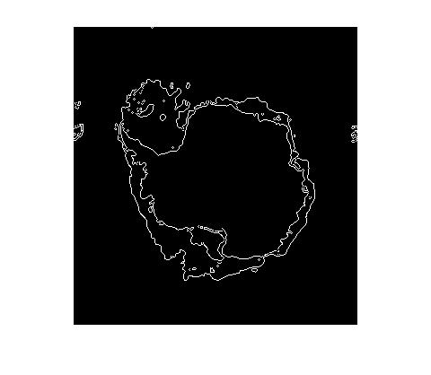
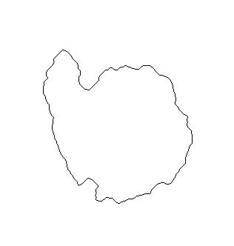
Different Steps To Getting Edge

Slide 11
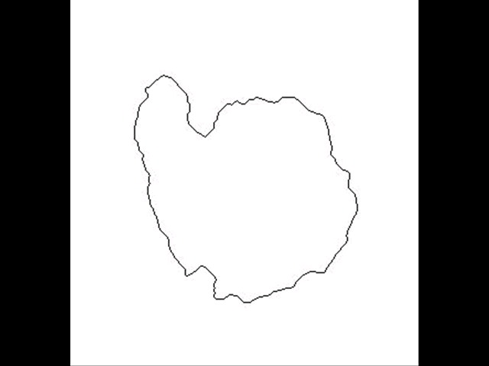
Variation in Sea Ice edge in Antarctica in 2006

Slide 12
Gradient Vector Flow Snake
Snake (or Active Contour ) are cures defined within an image domain that can move under the influence of the internal forces coming from within the cures itself and external forces computed form the image data
An energy minimizing spline guided by external constraint forces and pulled by image forces toward features.
Model is always minimizing its energy functional and therefore exhibits dynamic behavior : Active Contour Model.
The way the contours slither in the model while minimizing their energy is know as Snake Model.
The snake’s energy depends on its shape and location
Snakes can be closed or open
GVF snake is active contour which use the gradient vector field as a external force.

Slide 13
Applications of Snake
Edge Detection
Motion Tracking
Shape Modeling
Image Segmentation
Pattern Recognition

Slide 14
Why Gradient Vector Flow Snake?
Insensitivity to initialization
Large capture range
An ability to progress into boundary concavities
Detects shapes with boundary concavities
Does not need prior knowledge about whether to shrink, or expand towards boundary

Slide 15
GVF Snake Model
A snake is a curve X(s)=[x(s),y(s)],s Є [0,1] that moves through the spatial domain of an image to minimize the energy functional
E_{snake} = ∫₀¹ [E_{internal} (X(s)) + E_{external}(X(s))]ds
where, E_{internal} is the internal energy and E_{external} is the external energy of the snake, respectively

Slide 16
Internal Energy
E_{Internal} = [ { (α(s)|X̕(s)|² + β(s)|X̕̕(s)|²)} /2]
Elasticity Rigidity
Note : where X̕ and X̕̕ are the 1st and 2nd derivatives of the snake with respect to s and α(s),
β(s) specify the elasticity and rigidity of the snake, respectively.

Slide 17
External Energy
The external energy computed from the image data is a weighted combination of energies which attract the snake to lines or edges Image data
For a Gray-level Image I(x, y)
E¹_{external} = -|∇I(x, y)|²
E²_{external} = -|∇[G_{σ}(x, y)*I(x, y)|²
For a line drawing (black on white) Image I(x, y)
E³_{external} = I(x, y)
E⁴_{external} = G_{σ}(x, y)*I(x, y)
where G_{σ} is the 2D Gaussian function with standard deviation σ and ∇ is the gradient operator

Slide 18
Implementation
The process of my implementation:
1 Import an image
2. Initialize the snake for the image
3. Compute the edge map of the image
4. Input the edge map to the GVF solver
5. Deforms the snake

Slide 19
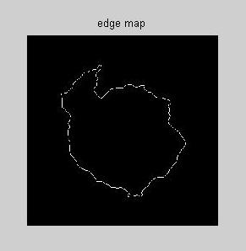
Edge Map
Edge map f(x , y) derived from the image I(x , y) having the property that it is larger near the image edges
f(x , y) = -E^{(i)}_{external}(x , y)
i=1,2,3, or 4.

Slide 20
Gradient Vector of Edge Map
General Properties:
Effects:
Pointing toward the edges
Large magnitudes only in the immediate vicinity of the edges
In homogeneous regions,( I(x, y) ≈constant), Δf ≈ 0.
A snake initialized close to the edge will converge to a stable configuration near the edge.
The capture range will be very small
In homogeneous regions, No external forces
Notes:
: Now consider how these properties affect the behavior of a traditional snake when the gradient of an edge map is used as an external force.
These last two properties are undesirable. Our approach is to keep the highly desirable property of the gradients near the edges, but to extend the gradient map farther away from the edges and into homogeneous regions using a computational diffusion process. As an important benefit, the inherent competition of the diffusion process will also create vectors that point into boundary concavities.

Slide 21
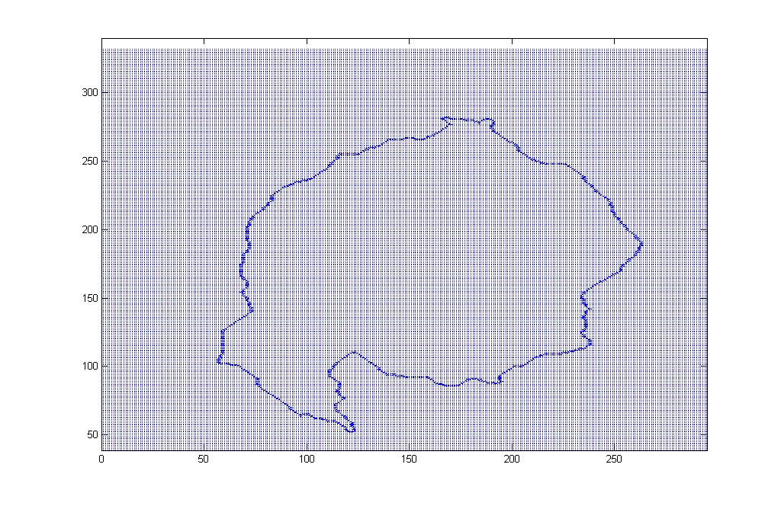
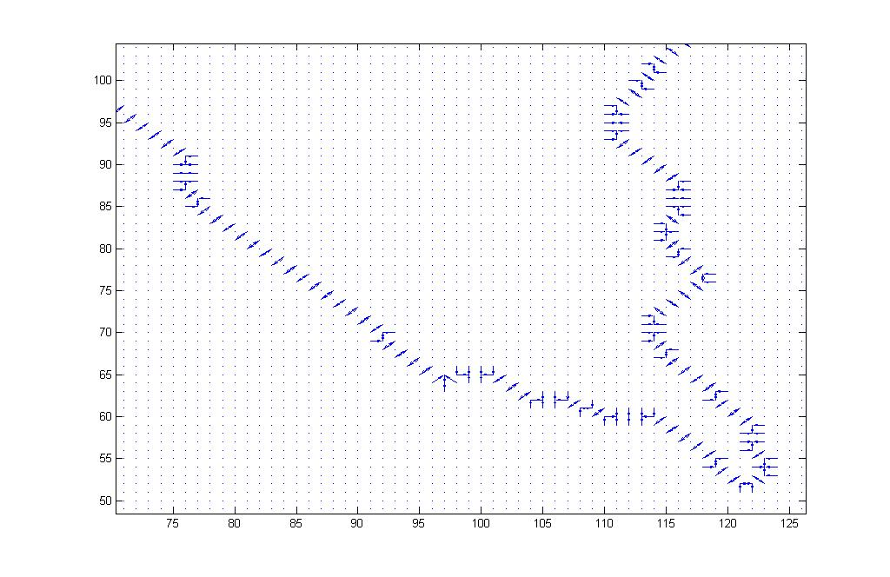
Gradient Vector of Edge Map

Slide 22
Gradient Vector Flow
The GVF field is defined to be a vector field
V(x , y) = [u(x , y), v(x , y) ]
V(x , y) is defined such that it minimizes the energy functional
ε=∫∫μ(u_{x}²+u_{y}²+v_{x}²+v_{y}²) +|∇f|²|V - ∇f|²dxdy
where f(x , y) is the edge map of the image and μ is noise parameter
Using the calculus of variations, GVF field can be obtained by solving following Euler equations
μ∇²u - (u - f_{x} )(f_{x}² + f_{y}²)=0
μ∇²v – (v - f_{y} )(f_{x}² + f_{y}²)=0
where ∇² is the Laplacian operator and f_{x} and f_{y} are the partial derivative of the edge map

Slide 23
Numerical Implementation
Equations can be solved by treating gradient vector flow u and v as functions of time and to set up the iterative solution, we can write
u_{i,j}^{n+1} = (1- b_{i,j}∆t)u_{i,j}^{n} + r(u_{i+1,j}^{n} + u_{i,j+1}^{n} + u_{i-1,j}^{n} + u_{i,j-1}^{n} - 4u_{i,j}^{n}) + c_{i,j}¹∆t
v_{i,j}^{n+1} = (1- b_{i,j}∆t)v_{i,j}^{n} + r(v_{i+1,j}^{n} + v_{i,j+1}^{n} + v_{i-1,j}^{n} + v_{i,j-1}^{n} – 4v_{i,j}^{n}) + c_{i,j}²1∆t
where the indices i, j, and n correspond to x, y and t respectively,
r = {μ∆t /∆x∆y}≤(1/4) and
b(x, y) = fx (x, y)² + fy(x, y)²
c¹=b(x, y)*fx(x, y)
c²=b(x, y)*fy(x, y)

Slide 24
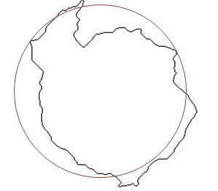
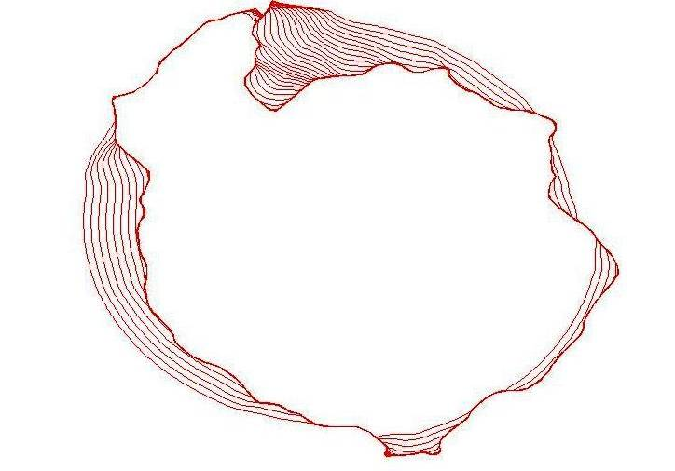
Convergence of a Snake
using GVF external force
towards edge
Initial GVF Snake

Slide 25
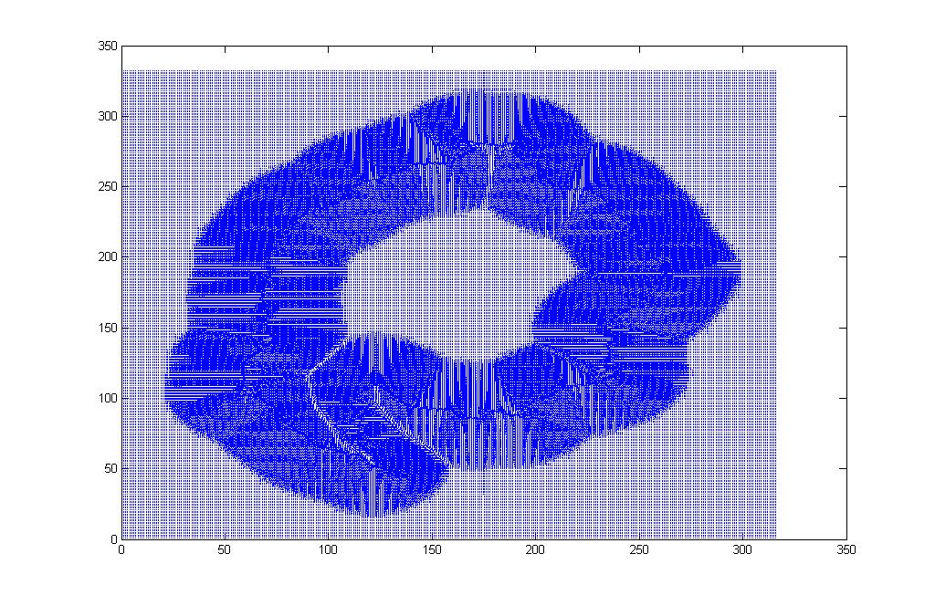
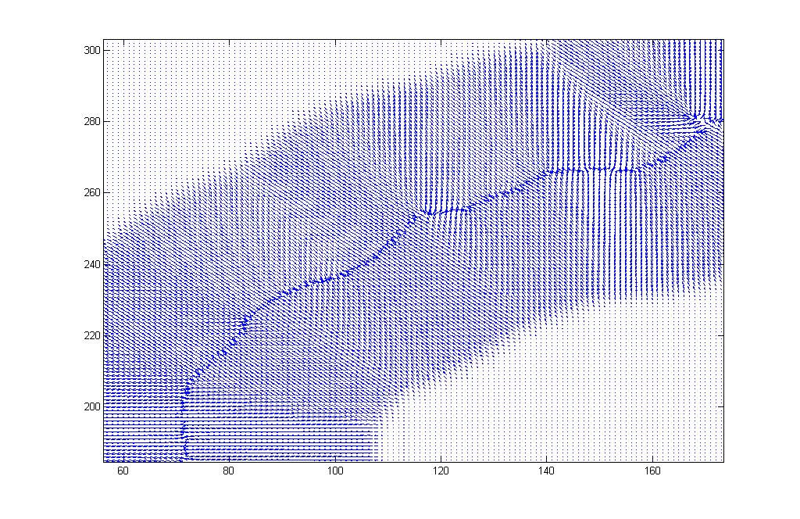
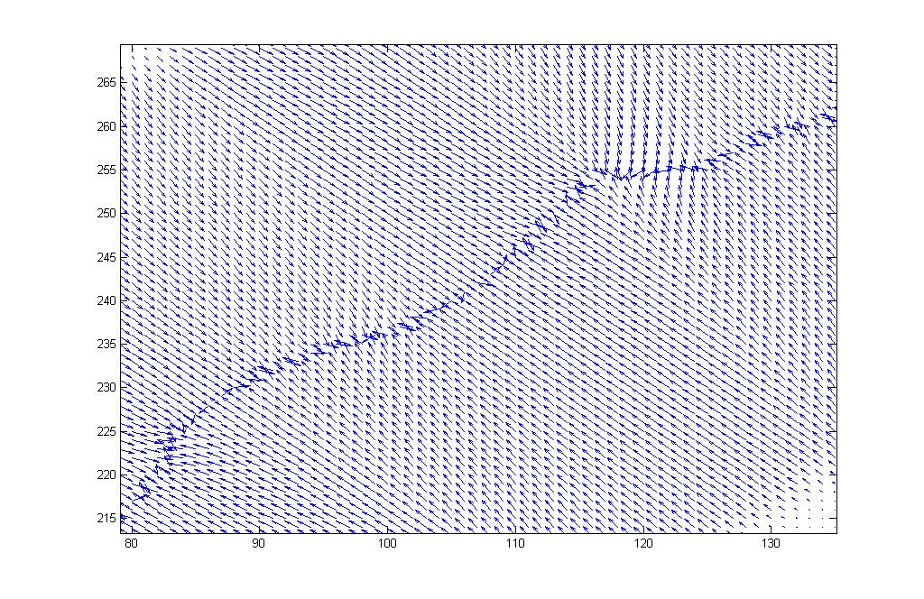
Normalized Gradient Vector Flow Field

Slide 26
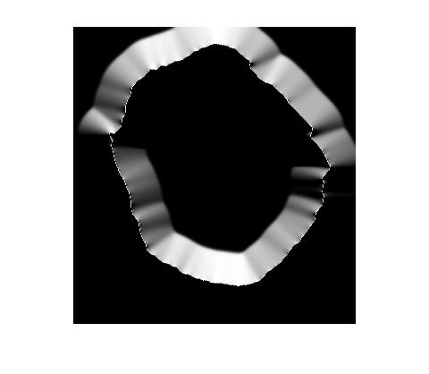
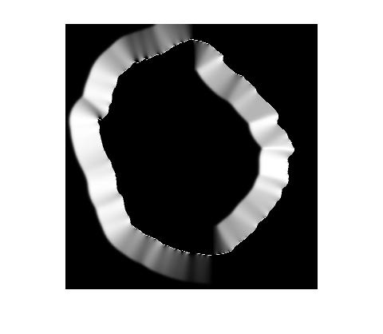
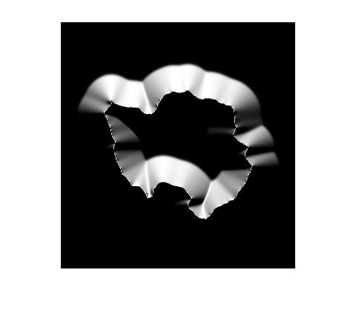
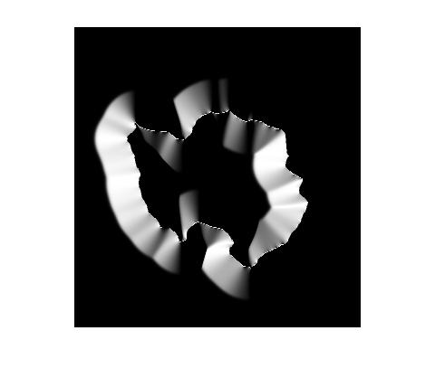
September, 2006
U GVF
V GVF
U GVF
Normalized GVF U- And V- Component
February, 2006
U GVF
V GVF

Slide 27
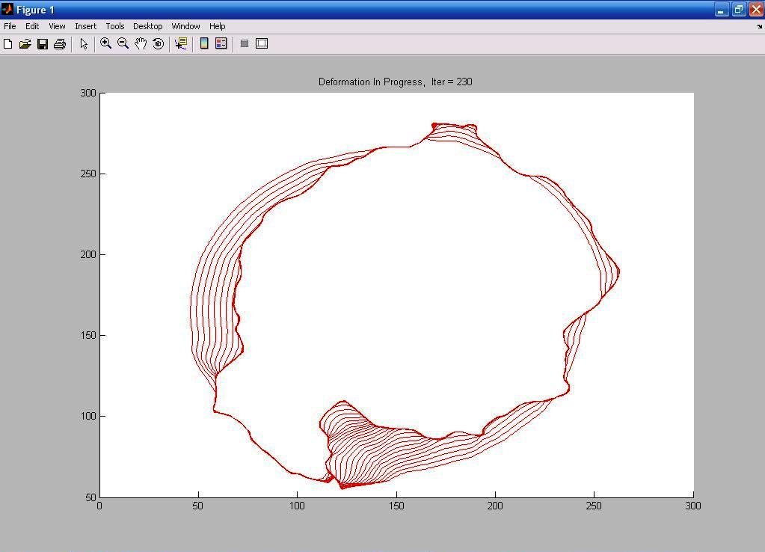

Slide 28
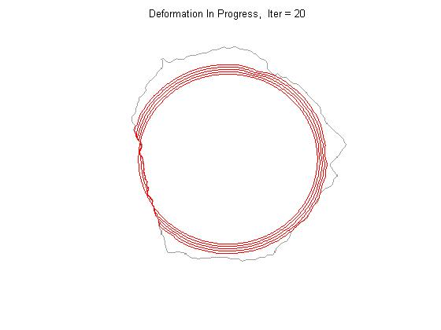
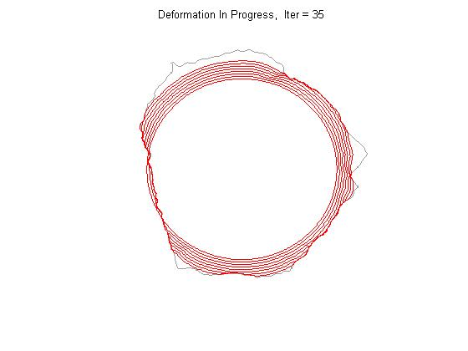
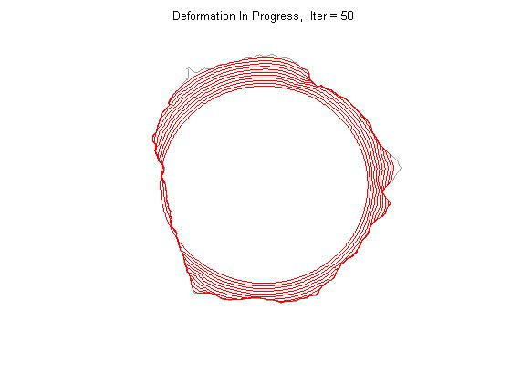
Deformation of GVF Snake

Slide 29
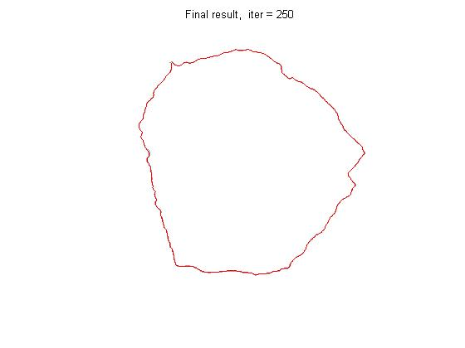
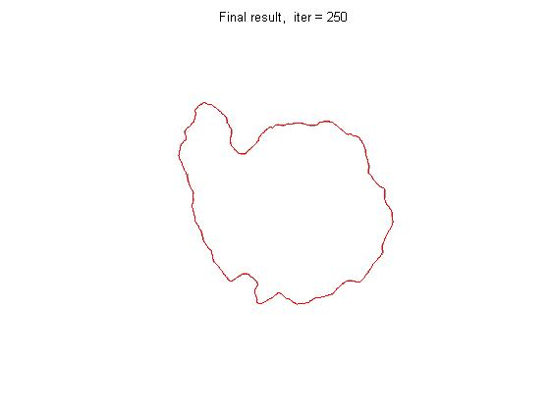
Simulation Result
September, 2006
February, 2006

Slide 30
GVF Snake Model Parameter
Elasticity(α) : 0.05
Rigidity(β): 0
Regularization (μ):0.02
Damping coefficient (γ):1

Slide 31
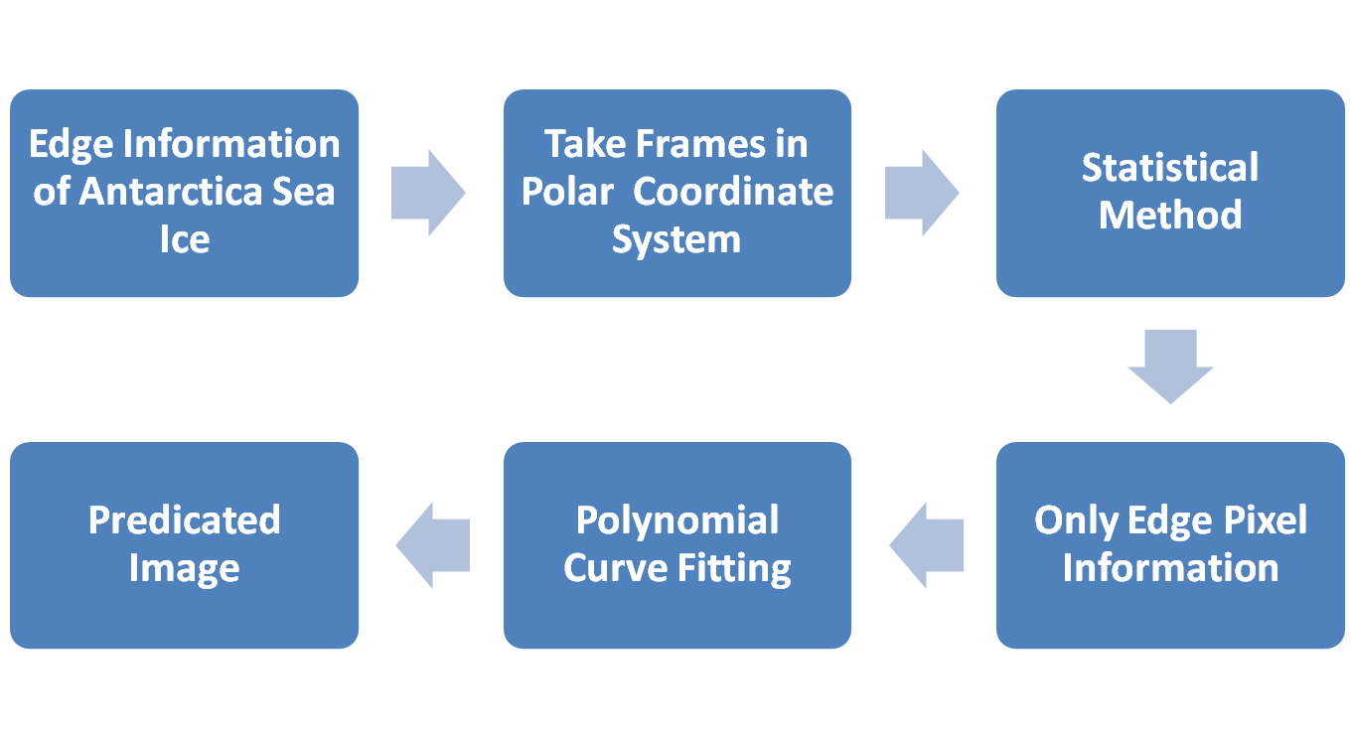
Prediction Method

Slide 32
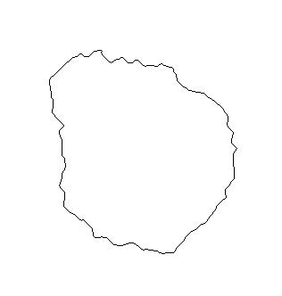
Image Polar Coordinate Parameter
(0,0)
(0,316)
j
Ф =tan⁻¹ [(i_{u}-i₀)/(j_{v}-j₀)]
r=√((i_{u}-i₀)²+(j_{v}-j₀)²)
(i_{u1}, j_{v1})
O(i₀, j₀)
Where,
u=1,2,…332,
v=1,2,…316,
(i_{u2}, j_{v2})
(332,0)
i

Slide 33
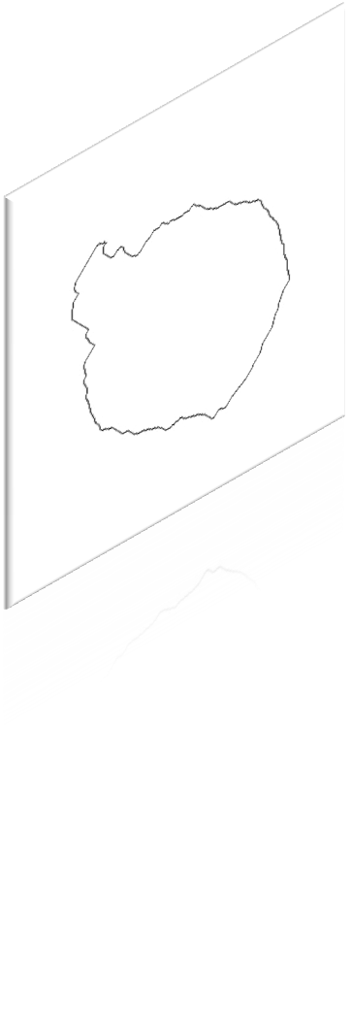
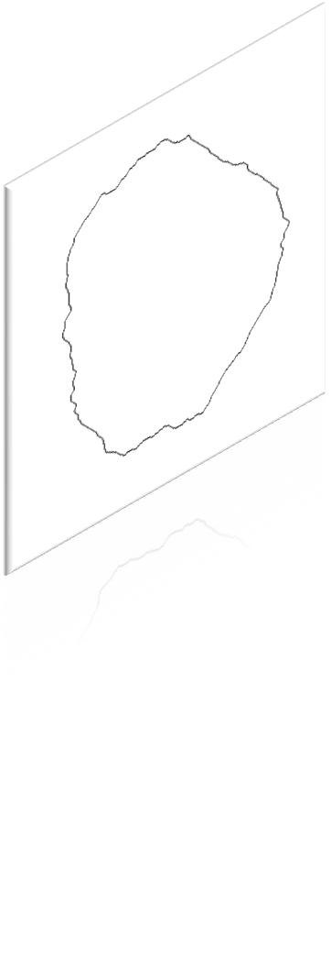
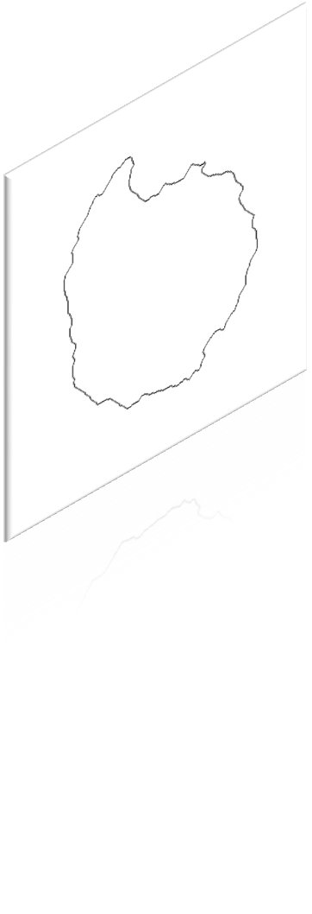
Angle Window Search

Slide 34
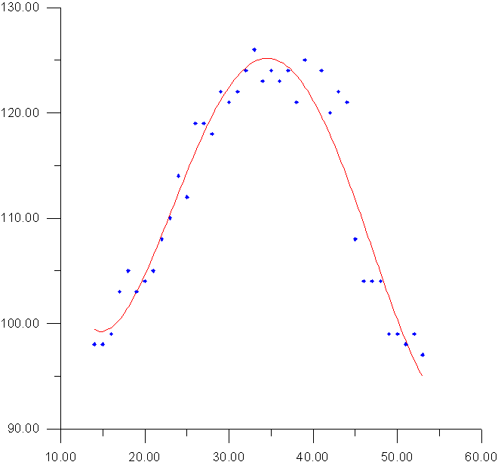
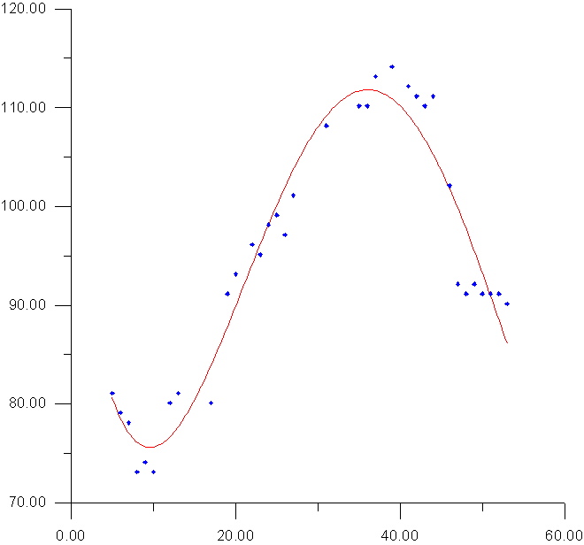
Polynomial Curve Fitting
1⁰
93⁰

Slide 35
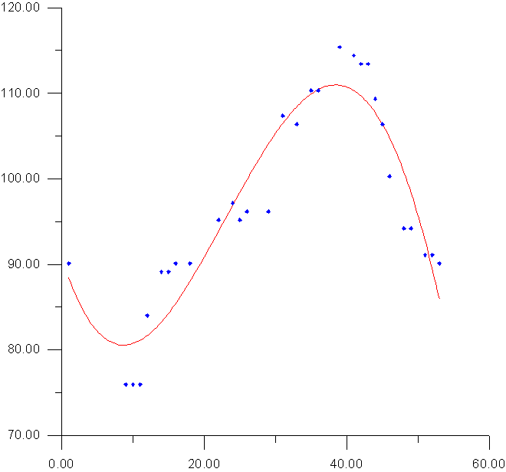
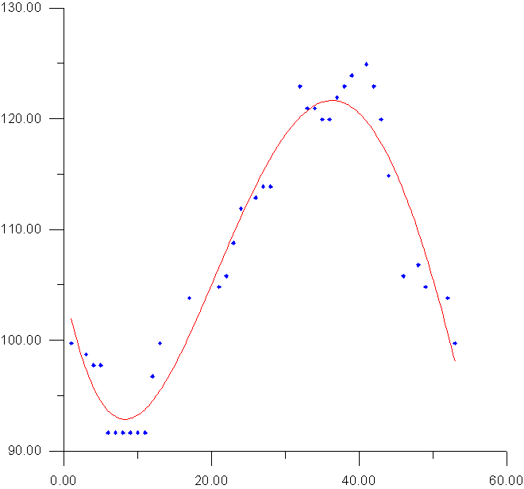
Polynomial Curve Fitting
185⁰
153⁰

Slide 36
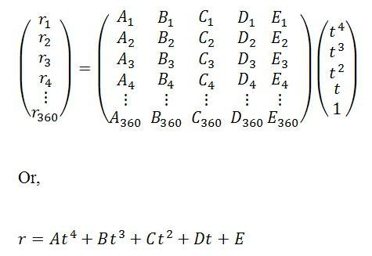
Prediction Model Equation
where,
r_{Ө} = The radius of the each pixel locations, Ө=1,2,3,4…,360
t= Time, t=1, 2, 3, 4…
and
A, B, C, D,E = Polynomial Coefficients

Slide 37
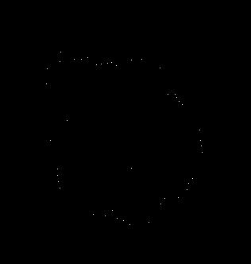
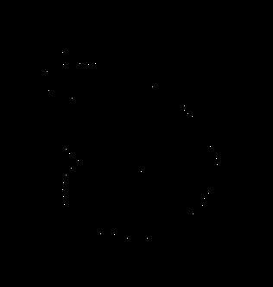
Predicted Edge Pixel
1st week of January, 2005
2nd week of January, 2005

Slide 38
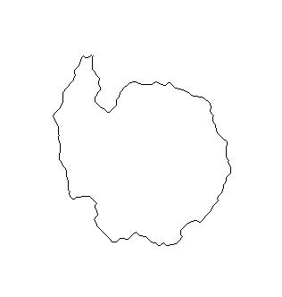
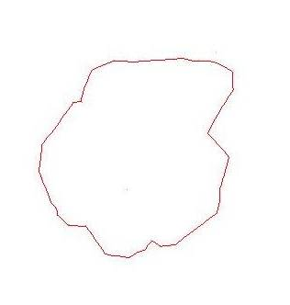
Result
Predicted Image : 1st week of January, 2005
SSM/I Image: 1st week of January , 2005

Slide 39
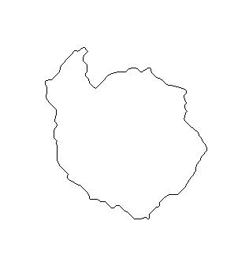
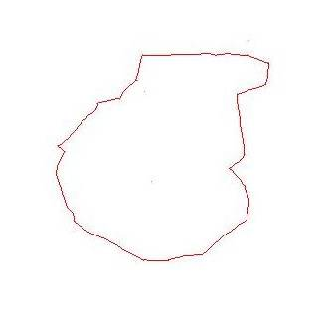
Result
Predicted Image : 2nd week of January, 2005
SSM/I Image : 2nd week of January, 2005

Slide 40

RMS Error Analysis
Where, r _{reference} = Reference Image Pixel Position
r _{predicted} = Predicted Image Pixel Position

Slide 41
RMS Error Analysis
Average Error : 10 %
Predicted Image : January 4th , 2005
SSM/I Image: January 4th , 2005

Slide 42
RMS Error Analysis
Average Error : 11 %
Predicted Image : January 11th , 2005
SSM/I Image : January 11th , 2005

Slide 43
Conclusion
The broad features of the predicted edge match well with that observed edge.
Radial RMS Error = Order of 10%
The visual interpretation shows the GVF snake model has simulated the ice edge with 90 % accuracy
Large deviation at the region around Antarctic peninsula due to use of the Averaging Technique to decide the ice edge when multiple edges are present at a particular angle

Slide 44
Future Work
Improve model reliability of Sea Ice Edge Prediction
  By applying more robust techniques
  By taking longer time series
Used for the regional sea ice prediction
Prediction of Random Deformation in Shape
Estimation and Tracking of Ice Bergs Deformation
Prediction of Biological Cell Growth and Decay

Slide 45
Applications
Used for deriving the sea ice extent before the satellite era
Used in the climate model to give a better forecast
Used for better study of the climate change signal
Help in coast effective navigation and military plan in Polar Region.
Used for prediction of the ice edge in the Arctic

Slide 46
References
Chenyang Xu and J.L. Prince, 1998: Gradient Vector Flow: A New External Force for Snakes, Proc. IEEE Conf. on Comp. Vis. Patt. Recog. (CVPR), Los Alamitos: Comp. Soc. Press., 7, pp. 66-71
Kass, M., A. Witkin, and D. Terzopoulos, 1987: Snakes: The Active contour models, International Journal of Computer Vision. 1, pp. 321-331

Slide 47
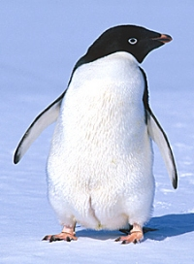
Thank You

