Slide 1

Disparity Compensated View Filters (DCVF): Experiments and Results
Pravin Kumar Rana
Sound and Image Processing Lab.(SIP)
KTH - Royal Institute of Technology
SE-10044 Stockholm, Sweden

Slide 2

Outline
Unidirectional DCVF
Bidirectional DCVF

Slide 3

Unidirectional DCVF
Common
View
Error
View
Unidirectional DCVF
Disparity
Field Information
( DF ₁ ₂ )
x₁ x₂

Slide 4
Experiment with Unidirectional DCVF
Nagoya Depth Estimation Reference Software
Common
view
Error
view
Pantomime
view 39
Block Matching
Function
Estimated
Depth
Map
Estimated
Disparity
Field
Unidirectional
DCVF
Pantomime
view 40
Pantomime
view 39
Pantomime
view 40
Pantomime
view 39
Disparity vector field
Depth map intensity
Camera focal length
Camera interval
Camera offset
Farthest clipping plane
Nearest clipping plane

Slide 5
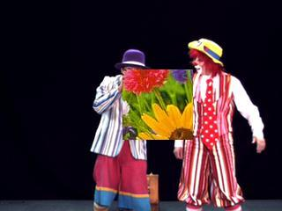
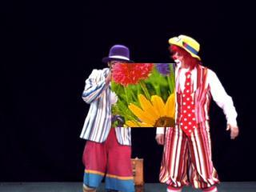
DCVF on the Modified Pantomime
Energy ratio = 0.46 %
Common view
Error view
DCVF
Disparity Vector Field
Modified
Pantomime
view 39
Modified
Pantomime
view 40

Slide 6


DCVF on the Pantomime
Energy ratio = 0.42 %
Common view
Error view
DCVF
Disparity Vector Field
Modified
Pantomime
view 39
Modified
Pantomime
view 40

Slide 7
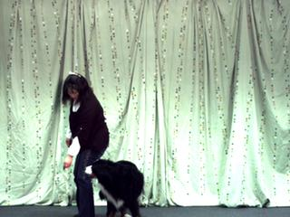
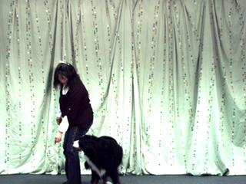
DCVF on the dog
Energy ratio = 2.41 %
Common view
Error view
DCVF
Disparity Vector Field
Dog view 40
Dog view 41

Slide 8
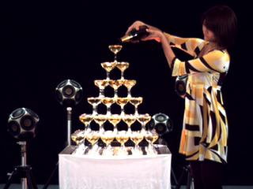
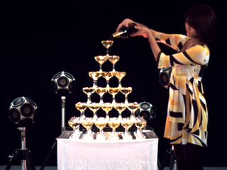
DCVF On the Champagne tower
Energy ratio = 2.01 %
Common view
Error view
DCVF
Disparity Vector Field
Champagne
view 40
Champagne
view 41

Slide 9
Bidirectional Disparity Compensated View Filter
Common
View 1
Common
View 2
Error
View
Bidirectional DCVF
DF₁₂
DF₃₂
x₁ x₂ x₃
Takes sequence of 3 views
Consider up to two disparity vector fields per view
Energy concentrated into two common views and one error view

Slide 10
Experiment-(1) with Bidirectional DCVF
Pantomime
view 39
Nagoya Depth Estimation Reference Software
Block Matching
Function
(39-40-39)
Estimated
Depth
Map
Estimated
Disparity
Field
Pantomime
view 40
Pantomime
view 39
Pantomime
View 39
Bidirectional
DCVF
Common
view
Pantomime
View 40
Error
view
Pantomime
view 41
Nagoya Depth Estimation Reference Software
Block Matching
Function
(40-41-40)
Estimated
Depth
Map
Estimated
Disparity
Field
Pantomime
View 41
Common
view
Pantomime
view 40
Pantomime
view 41
(Legacy of the disparity field estimation tool)

Slide 11
Bidirectional Disparity Vector Field
DVF between Pantomime
view 39 and 40
DVF between Pantomime
view 40 and 41

Slide 12
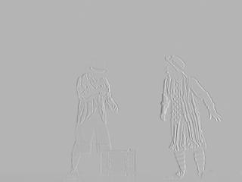


Experiment -(1) Results
Energy ratio = 0.37 %
Error view
Common view between
view 39 and 40
Common view between
view 40 and 41

Slide 13
Experiment-(2) with Bidirectional DCVF
NDE Reference Software
Pantomime
View 39
Block
Matchning
Function
(39 - 40 )
(40- 41)
Estimated
Depth
Map
Estimated
Disparity
Field
Pantomime
View 39
Bidirectional
DCVF
Common
view
Pantomime
View 40
Pantomime
View 40
Error
view
Estimated
Depth
Map
Estimated
Disparity
Field
Pantomime
View 41
Pantomime
View 41
Common
view

Slide 14
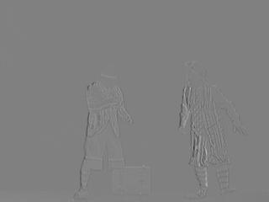

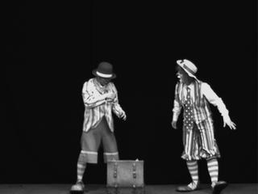
Experiment –(2) Results
Energy ratio = 0.18 %
Error view
Common view between
view 39 and 40
Common view between
view 40 and 41

Slide 15
Experiment-(3) with Bidirectional DCVF
NDE Reference Software
Pantomime
View 39
Block
Matchning
Function
(39 - 40 - 41)
Estimated
Depth
Map
Estimated
Disparity
Field
Pantomime
View 39
Bidirectional
DCVF
Common
view
Pantomime
View 40
Pantomime
View 40
Error
view
Estimated
Disparity
Field
Pantomime
View 41
Pantomime
View 41
Common
view

Slide 16
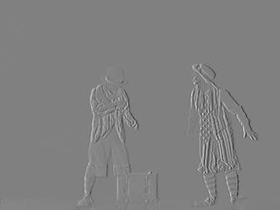

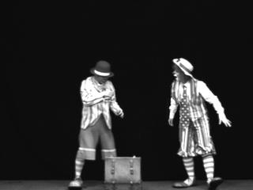
Experiment –(3) Results
Energy ratio = 0.92%
Error view
Common view between
view 39 and 40
Common view between
view 40 and 41

Slide 17
Results
DVF Estimation Method | Test Data | Energy Ratio (%)
Unidirectional DCVF
Experiment with UDCVF | Pantomime | 0.42
Experiment with UDCVF | Modified Pantomime | 0.46
Experiment with UDCVF | Dog | 2.41
Experiment with UDCVF | Champagne Tower | 2.01
Bidirectional DCVF
Experiment -1 | Pantomime | 0.37
Experiment -2 | Pantomime | 0.18
Experiment -3 | Pantomime | 0.92

Slide 18
Conclusion
DVF extraction from the NDE reference software has its limitations due to depth map representation.

Slide 19
Future Directions
Explore more efficient DVF representation for
the multiresolution analysis and synthesis.

