Slide 1

MPEG Requirements of 3D Video and Occlusion-Adaptive Unidirectional DCVF
Pravin Kumar Rana
Sound and Image Processing Lab.(SIP)
KTH - Royal Institute of Technology
SE-10044 Stockholm, Sweden

Slide 2
Outline
Part –I
Requirements of 3D Video
Reference Softwares
Part –II
Occlusion-Adaptive Unidirectional DCVF
Experiments
Present Scenario and Scope for Improvement

Slide 3
Part –I
MPEG Requirements of 3D Video

Slide 4
MPEG Requirements of 3D Video
Target of 3D Video Format
Courtesy: Ericsson & MPEG

Slide 5
MPEG Requirements of 3D Video
3D Video
Requirements
Data Format
Compression
Rendering
Efficiency
Synthesis Accuracy
Video Data
Supplementary Data
Low
Complexity
Depth Range
Display Adaptive
Low Complexity
Variable Baseline
Metadata
Rendering capability
Adjustable Depth Location
Backward Compatibility
Applicability
Scalability
Requirements of 3D Video
Courtesy: Ericsson & MPEG

Slide 6
MPEG Reference Software
Philips –Zhejiang Reference Software(LDVRS)
Thomson Reference Software(ViSBD )
Nagoya Reference Software(DERS, VSRS)
Courtesy: Ericsson & MPEG

Slide 7
Philips-Zhejiang Reference Software
Foreground View
Forward Warping
Foreground Depth
Merge
Hole Filing
Rendered
View
Background View
Forward Warping
Background Depth
LDV Rendering (LDVRen)
Warping : The foreground view and background view are warped to the virtual
view with foreground and background depth, respectively.
Merge : The warped foreground view and warped background view are merged.
Hole Filing : Remaining marked pixels as hole pixels after merge process in the
rendered view are filled by Inpainting Technique .
Courtesy: Ericsson & MPEG

Slide 8
Thomson Reference Software
Input depths
Disparity
Input Views
Z-Buffer
Warping
Merging
Hole
Filling
Virtual
View
View Synthesis Based on Disparity 1.0 (ViSBD 1.0)
ViSDB 2.0 (October 2008, Busan, Korea)
Reference View Upsampling
Boundary-aware Splatting
Smart Blending Method
Occlusion Layer Generation
Courtesy: Ericsson & MPEG

Slide 9
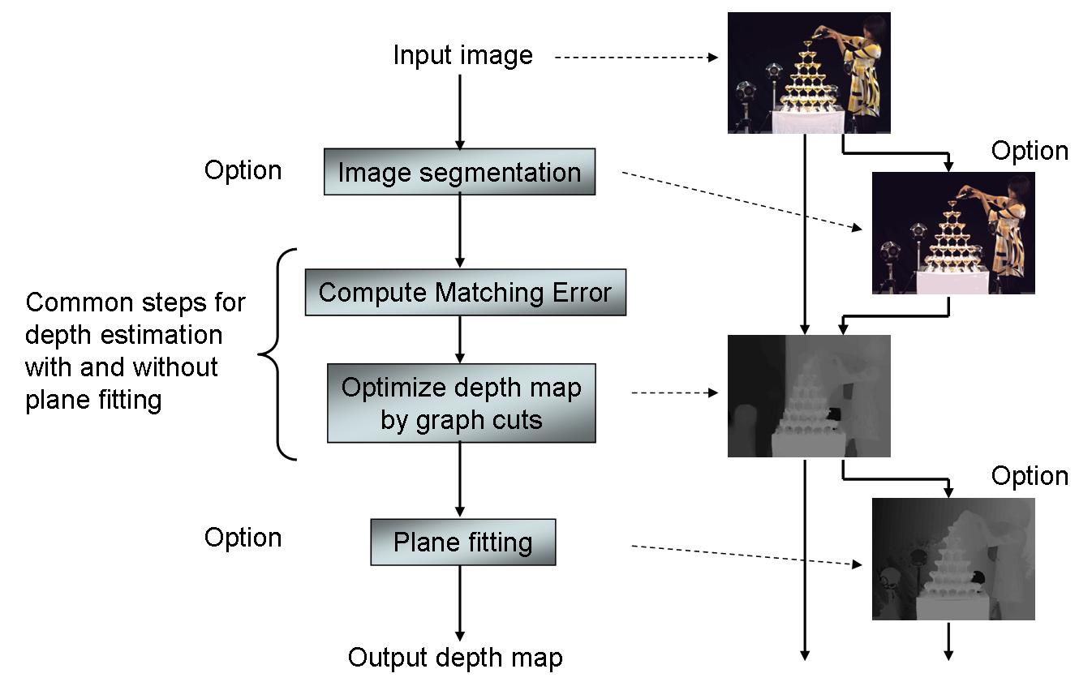
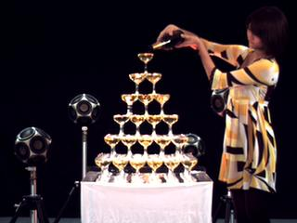
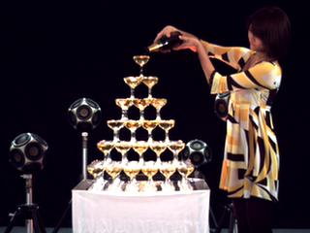

Nagoya Reference Software
Image Segmentation
Compute Matching Error
Optimize Depth Map by Graph Cut
Plane Fitting
Depth Estimation Reference Software 3.0
(DERS 3.0)
Courtesy: Ericsson & MPEG

Slide 10
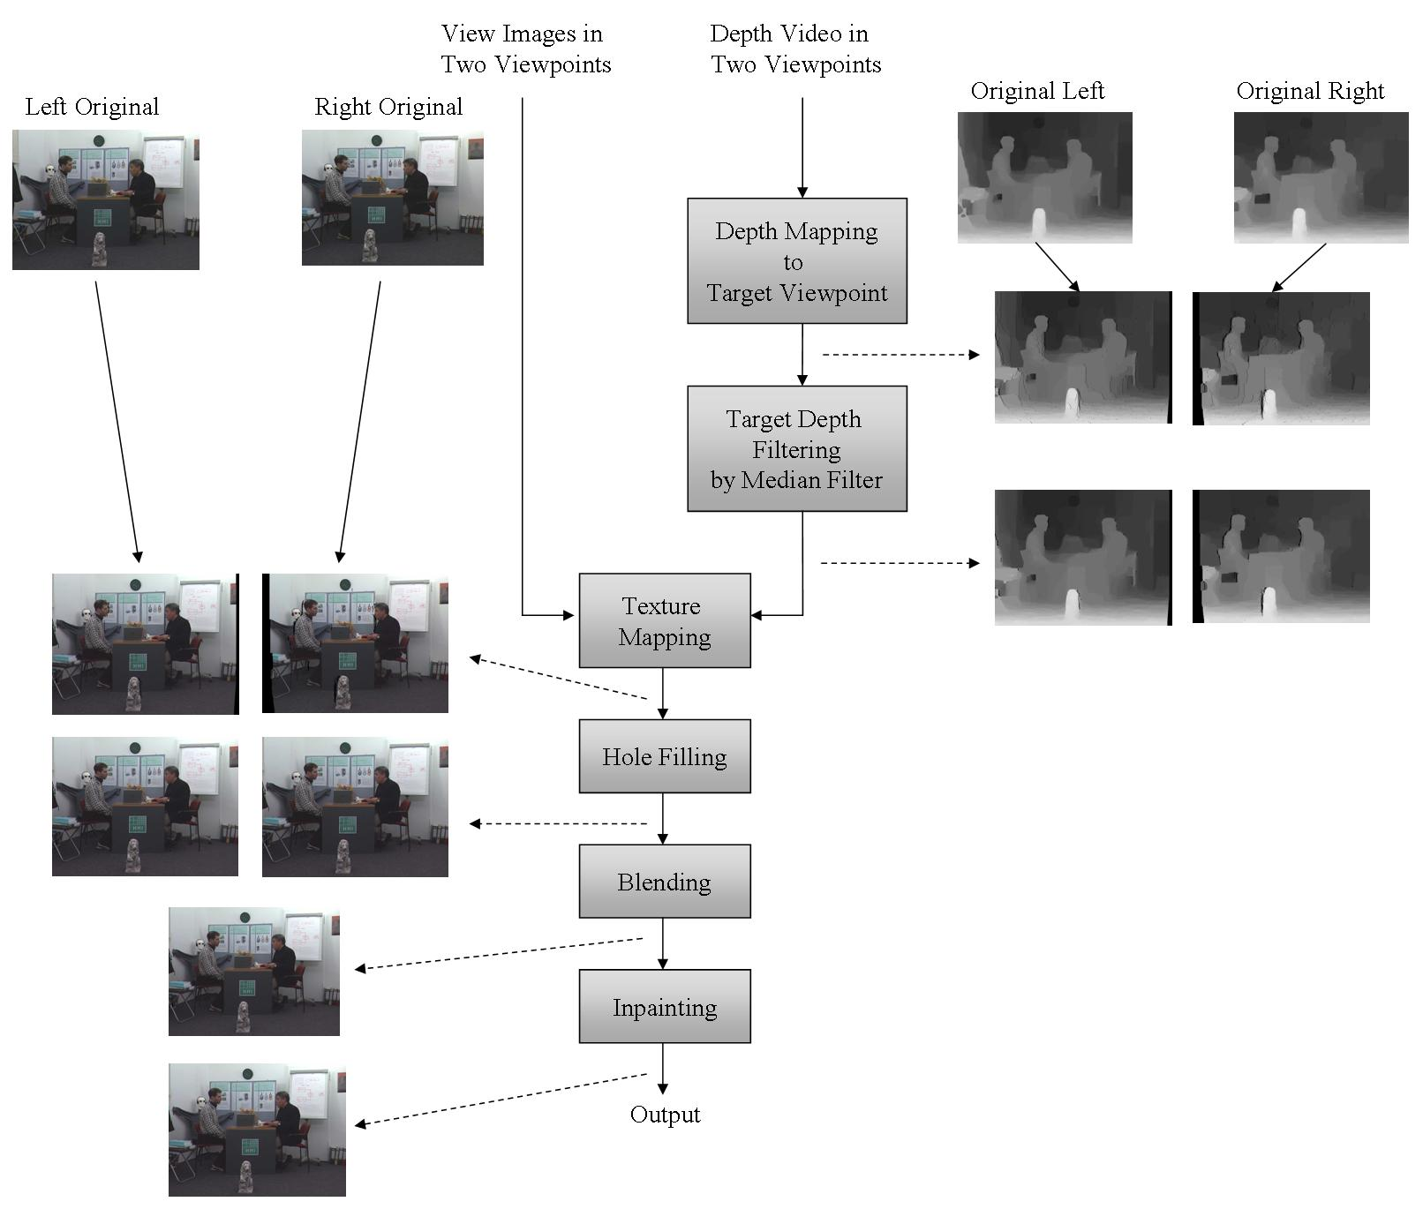
Nagoya Reference Software
View Synthesis Reference Software 2.0
(VSRS 2.0)
Courtesy: Ericsson & MPEG
Notes:
-Pixel-by-Pixel mapping using 3D warping or horizontal pixel shift;
-Generation of depth map for the target viewpoint;
-Median filter for filling small hole in the mapped depth map;
-Generation of texture image for target viewpoint;
-Large hole filling by copying from the other mapped texture image;
-Blending two mapped texture images;
-Inpainting for blended texture image.

Slide 11
Reference Software Performance
Reference : MPEG2008/M16040, February 2009, Lausanne, Switzerland
Average PSNR of Book Arrival synthesized view
8 by the three software
Average PSNR of Dog synthesized view
39 by the three software
Average PSNR of Champagne tower view 39 by the three software
Courtesy: Ericsson & MPEG

Slide 12
Part –II
Occlusion-Adaptive Unidirectional DCVF

Slide 13
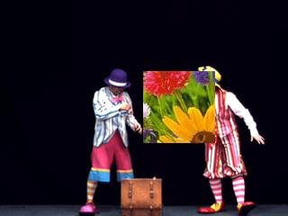
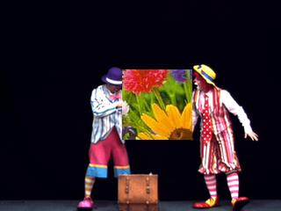
Effect of Occlusion
Well-Defined Disparity Field
Undefined Disparity Field
A pixel with undefined disparity field information affects energy compaction in the DCVF
Left view Right view
Left view Right view

Slide 14
Transform Modes
Unidirectional Mode
It is incremental orthogonal transform;
It is implemented to handle pixels with well-defined unidirectional disparity information.
Identity Mode
It is identity transform;
It is implemented to handle pixels with undefined disparity information (i.e., occlusion).
Criteria for Switching between Modes
Unidirectional Mode
Left view Right view

Slide 15
Transform Modes
Unidirectional Mode
It is incremental orthogonal transform;
It is implemented to handle pixels with well-defined unidirectional disparity information.
Identity Mode
It is identity transform;
It is implemented to handle pixels with undefined disparity information (i.e., occlusion).
Criteria for Switching between Modes
Identity Mode
Left view Right view

Slide 16
Occlusion Detection & High Band Energy Minimization Algorithm
Disparity Estimation
Input: Multiview
Imagery
Occlusion-Adaptive
Unidirectional DCVF
Disparity Field Information
Test:
Unidirectional Mode
Test:
Identity
Mode
Compare Energies
Yes
E_{U}< E_{I}
No
E_{U} = Energy of the pixel in the high
band in unidirectional mode
E_{I} = Energy of the pixel in the
second view in the identity mode
Use:
Unidirectional Mode
Use:
Identity
Mode
0utput:
Common View
& Error View

Slide 17
Occlusion-Adaptive Unidirectional DCVF
Common View
Error View (High Band III)
Occlusion-Adaptive Unidirectional
DCVF
DF _{39, 41}
Error View (High Band I)
Error View (High Band II)
Occlusion Adaptive Unidirectional
DCVF
Occlusion Adaptive Unidirectional
DCVF
DF _{39, 40}
DF _{41, 42}
39 40 41 42

Slide 18
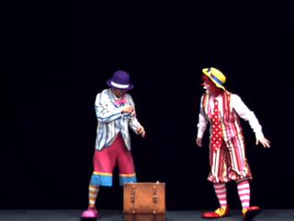
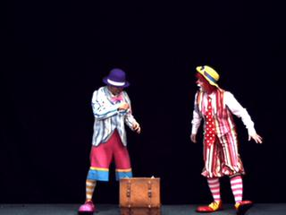

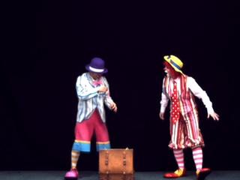
Pantomime
common view high band III high band II high band I
pantomime 39 pantomime 40 pantomime 41 pantomime 42

Slide 19
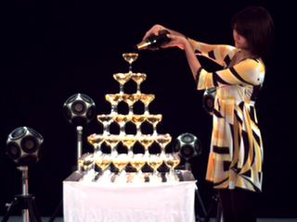
Champagne Tower
common view high band III high band II high band I
champagne tower 39 champagne tower 40 champagne tower 41 champagne tower 42

Slide 20
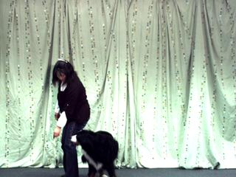
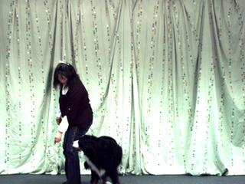
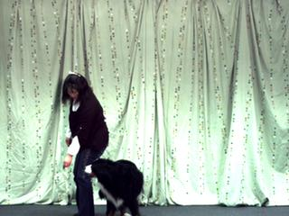
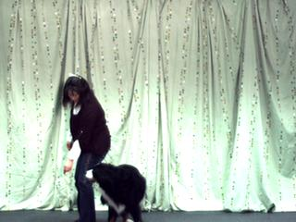
Dog
common view high band III high band II high band I
dog 39 dog 40 dog 41 dog 42

Slide 21
Performance Comparison
 | Disparity Compensated View Filters
Video Data | Energy Ratio(%) (Non-occlusion Adaptive) | Energy Ratio(%) (Occlusion-Adaptive)
Pantomime | 0.30 | 0.27
Champagne Tower | 0.24 | 0.20
Dog | 1.65 | 0.50

Slide 22
Present Scenario and Scope for Improvement
Present Scenario
Depth estimation just form two views
Depth in MVD is not consistent
LDV just distinguishes between foreground and background.
Scope for Improvement
Multi-resolution depth estimation
Consistence depth information across many scales
Minimize impact of hole filling / inpainting

Slide 23
Future Directions
Improve and make robust the occlusion-adaptive Unidirectional DCVF for higher levels of temporal decomposition;
Implement Occlusion Detection in the Bidirectional DCVF;
Explore more efficient DVF representation for the multiresolution analysis and synthesis;
Implement disparity field estimation in the DCVF.

Slide 24
Philips-Zhejiang Reference Software
Background View
Forward Warping
Background Depth
Filtering
&
Sampling
View
Foreground View
Line Delay
Forward Warping
Foreground Depth
Line Delay
Layered Depth Video Software (LDVS)
Warping : The foreground view and background view are warped to the virtual
view with foreground and background depth, respectively.
Pre-filtering : The warped signal is filtered using a box-filter.
Sampling : The signal is sampled on the output. Filling the holes between the warped
samples in the output is done by repeating samples (pixel repetition)
along the scan direction.
Courtesy: Ericsson & MPEG

Slide 25
Philips-Zhejiang Reference Software
Layered Depth Video Reference Software (LDVRS)
LDV Reference Software
LDVRen
LDVS
LDVRen : Layered Depth Video Rendering
LDVS : Layered Depth Video Software
Courtesy: Ericsson & MPEG

