Slide 1

MPEG 3DTV FTV EE on the Lovebird1 Data Set & Multiresolution View Interpolation
Pravin Kumar Rana
Sound and Image Processing Lab.(SIP)
KTH - Royal Institute of Technology
SE-10044 Stockholm, Sweden

Slide 2
Outline
FTV Exploration Experiments(EE)
EE1: Depth Estimation
EE4: Coding Experiment
Multiresolution View Interpolation

Slide 3
FTV Exploration Experiments
EE1
Experiment for the depth map generation improvement with DERS 5.0 and the synthesized views quality improvement with VSRS 3.5.
EE4
Coding experiments for the texture views and the depth map using the JMVC 5.0.5 reference software.
The goal of experiment is to get insights on how the depth maps coding affects the quality of synthesized views.

Slide 4
Exploration Experimental 1 Set Up
View 5
View 6
View 7 View 8
View 9
Depth 6
Depth 8
View 7 - Synthesized
Original View 8
Synthesized Stereo Pair

Slide 5
Reference Software
Depth Estimation Reference Software (Version 5.0)
View Synthesis Reference Software (Version 3.5)
View 5
View 6
View 7
View 6
Depth 6
View 8
Depth 8
DERS 5.0
VSRS 3.5
Depth 6
Synthesized View 7

Slide 6
Automatic Depth Estimation Mode

Slide 7
Semi-automatic Depth Estimation Mode 1

Slide 8
Semi-automatic Depth Estimation Mode 2

Slide 9
Reference Depth Estimation Mode

Slide 10
EE1 Summary
Depth Estimation Mode | Average Y-PSNR (dB)
Automatic Mode | 30.73070
Semi-automatic Mode 1 | 30.74090
Semi-automatic Mode 2 | 30.25470
Reference Depth Mode | 30.76841

Slide 11




Estimated Depth Maps
( Estimated depth maps obtained by DERS 5.0 using depth estimation mode “3”)
(a) Frame #01 (d)Frame #100
(C) Frame #150 (d)Frame #200

Slide 12
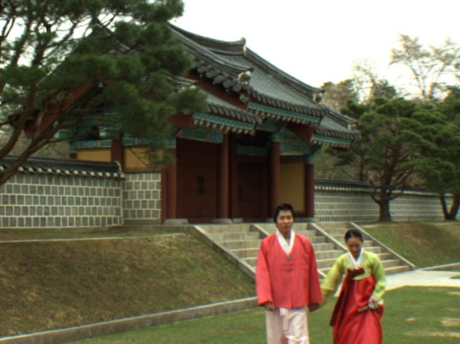
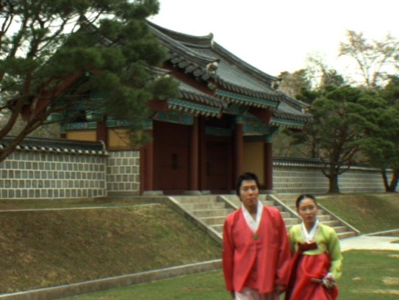
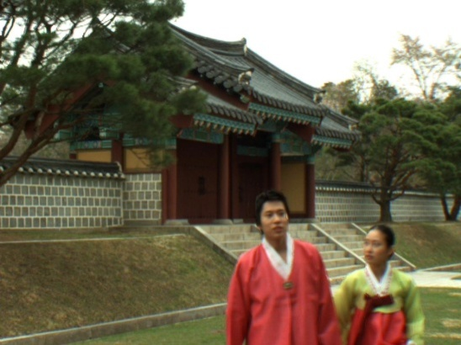
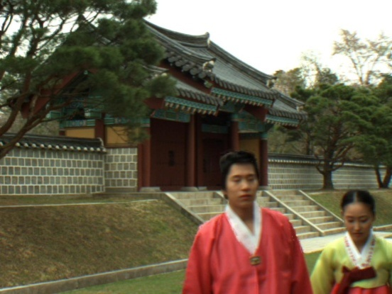
Synthesized Views
(Synthesized “lovebird1” view 7 using VSRS 3.5)
(a) Frame #01 (d)Frame #100
(C) Frame #150 (d)Frame #200

Slide 13
Exploration Experimental 4 Set Up
Original Texture 6
Original Texture 8
Depth View 6
Depth View 8
Encoder JMVC 5.0.5 Decoder
Encoder JMVC 5.0.5 Decoder
Decoded Texture 6
Decoded Texture 8
Decoded Depth 6
Decoded Depth 8
VSRS 3.5
Synthesized View 7

Slide 14
Coding Parameters
JMVC 5.0.5 Coding Parameter
Quantization Parameter (Texture) | {22, 24, 26, 28, 32, 34, 36, 38}
Quantization Parameter (Depth) | {22, 24, 26, 28 , 30 , 32, 34, 36, 38}
Frames To Be Encoded | 200
GOP Size | 8
Intra Period | 8
Inter Period Pics First | 1
Search Mode | Fast Search
Search Range | 96
View Scalability Information SEI | ON
View Order | 0-2

Slide 15
EE4 Results
Total bit rate spent on encoding texture with different depth QP for views (6, 8)

Slide 16
EE4 Results
Quality of the synthesized view 7 vs. the total bit rate. (when QP for depth map is fixed and QP for texture varies)

Slide 17
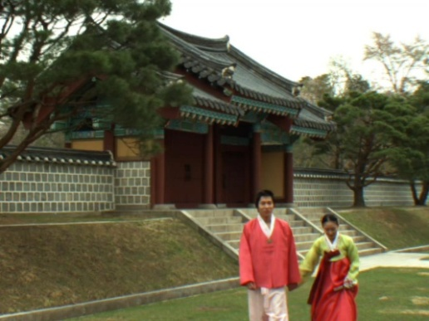
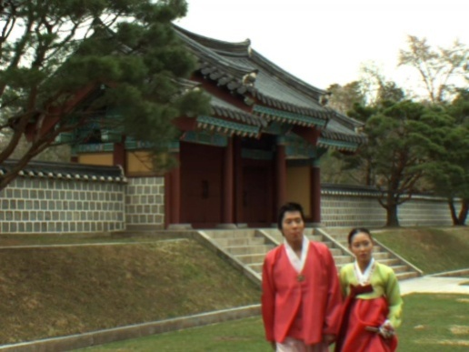


Synthesized Views
(Synthesized “lovebird1” view 7 using “decoded texture” and “decoded depth map”)
(a) Frame #01 (d)Frame #100
(C) Frame #150 (d)Frame #200

Slide 18
View Interpolation via Multiresolution View Analysis and Synthesis
Views 39 41 43 45 47 49 51 53
Multiresolution Synthesis
h₄₁ =0 h₄₃ h₄₅ =0 h₄₇ h₄₉ =0 h₅₁ h₅₃=0
Multiresolution Analysis
DVF
DERS 5.0
Views 39 43 47 51
Multiresolution View Analysis and Synthesis

Slide 19
Multiresolution View Analysis
Common view
Error view (h₄₇)
DVF
Unidirectional DCVF
Error view (h₄₃)
Error view (h₅₁)
DVF
Unidirectional DCVF
DVF
Unidirectional DCVF
Views 39 43 47 51

Slide 20
Multiresolution View Interpolation
Views 39 41 43 45 47 49 51 53
Interpolation
DVF
Inverse UDCVF
DVF
Inverse UDCVF
DVF
Inverse UDCVF
DVF
Inverse UDCVF
h₄₅ =0
h₄₅ =0
h₄₉ =0
h₅₃ =0
DVF
Inverse Unidirectional DCVF
DVF
Inverse Unidirectional DCVF
h₄₃
h₅₁
DVF
Inverse Unidirectional DCVF
Common View h₄₇

Slide 21
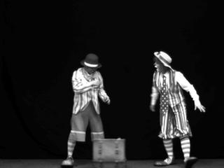
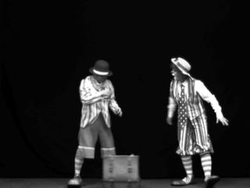
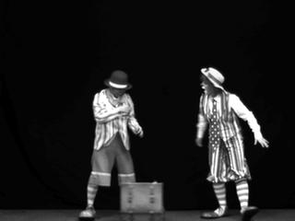
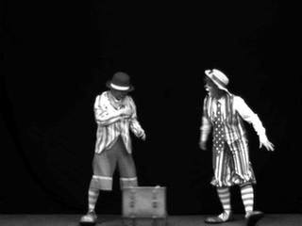


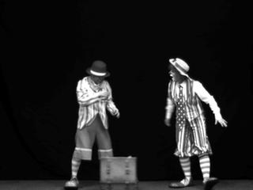

View Interpolation Results
Pantomime Views 39 Pantomime Views 41 Pantomime Views 43 Pantomime Views 45
Pantomime Views 47 Pantomime Views 49 Pantomime Views 51 Pantomime Views 53

Slide 22
Conclusions
EE1
Depth estimation by using a “reference depth map” (depth estimation mode “3”) improves the quality of estimated depth map and hence the quality of the view synthesis.
EE4
Quality of the synthesized view improves by assigning more bit rate to texture views.
Multiresolution View Interpolation
Investigating consistent DVF representations for the multi-resolution view interpolation by using the MPEG reference software

