Slide 1
Stereo Vision Based Distance Estimation in G6
Pravin Kumar Rana
Algorithm Team

Slide 2
Outline
Importance of Distance Information
Stereo Glint Based Distance Estimation
Benefits, Challenges, and Beyond 15

Slide 3
Brief Overview of Eye Tracking
Importance of Distance Information

Slide 4
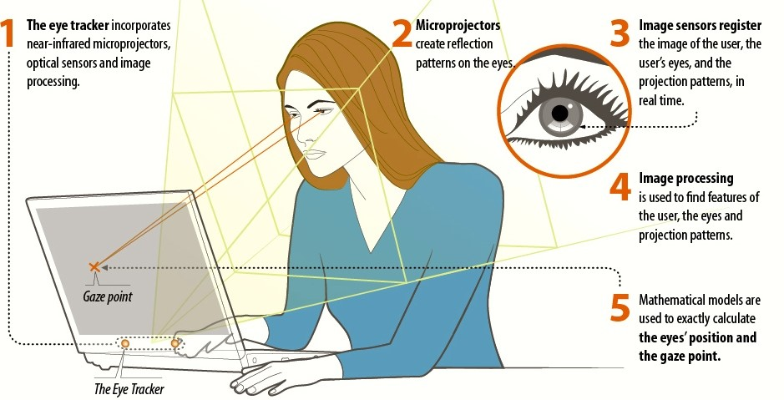
Brief Overview of Eye Tracking
Camera acquire
the image
of the user in real
time.
The G6 eye tracker
incorporates
two near-infrared
illuminators,
one high resolution
cameras, one low
resolution camera
and algorithms.
Illuminators
create
reflections,
know as
glints, on
the eyes.
Algorithms are
used to find
features in the image,
such as the eyes,
pupils, and glints.
Mathematical
models are used to
calculate the eye's
distance and the
gaze points.
Gaze Point
The G6 Eye Tracker

Slide 5

Importance of Distance Information
Screen
Eye
Tracker
Gaze point
Tracker to Eye Distance
Eye

Slide 6
Importance of Distance Information
Screen
Eye
Tracker
Gaze point
Screen
Eye
Tracker
Gaze point
Tracker to Eye Distance
Eye

Slide 7
Importance of Distance Information
Actual Gaze point
Screen
Eye
Tracker
Estimated Gaze point
Screen
Eye
Tracker
Gaze point
Tracker to Eye Distance
Eye

Slide 8
Stereo Glints Based Eye Position Estimation in G6

Slide 9
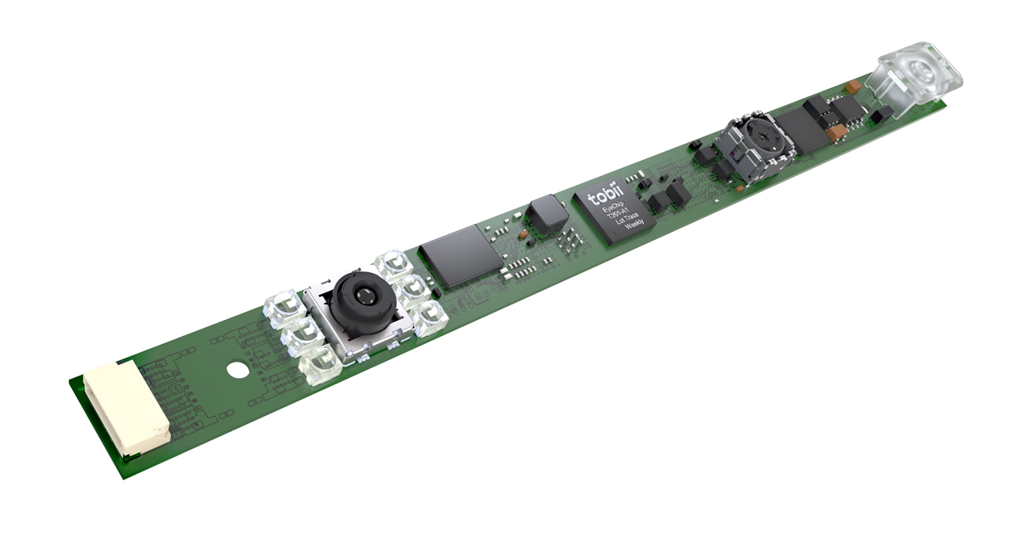
G6 Eye Tracker
G6 Base Geometry

Slide 10
G6 Eye Tracker
Low Resolution Camera
Tobii
ASIC
High Resolution Camera
Dark Pupil Illuminator
Bright Pupil Illuminator
G6 Base Geometry

Slide 11
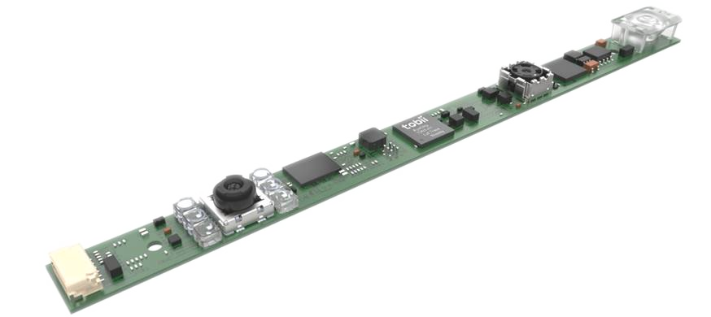
Glint in High
Resolution
Image
Eye
Dark Pupil Illuminator
Low Resolution Camera
Bright Pupil Illuminator
High Resolution Camera

Slide 12
Glint in High
Resolution
Image
Eye
Dark Pupil Illuminator
Low Resolution Camera
Bright Pupil Illuminator
High Resolution Camera

Slide 13
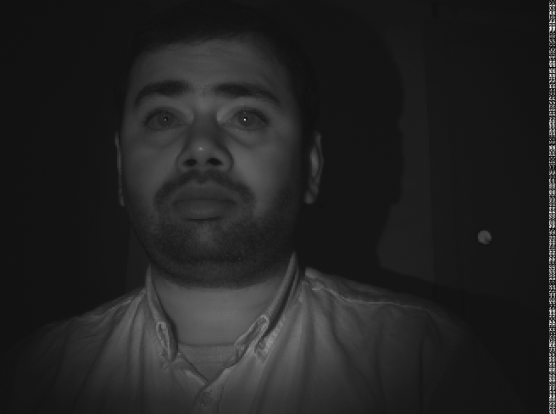
Glint in High
Resolution
Image
Eye
2600 X 1952
2600 X 1952
Dark Pupil Illuminator
Image
Low Resolution Camera
High Resolution Image
Bright Pupil Illuminator
High Resolution Camera

Slide 14
Glint in High
Resolution
Image
Eye
Eye Classification and Detection
Dark Pupil Illuminator
Image
Low Resolution Camera
High Resolution Image
Bright Pupil Illuminator
High Resolution Camera

Slide 15
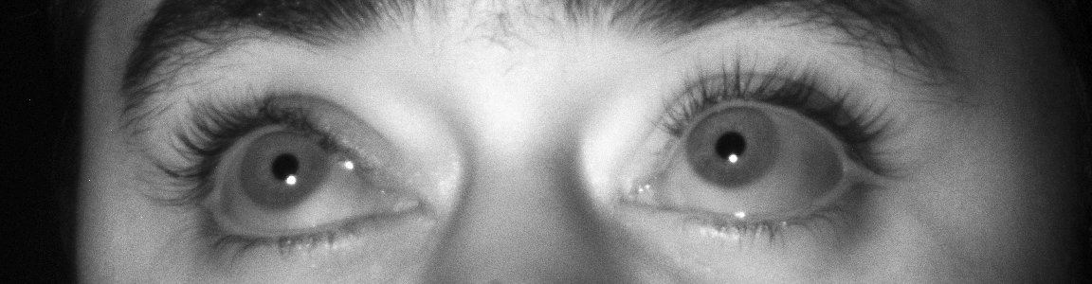
Glint in High
Resolution
Image
Eye
1160 X 300
Dark Pupil Illuminator
High Resolution ROI Image
Image
Low Resolution Camera
Bright Pupil Illuminator
High Resolution Camera

Slide 16
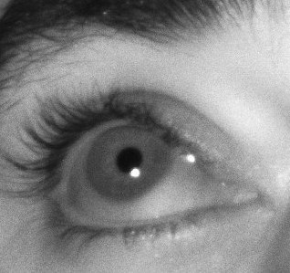
Glint in High
Resolution
Image
Eye
Dark Pupil Illuminator
High Resolution ROI Image Patch
Image
Low Resolution Camera
Bright Pupil Illuminator
High Resolution Camera

Slide 17
Glint in High
Resolution
Image
Eye
Glint Detector on Image Patch
Dark Pupil Illuminator
Image
High Resolution ROI Image Patch
Low Resolution Camera
Bright Pupil Illuminator
High Resolution Camera

Slide 18
Glint in High
Resolution
Image
Eye
Glint Detector on Image Patch
Dark Pupil Illuminator
Glint
Image
High Resolution ROI Image Patch
Low Resolution Camera
Bright Pupil Illuminator
High Resolution Camera

Slide 19
Glint in Low
Resolution
Image
Eye
Dark Pupil Illuminator
Image
Low Resolution Camera
Bright Pupil Illuminator
High Resolution Camera

Slide 20
Glint in Low
Resolution
Image
Eye
Dark Pupil Illuminator
Image
Low Resolution Camera
Bright Pupil Illuminator
High Resolution Camera

Slide 21
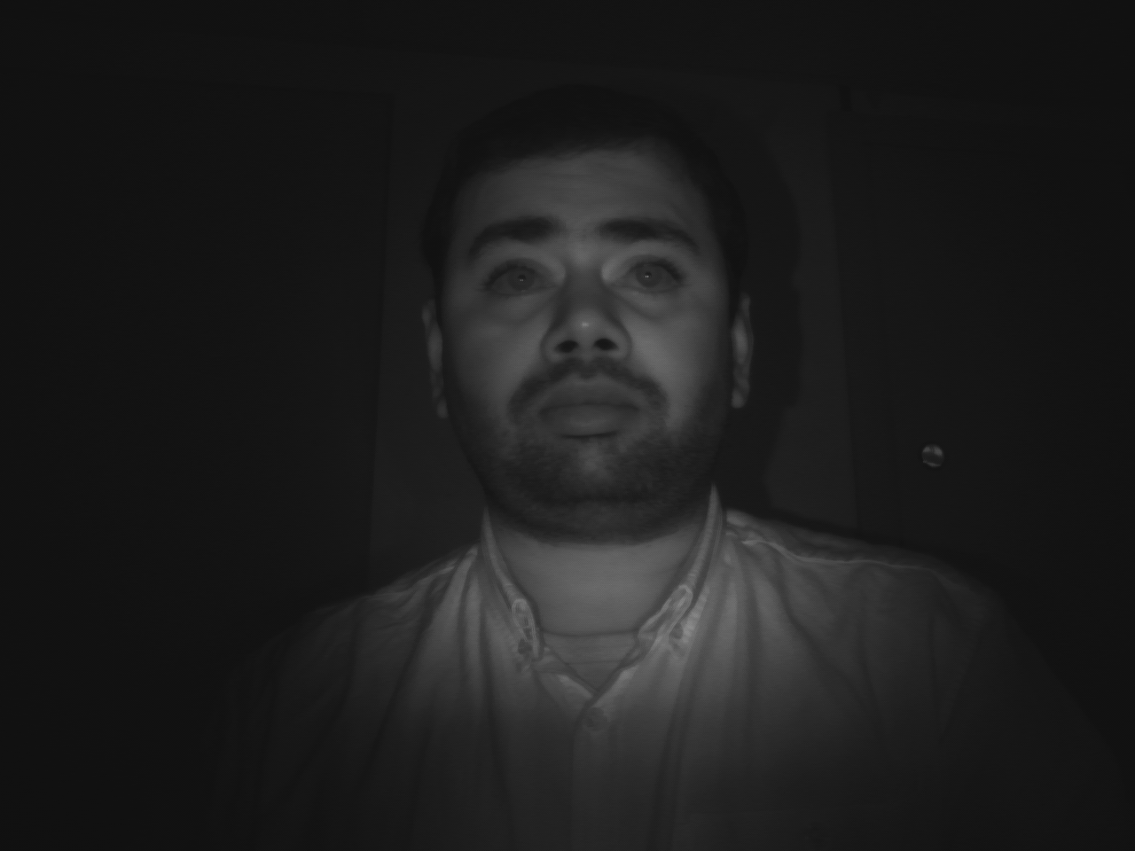
Glint in Low
Resolution
Image
Eye
1280 X 960
Dark Pupil Illuminator
Image
Image
Low Resolution Image
Low Resolution Camera
Bright Pupil Illuminator
High Resolution Camera

Slide 22
Glint in Low
Resolution
Image
Eye
No eye classification, detection, and tracking in low resolution image
Let us assume, a good initial guess of eye distance from tracker
Dark Pupil Illuminator
Image
Image
Low Resolution Camera
Bright Pupil Illuminator
High Resolution Camera

Slide 23
Glint in Low
Resolution
Image
Eye
Let us assume, a good initial guess of eye distance from tracker
Dark Pupil Illuminator
Image
Image
Low Resolution Camera
Bright Pupil Illuminator
High Resolution Camera

Slide 24
Glint in Low
Resolution
Image
Eye
Let us assume, a good initial guess of eye distance from tracker
Position of the low resolution camera and both of the illuminators are known
Dark Pupil Illuminator
Image
Image
Low Resolution Camera
Bright Pupil Illuminator
High Resolution Camera

Slide 25
Glint in Low
Resolution
Image
Eye
Let us assume, a good initial guess of eye distance from tracker
Position of the low resolution camera and both of the illuminators are known
Using pin-hole camera model, project the glint in low resolution camera
Dark Pupil Illuminator
Low Resolution Camera
Bright Pupil Illuminator
High Resolution Camera

Slide 26
Glint in Low
Resolution
Image
Eye
Let us assume, a good initial guess of eye distance from tracker
Position of the low resolution camera and both of the illuminators are known
Using pin-hole camera model, project the glint in low resolution camera
Low Resolution Image
Dark Pupil Illuminator
Low Resolution Camera
Bright Pupil Illuminator
High Resolution Camera

Slide 27
Glint in Low
Resolution
Image
Eye
Let us assume, a good initial guess of eye distance from tracker
Position of the low resolution camera and both of the illuminators are known
Using pin-hole camera model, project the glint in low resolution camera
Low Resolution Image
Expected Glint Position
Dark Pupil Illuminator
Low Resolution Camera
Bright Pupil Illuminator
High Resolution Camera

Slide 28
Glint Mapping and Detection
High Resolution ROI Image
Expected glint position in low resolution image
No eye classification and detection is required in low resolution image
Low Resolution Image

Slide 29
Glint Mapping and Detection
High Resolution ROI Image
Crop image patch around the expected glint position in low resolution image
No eye classification and detection is required in low resolution image
Low Resolution Image

Slide 30

Glint Mapping and Detection
Glint Detector on Image Patch
Low Resolution ROI Image Patch

Slide 31
Glint Mapping and Detection
Glint Detector on Image Patch
Detected double glint position in low resolution image patch
Low Resolution ROI Image Patch

Slide 32
Glint in Low
Resolution
Image
Eye
Dark Pupil Illuminator
Image
Low Resolution ROI Image Patch
Image
Low Resolution Camera
Bright Pupil Illuminator
High Resolution Camera

Slide 33
Glint in Low
Resolution
Image
Eye
Dark Pupil Illuminator
Image
Image
Low Resolution Camera
Bright Pupil Illuminator
High Resolution Camera

Slide 34
Glint in Low
Resolution
Image
Eye
Double glint
Dark Pupil Illuminator
Image
Low Resolution ROI Image Patch
Image
Low Resolution Camera
Bright Pupil Illuminator
High Resolution Camera

Slide 35
Stereo Glint Pair
Single
glint
Double glint
High Resolution ROI Image Patch
Low Resolution ROI Image Patch

Slide 36
Stereo Glint
Based Distance
Estimation
Eye
Dark Pupil Illuminator
Image
Image
Low Resolution Camera
Bright Pupil Illuminator
High Resolution Camera

Slide 37
Stereo Glint
Based Distance
Estimation
Eye
Dark Pupil Illuminator
Image
Image
Low Resolution Camera
Bright Pupil Illuminator
High Resolution Camera

Slide 38
Stereo Glint
Based Distance
Estimation
Eye
Assume double glint as a big single glint
Dark Pupil Illuminator
Image
Image
Low Resolution Camera
Bright Pupil Illuminator
High Resolution Camera

Slide 39
Stereo Glint
Based Distance
Estimation
Eye
Point of Intersection
Dark Pupil Illuminator
Image
Image
Low Resolution Camera
Bright Pupil Illuminator
High Resolution Camera

Slide 40
Stereo Glint
Based Distance
Estimation
Eye
Point of Intersection
Point of intersection gives distance of the tracker from the eye
For next frame, initialize the stereo algorithm with the estimated stereo distance
Dark Pupil Illuminator
Low Resolution Camera
Bright Pupil Illuminator
High Resolution Camera

Slide 41
Benefits, Challenges, and Beyond 15

Slide 42
Benefits
Stable distance estimation when compare to temporal glints based position information
Only one glint is required to estimate distance information
Improve gaze at large gaze angles
Distance information is even when temporal glint based distance estimation fails
Help to improve temporal glints based distance estimates
Improves gaze accuracy and precision with estimated cornea radius, instead of a fixed default value

Slide 43
Challenges
Unsynchronized stereo system
Acquisition time will be different for the low and high resolution images
Double glints in low resolution images
Asymmetric stereo system
Detected glint position in low resolution will have limited accuracy and precision
Highly sensitive to camera calibration parameters

Slide 44
Develop Beyond 15
Online self-calibration for the stereo camera rig

Slide 45
Thank You

