Slide 1

N-view Depth Consistency Testing Algorithm
Pravin Kumar Rana
Sound and Image Processing Lab.(SIP)
KTH - Royal Institute of Technology
SE-10044 Stockholm, Sweden

Slide 2
Outline
N-view Depth Consistency Testing Algorithm (DCTA)
Adaptive Connection Threshold: Cluster Approach

Slide 3
Depth Consistency Testing Algorithm(DCTA)

Slide 4
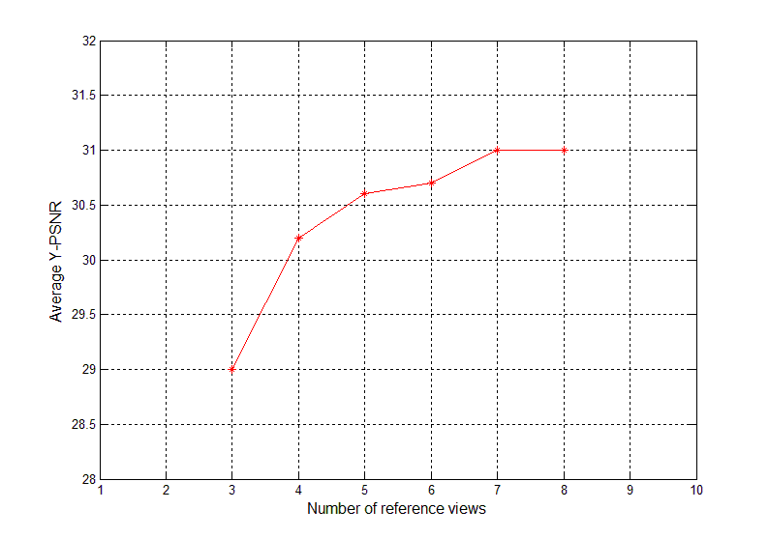
N-view DCTA Performance

Slide 5
N-view DCTA Performance
Table 1.
Average PSNR (in dB) of the virtual view synthesized by using N-view DCTA supported View Synthesis (Averaged over 10 frames ).
Test Sequences | Virtual Viewpoint | Number of References
 |  | #3 | #4 | #5 | #6 | #7 | #8
Pantomime | 40 | 39.3 | 39.8 | 39.8 | 40.3 | 40.5 | 40.2
Dog | 43 | 29.6 | 32.0 | 32.8 | 33.5 | 33.3 | 32.6
Newspaper | 04 | 28.7 | 30.3 | 30.5 | 30.7 | X
Lovebird1 | 07 | 29.0 | 30.2 | 30.6 | 30.7 | 31.0 | 31.0

Slide 6
Connection Threshold
Reference Depth Maps
d₁
d₂
d₃
d_{N}
Multiple warped Depth Maps
@ Virtual viewpoint
Depth Difference
Matrix(DDM)

Slide 7
Connection Threshold : A Cluster Approach
Depth Difference
Matrix (DDM)
Cluster A
Cluster B
Cluster C

Slide 8
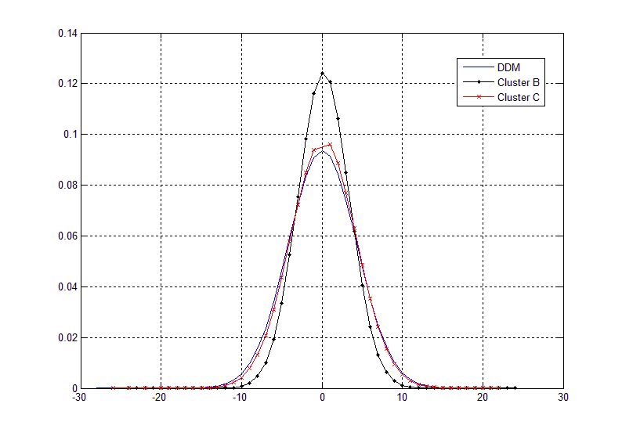
Cluster Distribution
3 reference-view scenario

Slide 9
Relative Distance Classification for Class C Cluster

Slide 10
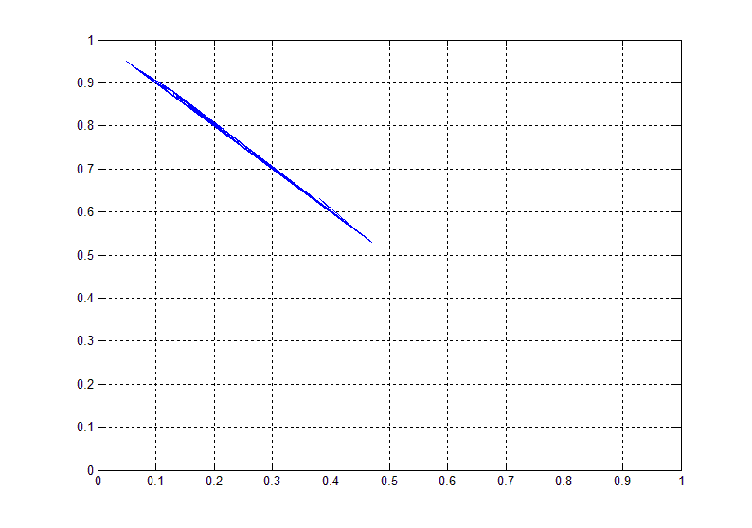
Relative Distance Classification for Class C Cluster
3 reference-view scenario
C₁
C₂

Slide 11
Connection Threshold
Class A Cluster Depth Pixel
Class B Cluster Depth Pixel
Class C₁ Cluster
Class C Cluster Depth Pixel
Class C₂ Cluster
Class C_{i} Cluster Depth Pixel

Slide 12
N-view DCTA Performance
Test Sequences | Virtual Viewpoint | Cluster A, plus | Number of References
 |  |  | #3 | #4 | #5 | #6 | #7 | #8
Pantomime | 40 | B, C | 39.2 | 39.7 | 39.8 | 40.3 | 40.0 | 39.6
 |  | B, C₁, C₂ | 39.3 | 39.8 | 39.8 | - | - | -
 |  | B₁, B₂ | - | - | - | - | 40.5 | 40.2
Dog | 43 | B, C | 29.0 | 30.7 | 32.5 | 33.5 | 33.3 | 32.6
 |  | B, C₁, C₂ | 29.6 | 31.0 | 32.8 | - | - | -
Newspaper | 04 | B, C | 28.1 | 29.9 | 30.2 | 30.7 | X
 |  | B, C₁, C₂ | 28.7 | 30.2 | 30.5 | 30.7
Lovebird1 | 07 | B, C | 28.6 | 29.8 | 30.3 | 30.7 | 31.0 | 31.0
 |  | B, C₁, C₂ | 29.0 | 30.2 | 30.6 | - | - | -
Table 2: Average PSNR (in dB) of the virtual view synthesized by using N-view DCTA supported View Synthesis (Averaged over 10 frames ).

