Slide 1
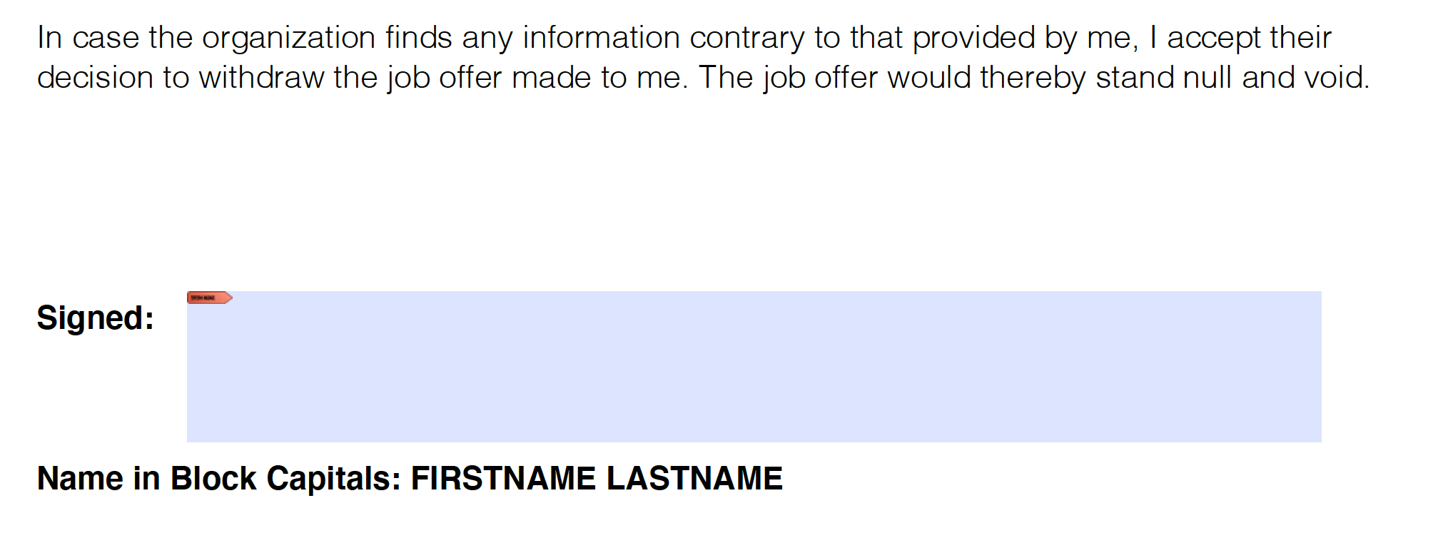
Please read the Letter of Authorization. At the bottom of the page (as seen above) click on the box next to Signed.

Slide 2
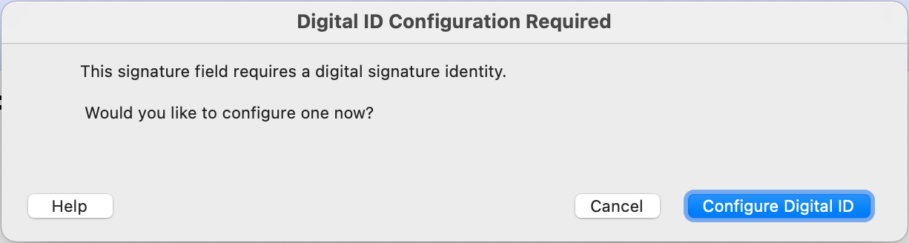
Click on “Configure Digital ID” as shown above.

Slide 3
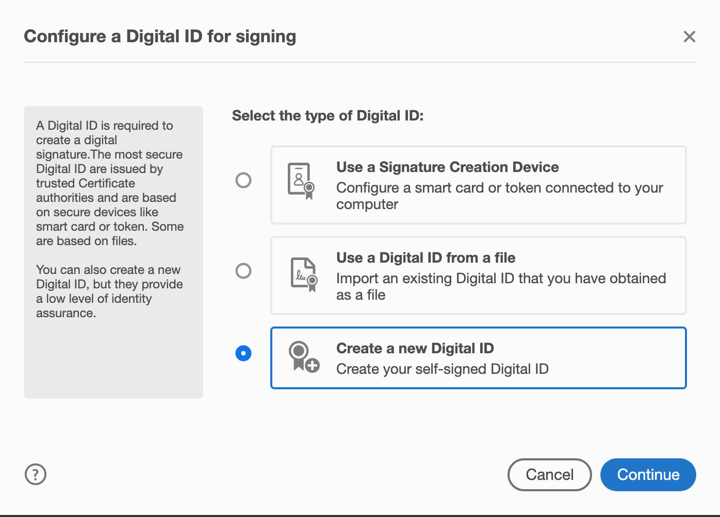
Select on “Create a new Digital ID” as shown above and then click “Continue”

Slide 4
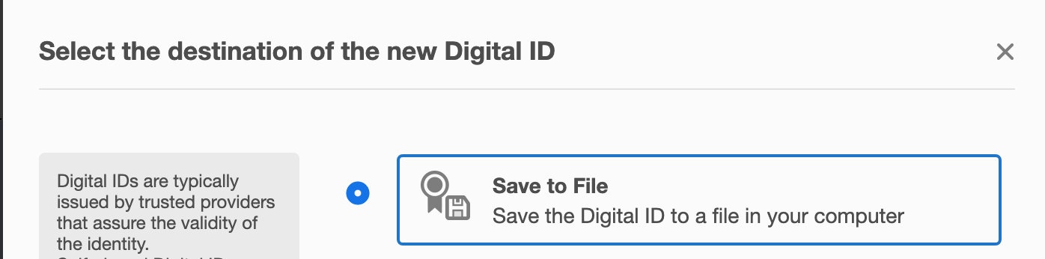
Select on “Save to File” as shown above and then click “Continue”

Slide 5
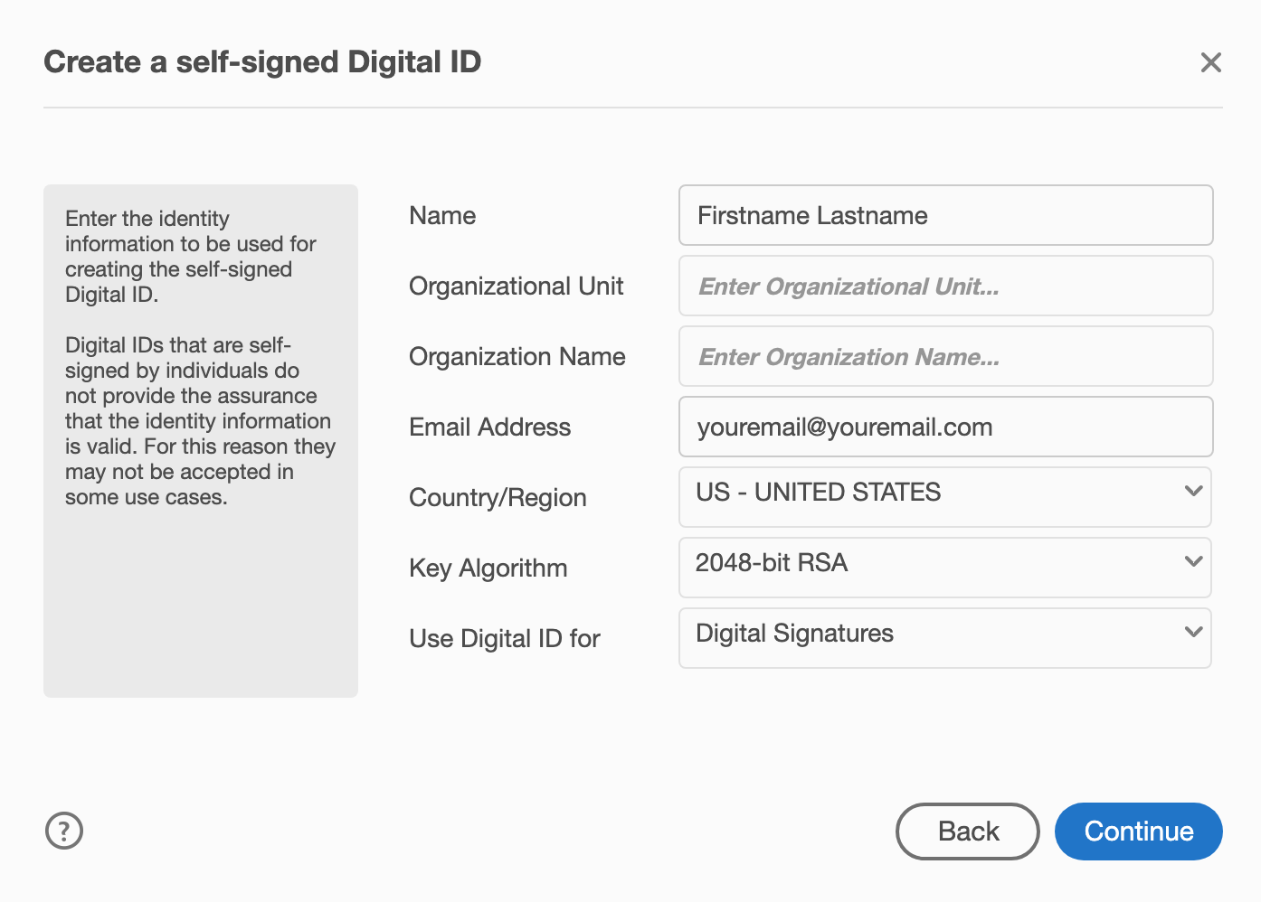
Provide details on this scree with your name, organization, email address, country details. Click “Continue” once done.

Slide 6
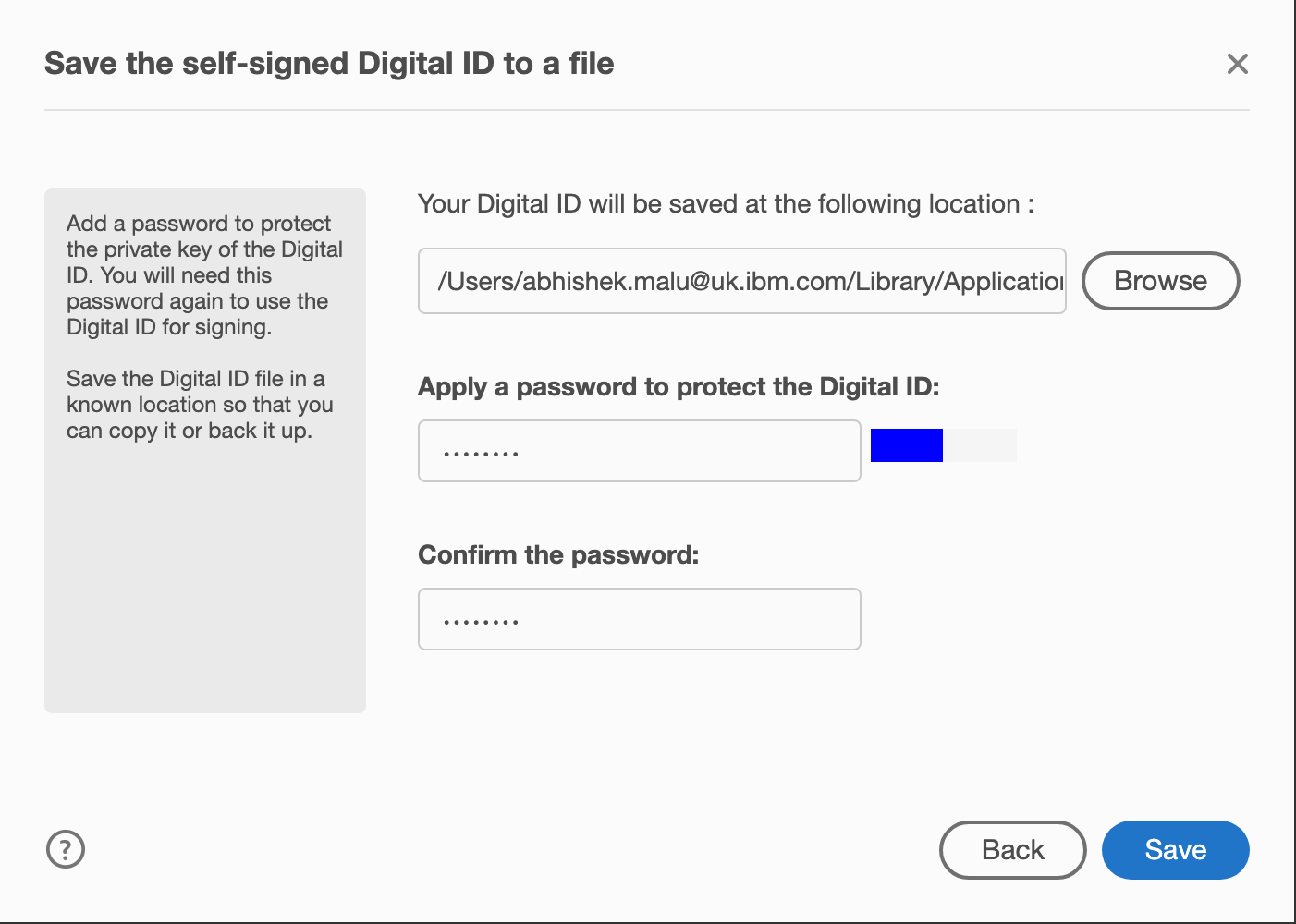
Provide the Location to save the digital ID and password to use this Digital ID.

Slide 7
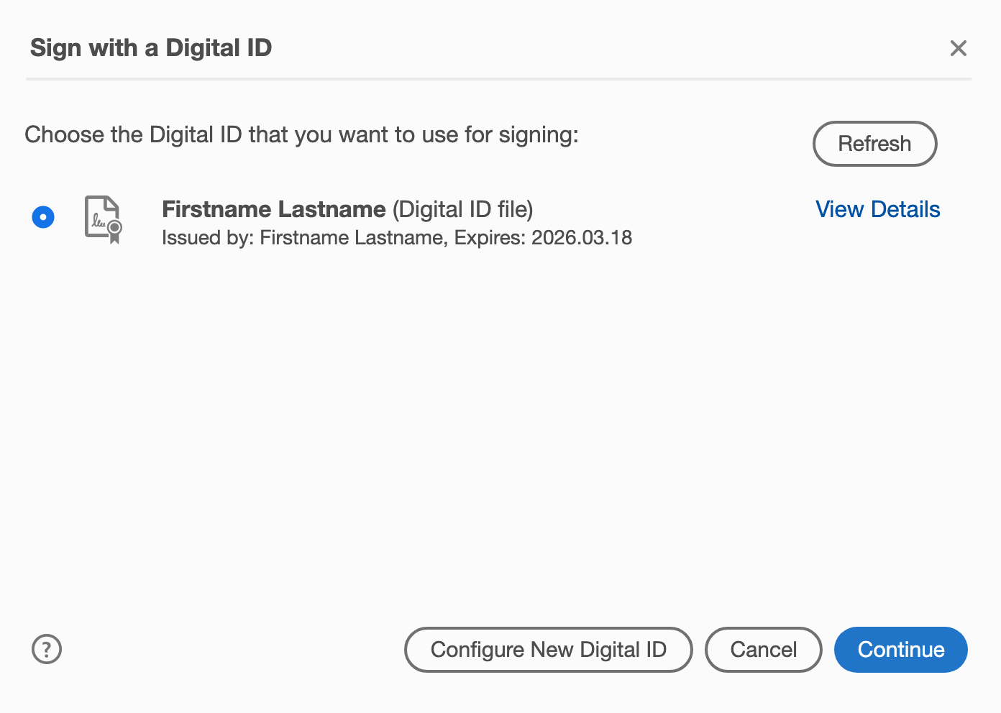
You will now see your Digital ID is now created. Click “Continue” as shown above.

Slide 8
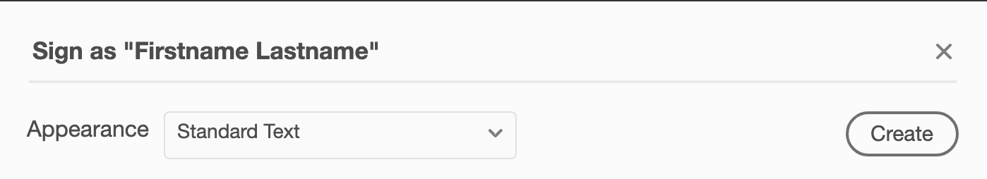
Click on “Create” button. This will allow you to create a signature to be placed on the document.

Slide 9
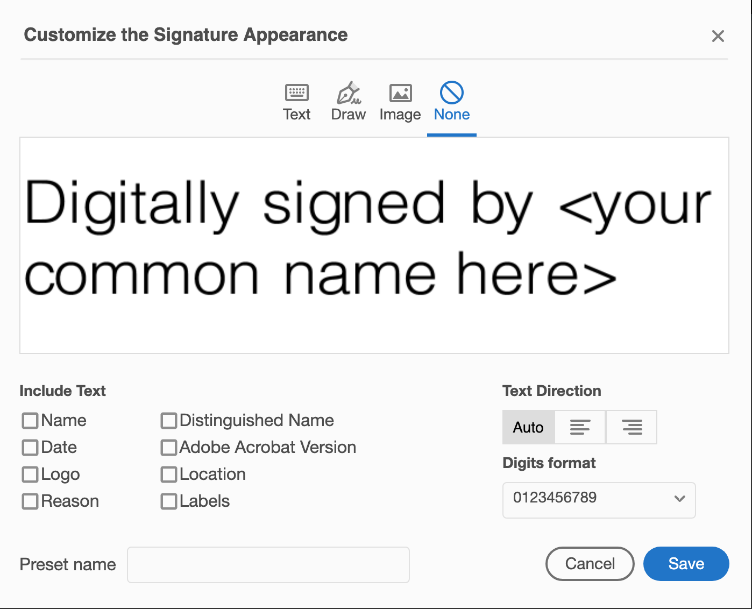
Please select “None” on the top Deselect all the checkboxes below “Include Text”. Make sure it looks as shown above and click “Save”

Slide 10
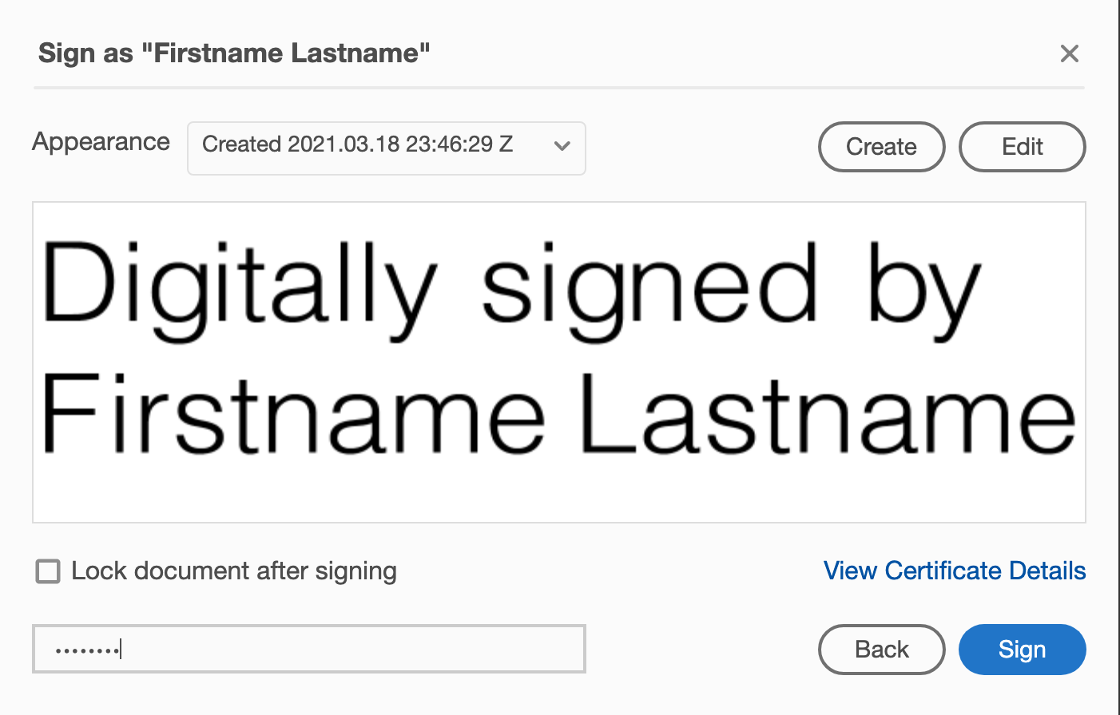
Provide the password you had set for your Digital ID. (Refer Slide 6) and now Click “Sign”

Slide 11
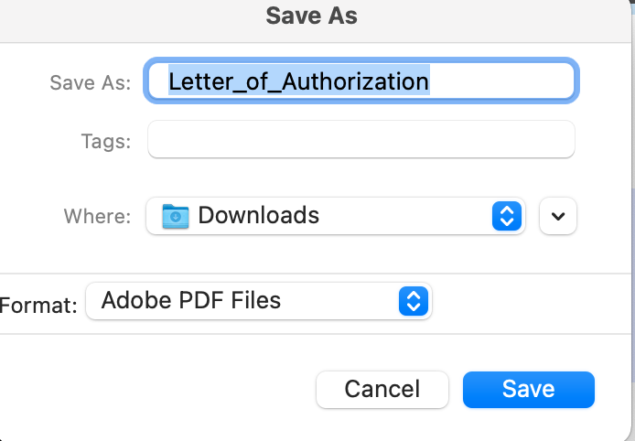
You will now be asked to save the digitally signed file. Please save to a location of your choice,

Slide 12
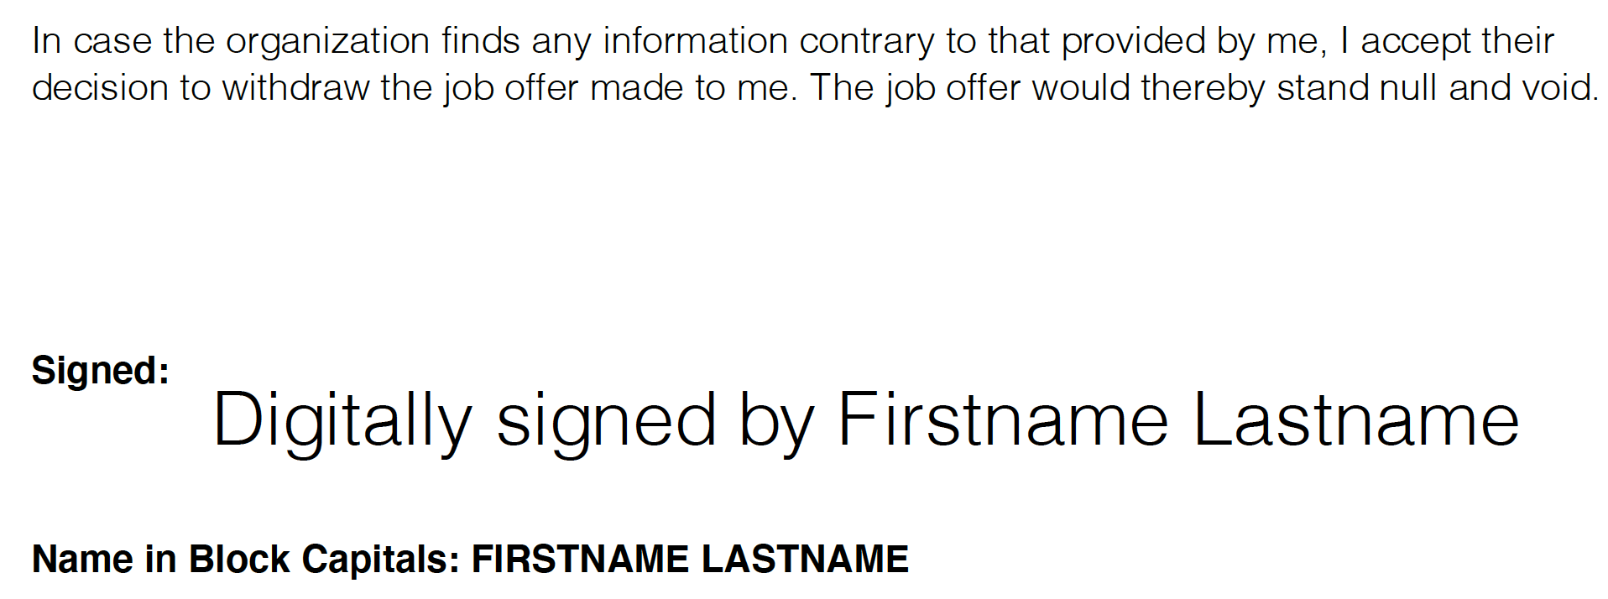
The saved file will look like above. Please upload this file now on the Digiverify portal.

