Slide 1
Statistical Analysis To Improve Sales

Slide 2
Project Objective
Conduct specification-based analysis to refine product strategy and improve sales performance, aligning products with customer needs.
Assess price disparities between premium and non-premium computers to guide strategic pricing decisions.
Analyze computer price trends through distribution analysis to inform pricing strategies, market positioning, and optimize advertising budget allocation.
Clean the dataset to support the analysis, improving
overall product strategy and sales performance.

Slide 3
premium_count = computer_df[computer_df['premium'] == 'yes'].shape[0]total_computers = computer_df.shape[0]probability_premium = premium_count / total_computersprint(f"Probability of selling a premium computer: {probability_premium:.2f}")premium_with_cd_count = computer_df[(computer_df['premium'] == 'yes') & (computer_df['cd'] == 'yes')].shape[0]probability_premium_cd = premium_with_cd_count / premium_countprint(f"Given that a computer is premium, probability that it has a CD player: {probability_premium_cd:.2f}")
Interpretation
Probability of selling a premium computer: 0.90 Given that a computer is premium, probability that it has a CD player: 0.50
condition = (computer_df['ram'] >= 8) & (computer_df['screen'] == 14) & (computer_df['speed'] >
computer_df[condition].shape[0]
total_computers= computer_df.shape[0
probability= computers_meeting_condition / total_computers
Probability of purchasing a computer with at least 8GB RAM, 14 inch screen, and processor speed > 33 MHz: 0.16

Slide 4

Assessing Price Disparities Between Premium
and Non-Premium Computers
Average price (Simple Random Sampling): 3014.80 Average price (Systematic Sampling): 2214.96 Average price (Stratified Sampling by RAM): 2226.60 Average price (Cluster Sampling by screen size = 14): 2083.56
Average price of premium computers (whole data): 2204.15 Average price of non-premium computers (whole data): 2361.93
Average price of premium computers (sampled data): 2367.67 Average price of non-premium computers (sampled data): 3341.50

Slide 5
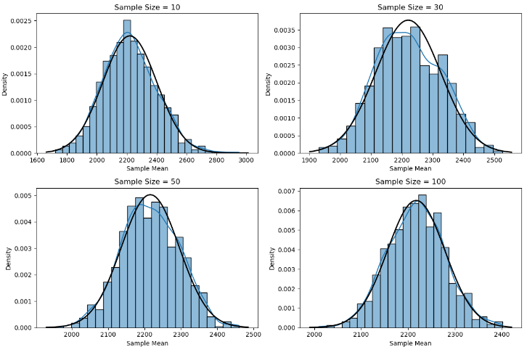

Slide 6
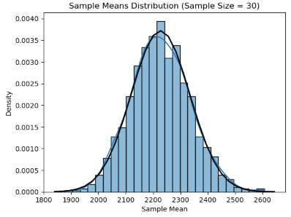
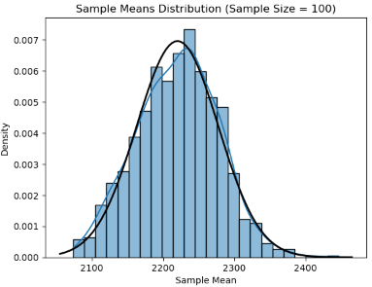

Slide 7
population_mean = computer_df['price'].
mean()sample_means_mean = np.mean(sample_means_100)
print(f"Population Mean: {population_mean:.2f}")print(f"Mean of Sample Means (n=100): {sample_means_mean:.2f}")population_std = computer_df['price'].
std()sample_means_std = np.std(sample_means_100)expected_
std = population_std / np.sqrt(100)
print(f"Population Standard Deviation: {population_std:.2f}")
print(f"Standard Deviation of Sample Means (n=100): {sample_means_std:.2f}")
print(f"Expected Standard Deviation (n=100): {expected_std:.2f}")
Population Mean: 2219.58Mean of Sample Means (n=100):
2217.56Population Standard Deviation: 580.80Standard Deviation of Sample Means (n=100): 58.13Expected Standard Deviation (n=100):
58.08 The mean of the sample means are close to the population mean.
The standard deviation of the sample means are approximate the population standard deviation divided by the square root of the sample size.
Thus, it satisfies the CLT theorem.

Slide 8
# Analyse the dataimport mathimport statistics as stfrom scipy.stats import norm# Calculating critical value of the hypothesis testz_critical=norm.ppf(1-alpha)print("Z Critical: ",z_critical)# Calculating test statistics for hypothesis testz_stats=(s_mean-p_mean)/(pop_stdv/math.sqrt(n))print("Z Statistical Value: ",z_stats)# Calculating the p-value for the hypothesis testp_val=norm.sf(abs(z_stats))print("P Value: ",p_val)
Z Critical: 1.6448536269514722 Z Statistical Value: 0.076067082
P Value: 0.4696828642738865
if z_stats > z_critical: print("Reject the null hypothesis ")else: print("Fail to reject the null hypothesis ")if p_val< alpha: print("p-value with alpha value : Reject the null hypothesis : The average advertising budget in 2023 is significantly higher than 2022.")else: print("Fail to reject the null hypothesis : There is insufficient evidence to suggest that the average advertising budget in 2023 is higher than 2022.")
Fail to reject the null hypothesis
Fail to reject the null hypothesis There is insufficient evidence to suggest that the average advertising budget in 2023 is higher than 2022.
Prices with CD MEAN: 2342.6055708390645
Prices without CD MEAN: 2112.8119964189796
Standard deviation of Prices with CD : 527.4477919505294
Standard deviation of Prices without CD : 603.494237086272
Size of Prices with CD : 2908
Size of Prices without CD : 3351
Variance of Prices with CD : 278201.173233489
Variance of Prices without CD : 364205.29419634154

Slide 9
import math num=abs(prices_with_cd_mean - prices_without_cd_mean)denom=math.sqrt(prices_with_cd_var*(prices_with_cd_size-1)+prices_without_cd_var*(prices_without_cd_size-1))* math.sqrt((1/prices_with_cd_size)+(1/prices_without_cd_size))tstats=num/denomprint("T Statistics: ", tstats)tcritical=t.ppf(alpha/2,dof)print("T Critical: ",tcritical)p_val=t.sf(abs(tstats),dof)*2print("P Value :",p_val)
T Statistics: 0.20130205884119745
T Critical: -1.9603431954063066
P Value : 0.840468936223419
# Check if p-value is less than the significance level (0.05)alpha = 0.05if p_value < alpha: print("Reject the null hypothesis (H₀). There is a statistically significant difference in the average prices.")else: print("Fail to reject the null hypothesis (H₀). There is no statistically significant difference in the average prices.")
Reject the null hypothesis (H₀). There is a statistically significant difference in the average prices.
Null hypothesis: The claim that there is no effect in the population, or that there is no relationship between two sets of data. It's often denoted as H0.
Alternative hypothesis: The claim that there is an effect in the population, or that there is a relationship between two variables. It's often denoted as Ha or H1.

Slide 10
# Filter out only premium computerspremium_computers = computer_df[computer_df['premium'] == 'yes']['price']# Randomly select 25 premium computers sample_premium = premium_computers.sample(n=25, replace=True, random_state=42) # Sampling with replacement to meet n=25# Perform a one-sample t-testpop_mean = 2200 # Hypothesized population meansample_premium_mean= st.mean(sample_premium) n=25sample_premium_std=st.stdev(sample_premium)dof=n-1print("Sample Mean :" ,sample_premium_mean)print("Standard deviation of sample: ", sample_premium_std)
Sample Mean : 2168.32
Standard deviation of sample: 589.4063906451416
T Statistics: -0.26874496529740816
T Critical: -2.063898561628021
P Value : 0.7904226567567547
Reject the null hypothesis (H₀). The mean price of premium computers significantly differs from $2200.
tstats = (sample_premium_mean - pop_mean)/(sample_premium_std/(n**0.5))print("T Statistics: ",tstats)t_critical=t.ppf(alpha/2,dof)print("T Critical: ",t_critical)p_val=t.sf(abs(tstats),dof)*2print("P Value :",p_val)
# Check if p-value is less than the significance level (0.05)alpha = 0.05if p_value < alpha: print("Reject the null hypothesis (H₀). The mean price of premium computers significantly differs from $2200.")else: print("Fail to reject the null hypothesis (H₀). There is no significant difference in the mean price of premium computers from $2200.")

Slide 11
num=abs(premium_computers_mean - non_premium_computers_mean)denom=math.sqrt(premium_computers_var*(premium_computers_size-1)+non_premium_computers_var*(non_premium_computers_size-1))* math.sqrt((1/premium_computers_size)+(1/non_premium_computers_size))tstats=num/denomprint("T Statistics: ", tstats)tcritical=t.ppf(alpha/2,dof)print("T Critical: ",tcritical)p_val=t.sf(abs(tstats),dof)*2print("P Value :",p_val)
# Check if p-value is less than the significance level (0.05)alpha = 0.05if p_value < alpha: print("Reject the null hypothesis (H₀). There is a significant difference in the mean prices of premium and non-premium computers.")else: print("Fail to reject the null hypothesis (H₀). There is no significant difference in the mean prices of premium and non-premium computers.")
Premium Computers MEAN: 2204.148397379139
Non-Premium Computers MEAN: 2361.9346405228757
Standard deviation of premium_computers : 570.4449058900096
Standard deviation of Non-Premium Computers : 652.3712599894812
Size of premium_computers : 5647
Size of Non-Premium Computers : 612
T Statistics: 0.08096038890586069
T Critical: -1.9603431954063066
P Value : 0.9354760434827551
Reject the null hypothesis (H₀). There is a significant difference in the mean prices of premium and non-premium computers.
Variance of premium_computers : 325407.39065586193
Variance of Non-Premium Computers : 425588.2608602633

Slide 12

Conclusion
Key Insights:
Low Purchase Probability: Only 16% chance of buying a computer with 8GB RAM, 14-inch screen, and processor speed >33 MHz.
Premium Dominance: 90% probability of selling a premium computer, with 50% including a CD player.
Non-Premium Trends: 69% of non-premium computers have screen sizes ≤14 inches.
Price Analysis:
Average Prices: Prices vary across samples, but cluster around
the population mean of $2219.58.
Premium vs Non-Premium: Non-premium computers have a
higher average price than premium ones:
Premium: $2204.15
Non-Premium: $2361.93
CD Players & Price: Computers with CD players are priced
higher than those without.

Slide 13
Statistical Testing Results:
Ad Budget: No significant increase in the 2023 advertising budget.
Price Differences: Significant difference in mean prices between premium and non-premium computers.
CLT Validation: The sample means closely match the population mean, validating the sampling methods used.
This analysis provides a quick overview of the findings, emphasizing key points on probabilities, price trends, and statistical tests.

