Slide 1
Unveiling
Automobile
Sales trends
Exploring data of automobile sales to find out valuable trends that help business to grow.

Slide 2
Exploratory Data Analysis:
Insight Extraction:
01
02
Perform an exploratory data analysis using Tableau to explore sales data of miniature automobiles popular among hobbyists and collectors
Extract key insights related to sales trends, customer segmentation, and product performance.
Data Cleaning and Analysis:
Summary and Recommendations:
03
04
Clean the dataset and analyze sales performance, customer segments, and forecast sales
Summarize key findings to guide future strategies and decisions
Project Objective

Slide 3
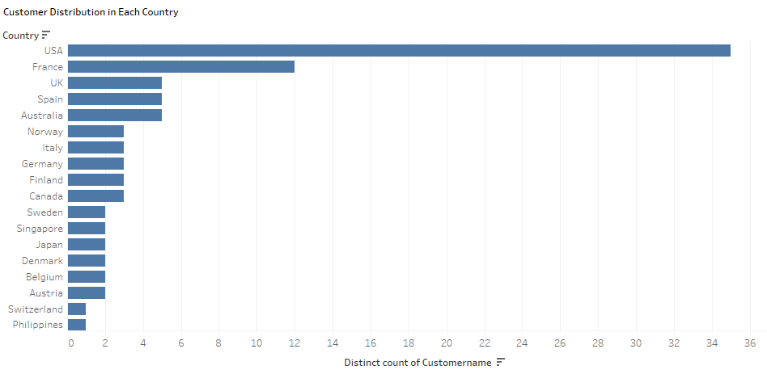
The bar chart shows the number of unique customers in each country. The USA has the highest number of customers, followed by France and the UK. The Philippines has the lowest number of customers.

Slide 4
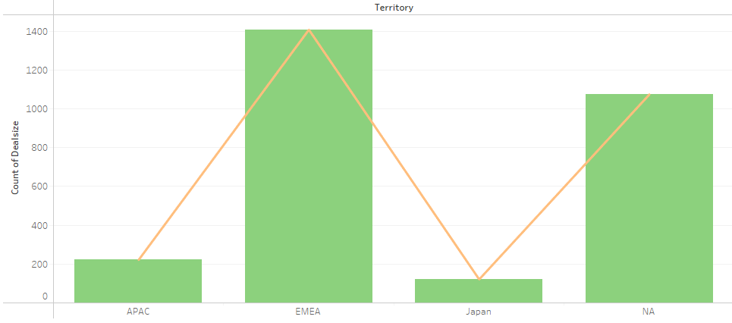
The bar chart shows the number of deals in each territory. EMEA has the highest number of deals, followed by NA and APAC. Japan has the lowest number of deals.

Slide 5
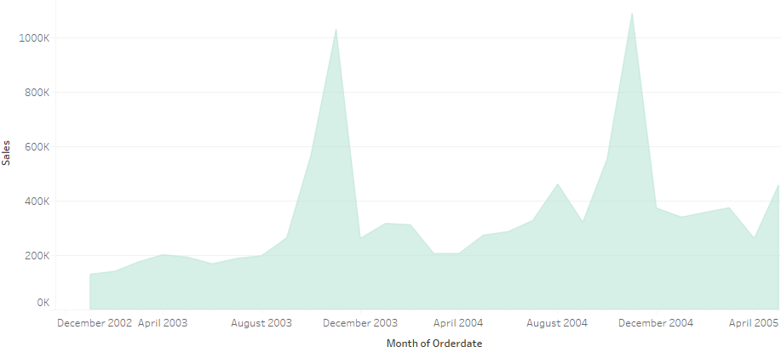
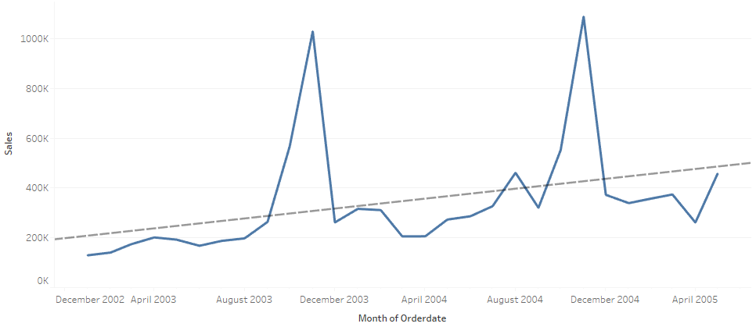
The line chart shows the sales trend over time. Sales increased significantly from December 2002 to December 2003, then declined until April 2004. After that, sales increased again until December 2004, then declined until April 2005. There is an overall upward trend, but with some fluctuations.
The line chart shows the sales trend over time. Sales increased significantly from December 2002 to December 2003, then declined until April 2004. After that, sales increased again until December 2004, then declined until April 2005.

Slide 6
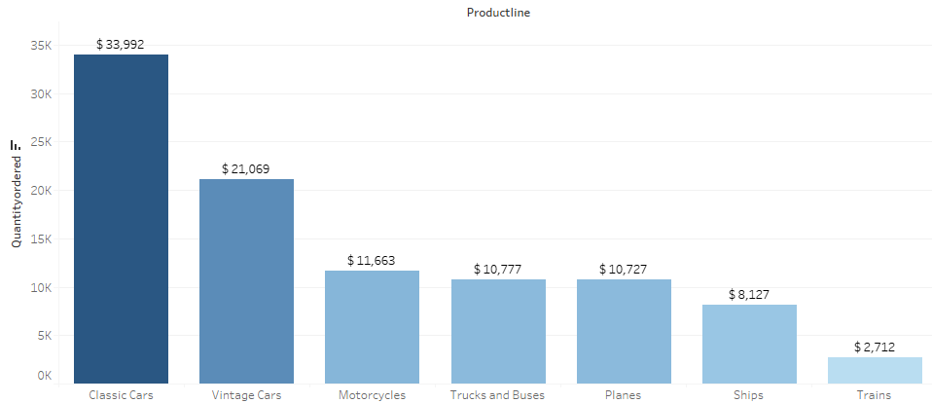
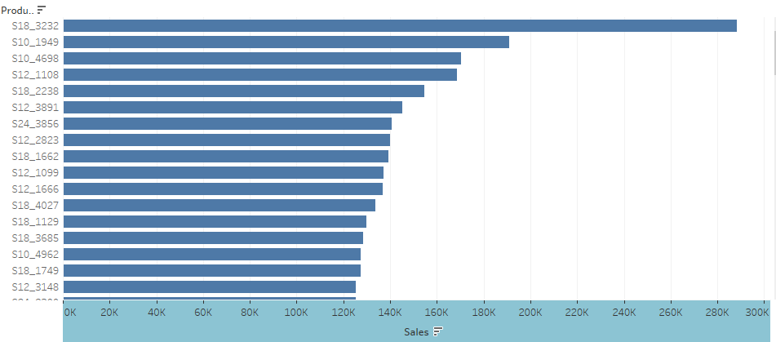
Classic Cars have the highest quantity ordered, followed by Vintage Cars and Motorcycles. Trains have the lowest quantity ordered.
The bar chart shows the sales for different product IDs. S18_3232 has the highest sales, followed by S10_1949 and S10_4698. S12_3148 has the lowest sales.

Slide 7
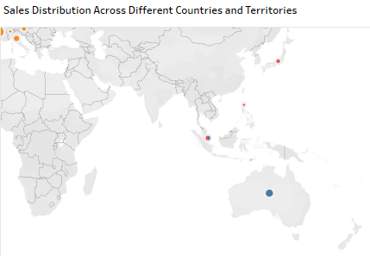
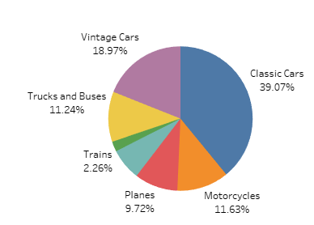
The pie chart shows the percentage distribution of accidents according to the vehicle involved. Classic Cars have the highest percentage, followed by Vintage Cars and Trucks and Buses. Trains have the lowest percentage.

Slide 8
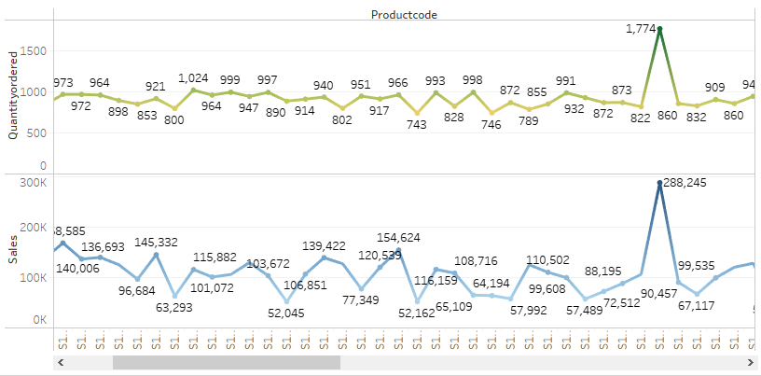
The trends of sum of Quantityordered and sum of Sales for Productcode. For pane Sum of Quantityordered: Color shows sum of Quantityordered. The marks are labeled by sum of Quantityordered. For pane Sum of Sales: Color shows sum of Sales. The marks are labeled by sum of Sales.

Slide 9
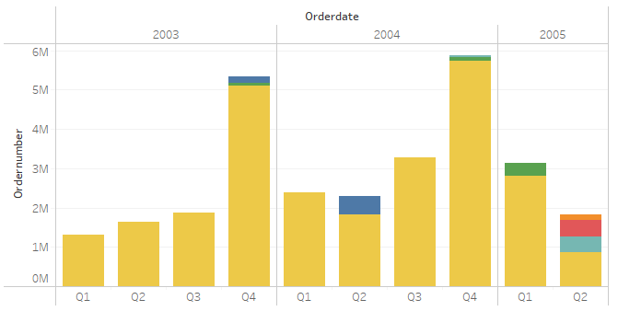
Sum of Ordernumber for each Orderdate Quarter broken down by Orderdate Year. Color shows details about Status.

Slide 10
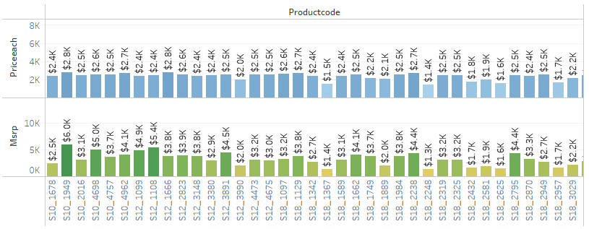
Sum of Priceeach and sum of Msrp for each Productcode. For pane Sum of Msrp: Color shows sum of Msrp. The marks are labeled by sum of Msrp. For pane Sum of Priceeach: Color shows sum of Priceeach. The marks are labeled by sum of Priceeach.

Slide 11
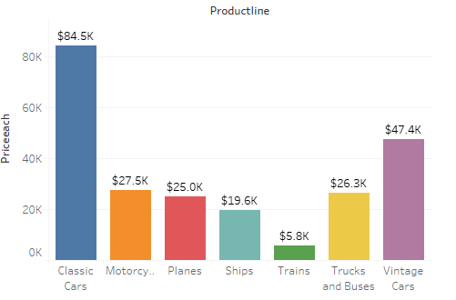
Sum of Priceeach for each Productline. Color shows details about Productline. The marks are labeled by sum of Priceeach.

Slide 12
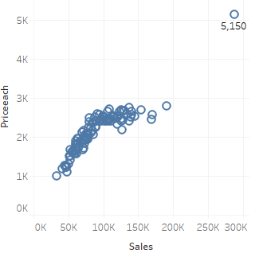
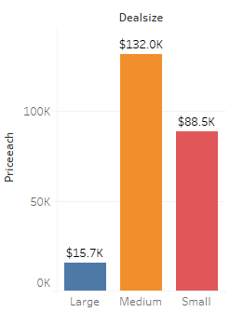
Sum of Priceeach for each Dealsize. Color shows details about Dealsize. The marks are labeled by sum of Priceeach.
Sum of Sales vs. sum of Priceeach. Details are shown for Productcode

Slide 13
Customer and Sales Data
Customer Distribution: The USA has the largest customer base, followed by France and the UK.
Deal Distribution: EMEA has the highest number of deals, indicating strong market potential.
Sales Trends: While there are fluctuations, there is an overall upward trend in sales.
Product Performance
Product Popularity: Classic Cars have the highest demand, followed by Vintage Cars and Motorcycles.
Sales Leaders: S18_3232 is the top-selling product, followed by S10_1949 and S10_4698.
Product Pricing: Analysis of MSRP and price each can help optimize pricing strategies.
Accident Data
Vehicle Involvement: Classic Cars are involved in the highest percentage of accidents, followed by Vintage Cars and Trucks & Buses.

Slide 14
Business Conclusions
Target Key Markets: Focus on expanding in the USA, France, and the UK to capitalize on the larger customer base.
Strengthen EMEA Presence: Increase marketing efforts and sales initiatives in EMEA to further drive growth.
Optimize Product Portfolio: Analyze sales data to identify product lines that require adjustments or discontinuation.
Improve Safety Features: Focus on enhancing safety features in Classic Cars to reduce accident rates.
Price Optimization: Regularly review pricing strategies to ensure profitability and competitiveness.
By implementing these strategies, manufacturers can improve sales, market share, and overall business performance.

