Slide 1
Semester Long Project on Time Series Trend Prediction
by
Name: Pravin Reddy Sereddy
B-Number: B00714266
B-Mail: spravin1@Binghamton.edu

Slide 2
Table of Content
What is time series data mining?
Problem Statement
Method Used
Implementation
Results
References

Slide 3
What is time series data mining?
What is time series data?
A time series data is a sequence of data points recorded at specific time points - most often in regular time intervals (seconds, hours, days, months etc.).
What is time series data mining ?
A time series data mining is the process of extracting the interesting patterns from the time series data

Slide 4
Problem Statement
In this project we are asked to study the time series data trend prediction
We got the e-commerce dataset where there were 1000 products and 31490 costumer’s data
In this we have 100 key products and the dataset has product sale quantity form the 0th day to 117th day total of 118 days
Out of this we are asked to predict the sales quantity prediction for next 29 days from 118th day to 146th day

Slide 5
Method used
I have used ARIMA model to predict the sales of this dataset
ARIMA stands for Auto Regressive Integrated Moving Average
There are three key aspects of the model
AR: Autoregression. A model that uses the dependent relationship between an observation and some number of lagged observations
I: Integrated. The use of differencing of raw observations (e.g. subtracting an observation from an observation at the previous time step) in order to make the time series stationary
MA: Moving Average. A model that uses the dependency between an observation and a residual error from a moving average model applied to lagged observations.

Slide 6
Implementation
Language: Python
Libraries:
Statsmodels
Pandas
IDE: PyCharm

Slide 7
Implementation
The standard notation of the ARIMA is ARIMA( p, d, q)
For building the ARIMA model we must find these 3 parameters
p: The number of lag observation called lag order
d: The number of times that the raw observations are differenced called degree of differencing
q: The size of moving average window called as order of moving average
We can construct the good model when we pass the good parameters

Slide 8
Implementation
Finding the good parameters for ARIMA
PACF( Partial Auto Correlation Function) to determine the value of P
The level of differencing to determine the value of D
ACF( Auto Correlation Function) to determine the value of Q
Testing the model
I have taken first 90 days of data to build the model from the time series dataset
I have predicted the next 28 days sales data and choose the best model that is predicted through overall RMSE value

Slide 9
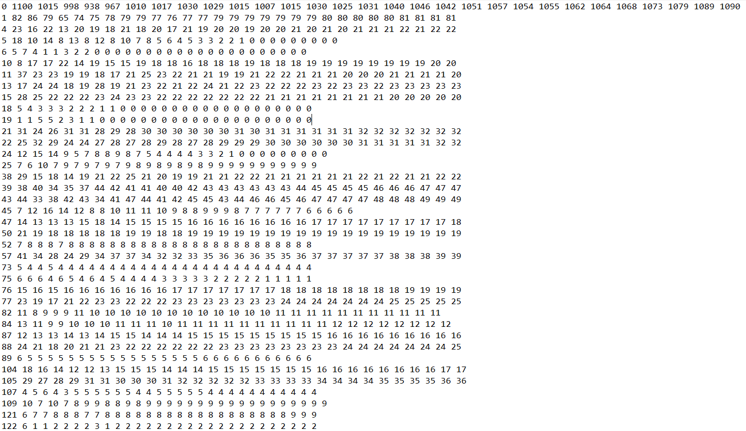
Results

Slide 10
References
Peter J. Brockwell and Richard A. Davis, Time Series: Theory and Methods, 2ndEdition, Springer Science + Business Media, New York, 2006
Michael Schaidnagel, Christian Abele and Fritz Laux, Sales Prediction with Parametrized Time Series Analysis, Germany, 2013
https://machinelearningmastery.com/arima-for-time-series-forecasting-with-python
https://en.wikipedia.org/wiki/Autoregressive_integrated_moving_average

Slide 11
Thank You

