Slide 1
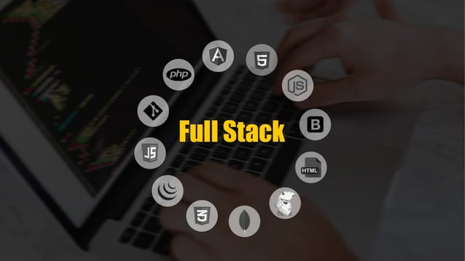

Slide 2
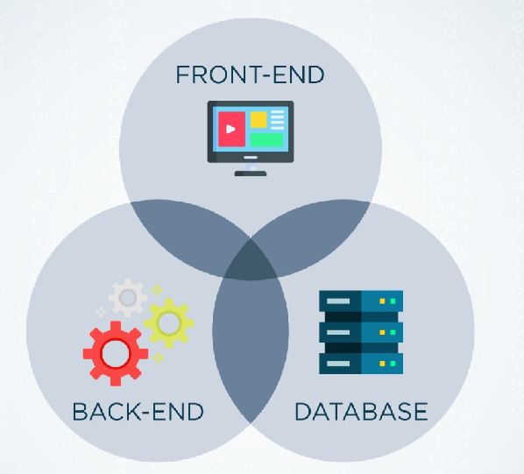
What is Full Stack ?
A full stack web developer is a person who can develop both client and server software.
In addition to mastering HTML and CSS, he/she also knows how to: Program a browser (like using JavaScript, jQuery, Angular, or Vue) Program a server (like using PHP, ASP, Python, or Node)

Slide 3
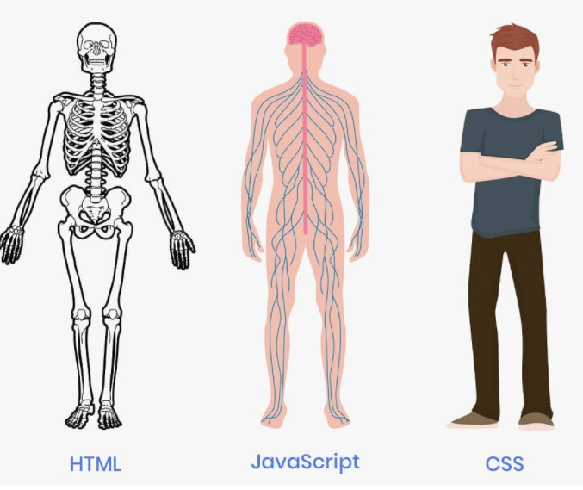
Front End Technologies
Front End Technologies Includes
HTML,
CSS,
Java Script,
Bootstrap
Front-end developers are responsible for a website's user-facing code and the architecture of its immersive user experience design.
In order to execute those objectives, front-end devs must be adept at three main languages: HTML, CSS, and JavaScript programming.

Slide 4

Back End Technologies
Back End Technologies includes
PHP
Python
Java
NodeJS
SQL
Back end developers deal with the parts of a website that users don't interact with directly or see. Their work is much more behind the scenes. They mainly create pathways to deliver information to users. It's mainly about servers and database.

Slide 5
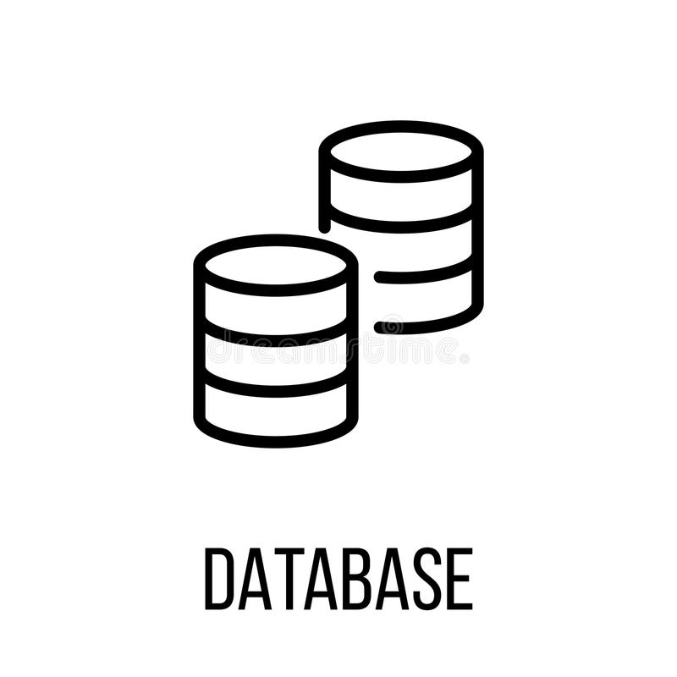
DATABASES
MYSQL,
MONGODB,
POSTGRESQL,
REDIS,
ORACLE

Slide 6
Thank You

