Slide 1
Understanding the Low Fragmentation Heap
Chris Valasek – Sr. Research Scientist
cvalasek@gmail.com / @nudehaberdasher

Slide 2
Introduction
“What. Are. You……?”

Slide 3
Introduction
Much has changed since Windows XP
Data structures have been added and altered
Memory management is now a bit more complex
New security measures are in place to prevent meta-data corruption
Heap determinism is worth more than it used to be
Meta-data corruption isn’t entirely dead
Why is this important?
Stack overflow == dead
Easy write-4 == dead
Not much documentation on LFH
People believe protection mechanisms make heap corruption un-exploitable

Slide 4
Beer List
Core data structures
_HEAP
_LFH_HEAP
_HEAP_LIST_LOOKUP
Architecture
FreeLists
Core Algorithms
Back-end allocation (RtlpAllocateHeap) [Overview]
Front-end allocation (RtlpLowFragHeapAllocFromContext)
Back-end de-allocation (RtlpFreeHeap) [Overview]
Front-end de-allocation (RtlpLowFragHeapFree)
Tactics
Heap determinism
LFH specific heap manipulation
Exploitation
Ben Hawkes #1
FreeEntry Offset

Slide 5
Prerequisites
All pseudo-code and data structures are taken from Windows 7 ntdll.dll version 6.1.7600.16385 (32-bit)
Yikes! I think there is a new one…
Block/Blocks = 8-bytes
Chunk = contiguous piece of memory measured in blocks or bytes
HeapBase = _HEAP pointer
LFH = Low Fragmentation Heap
BlocksIndex = _HEAP_LIST_LOOKUP structure
1st BlocksIndex manages chunks from 8 to 1024 bytes
ListHint[0x7F] = Chunks >= 0x7F blocks
2nd BlocksIndex managages chunks from 1024 bytes to 16k bytes
ListHint[0x77F] = Chunks >= 0x7FF blocks
Bucket/HeapBucket = _HEAP_BUCKET structure used as size/offset reference
HeapBin/UserBlocks = Actually memory the LFH uses to fulfill requests

Slide 6
Core Data Structures
“Ntdll changed, surprisingly I didn’t quit”

Slide 7
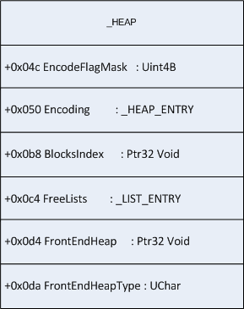
_HEAP (HeapBase)

Slide 8
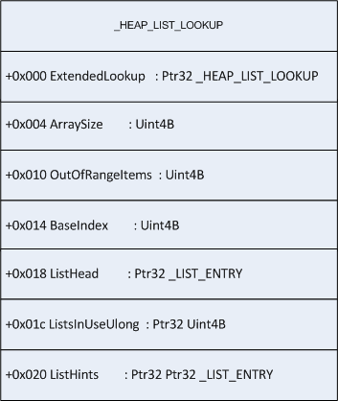
_HEAP_LIST_LOOKUP (HeapBase->BlocksIndex)

Slide 9
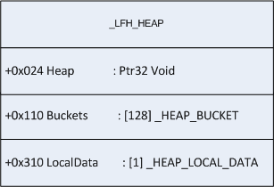
_LFH_HEAP (HeapBase->FrontEndHeap)

Slide 10
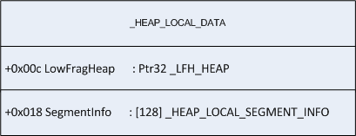
_HEAP_LOCAL_DATA (HeapBase->FrontEndHeap->LocalData)

Slide 11
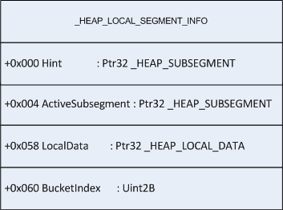
_HEAP_LOCAL_SEGMENT_INFO (HeapBase->FrontEndHeap->LocalData->SegmentInfo[])

Slide 12
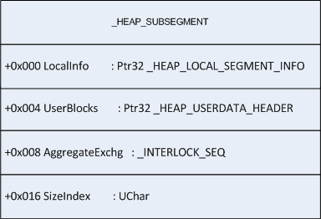
_HEAP_SUBSEGMENT (HeapBase->FrontEndHeap->LocalData->SegmentInfo[]->Hint,ActiveSubsegment,CachedItems)

Slide 13
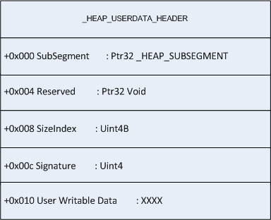
_HEAP_USERDATA_HEADER (HeapBase->FrontEndHeap->LocalData->SegmentInfo[]->Hint,ActiveSubsegment,CachedItems->UserBlocks)

Slide 14
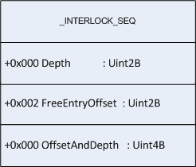
_INTERLOCK_SEQ (HeapBase->FrontEndHeap->LocalData->SegmentInfo[]->Hint,ActiveSubsegment,CachedItems->AggregateExchg)

Slide 15
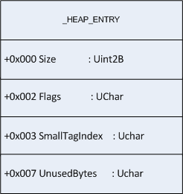
_HEAP_ENTRY (Chunk Header)

Slide 16
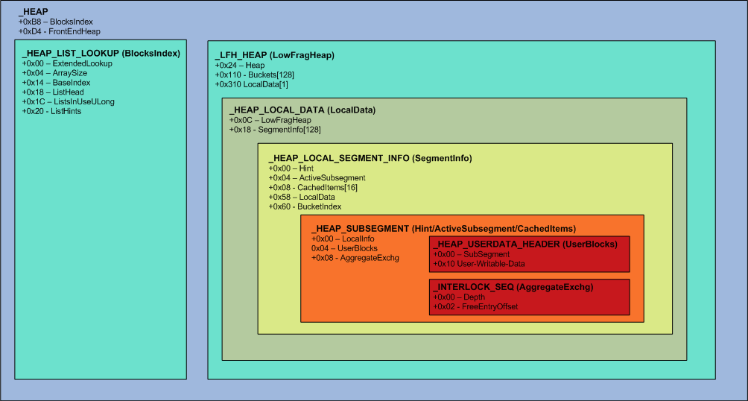
Overview

Slide 17
Architecture
“The winner of the BIG award is…”

Slide 18
Windows XP FreeLists
Once upon a time there were dedicated FreeLists which were terminated with pointers to sentinel nodes. Empty lists would contain a Flink and Blink pointing to itself.

Slide 19
Windows 7 FreeLists
The concept of dedicated FreeLists have gone away. FreeList or ListHints will point to a location within Heap->FreeLists.
They Terminate by pointing to &HeapBase->FreeLists. Empty lists will be NULL or contain information used by the LFH.
Only Heap->FreeLists initialized to have Flink/Blink pointing to itself.
Chunks >= ArraySize-1 will be tracked in BlocksIndex->ListHints[ArraySize-BaseIndex-1]
If the LFH is enabled for a specific Bucket then the ListHint->Blink will contain the address of a _HEAP_BUCKET + 1. Otherwise…..
ListHint->Blink can contain a counter used to enable the LFH for that specific _HEAP_BUCKET.
LFH can manage chunks from 8-16k bytes.
FreeLists can track 16k+ byte chunks, but will not use the LFH.

Slide 20
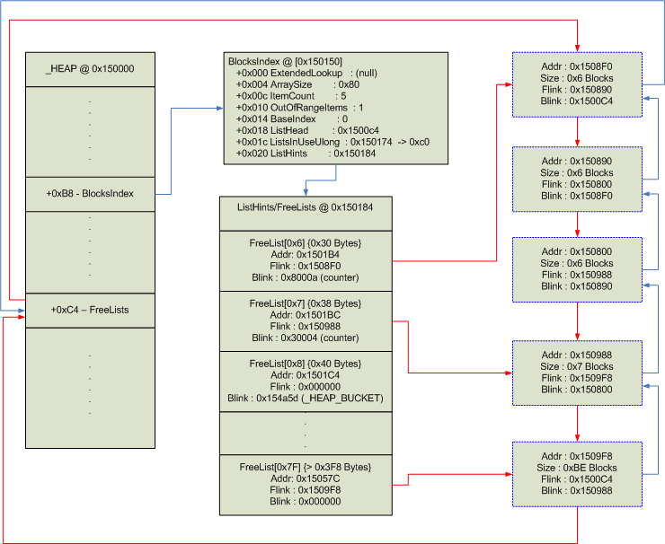
Windows 7 FreeLists

Slide 21
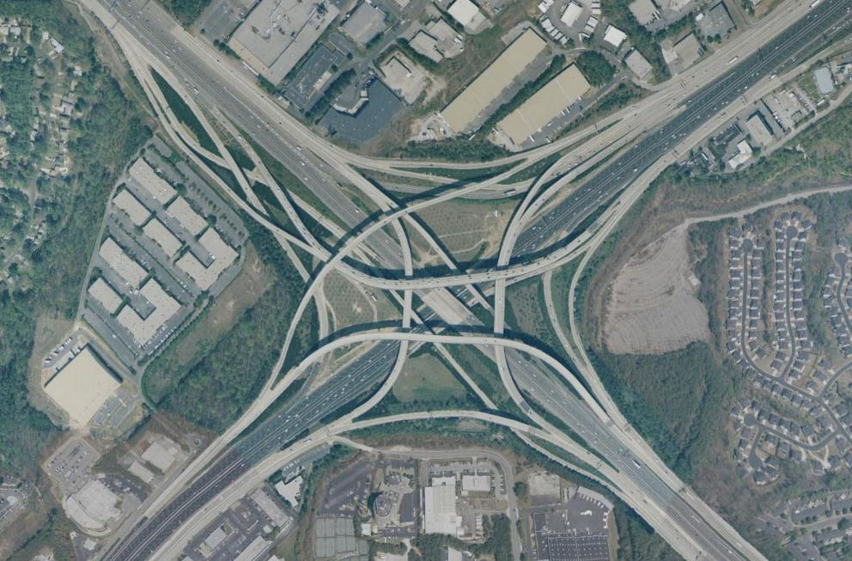
Circular Organization of Chunk Headers (COCHs)

Slide 22
Allocation
“@hzon Do you remember any of the stuff we did last year?”

Slide 23
Allocation
RtlAllocateHeap: Part I
It will round the size to be 8-byte aligned then find the appropriate BlocksIndex structure to service this request. Using the FreeList[0] like structure if it cannot service the request.
* The above searching now will be referred to as: BlocksIndexSearch()

Slide 24
Allocation
RtlAllocateHeap: Part II
The ListHints will now be queried look for an optimal entry point into the FreeLists. A check is then made to see if the LFH or the Back-end should be used.

Slide 25
Allocation: Back End (Overview)
“Working in the library? Everyday day I’m Hustlin’!”

Slide 26
Allocation: Back End (Overview)
Round size
Check Heap->CompatibilityFlags to see if it is capable of enabling the LFH
Add 0x2 to the FreeList->Blink if a HeapBucket isn’t enabled for this size.
Update the heuristic to activate the HeapBucket for this size if necessary
If there is a HeapBucket activate for a specific size, store it in the FreeList->Blink
Attempt to locate a chunk in the FreeList to use. If it exists, return it to the calling function
If a chunk isn’t found, start looking at the ListHead (list of all free chunks) for one to sufficiently fulfill the request. Split if necessary and return to the calling function
If no sufficiently sized chunks are found, call RtlpExtendHeap() to commit more memory.

Slide 27
Allocation: Front End (LFH)
“Nico will take your pizza, fo sho“

Slide 28
Allocation: Front End
RtlpLowFragHeapAllocFromConext: Part I
A _HEAP_SUBSEGMENT is acquired based off the _HEAP_BUCKET passed to the function. The Hint SubSegment is tried first, proceeding to the ActiveSubsegment pending a failure. If either of these succeed in the allocation request, the chunk is returned.

Slide 29
Allocation: Front End
RtlpLowFragHeapAllocFromConext: Part II
If a SubSegment wasn’t able to fulfill the allocation, the LFH must create a new SubSegment along with an associated UserBlock. A UserBlock is the chunk of memory that holds individual chunks for a specific _HEAP_BUCKET. A certain formula is used to calculate how much memory should actually be acquired via the back-end allocator.

Slide 30
Allocation: Front End
RtlpLowFragHeapAllocFromConext: Part III
Now that a UserBlock has been allocated, the LFH can acquire a _HEAP_SUBSEGMENT. If a SubSegment has been found it will then initialize that SubSegment along with the UserBlock; otherwise the back-end will have to be used to fulfill the allocation request.

Slide 31
Allocation: Front End
RtlpLowFragHeapAllocFromConext: Part IV [RtlpSubSegmentInitalize]
The UserBlock chunk is divided into BucketBlockSize chunks followed by the SubSegment initialization. Finally, this new SubSegment is ready to be assigned to the
HeapLocalSegmentInfo->ActiveSubsegment.

Slide 32
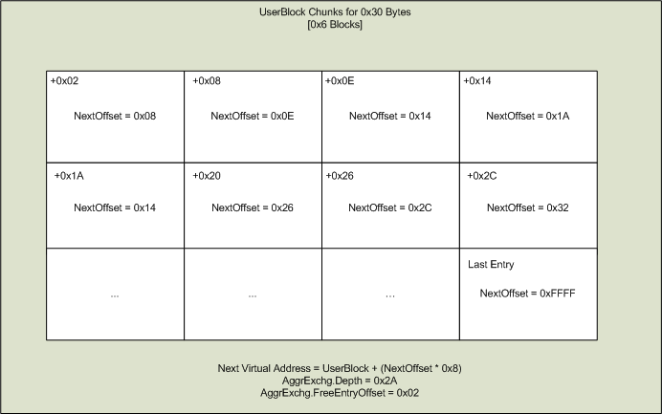
Allocation: Front End : Example 1

Slide 33
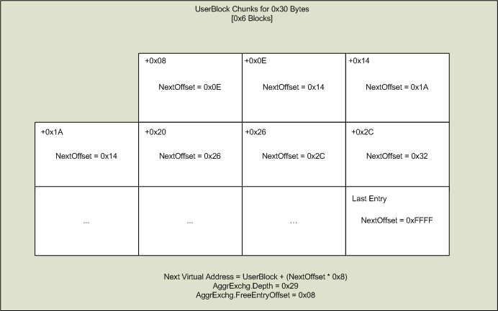
Allocation: Front End : Example 2

Slide 34
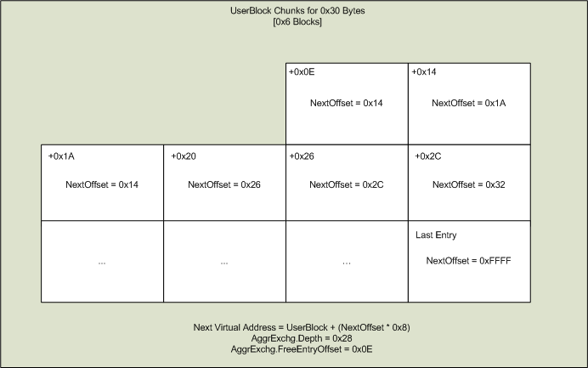
Allocation: Front End : Example 3

Slide 35
Freeing
“How can you go wrong? (re: Dogs wearing sunglasses)”

Slide 36
Freeing
RtlFreeHeap
RtlFreeHeap will determine if the chunk is free-able. If so it will decide if the LFH or the back-end should be responsible for releasing the chunk.

Slide 37
Freeing : Back End
“Spencer Pratt explained this to me”

Slide 38
Freeing: Back End
SearchBlocksIndex() for appropraite structure
Find the appropriate FreeList if possible and use it as the insertion point
If the FreeList->Blink does not contain a HeapBucket and has more than 0x1 allocation, decrement the counter (used to activate the LFH) by 0x2
Coalesce the chunk to be freed with the chunk before and after it, if possible
Ensure that the FreeList can be used as an insertion point, then proceed to find the last chunk in that FreeList
Safely link in the recently freed chunk (will discuss safe linking later) and update the bitmap and ListHint

Slide 39
Freeing : Front End
“Omar! Omar! Omar comin’!”

Slide 40
Freeing: Front End
RtlpLowFragHeapFree: Part I
The chunk header will be checked to see if a relocation is necessary. Then the chunk to be freed will be used to get the SubSegment. Flags indicating the chunk is now FREE are also set.

Slide 41
Freeing: Front End
RtlpLowFragHeapFree: Part II
The Offset and Depth can now be updated. The NewOffset should point to the chunk that was recently freed and the depth will be incremented by 0x1.

Slide 42
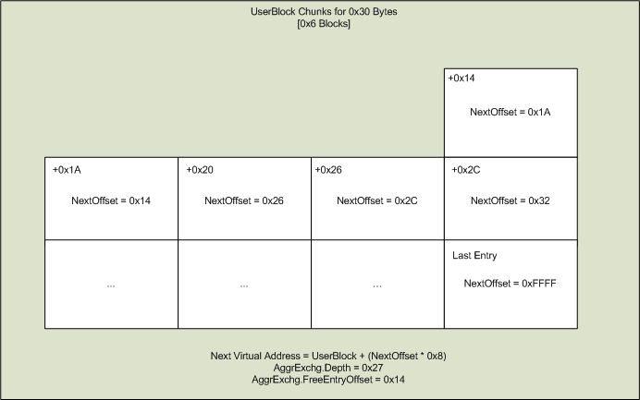
Freeing: Front End : Example 1

Slide 43
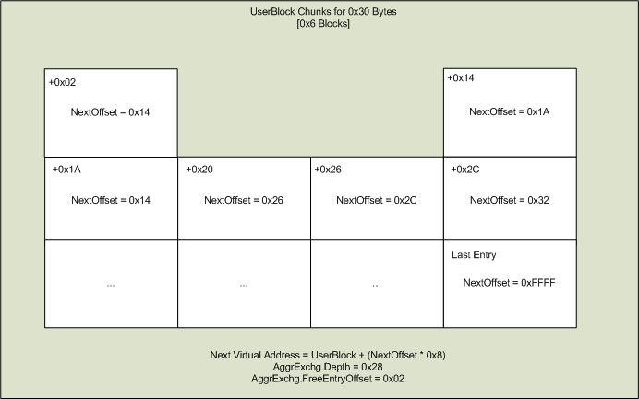
Freeing: Front End : Example 2

Slide 44
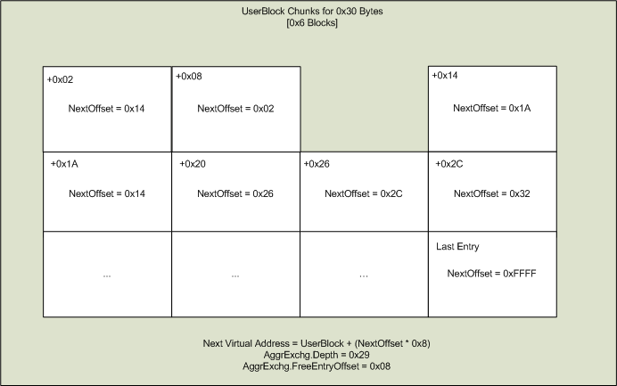
Freeing: Front End : Example 3

Slide 45
Security Mechanisms
“@shydemeanor I think I’m using too much code in the slides.”

Slide 46
Security Mechanisms: Heap Randomization
Information
64k aligned
5-bits of entropy
Used to avoid the same HeapBase on consecutive runs
Thoughts
Not impossible to brute force
If TotalMaxSize wraps, there will be no RandPad
Hard to influence HeapCreate()
Unlikely due to NtAllocateVirtualmemory() failing

Slide 47
Security Mechanisms : Header Encoding/Decoding
Information
Size, Flags, CheckSum encoded
Prevents predictable overwrites w/o information leak
Makes header overwrites much more difficult
Thoughts
NULL out Heap->EncodeFlagMask
I believe a new heap would be in order.
Overwrite first 4 bytes of encoded header to break Header & Heap->EncodeFlagMask
(Only useful for items in FreeLists)
Attack last 4 bytes of the header

Slide 48
Security Mechanisms : Death of Bitmap Flipping
Information
XOR no longer used
OR for population
AND for exhaustion
Thoughts
Not as important as before because FreeLists/ListHints aren’t initialized to point to themselves.

Slide 49
Security Mechanisms : Safe Linking
Information
Prevents overwriting a FreeList->Blink, which when linking a chunk in can be overwritten to point to the chunk that was inserted before it
Brett Moore Attacking FreeList[0]
Thoughts
Although it prevents Insertion attacks, if it doesn’t terminate, the chunk will be placed in one of the ListHints
The problem is the Flink/Blink are fully controlled due to no Linking process
You still have to deal with Safe Unlinking, but it’s a starting point.

Slide 50
Tactics
“You do not want to pray-after-free – Nico Waisman”

Slide 51
Tactics : Heap Determinism : Activating the LFH
0x12 (18)consecutive allocations will guarantee LFH enabled for SIZE
0x11 (17) if the _LFH_HEAP has been previously activated

Slide 52
Tactics : Heap Determinism : Defragmentation
A game of filling the holes
Easily done by making enough allocations to create a new SubSegment with associated UserBlock

Slide 53
Tactics : Heap Determinism : Adjacent Data
Overwrite into adjacent chunks (requires normalization)
Can overwrite NULL terminator (Vreugdenhil 2010)
Ability to use data in a recently freed chunk with proper heap manipulation

Slide 54
Tactics : Heap Determinism : Seeding Data
Saved FreeEntryOffset resides in 1st 2 bytes
Influence the LSB of vtable
Good for use-after-free
See Nico Wasiman’s 2010 BH Presentation / Paper
NICO Rules!

Slide 55
Tactics: Exploitation
“For the Busticati, By the Busticati”

Slide 56
Tactics : Exploitation : Ben Hawkes #1 : Part 1
RtlpLowFragHeapFree() will adjust the _HEAP_ENTRY if certain flags are set.
If you can overflow into a chunk that will be freed, the SegmentOffset can be used to point to another valid _HEAP_ENTRY.
This could lead to controlling data that was previously allocated (Think C++ objects)

Slide 57
Tactics : Exploitation : Ben Hawkes #1 : Part 2
Prerequisites
Ability to allocate SIZE
Place legitimate a chunk before a chunk to be overflowed
Overflow at least 8-bytes
Ability to free overwritten chunk
Methodology
Enable LFH
Normalize LFH
Alloc1
Alloc2
Overwrite Alloc2’s header to point to an object of interest
Free Alloc2
Alloc3 (will point to the object of interest)
Write data

Slide 58
Tactics : Exploitation : FreeEntryOffset Overwrite: Part 1
All code in RtlpLowFragHeapAllocFromContext() is wrapped in try/catch{} . All exceptions will return 0, letting the back-end handle the allocation.
As we saw, the FreeEntryOffset is stored in the 1st 2 bytes of user-writable data within each chunk in a UserBlock.
This will be used to get the address of the next free chunk used for allocation. What if we overflow this chunk?

Slide 59
Tactics : Exploitation : FreeEntryOffset Overwrite: Part 2
Assume a full UserBlock for 0x30 bytes (0x6 blocks). Our first allocation will update the FreeEntryOffset to 0x0008. (Stored in the _INTERLOCK_SEQ.FreeEntryOffset

Slide 60
Tactics : Exploitation : FreeEntryOffset Overwrite: Part 3
If an overflow of at least 0x9 bytes (0xA preferable) is made. The saved FreeEntryOffset of the adjacent chunk can be overwritten. This gives the attacker a range of 0xFFFF * 0x8 (Offsets are stored in blocks and converted to byte offsets.)

Slide 61
Tactics : Exploitation : FreeEntryOffset Overwrite: Part 4
An allocation for the overwritten block must be made next to store the tainted offset in the _INTERLOCK_SEQ. In this example, we will have a 0x1501 * 0x8 jump to the next ‘free chunk’.

Slide 62
Tactics : Exploitation : FreeEntryOffset Overwrite: Part 5
Since it’s possible to get SubSegments adjacent to each other in memory, you can write into other forwardly adjacent memory pages (Control over allocations is required). This gives you the ability to overwrite data that is in a different _HEAP_SUBSEGMENT than the one which you are overflowing.

Slide 63
Tactics : Exploitation : FreeEntryOffset Overwrite: Part 6
Prerequisites
Enabled the LFH
Normalize the heap
Control allocations for SIZE
0x9 – 0xA byte overflow into an adjacent chunk
Adjacent chunk must be FREE
Object to overwrite within the range (0xFFFF * 0x8 = max)
Methodology
Enable LFH
Normalize LFH
Alloc1
Overwrite into free chunk from Alloc1
Alloc2 (contains overwritten header)
Alloc3 (Uses overwritten FreeEntryOffset)
Write data to Alloc3 (which will be object of your choosing w/in 0xFFFF * 0x8)

Slide 64
Conclusion
“I know that most of the audience will be fast asleep by now.”

Slide 65
Conclusion
Data structures have become far more complex
Dedicated FreeLists / Lookaside List are dead
Replaced with new FreeList structure and LFH
Many security mechanisms added since Win XP SP2
Meta data corruption now leveraged to overwrite application data
Heap normalization more important than ever
Much more work to be done…

Slide 66
What’s Next
See ‘Observations’ and other sections in my paper
http://www.illmatics.com/Understanding_the_LFH.pdf
http://www.illmatics.com/Understanding_the_LFH_Slides.pdf
Developing reliable exploits specifically for Win7
Abusing Un-encoded header information
Look at Virtual / Debug allocation/free routines
Caching mechanisms
Continuing to come up with heap manipulation techniques
Figuring out information leaks (heap addresses)
Affinity (SMP) specifics

