Slide 1
Customer Segmentation Analysis
1,000
invoices
Shopping behaviour across 10 Istanbul malls, Jan 2021 - Mar 2023 (1,000 invoices)
10 malls | 8 categories

Slide 2
Executive summary
2.37M
2,981
62%
94%
Total revenue (TRY)
Units sold
Of invoices are from women
Of revenue: Clothing, Shoes, Technology
Women lead in invoices, units and revenue; men spend more per invoice.
Ages 56-69 are the top group by units and revenue (31% of revenue).
Payment method is independent of gender, age, category and mall.
Focus growth on Clothing, Shoes and Technology and on the 56-69 segment.

Slide 3
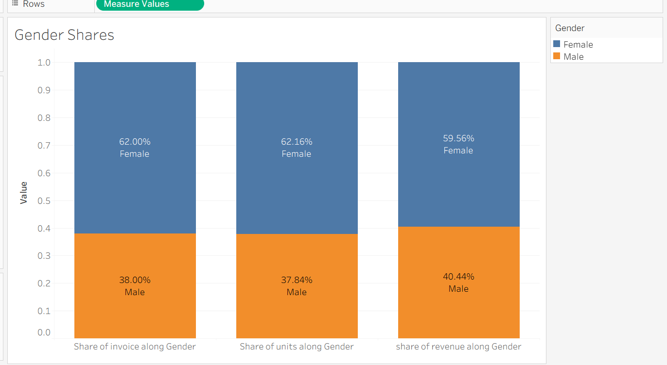
Women drive volume and revenue
Q1 Distribution
Women are 62% of invoices (620), men 38% (380).
Q2 Units sold
Female: 1,853 units vs Male: 1,128.
Q3 Revenue
Female: 1.41M (59.6%) vs Male: 0.96M. Men spend more per invoice: 2,517 vs 2,272.

Slide 4
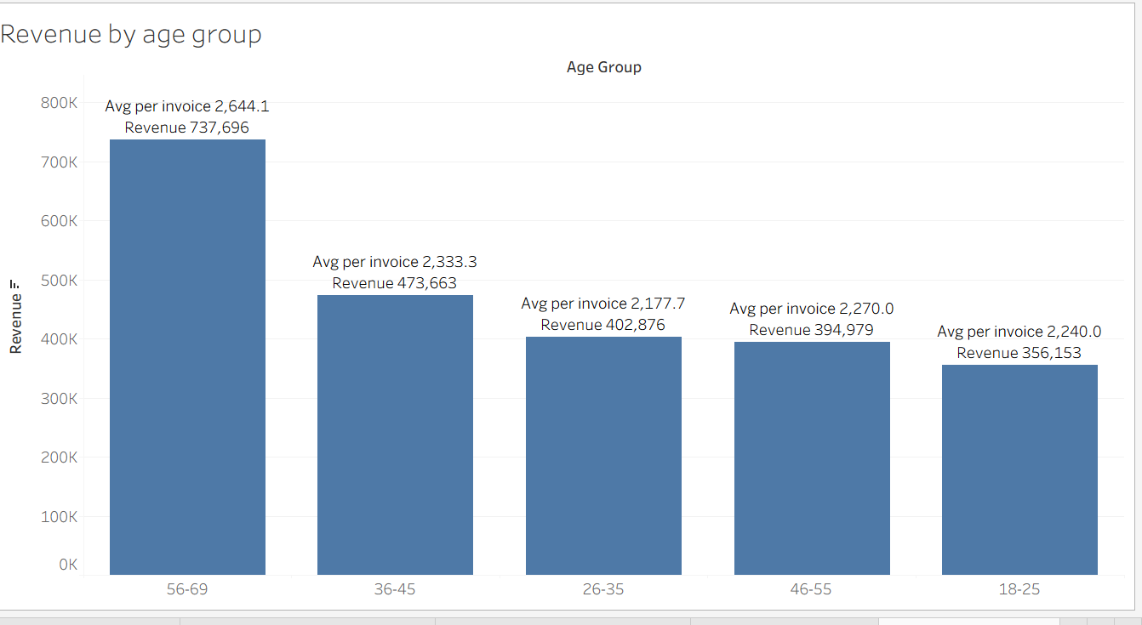
Ages 56-69 are the biggest segment
Q5 Distribution
Invoices: 159, 185, 203, 174 and 279 for the five groups, oldest group largest.
Q6 Units sold
56-69: 800 units (26.8%), then 36-45 with 618.
Q7 Revenue
56-69: 738K (31.2%), with the highest average invoice (2,644).

Slide 5
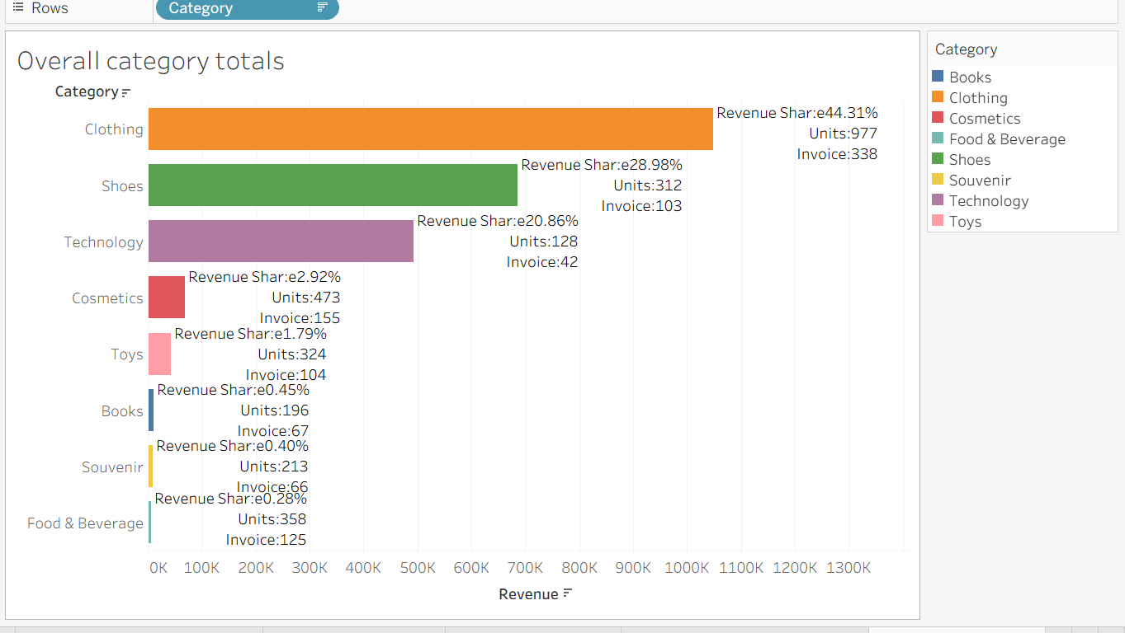
Three categories bring in 94% of revenue
Clothing
44% of revenue and 34% of invoices: the core category.
Shoes and Technology
29% and 21% of revenue from only 15% of invoices (high prices).
Low-revenue categories
Food & Beverage, Books and Souvenir sell 21% of units but about 1% of revenue.

Slide 6
Category mix by gender and age (Q4, Q8)
Category | Female | Male | 18-25 | 26-35 | 36-45 | 46-55 | 56-69
Clothing | 34.0% | 33.4% | 37.1% | 31.4% | 31.5% | 36.2% | 33.7%
Cosmetics | 16.1% | 14.5% | 15.1% | 17.3% | 15.3% | 16.7% | 14.0%
Food & Beverage | 12.1% | 13.2% | 10.1% | 14.6% | 13.3% | 13.8% | 11.1%
Toys | 10.5% | 10.3% | 13.2% | 7.0% | 9.9% | 8.6% | 12.5%
Shoes | 9.8% | 11.1% | 5.7% | 11.4% | 11.3% | 9.2% | 12.2%
Souvenir | 7.3% | 5.5% | 6.3% | 9.7% | 6.9% | 5.2% | 5.4%
Books | 6.1% | 7.6% | 6.3% | 6.5% | 7.9% | 8.0% | 5.4%
Technology | 4.0% | 4.5% | 6.3% | 2.2% | 3.9% | 2.3% | 5.7%
Share of each segment's invoices. The mix is nearly identical for women and men (p = 0.89); age differences are small and not significant (p = 0.53). Clothing leads in every group.

Slide 7
Cash is still the most used payment method
Cash
420 invoices | 1.04M revenue (44%)
Credit Card
366 invoices | 0.77M revenue (33%)
Debit Card
214 invoices | 0.55M revenue (23%)

Slide 8
Payment method has no real link to other columns
Compared with | p-value | Related?
Gender | 0.604 | No
Age group | 0.362 | No
Category | 0.141 | No
Shopping mall | 0.456 | No
Year | 0.521 | No
Quantity | 0.589 | No
Q9 Answer
No significant relation. Payment choice looks independent of who buys, what they buy and where.
Small leanings only
Ages 46-55 use cash most (48%)
Ages 18-25 use credit cards most (41.5%)
Emaar Square: credit card leads (49%)
Chi-square tests; a relation needs p < 0.05.

Slide 9
Three malls bring in 53% of revenue
High value, low traffic
Zorlu Center, Viaport Outlet, Metropol AVM: 2,800-3,100 per invoice.
High traffic, lower value
Kanyon and Istinye Park: about 1,900 per invoice.
Seasonality
July peaks (292K); December is lowest (97K).

Slide 10
Recommendations
1
2
3
Focus on Clothing, Shoes, Tech
Target the 56-69 segment
Grow male traffic
Prime floor space, promotions and loyalty offers.
Premium Technology and Shoes bundles.
Men's Clothing and Shoes campaigns.
4
5
6
Upsell Cosmetics and Toys
Use mall differences
Plan the calendar
Bundles or premium lines to lift value.
Market high-value malls; upsell at Kanyon and Istinye.
Back July; lift December; promote card offers.

Slide 11
Data notes
1,000-row sample: treat percentages as indicative.
2023 covers only Jan to early Mar.
Revenue = quantity x price; prices drive category rankings.

