Slide 1
Startup Profit Analysis
R&D
How R&D, Administration and Marketing spend affect profit
Regression analysis | Power BI visuals | Recommendations
Mktg
Admin
Circle size = influence on profit
Notes:
Introduce the project: three spend types, one outcome (Profit).

Slide 2
Problem and dataset
Problem
Measure how R&D, Administration and Marketing spend affect Profit, then predict Profit for two new startups.
Dataset source
CSV file (startup_profit_analysis.csv), not a database.
Features
R&D, Administration and Marketing spend, State, and Profit (the target).
50
5
Startups
Columns
0
3
Missing values
States

Slide 3
Data cleaning and preparation
1
Loaded: CSV imported into Excel and Power BI: 50 rows, 5 columns.
2
Checked quality: No missing values and no duplicate rows.
3
Fixed data types: Spend and Profit as numbers, State as text.
4
Reviewed zeros: R&D has 2 zero values and Marketing has 3. Kept as valid no-spend startups.
5
Handled State: Text column kept out of the numeric model and tested separately.

Slide 4
Correlation with profit
0.97
R&D and Profit move almost in lockstep
R&D and Marketing also rise together (r = 0.72), so Marketing’s separate effect is hard to isolate.

Slide 5
Regression results
Variable | Coefficient | p-value | Verdict
R&D Spend | 0.8057 | < 0.001 | Strong driver
Administration | −0.0268 | 0.602 | No effect
Marketing Spend | 0.0272 | 0.105 | Not significant
Intercept | 50,122 | < 0.001 | Base profit
0.951
R²: share of profit variation explained
Adjusted R² = 0.948
Profit = 50,122 + 0.806 × R&D − 0.027 × Admin + 0.027 × Marketing

Slide 6
Profit predictions
Case | R&D | Admin | Marketing
Startup 1 | 21,892.92 | 81,910.77 | 164,270.70
Startup 2 | 23,940.93 | 96,489.63 | 137,001.10
70,038
Predicted profit, Startup 1
Both startups spend little on R&D (about 22–24k against an average of 73.7k), so predicted profit sits below the dataset average of 112,013.
70,555
Predicted profit, Startup 2
Typical model error: about ±9,232.

Slide 7
R&D spend vs profit
94.7%
of profit variation explained by R&D alone
Points sit tightly around a straight line. Each extra unit of R&D adds about 0.85 profit in a simple regression.

Slide 8
Average profit by state
p = 0.997
Joint test: State adds no explanatory power
Florida leads because its startups spend more on R&D and Marketing, not because of location.

Slide 9
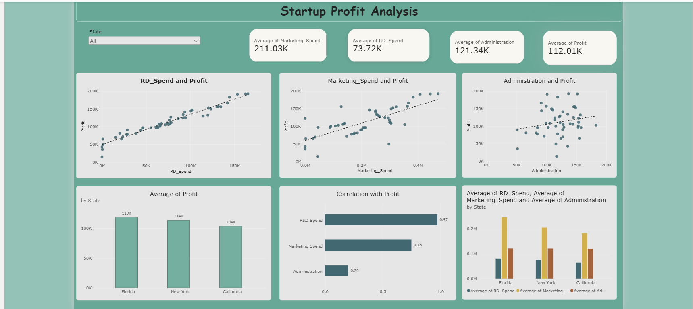
Power BI dashboard
Paste your Power BI dashboard screenshot here
Notes:
Replace the dashed frame with your Power BI screenshot (cards, scatter charts, state chart, slicer).

Slide 10




Key insights
R&D drives profit
Administration adds little
Each extra unit adds about 0.81 profit. Correlation with profit is 0.97.
Effect is close to zero (p = 0.60). More admin spend does not lift profit.
Marketing is secondary
Location does not matter
Positive but not significant (p = 0.105). It overlaps with R&D (r = 0.72).
State differences are small and not significant (p = 0.997).

Slide 11
Recommendations
1
Prioritise R&D
Shift budget toward R&D, the only spend with a clear and strong return.
2
Control Administration cost
Hold or reduce admin spend, since the data shows no profit benefit.
3
Make Marketing earn its place
Keep it balanced with R&D and track its return on its own.
4
Back low-R&D startups
California startups spend least on R&D (avg 64.7k) and earn least, so they have the most room to grow.

Slide 12
Conclusion
What we found
R&D explains most of profit (full model R² = 0.95).
Administration and State add nothing measurable; Marketing adds little.
Predicted profit: 70,038 and 70,555 for the two new startups.
Limitations
Only 50 startups and a linear model.
Correlation is not causation.
Both predictions use low R&D, so allow for the ±9,232 error.

