Slide 1
ZeroBus Ingestion with Genie MCP Integration
Solutions Architecture

Slide 2
ZeroBus Ingestion with Genie MCP Integration
Modern data ingestion and AI integration
Leveraging latest Databricks innovations
Scalable, production-ready architecture

Slide 3
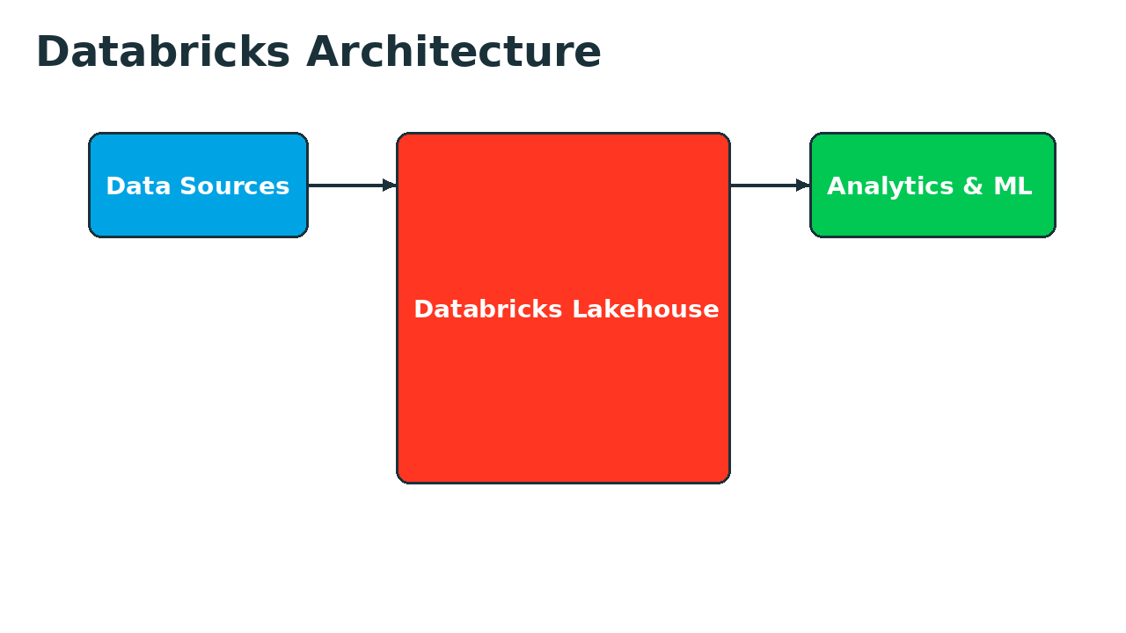
ZeroBus: Real-Time Lakehouse Ingestion
Zero-latency data ingestion framework
Seamless integration with Databricks Lakehouse
Auto-scaling and fault-tolerant architecture
Support for multiple data sources and formats
Built-in schema evolution and validation

Slide 4
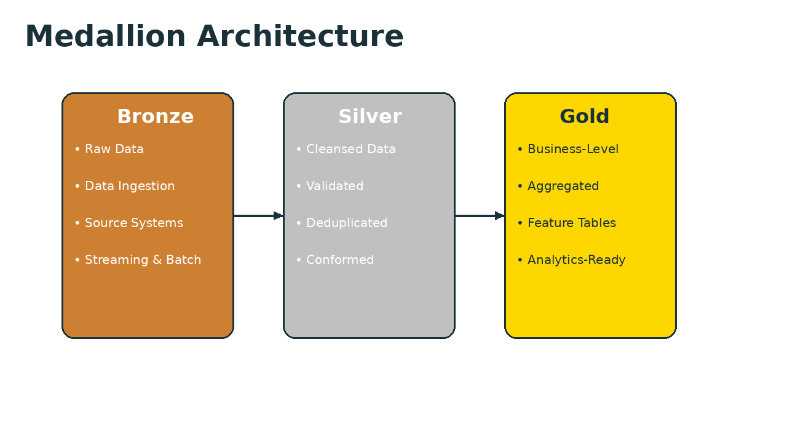
ZeroBus Medallion Architecture
Bronze: ZeroBus ingests raw data in real-time
Silver: Transformation and quality validation
Gold: Business-ready analytics tables
Delta Lake ensures ACID transactions
Unity Catalog for governance

Slide 5
Genie MCP: Model Context Protocol
Simplifies AI agent integration with Databricks
Standard protocol for context sharing
Enables seamless agent-to-lakehouse connectivity
Built-in authentication and authorization
Supports multiple agent frameworks

Slide 6
End-to-End Integration
ZeroBus ingests data into Lakehouse
Data flows through medallion layers
Genie MCP exposes data to AI agents
Agents query and analyze with natural language
Real-time insights and automated actions

Slide 7
Key Benefits
Reduced time-to-insight with real-time ingestion
Simplified AI integration via standard protocols
Enterprise-grade governance and security
Scalable architecture for any data volume
Lower TCO with unified platform

Slide 8
Implementation Step 1
Configure data sources and connections
Set up ZeroBus ingestion pipelines
Deploy medallion architecture layers
Enable Genie MCP endpoints
Test and validate integration

