Slide 1
Energy Australia
Agentic AI Journey
Transformation Roadmap 2025-2026
Powered by Databricks Lakehouse Platform

Slide 2
Agenda
1. Agentic AI Journey Overview
• 4-phase transformation roadmap
• Traditional → Predictive → Augmented → Agentic
2. Full Platform Architecture
• End-to-end data and AI platform
• Model Context Protocol (MCP) integration
3. Customer Service Agent
• Autonomous customer interactions
• 70% automation rate
4. Energy Optimization Agent
• Real-time demand forecasting
• $5M annual savings
5. Business Impact & ROI
• $19M annual benefits by 2026
• 180% three-year ROI

Slide 3
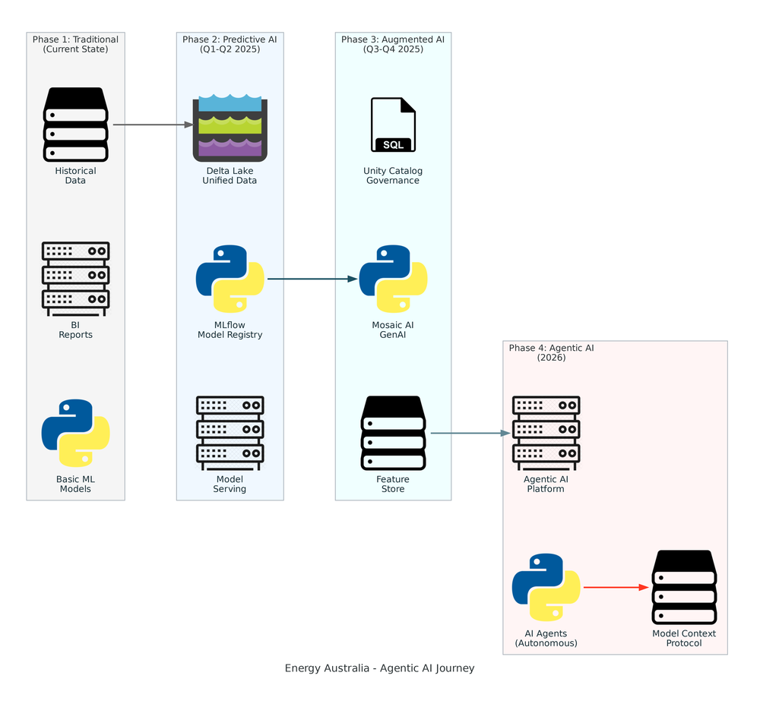
Agentic AI Journey - 4 Phase Transformation
Traditional → Predictive AI → Augmented AI → Agentic AI

Slide 4
Journey Phases
• Phase 1: Traditional Analytics (Current)
- Historical data analysis and static BI reports
- Basic ML models with limited deployment
• Phase 2: Predictive AI (Q1-Q2 2025)
- Delta Lake unified platform on Azure
- MLflow model registry and serving
- Demand forecasting and churn prediction
• Phase 3: Augmented AI (Q3-Q4 2025)
- Unity Catalog governance and Mosaic AI GenAI
- Feature Store and RAG implementation
- AI-assisted customer service (human-in-loop)
• Phase 4: Agentic AI (2026)
- Fully autonomous AI agents with MCP
- 70% autonomous customer service handling
- Real-time energy optimization and grid control

Slide 5
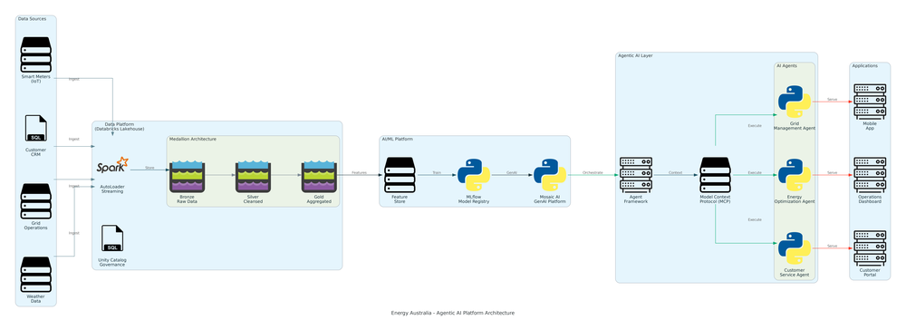
Full Agentic AI Platform Architecture
End-to-end platform from data sources to AI agents and applications

Slide 6
Platform Components
• Data Sources
- Smart Meters (IoT streaming), Customer CRM, Grid Operations, Weather Data
• Databricks Lakehouse Platform
- AutoLoader streaming ingestion, Medallion architecture (Bronze/Silver/Gold)
- Unity Catalog governance, Delta Lake ACID storage
• AI/ML Platform
- Feature Store for centralized features
- MLflow for model lifecycle management
- Mosaic AI GenAI platform with LLMs
• Agentic AI Layer
- Agent Framework with MCP (Model Context Protocol)
- Customer Service, Energy Optimization, Grid Management Agents
• Applications
- Customer Portal, Operations Dashboard, Mobile App

Slide 7
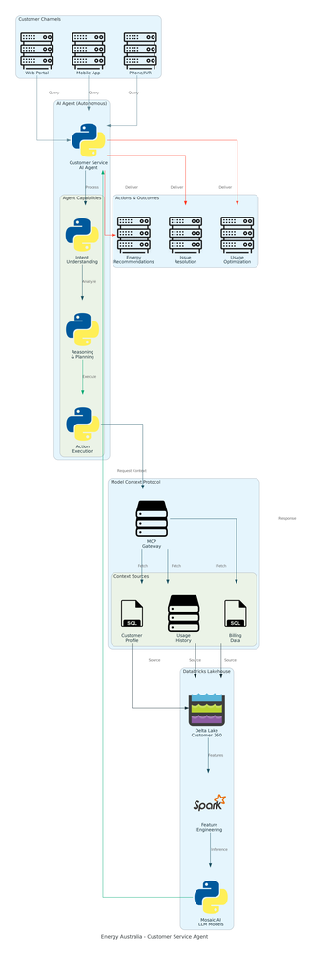
Customer Service Agent - Autonomous Support
Intent Understanding → Reasoning → Action Execution with MCP Context

Slide 8
Customer Service Agent - Use Case
• Customer Interaction Channels
- Web portal, mobile app, phone/IVR with natural language
• Agent Processing Flow
- Intent Understanding: What does customer want?
- Reasoning & Planning: How to best serve request?
- Action Execution: Execute the solution autonomously
• MCP Context Enrichment
- Customer profile (demographics, preferences)
- Usage history (consumption patterns, anomalies)
- Billing data (payment history, current balance)
• Autonomous Outcomes
- Energy usage recommendations and insights
- Issue resolution (billing questions, outages)
- Usage optimization tips and plan adjustments
• Impact: 70% automation rate, 50% faster response, 40% cost reduction

Slide 9
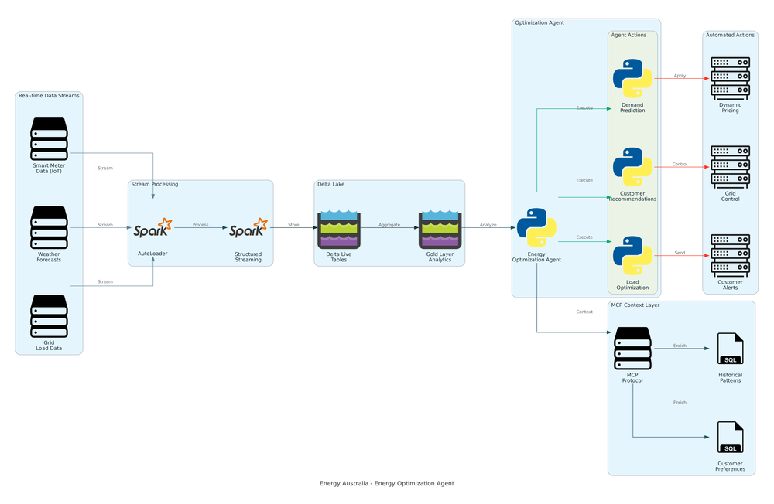
Energy Optimization Agent - Real-Time Forecasting
Streaming data processing with autonomous demand prediction and grid control

Slide 10
Energy Optimization Agent - Use Case
• Real-Time Data Streams
- Smart meter data (15-min intervals)
- Weather forecasts (hourly updates)
- Grid load data (real-time SCADA)
• Stream Processing
- AutoLoader for incremental ingestion
- Structured Streaming for real-time analytics
- Delta Live Tables for always-fresh data
• Agent Actions
- Demand Prediction: 1-48 hour forecasting with ML
- Load Optimization: Grid balancing and peak shaving
- Customer Recommendations: Time-of-use pricing, smart scheduling
• Automated Outcomes
- Dynamic Pricing: Adjust rates based on demand/supply
- Customer Alerts: Notify of high-cost periods
- Grid Control: Automated load balancing
• Impact: 30% forecast improvement, $5M annual savings, 15% peak reduction

Slide 11
Business Impact & ROI
Investment (3-Year TCO)
Year 1: $2.15M
• Databricks Platform: $500K
• Azure Infrastructure: $300K
• Data Engineering: $400K
• ML/AI Development: $600K
Year 2: $2.25M
Year 3: $2.35M
Total: $6.75M
Annual Benefits (Year 3)
Customer Service: $6M
Energy Optimization: $5M
Churn Reduction: $3M
Grid Infrastructure: $3M
Operational Efficiency: $2M
Total: $19M/year
ROI Metrics:
• Payback: 15 months
• 3-Year ROI: 180%
• 5-Year NPV: $42M

Slide 12
Implementation Next Steps
• Q1 2025: Foundation & Data Platform
- Deploy Delta Lake on Azure ADLS Gen2
- Implement Medallion architecture (Bronze/Silver/Gold)
- Set up MLflow model registry and serving
• Q2 2025: Predictive Models
- Build demand forecasting and churn prediction
- Deploy customer 360 view and personalization
- Production rollout with A/B testing
• Q3-Q4 2025: GenAI & Governance
- Deploy Unity Catalog and Mosaic AI platform
- Implement RAG and LLM endpoints
- Build Feature Store and human-in-loop AI
• Q1-Q2 2026: Agentic AI
- Deploy agent framework with MCP protocol
- Launch Customer Service and Energy Optimization agents
- Full production rollout with monitoring

Slide 13
Questions?
Ready to transform Energy Australia with Agentic AI

