Slide 1


SMART INDIA HACKATHON 2026
TITLE PAGE
Problem Statement ID – SIH26176
Problem Statement Title - ORCA Marine EcOsystem Reasoning with Collaborative Agents
Theme – Disaster Management
PS Category – Software
Team ID -
Team Name – VCT 2.0

Slide 2
IDEA TITLE
VCT 2.0
Idea
The ORCA Marine Intelligence Platform (AMIP) is a unified conversational system that integrates satellite, ocean, and geospatial data to provide real-time, explainable insights for fishing zones, safety, and navigation. Using Agentic AI and multi-source data fusion, it enables users to access and analyze marine intelligence easily, supporting better decision-making. By combining Earth Observation data (SST, chlorophyll) with ocean forecasts, it enhances operational efficiency, improves maritime safety, and promotes sustainable marine resource management.
Key Features:
Automated Data Ingestion:
Continuously collects and processes satellite data (Sentinel-3, MODIS), ocean forecasts (INCOIS OSF), and bathymetry datasets (GEBCO), ensuring real-time, structured, and reliable data availability.
PFZ Analytics Engine:
Identifies Potential Fishing Zones using thermal gradients (SST) and chlorophyll concentration, combined with bathymetric filtering to highlight high-yield and safe fishing regions.
Agentic AI Conversational Copilot:
Enables users to ask queries in natural language (e.g., safety, routes, fishing zones) and receive intelligent, context-aware, and explainable responses.
Ocean State & Risk Assessment Module:
Evaluates wave height, wind speed, and ocean conditions against vessel safety thresholds to provide dynamic safety advisories (SAFE / CAUTION / DANGER).
Geospatial Navigation & Route Optimization:
Calculates optimal routes using geodesic algorithms (Great-Circle / Rhumb-Line), considering environmental conditions and operational constraints.
Innovation & Uniqueness:
Agentic AI Architecture:
Implements a multi-agent system where specialized AI components autonomously plan, analyze, and collaborate to solve complex marine intelligence tasks.
Multi-Source Data Fusion:
First-of-its-kind integration of satellite Earth Observation, ocean forecasts, bathymetry, and geospatial intelligence into a unified decision-support platform.
Conversational Marine Intelligence:
Transforms complex marine data into simple, natural language insights, making advanced analytics accessible to non-technical users like fishermen.
Explainable Decision Support:
Every output is backed by verifiable data sources and reasoning through a strict provenance system, ensuring trust and reliability.
Real-Time Safety & Operational Intelligence:
Combines environmental monitoring with AI-based risk evaluation to enhance maritime safety and reduce operational risks.

Slide 3
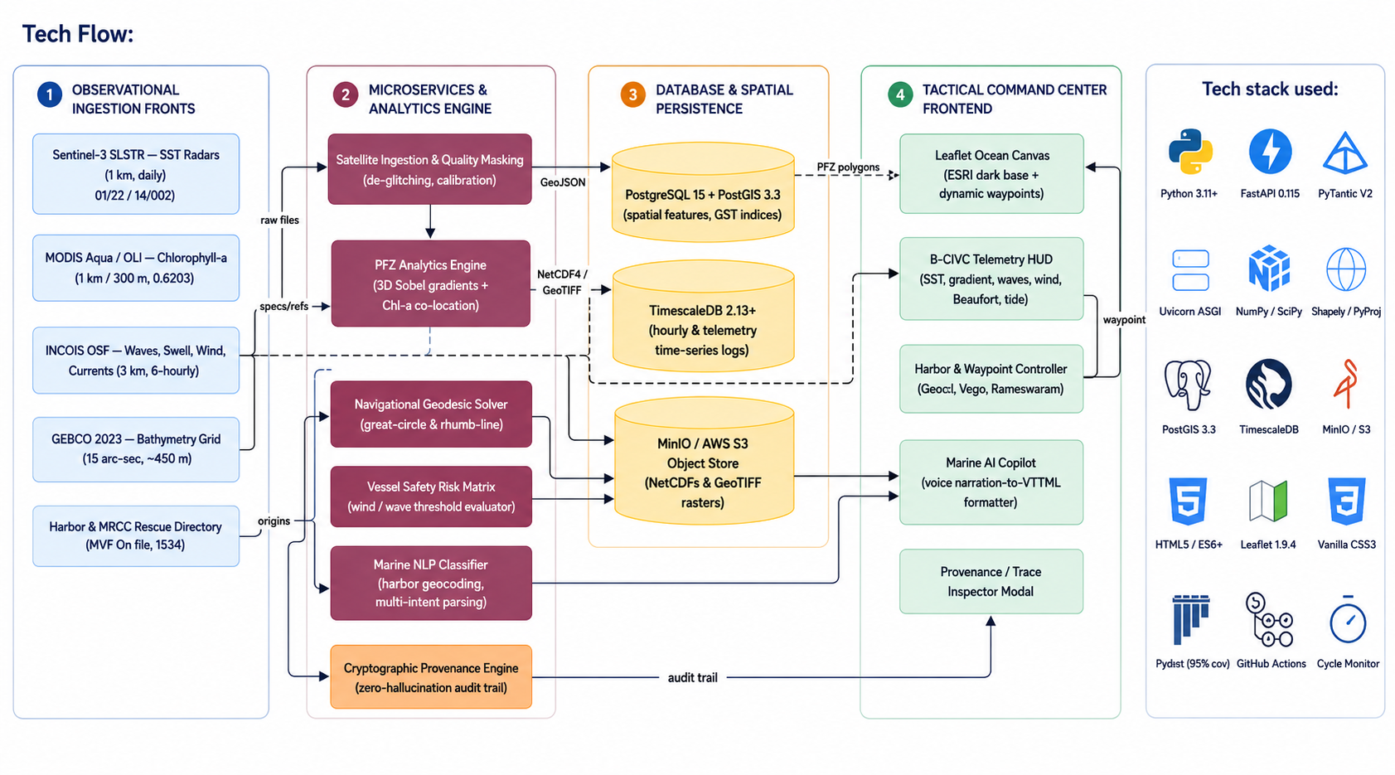
TECHNICAL APPROACH
VCT 2.0

Slide 4
FEASIBILITY & VIABILITY
VCT 2.0
Feasibility Analysis:
The ORCA Marine Intelligence Platform is technically feasible as it is built on proven and widely adopted technologies. It leverages satellite Earth Observation data (Sentinel-3, MODIS), ocean forecast systems (INCOIS OSF), and geospatial tools (PostGIS, Leaflet) to deliver accurate marine insights.
The system uses data pipelines for automated ingestion, AI-based risk evaluation, and a microservices architecture, ensuring scalability, real-time processing, and seamless integration of multiple data sources. This makes the platform practical for real-world deployment in marine operations.
Potential Challenges / Risks
Heterogeneous Data Integration: Different formats from satellite, ocean, and GIS sources may complicate processing Data Quality & Validation.
Data Latency: Real-time updates may be delayed due to satellite pass timings and forecast refresh cycles.
AI Accuracy Limitations: Risk predictions may vary based on data quality and environmental variability.
High Computational Load: Processing raster data, geospatial queries, and analytics can be resource-intensive.
User Adoption Barriers: Fishermen and non-technical users may require training to effectively use the system.
Overcoming the Challenges
Standardized Data Pipelines: Unified schemas and preprocessing ensure smooth integration across datasets.
Hybrid Data Handling: Combining real-time feeds with cached data ensures faster and reliable responses.
Rule + AI-Based Models: Safety decisions combine deterministic thresholds (wind, waves) with AI insights.
Scalable Architecture: Microservices and cloud support handle heavy computation and future scaling.
User-Centric Design: Simple conversational interface and visual maps reduce the learning curve.

Slide 5
IMPACTS AND BENEFITS
VCT 2.0
Use Case 1: Fishermen & Coastal Communities
Impact: Real-time access to Potential Fishing Zones (PFZ), ocean conditions, and safety advisories through an intelligent conversational system.
Benefit: Reduces search time, fuel consumption, and operational risk while increasing catch efficiency and livelihood stability.
Use Case 2: Maritime Operators & Safety Agencies
Impact: AI-driven risk assessment using wave height, wind speed, and ocean forecasts for safe navigation and route optimization.
Benefit: Enhances maritime safety, reduces accidents, and enables proactive disaster response (cyclones, high waves, lightning alerts).
Use Case 3: Researchers & Oceanographers
Impact: Unified platform integrating satellite data (SST, chlorophyll), ocean forecasts, and geospatial analytics.
Benefit: Enables faster marine ecosystem analysis, fisheries forecasting, and data-driven scientific research.
Use Case 4: Government & Policy Makers
Impact: Evidence-based decision support for fisheries management, marine conservation, and coastal planning.
Benefit: Supports sustainable fishing policies, Blue Economy initiatives, and national programs like PMMSY & Blue Vision 2030.

Slide 6
RESEARCH AND REFERENCES
VCT 2.0
Paper Title | Author Name | Publication Year | Paper Link
Satellite-based Potential Fishing Zone (PFZ) Forecasting using SST and Chlorophyll Data | V. S. Somvanshi, INCOIS | 2018 | https://incois.gov.in/documents/PFZ_forecasting.pdf
Ocean Color Remote Sensing for Fisheries Applications | IOCCG (International Ocean Colour Coordinating Group) | 2019 | https://ioccg.org/wp-content/uploads/2019/10/report19.pdf
Sea Surface Temperature and Chlorophyll Fronts in Marine Ecosystems | Peter Lehodey et al. | 2006 | https://www.sciencedirect.com/science/article/pii/S0079661106000044
GEBCO Bathymetric Grid: A Global Terrain Model of the Ocean Floor | GEBCO Compilation Group | 2023 | https://www.gebco.net/data_and_products/gridded_bathymetry_data/
INCOIS Ocean State Forecast (OSF) System for Marine Safety | INCOIS (MoES, India) | 2020 | https://incois.gov.in/portal/osf/osf.jsp

