Slide 1
JSS MAHAVIDYAPEETHA JSS ACADEMY OF TECHNICAL EDUCATION BENGALURU DEPARTMENT OF COMPUTER SCIENCE & ENGINEERING COURSE: Project Phase II PROJECT TITLE: DRIVER DISTRACTION & DROWSINESS DETECTION SYSTEM
PROJECT GUIDE: Dr. Prabhudev Jagadeesh
TEAM MEMBERS:
AKANSHA JAIN 1JS16CS005
KARTIK NESARI 1JS15CS047
PratIK SHANKAR 1JS16CS072
PRAWALIKA TEWARI 1JS16CS073

Slide 2
PROPOSED PROBLEM STATEMENT
The existing problem statements can be split into subparts parts after which the problem statements become easier to find answers of
The distracted or drowsy driver can be split into:
How to track the driver’s eyes to notice any potential drowsiness or distraction?
How to track driver’s head movement?
How to prevent further drowsiness or distraction?
Use sound, vibrations or some other medium to make the driver attentive again?
Use intelligent entertainment system assistant to prevent the driver from getting drowsy again?

Slide 3
METHODOLOGY

Slide 4
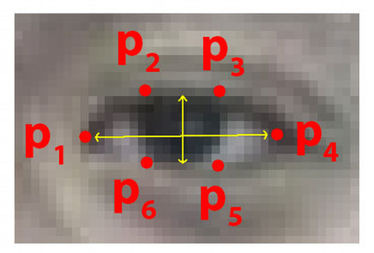
Eye Detection:
Eye Landmark Detection:
Each eye is represented by 6 (x, y)-coordinates, starting at the left-corner of the eye (as if you were looking at the person), and then working clockwise around the remainder of the region:

Slide 5
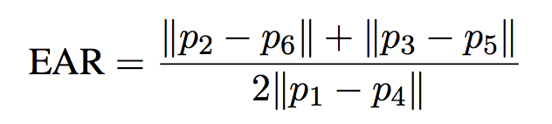
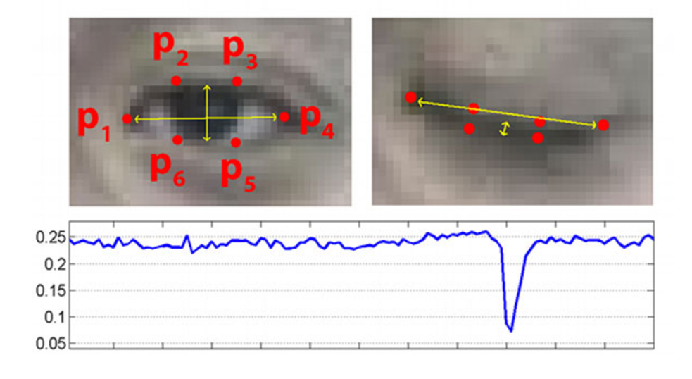
I It generates the Eye Aspect Ratio using the following formula. It checks 20 consecutive frames and if the Eye Aspect ratio is less than 0.25, an alert is generated.

Slide 6
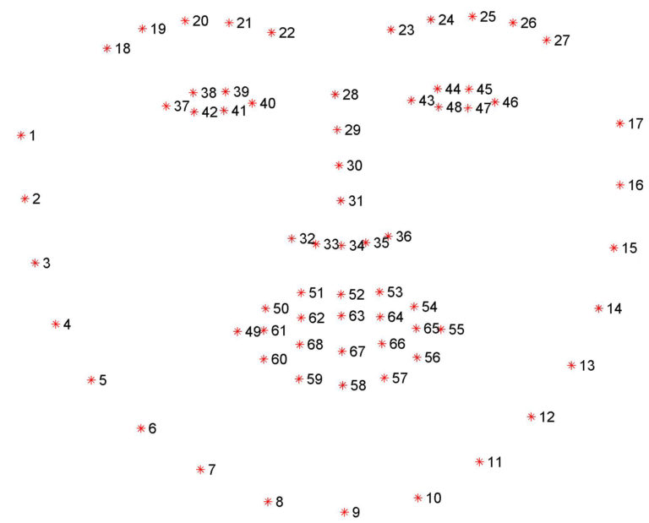
Face Detection:
Face detection is necessary to find whether the driver is distracted or not
If the driver moves his face in any direction other than towards the screen, In that case, driver is found to be distracted.
To achieve this, we use Haar-cascade features algorithm. This algorithm used for finding the location of the human faces in a frame or image.

Slide 7
Chatting and Alarm system:
Once the system detects that the driver is either drowsy or distracted the system activates a active chatting feature which constantly chats with the driver.
The system asks the driver interesting and calculation based questions like 15*15=? , so that the driver becomes active.
This system will use python libraries like NLTK , to apply small scale NLP to chat with the driver.

Slide 8
SYSTEM REQUIREMENTS
Chipset: Raspberry pi or Arduino
Operating System: Windows 7/8/10 or Ubuntu or OS X
Memory: 2 GB
Graphics: Intel Integrated Graphics Card
Video Camera
Audio Receiver
Speaker

Slide 9
SYSTEM ARCHITECTURE

Slide 10
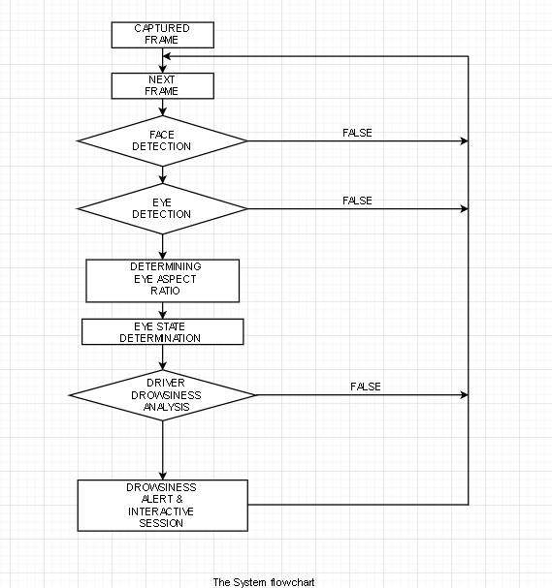

Slide 11
UML DIAGRAMS

Slide 12
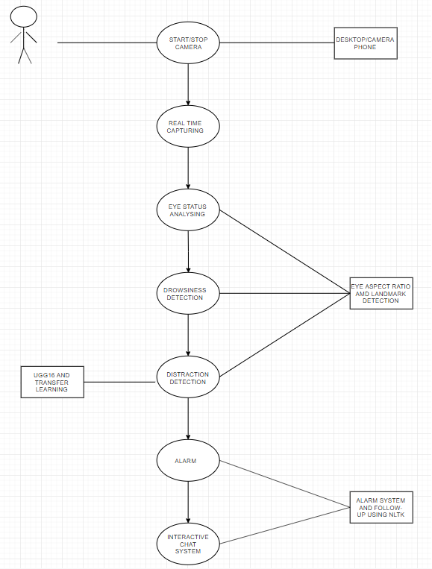

Slide 13
THANK YOU

