Slide 1
ENTERPRISE SOFTWARE ARCHITECT & FULL STACK DEVELOPER
Full Stack & ERP Software Development Portfolio
Scalable Web Applications | Enterprise ERP Systems | High-Performance SaaS Platforms
Prawin Kumar N
Erode, Tamil Nadu • prawin.vercel.app • github.com/prawinkumar2k • linkedin.com/in/prawinkumar-n

Slide 2
PROFESSIONAL PROFILE
About Me
CORE MISSION
Bridging advanced backend architecture with ultra-slick frontend execution to build enterprise-grade software that drives organizational efficiency.
📍 Based in Erode, Tamil Nadu 🚀 Specialized in High-Volume Portals
PROFESSIONAL SNAPSHOT
✦ Scalable System Architect: Experienced in creating heavy-duty web systems with cluster mode capability, optimizing response times to under 50ms.
✦ Government Tech Excellence: Developed state-level public admission platforms running smoothly for over 50,000+ applicants.
✦ Industrial IoT Integration: Successfully built smart attendance systems syncing Arduino hardware/RFID logs to enterprise databases in real-time.
✦ Premium UI/UX Implementation: Fluent in crafting sleek client portals utilizing React 19, AG Grid, Framer Motion, and Tailwind CSS.

Slide 3
SKILLS MATRIX
Technical Expertise
FRONTEND
BACKEND
DATABASES
DEVOPS & CLOUD
TOOLS & LIBS
• React.js (19/Vite)
• Tailwind CSS
• Bootstrap 5
• Framer Motion
• AG Grid Enterprise
• Responsive UI/UX
• Node.js (LTS)
• Express.js 5
• PHP
• RESTful API Dev
• Cluster Mode Multi-threading
• JWT/RBAC Auth
• MySQL 8.0
• MongoDB
• SQL Server (T-SQL)
• Connection Pooling
• Indexing & Optimization
• Normalized Database Design
• Docker Containerization
• Kubernetes (K3s)
• Nginx Reverse Proxy
• Dedicated Server Admin
• Linux System Administration
• CI/CD Workflows
• Git / GitHub
• Puppeteer (PDF Generation)
• Winston Logging
• RFID/Arduino IoT
• Postman API Suite
• Vercel / Heroku

Slide 4
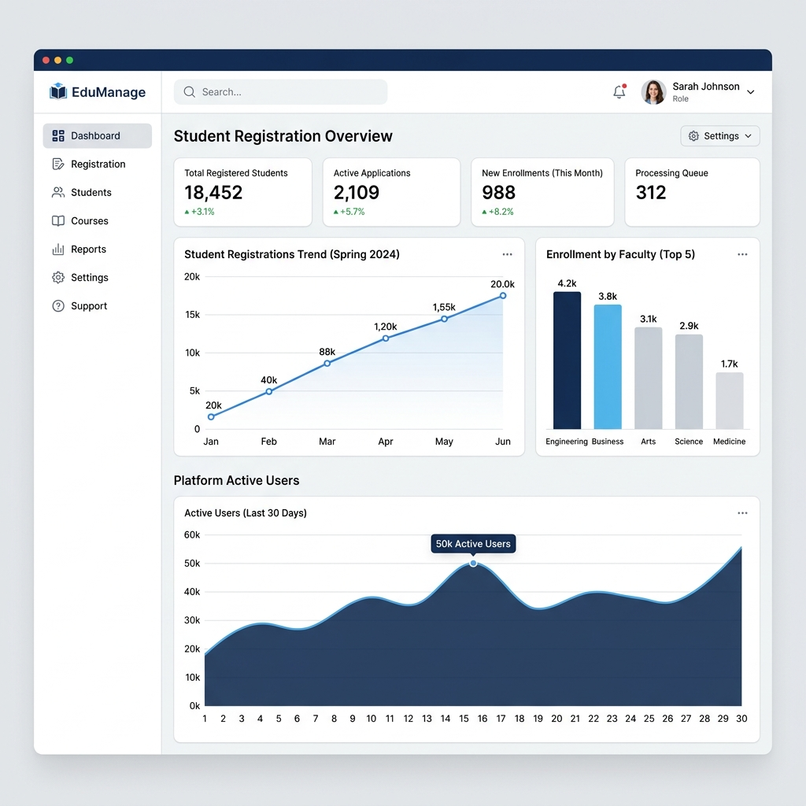
CASE STUDY 01
Government Admissions Portal (DOTE Tamil Nadu)
HIGH-VOLUME PUBLIC REGISTRATION PORTAL
👥 Massive User Volume: Successfully architected and deployed to handle 50,000+ active state-wide student admissions smoothly.
⚡ Technology Stack: Powered by React.js on the frontend with a highly resilient Node.js Express clustered backend API.
💳 Secure Payment Integration: Unified secure multi-bank payment gateway integration for real-time application fee collection.
🔐 Strict Security Guardrails: Implemented strict JWT session handling and fine-grained Role-Based Access Control (RBAC) protecting sensitive files.
🖥️ Dedicated Server Infrastructure: Engineered custom server deployment with Nginx routing, SSL certificates, load balancing, and active server health monitors.

Slide 5
CASE STUDY 02
Enterprise Campus ERP System
INTEGRATED CAMPUS RESOURCE & ACADEMIC ENGINE
👨‍🎓 Full Student Lifecycle: Unified student record keeping spanning initial admission, profile administration, grading, and transfer certificates.
📅 Real-time Attendance & eMAR: Automated attendance charting with daily tracking and instant SMS/Email notifications to stakeholders.
📊 Academic Reporting Engine: Powerful dashboard generating detailed analytical academic reports, test scores, class performance matrices, and custom GPA cards.
🗄️ SQL Server Database Core: Heavy database structure utilizing optimized stored procedures, indexed views, and optimized relational schemas.
🎨 Premium Bootstrap UI Console: Highly visual administration panels with clean corporate styling, mobile responsiveness, and dynamic tables.
ERP SYSTEM SCHEMATICS
Integrated Modules: ✔️ Admin Console ✔️ Student Portal ✔️ Faculty Station ✔️ Finance & Fees Desk ✔️ Library Catalog Database: SQL Server Core Frontend: Bootstrap 5 Dashboard

Slide 6
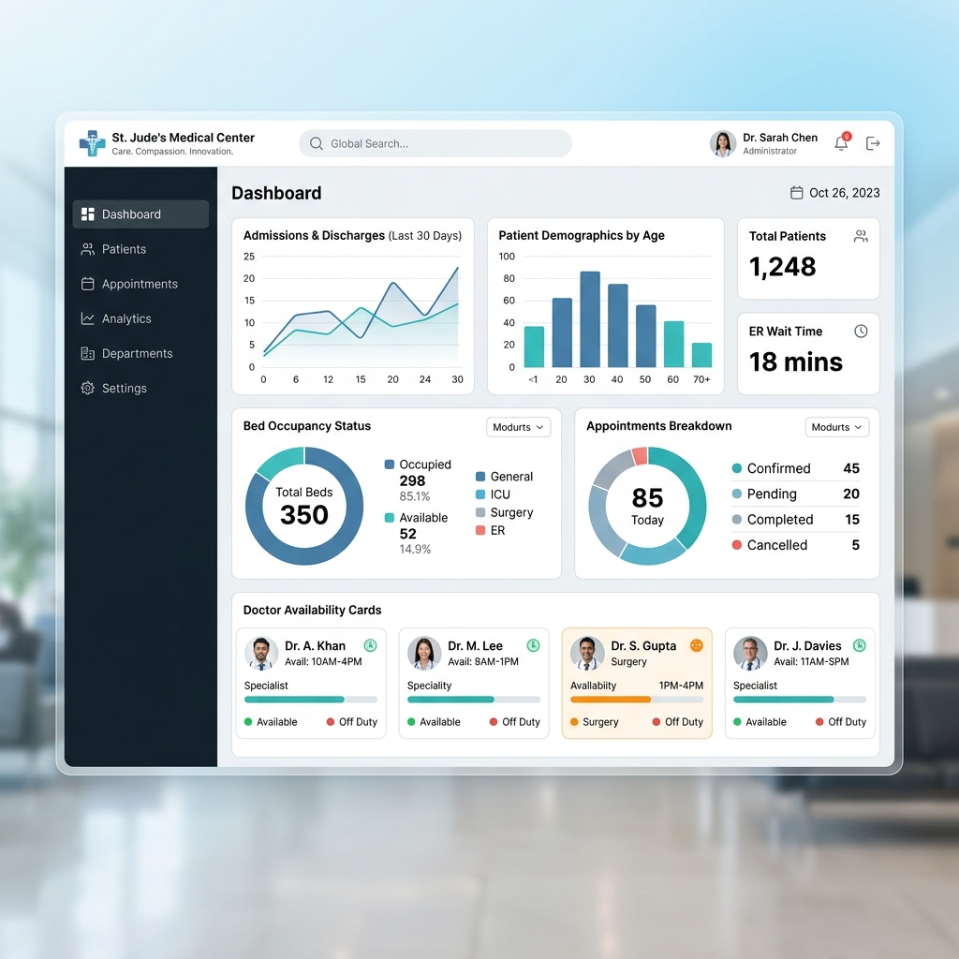
CASE STUDY 03
Lifeline Hospital Management System (HMS)
CLINICAL & BILLING PATIENT LIFECYCLE MANAGEMENT
🏥 Clinical PLCM Flow: Tracks complete patient journey from Registration (OPD), Admission (IPD), Ward assignment, Nursing charts, down to discharge.
👨‍⚕️ Role-Based Medical Stations: Dedicated clinical workstations for Admin, Doctor, Receptionist, Nurse, Pharmacist, Lab Technician, and Billing clerk.
🔬 Pharmacy & Lab Integration: Dynamic pharmacy stock inventory control and digital laboratory test reports generation via Puppeteer PDF renderer.
💰 Unified Billing Engine: Auto-aggregates room charges, laboratory tests, medicine dispensation, and doctor fees into a clear, unified invoice.
⚡ Modern Tech Stack Architecture: React 19 + Node.js cluster architecture, optimized with MySQL 8.0 connection pooling handling hundreds of simultaneous entries.

Slide 7
CASE STUDY 04
Enterprise Payroll Management System
AUTOMATED SALARY & STAFF RESOURCE MANAGER
🔐 Solid JWT Authentication: Secure authentication using JSON Web Tokens (JWT) ensuring secure access for employees and system administrators.
👥 Complete Employee Directory: Manages employee profiles, work contracts, job roles, attendance logs, and digital tax declaration files.
💰 Precision Payroll Calculator: Fully automated salary processing factoring in basic pay, custom allowances, tax deductions, unpaid leaves, and bonuses.
🗄️ Optimized MongoDB Schemas: Employs high-performance NoSQL models for highly flexible logs, historical payroll logs, and dynamic structure alterations.
📊 HR Analytics Command Center: Sleek charts displaying monthly payouts, salary distributions, active headcount trends, and department expenses.
PAYROLL METRICS CONSOLE
System Integrations: ✔️ Biometric Time Tracker ✔️ Direct Deposit Bank Generator ✔️ Custom Payslip PDF Creator ✔️ Dynamic Deductions Desk ✔️ Active Staff Dashboard Database: MongoDB Core Auth: Secure JWT Session Lock

Slide 8
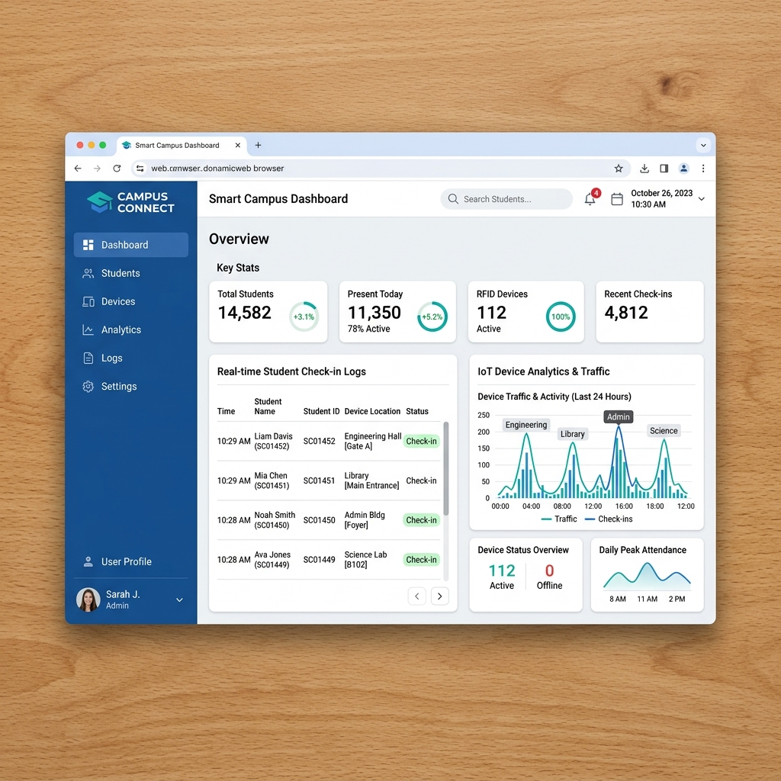
CASE STUDY 05
RFID Smart Attendance System (IoT)
HARDWARE-TO-CLOUD REAL-TIME AUTOMATION
🔌 Arduino Hardware Link: Designed real-time serial hardware controller communicating Arduino microcontroller and RFID chip directly to cloud endpoints.
🌐 PHP & SQL Server Engine: Robust PHP backend that instantly processes incoming hardware payload, maps RFID serial code, and records entry.
🏆 Innovation Award Winner: Formally recognized for engineering innovation by creating a highly cost-efficient IoT hardware prototype.
⚡ Instant Check-in Analytics: Live dashboard updating checked-in profiles as cards, highlighting late check-ins, and auto-logging missing members.
📊 Clean Admin Control Portal: Responsive, interactive system allowing administrators to easily link RFID tags, manage profiles, and export monthly Excel spreadsheets.

Slide 9
MY OFFERINGS
Core Software Services
Enterprise ERP Development
Custom workflows, payroll processing, multi-department academic/clinical inventory automation engineered to fit your processes perfectly.
Custom SaaS Platforms
Scalable, secure multi-tenant web applications with ultra-modern UI layouts, real-time analytics, and secure billing models.
Interactive Admin Panels
Polished developer dashboards built using React, AG Grid, Tailwind, and Recharts, optimized for handling massive data grids seamlessly.
Robust API Engineering
Highly secure, modular RESTful APIs developed with Node.js or PHP, optimized database operations, and micro-second query processing.
DevOps & Cloud Deploy
Professional Linux deployment setups using Docker, Nginx load-balancing, robust SSL integration, and automatic backup routines.
IoT & System Automation
Smart hardware integration (Arduino/RFID microcontrollers) linked directly to web dashboard APIs for real-time monitoring.

Slide 10
MY VALUE PROPOSITION
Why Partner With Me?
💼 Battle-Tested Real World Experience
Proven track record designing heavy administrative systems handling tens of thousands of real active student registrations and medical records daily.
⚡ Enterprise-Class Resilient Architecture
Fluent in implementing Node.js cluster modes, database connection pooling, parameterized indexing, and optimal JWT/RBAC security protocols.
🎨 Exceptional Custom UI/UX & Responsive Flow
Clean, pixel-perfect modern web layouts engineered using React 19, AG Grid, Framer Motion, and Tailwind CSS. No generic, boring placeholders used.
🚀 Professional Full-Cycle System Delivery
Complete project execution starting from requirements mapping, wireframing, core programming, staging tests, down to robust live server setups.

Slide 11
MY WORKFLOW
Professional Development Process
01
02
03
04
05
06
Requirements Mapping
Mapping business specifications, data schemas, and key integrations.
Sleek UI/UX Wireframing
Prototyping premium responsive interfaces focused on ease of operation.
Agile Development Cycle
Structured clean coding using modern backend clusters & React modules.
Rigorous End-to-End Test
Automated security vetting, database query performance profiling.
Production Deployment
Linux server configuration with Nginx reverse proxy, SSL secure locks.
Dedicated Aftercare
Active system health telemetry monitoring and performance updates.

Slide 12
LET'S BUILD SOMETHING EXCEPTIONAL
Partner With an Enterprise Software Expert Today.
📧 EMAIL CHANNEL
prawin1209@gmail.com
Direct Communication
🌐 DIGITAL PORTFOLIO
prawin.vercel.app
Live Demos & Projects
🐙 GITHUB SOURCE
github.com/prawinkumar2k
Clean Repositories & Diffs
👥 PROFESSIONAL LINKEDIN
linkedin.com/in/prawinkumar-n
Industry Networking

