Slide 1
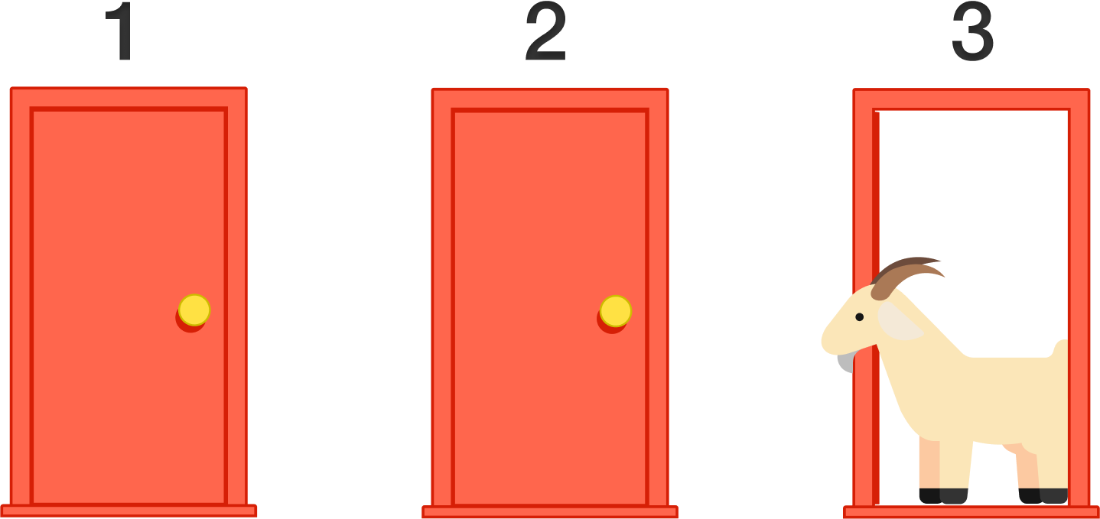
The Monty Hall Problem
Investigation Number 2
Sean Chan
1 Reward
2 Goats
3 Doors

Slide 2
Section 1
An Overview

Slide 3
The Monty Hall Problem
What is it? Coding? No.
The Monty Hall Problem is a brain teaser developed by, well, Monty Hall. The game was used in a game show called Let’s Make a Deal. The problem was originally proposed (and solved) in 1975 by Steve Selvin.
1. The game originally starts with 3 doors, each with a secret behind.
There are 2 goat doors and 1 prize door.
2. The player first selects a door, and the host reveals one of the goat doors that wasn’t selected.
3. Then the player gets to choose between staying with the original choice or switching to the remaining door.

Slide 4
Isomorphic Versions
Pick 3 doors please…
These are some different but similar variants of the 3-door problem…
In the beginning of the game, you choose two doors out of three. Among the two chosen doors, Monty reveals a goat, then asks which of the remaining doors you would like to choose.
Monty chooses two random doors himself. Between the two doors, Monty opens a door to reveal a goat. Monty then asks which of the remaining doors you would like to choose.

Slide 5
Section 2
The Code

Slide 6
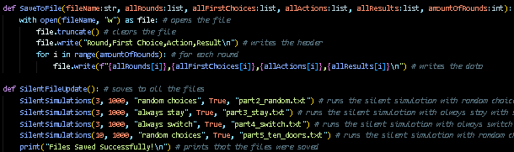
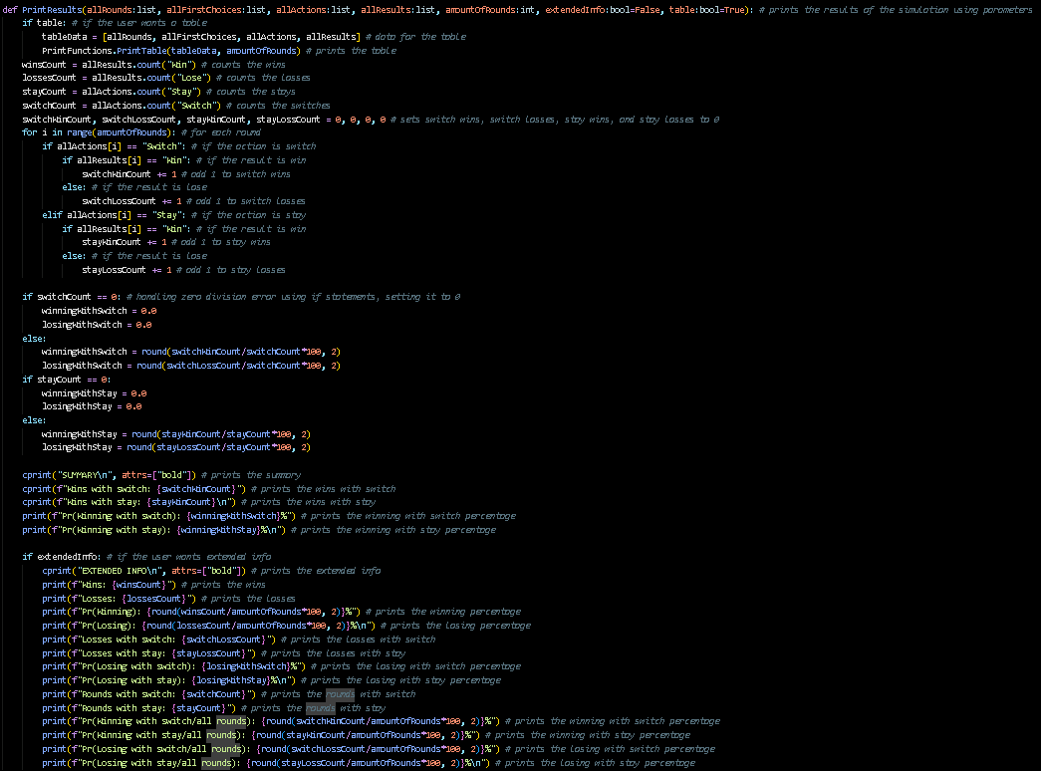
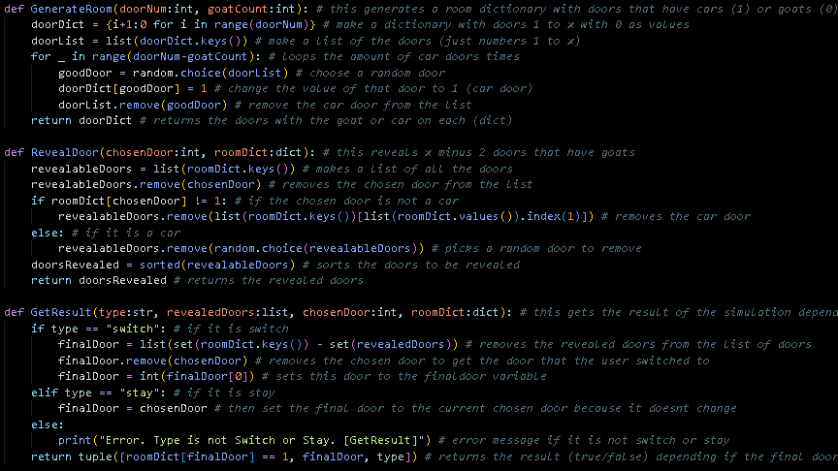
Some Functions
Functions… Oh functions…
These are a few of the many functions in my code:
- GenerateRoom: Generates a dictionary of doors that have a value of 0 or 1, 1 being the prize.
- RevealDoor: Reveals a door that wasn’t picked and is a goat.
- GetResult: Gets the action (switch or stay) and does that action. It then checks for the win or lose.
- PrintResults: Prints a table with the stats and the probabilities. It can print more detailed results if needed.
- SaveToFile: Clears and saves stats to a specified file.
- SilentFileUpdate: Updates all the files in one shot by running the simulation and saving to files.

Slide 7
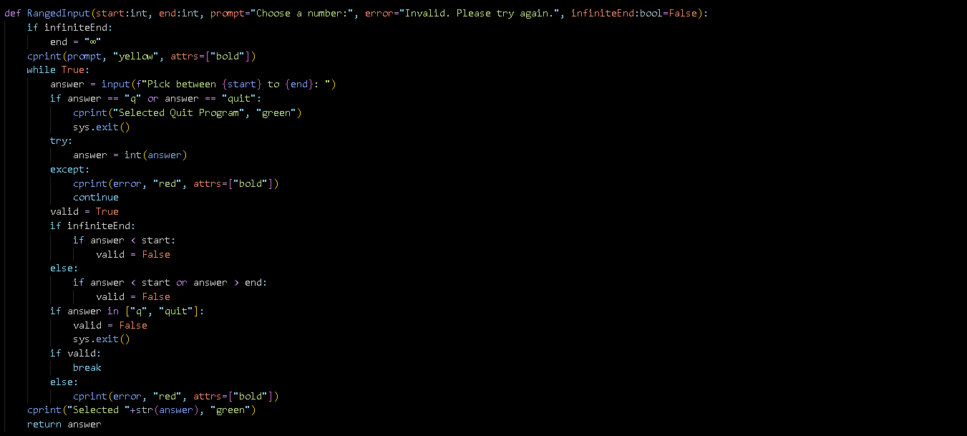
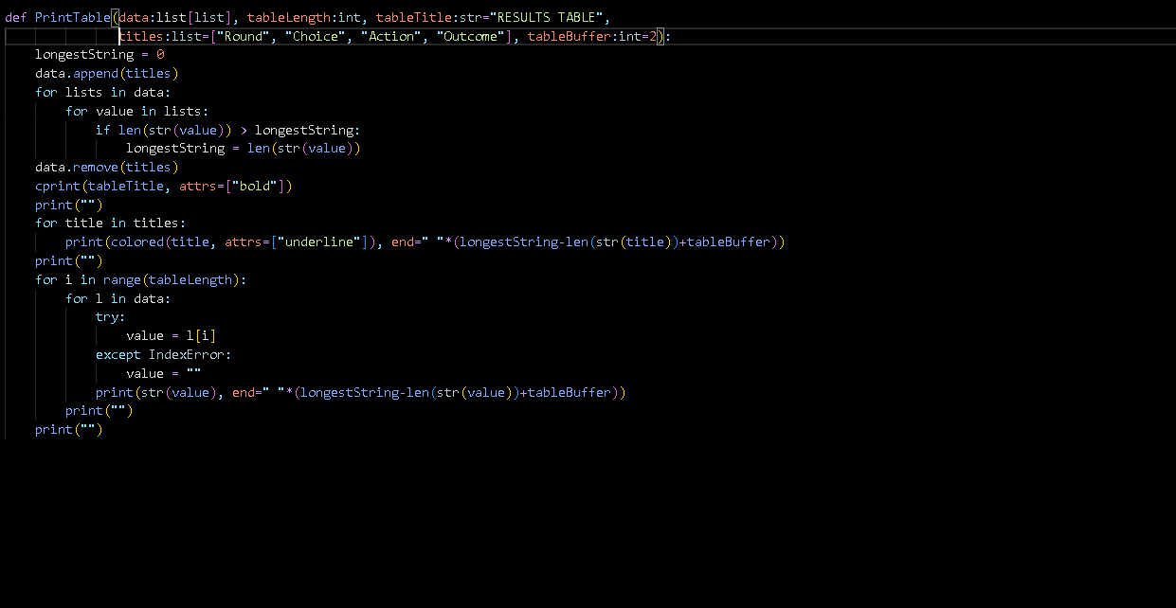
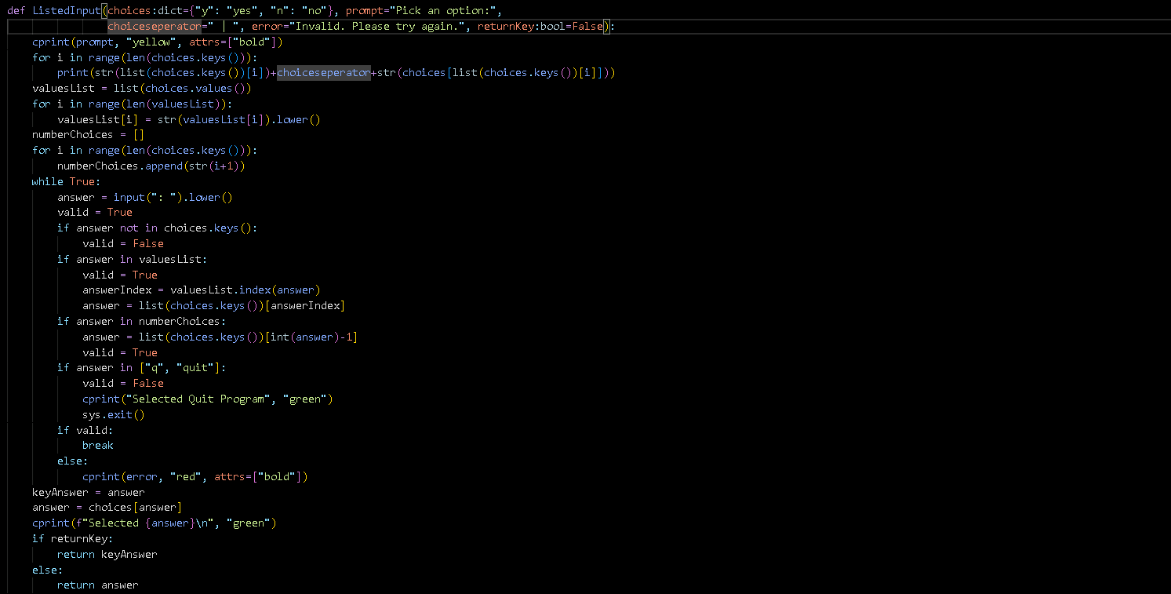
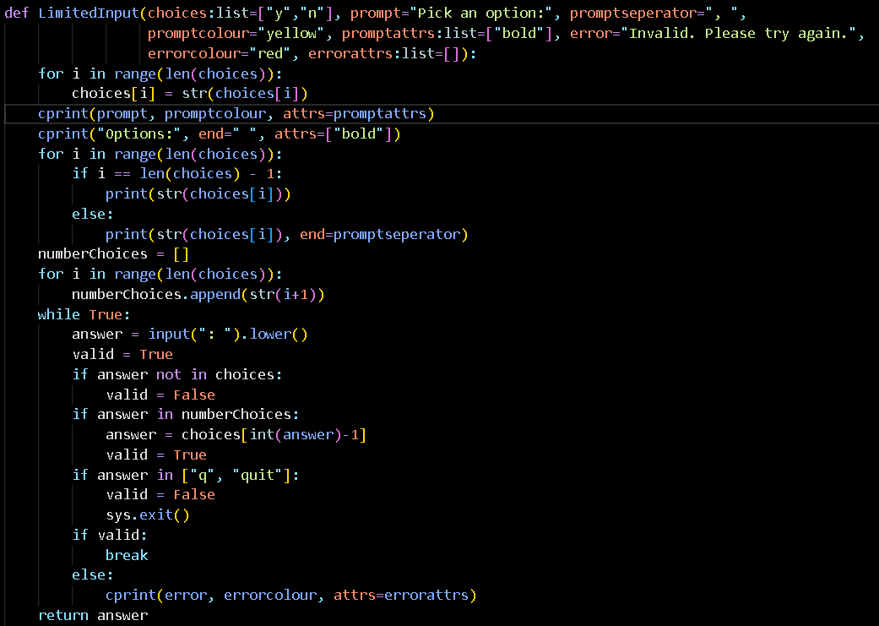
Print Functions
For Printing, obviously
I made a new file that stores input and printing table functions with user error, these are the functions in that file:
- LimitedInput: a input function with user error.
- ListedInput: a input function that lists all the options with shortcuts, with user error.
- RangedInput: a input function for a range of numbers.
- PrintTable: a function that prints a table.

Slide 8
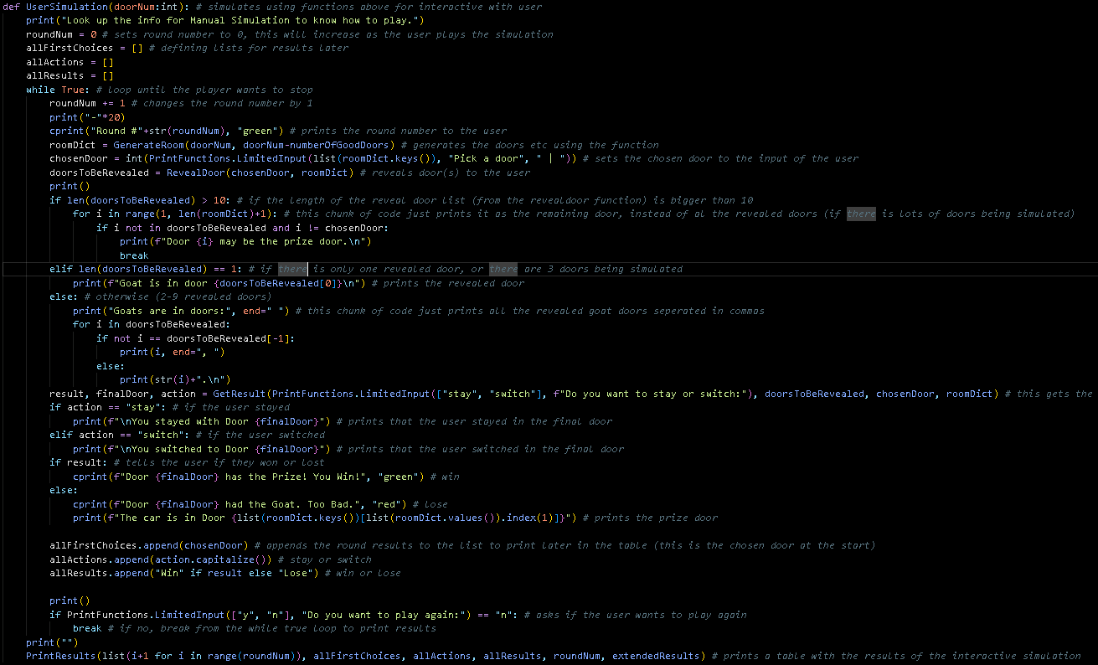
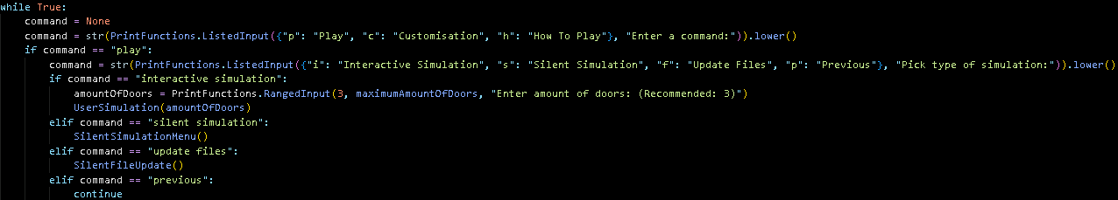
Part 1: User Interaction
Type them, don’t open them.
I implemented it into the menu so that the user can play it by selecting it from the menu.
I made a function for user simulation that uses the previous function to assist in running a simulation with user input and user error handling.
The function then prints the results using the previous print result function.
This can be customized with number of doors and is accessed through the menu.

Slide 9
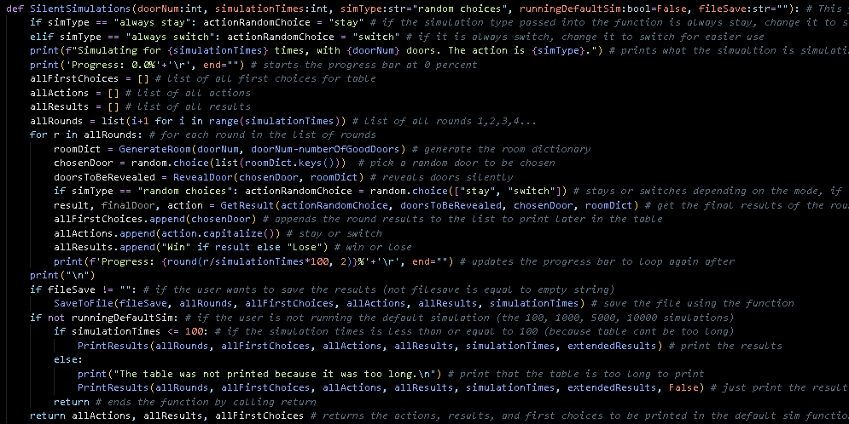
Silent Simulations
Shh… It’s silent…
I made one function called silentSimulations() to run all the silent simulations.
It takes different parameters depending on the part:
- doorNum: This is the number of doors.
- simulationTimes: This is the number of rounds to simulate.
- simType: This is the type of action, e.g. “always stay”.
- runningDefaultSim: This is to print the results straight after or not. I used this when I was running the 50, 100, 500… rounds so that it wouldn’t print the table and stats after each round.
- fileSave

Slide 10
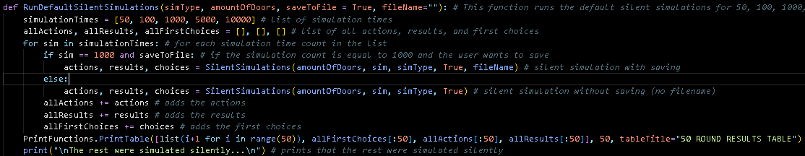
Running the Rounds
50, 100, 500, 1000, 10000.
For running the rounds, (50, 100, 500, 1000, 10000) I created a function that uses the silentSimulation() function 5 times to run each round.
It uses a for loop to run the rounds, and if the round is the 50 round, it prints a table using the PrintTable() function. If the round is the 1000 round, it saves to the corresponding file as needed.
Then it prints a special table with the rounds and the stay with winning and switch with winning probabilities.

Slide 11
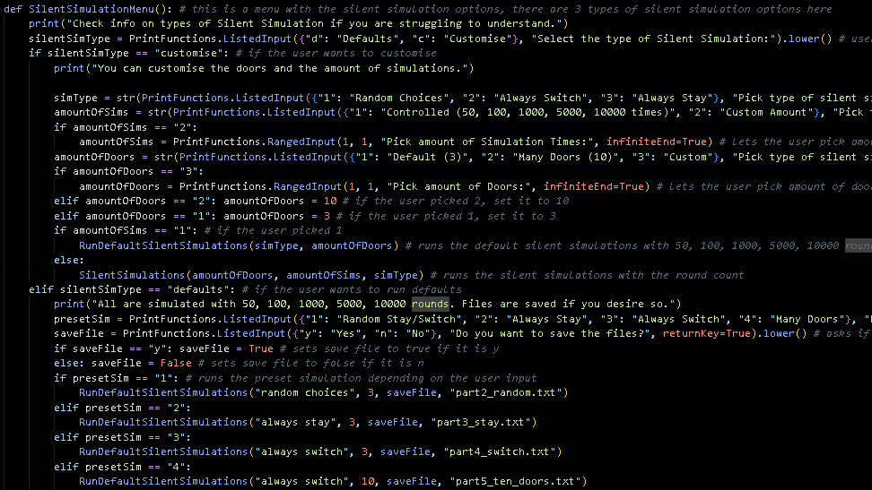
Parts 2, 3, 4 & 5: Menu Implementation
Select a simulation: quit
I made the menu let the user choose which part they wanted to run, and I also made it so that you could manually pick the number of doors, simulation times and action. (e.g. always stay)
I did this all in a SilentSimulationMenu() function that is called in my main loop or menu after the user wants to run silent simulations.

Slide 12
Part 2: Random Choices
Choice = random.choices(doors)
This uses the RunDefaultSilentSimulation() function in the menu with these parameters:
Note: saveFile can be True or False depending if the user wants to save files or not.
I will talk about the statistics of parts 2, 3, 4 & 5 later.

Slide 13
Part 3: Always Stay
Staying is the safest option.
This uses the RunDefaultSilentSimulation() function in the menu with these parameters:

Slide 14
Part 4: Always Switch
This could be better than staying…
This uses the RunDefaultSilentSimulation() function in the menu with these parameters:

Slide 15
Part 5: Many Doors
This is where staying becomes insignificant…
This uses the RunDefaultSilentSimulation() function in the menu with these parameters:

Slide 16
Part 6: Menu System
10 doors? No, 10,000,000 doors.
As mentioned before, I have a menu system that lets the user pick what part they want to run.
I also have many customisable options:
Silent Simulation Menu: (from before)
- Number of doors
- Number of rounds
- Type of simulation (e.g. always stay)
Others:
- Number of doors (Interactive Simulation)
- Extended results (Prints more results)

Slide 17
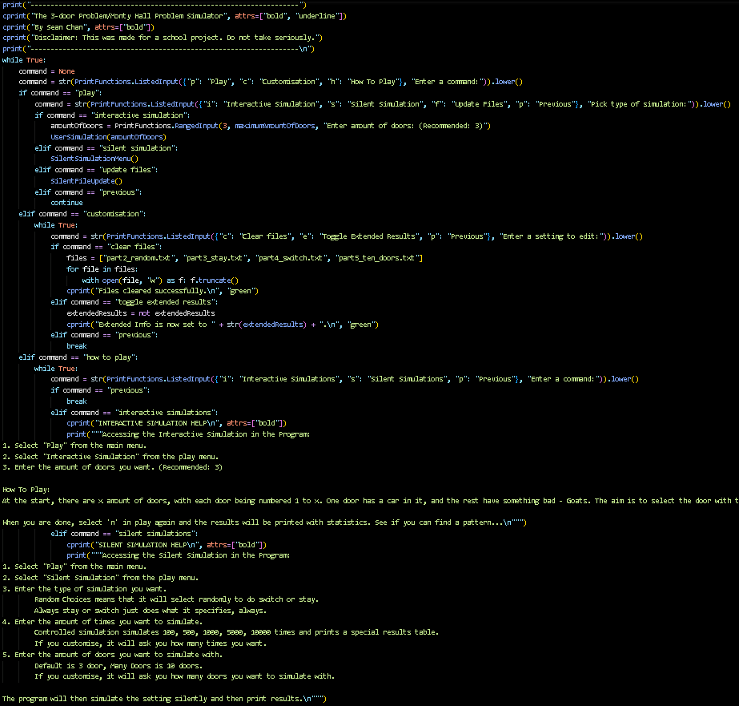
Part 6: Menu System
10 doors? No, 10,000,000 doors.
My menu is split into 2 parts:
The main loop of the menu
Silent simulation selections
I also have instructions on how to play in my menu.
This is how to play section

Slide 18
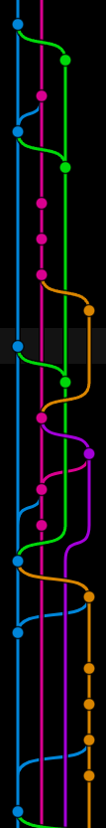

Part 7: Committing
Committing is good for knowing what you changed. That’s all.
See my commits, see my last change. If there are any short commits it is only because of a small change, or I was adding comments to code.

Slide 19
Section 3
Analysis

Slide 20
Analysis of 3 Doors
Which is better? The hard stats.

Slide 21
Analysis of 3 Doors
Which is better? The hard stats.
1/3 Winning with stay 2/3 Winning with switch
Because you have only 1/3 chance of picking the right door when you start.
Switching will give you a 2/3 chance of winning.
Door 1: Win; Door 2 & 3: Goat
Scenario 1: You pick door 1 and stay -> win
Scenario 2: You pick door 1 and switch -> lose
Scenario 3 & 4: You pick door 2 or 3 and stay -> lose
Scenario 5 & 6: You pick door 2 or 3 and switch -> win
Stay (Winning): 1/3 Switch (Winning): 2/3

Slide 22
3 Door vs. 10 Door
Probabilities. Stats.

Slide 23
3 Door vs. 10 Door
Probabilities. Stats.
1/10 Winning with stay
9/10 Winning with switch
Because you have only 1/10 chance of picking the right door when you start. Switching will give you a 9/10 chance of winning. The more doors, the value there is in switching.
Therefore, the chance with winning with stay: 1 / Number of doors
With switch: (Number of doors – 1) / Number of doors

Slide 24
Thanks for Listening
Make sure to check out CYOA, a python game made by Me, Oliver and Levi…
Gimme that 100! Thanks a ton.
I stayed in 100 doors and won first try. I think that is lucky. (1/100 chance)

