Slide 1
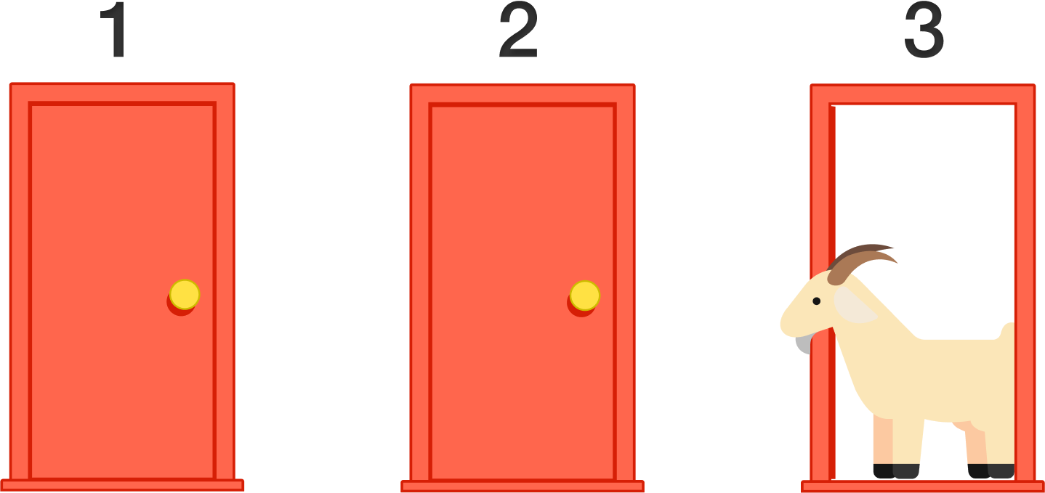
The Monty Hall Problem
Investigation Number 2
Sean Chan
1 Reward
2 Goats
3 Doors

Slide 2
The Monty Hall Problem
What is it? Coding? No.

