Slide 1










Modelling bacteria growth
Sean Chan

Slide 2










Part 1
Overview

Slide 3
Part 2
The Code

Slide 4
1.1 Document any use of imported modules and libraries

Slide 5
1.2 Create and explain a reusable means of converting time periods (5 marks)

Slide 6
Module 1: NAIVE VS SOPHISTICATED MODEL COMPARISON

Slide 7
2.1 Prompt as specified and summarise the entered information (5 Marks)
2.1.1 Accept a custom fission-event frequency

Slide 8
2.2 Output the correct projected population size and explain your design (10 marks)

Slide 9
PART II: TIME FOR A POPULATION TO REACH A TARGET SIZE
Bye to Naïve Model…

Slide 10
3.1 Prompt in the specified format and summarise (5 Marks)

Slide 11
3.2 Output projection and explain algorithm in your slides (10 Marks)

Slide 12
PART III: COMPARE SOPHISTICATED MODELS (5 Marks)

Slide 13
PART IV: GENERATE MORE DETAILED PROJECTIONS

Slide 14
5.1 Explain your design and output projections as columns (10 Marks)
5.1.1 Accept a length of time or a dollar amount as the projection target

Slide 15
PART V: SIMULATE INCREASES IN FISSION-EVENT FREQUENCY (10 MARKS)

Slide 16
5.1 Explain your design and output projections as columns (10 Marks)
5.1.1 Accept a length of time or a dollar amount as the projection target
Mr. Kigodi caught lacking!!
I assumed this was a mistake and ignored it.

Slide 17
PART VI: CREATE A USER INTERFACE

Slide 18
7.1 Provide a menu of choices to the user (5 marks)

Slide 19
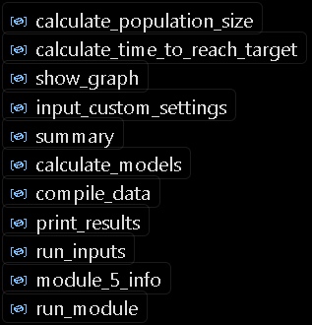
7.2 Use functions throughout your program (5 marks)
Dunno how this is related to user interface, but it was in the pdf…
You’ve already seen most of them, but here’s a list again.
There is also if __name__ == ‘main’: for the main loop.

Slide 20
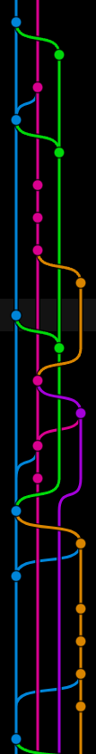

PART VII: DOCUMENT YOUR CODING PROCESS WITH FREQUENT AND DETAILED COMMITS
(30 MARKS)
You can check my commits now…
If there are any short ones I will explain why.

Slide 21
Thanks for listening!
Credits:
Font Picking: Kingsley Wong (Blame him for MingLiU_HKSCS-ExtB, Times New Roman)
Code: AI Sean Chan
Presentation: Sean Chan
Code Writing: Visual Studio
I have new Opps with the math department what is this investigation…

