Slide 1












Modelling bacteria growth
Sean Chan

Slide 2










Part 1
Overview

Slide 3




The 5 second rule – Bacteria Growth Measured
The 5 second rule is an idea that food is safe to eat after dropped on the floor if you picked it up in less that 5 seconds. However, (spoiler alert) scientists have debunked it, and it is proven that bacteria can transfer instantly when in contact with food.

Slide 4
Part 2
The Code

Slide 5






How my code works (Structure)
Steps:
Main Menu -> User picks a module.
function runs the module, using its settings.
Inside of the function it runs, in order:
Then it asks for replay
If replay go to step 3
If no replay go back to step 1
I will explain all these functions later in this presentation.

Slide 6
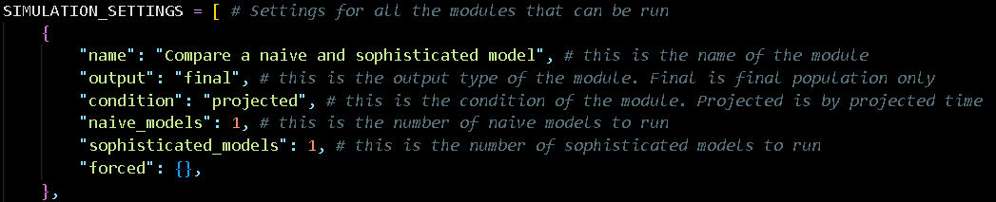
Settings
Each module has its own settings so that my code can run each one differently.
Output:
Final: The final value
List: A list of all the populations leading up to the final value
Columns: Start, added, end
Compare: Listed models side-by-side in a table.
Condition:
Population: Target population
Projected: Projected Time
Varied: User can pick

Slide 7
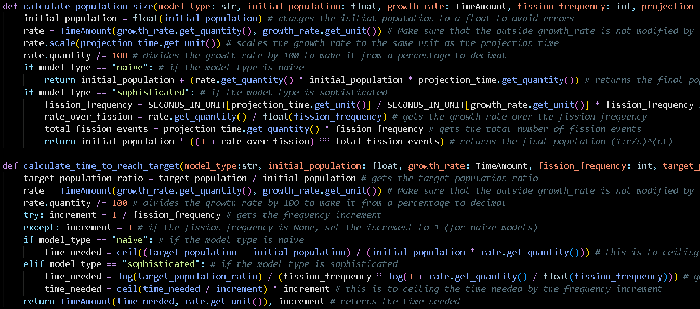
Calculation Functions
I have 2 calculation functions throughout my code:

Slide 8





1.1 Document any use of imported modules and libraries

Slide 9
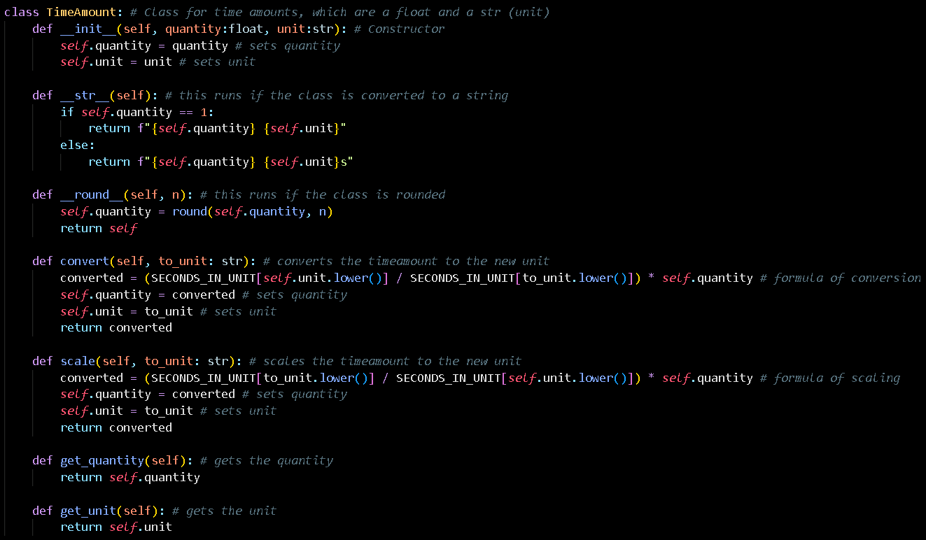
1.2 Create and explain a reusable means of converting time periods (5 marks)

Slide 10
Module 1: NAIVE VS SOPHISTICATED MODEL COMPARISON

Slide 11
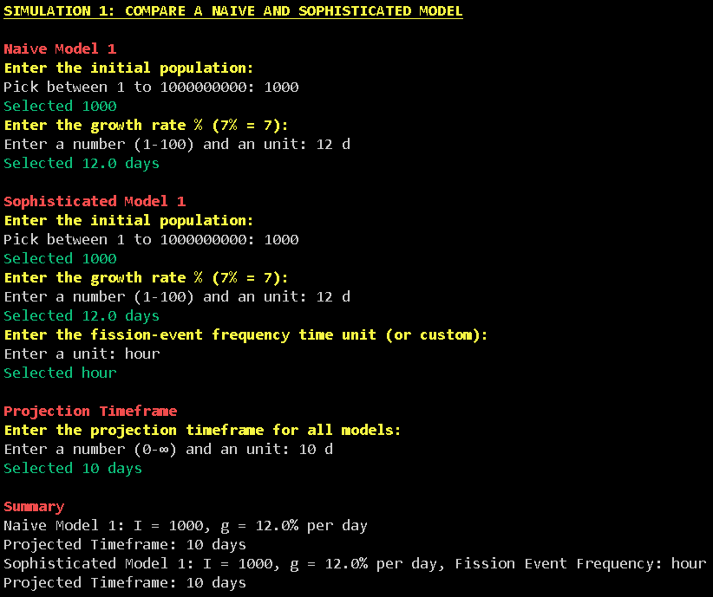

2.1 Prompt as specified and summarise the entered information (5 Marks)
Uses , functions to achieve this.

Slide 12
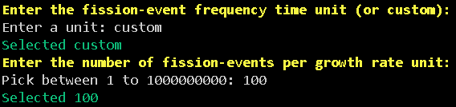
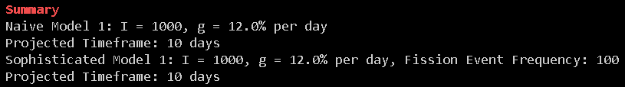
2.1.1 Accept a custom fission-event frequency
Uses , functions to achieve this.

Slide 13
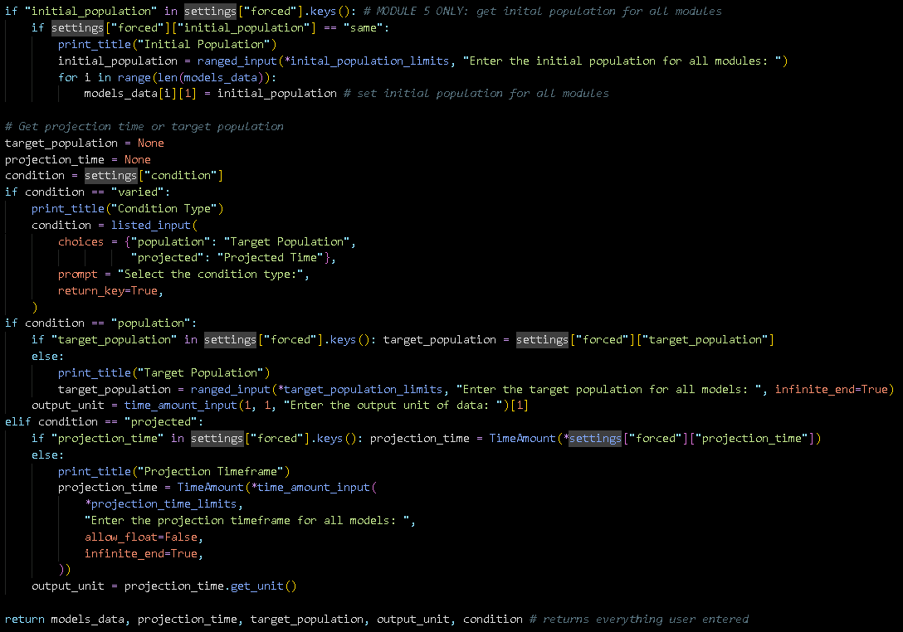
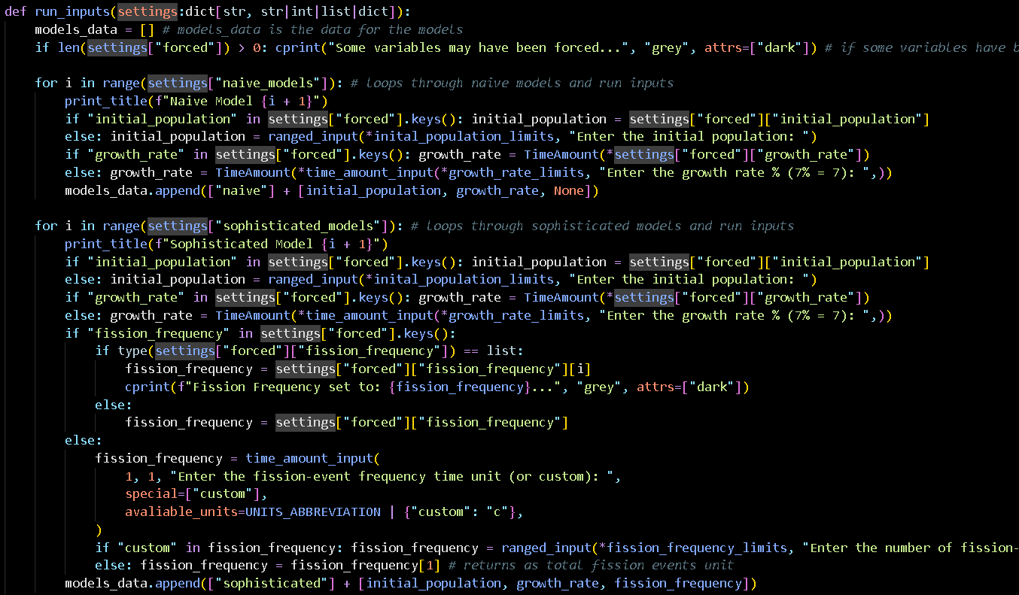
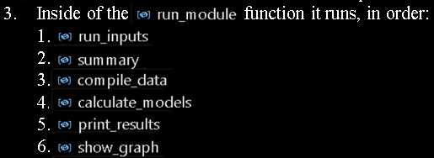

The function

Slide 14
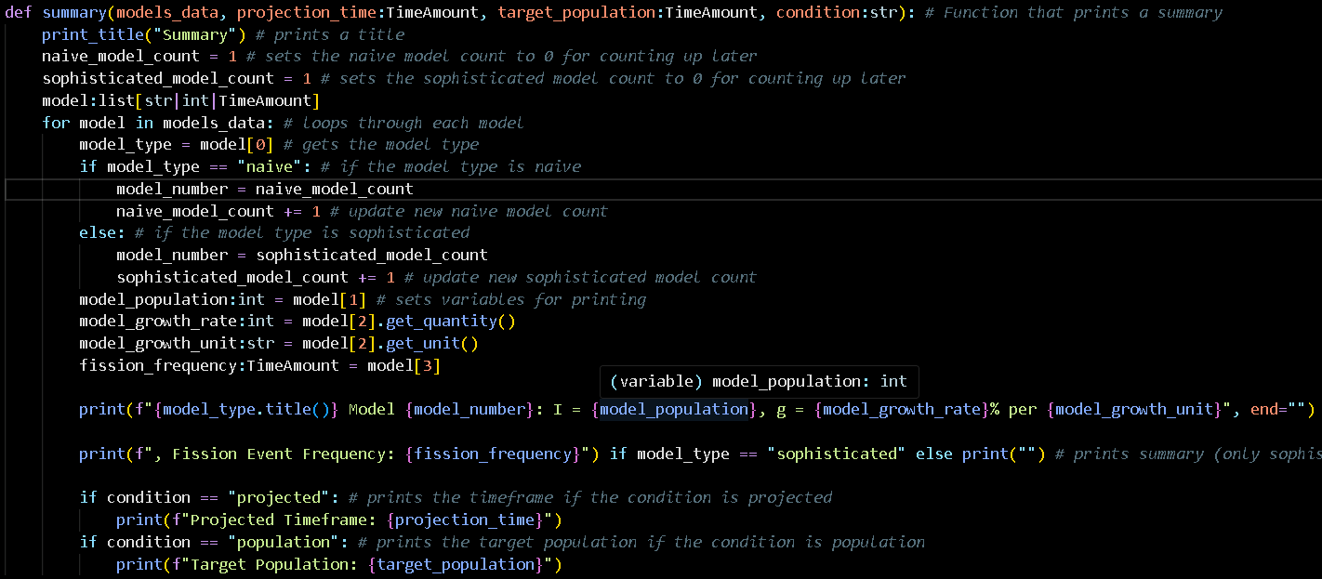

The function

Slide 15
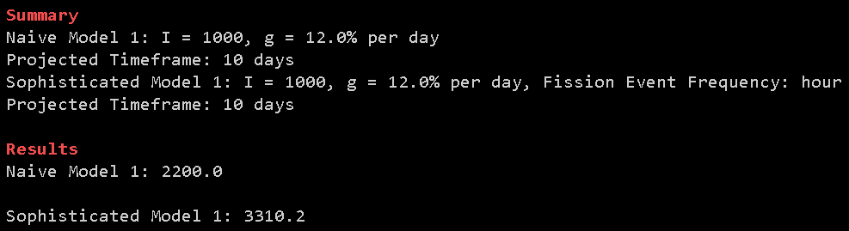
2.2 Output the correct projected population size and explain your design (10 marks)
Uses ,, functions to do calculations, and to do printing.
This is correct if you want to check it yourself.
1000 + 1000*0.12*10 = 2200
1000 * (1 + 0.12/24) ^ (24*10) = 3310.2…

Slide 16
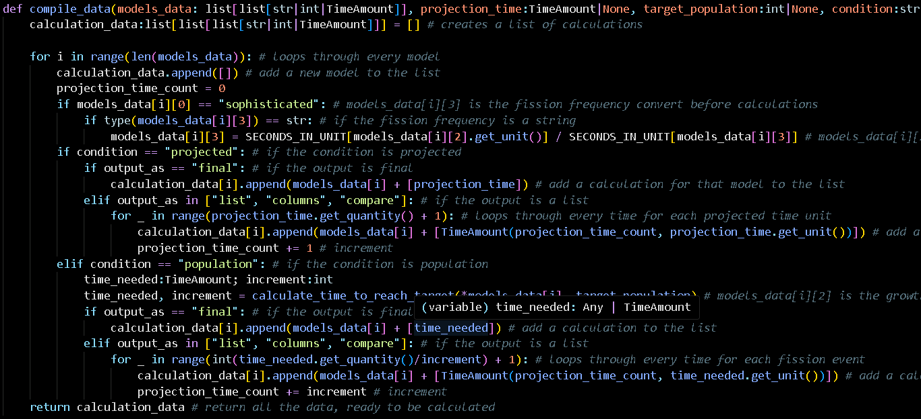

The function (Final)

Slide 17
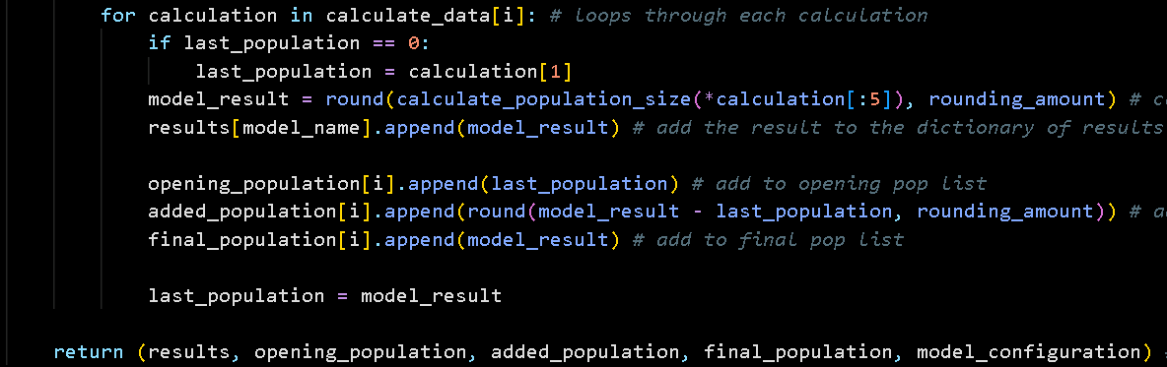
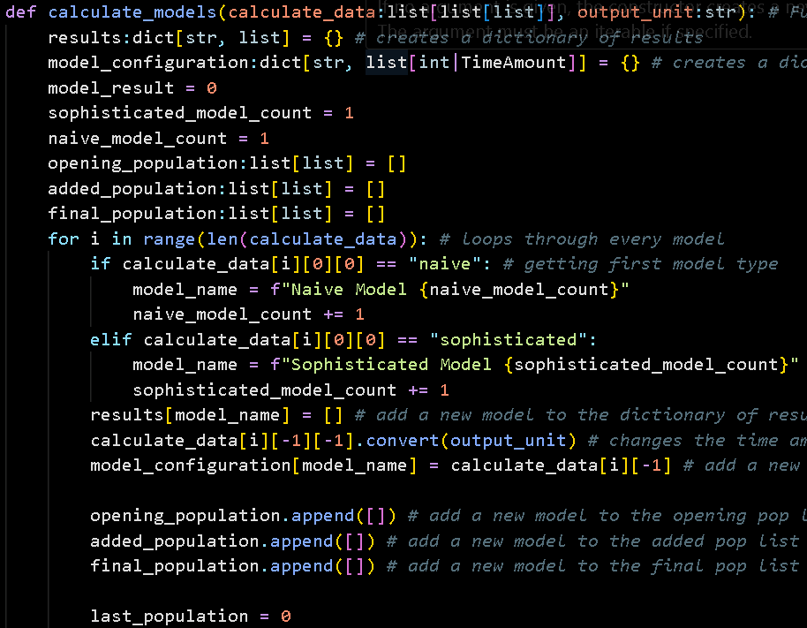

The function

Slide 18


The function (Final Population)

Slide 19

PART II: TIME FOR A POPULATION TO REACH A TARGET SIZE
Bye to Naïve Model…

Slide 20
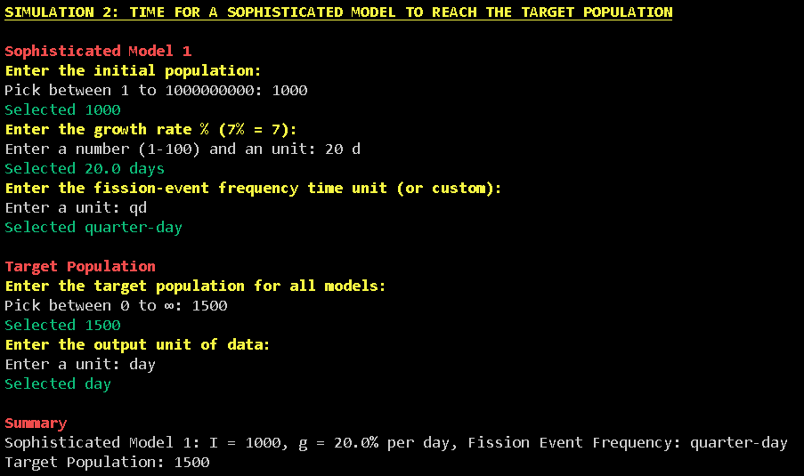
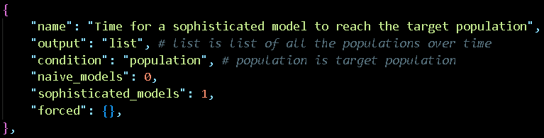
3.1 Prompt in the specified format and summarise (5 Marks)

Slide 21
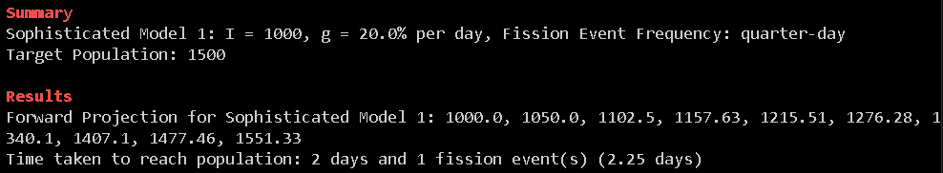
3.2 Output projection and explain algorithm in your slides (10 Marks)
In here I re-use all the functions, just with different settings.

Slide 22
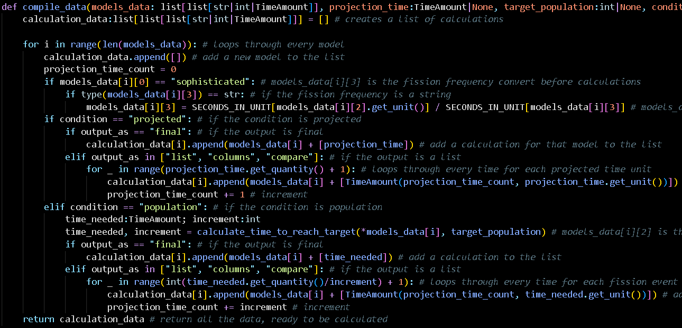

The function (List, Population)

Slide 23
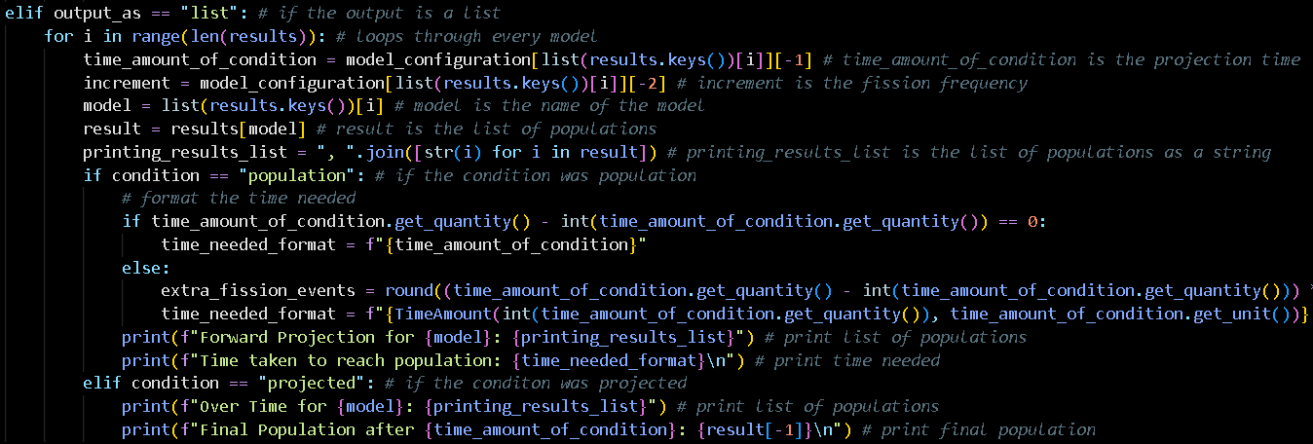

The function (Listed Population)

Slide 24
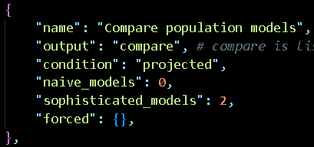
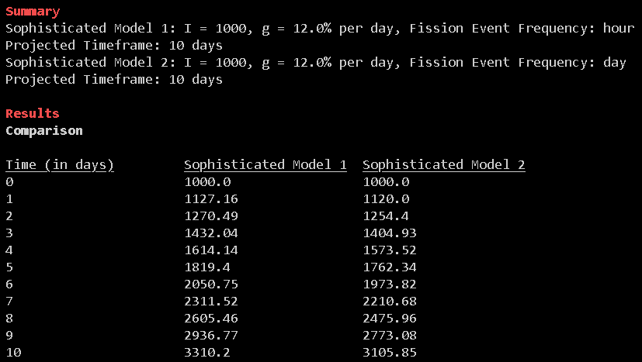
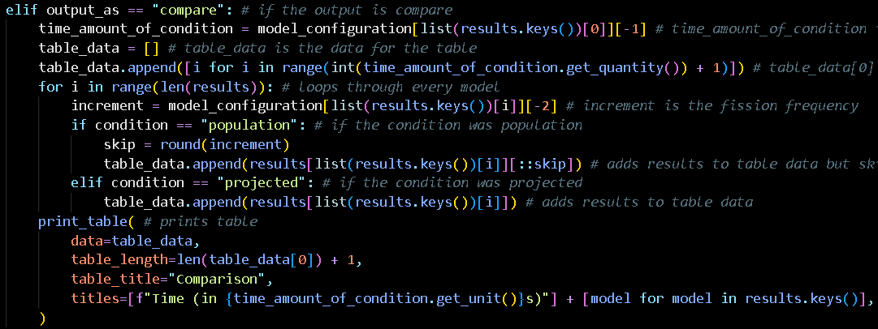
PART III: COMPARE SOPHISTICATED MODELS (5 Marks)
In here I re-use all the functions like in module 2 but it outputs a little bit differently.

Slide 25






PART IV: GENERATE MORE DETAILED PROJECTIONS

Slide 26
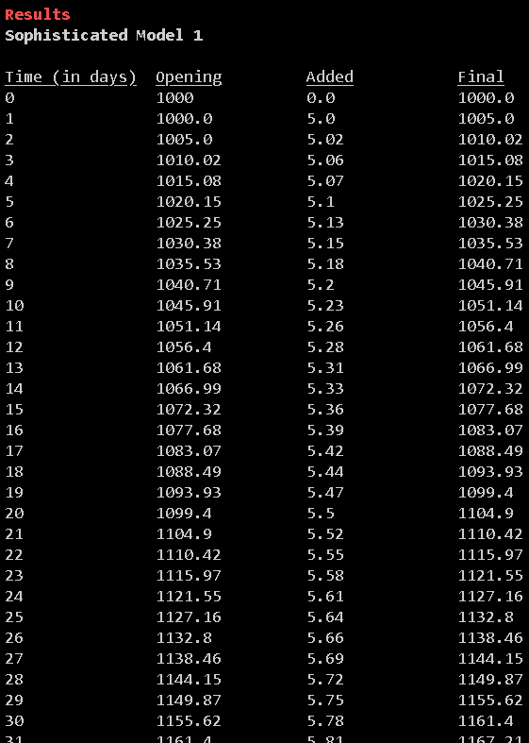
5.1 Explain your design and output projections as columns (10 Marks)

Slide 27
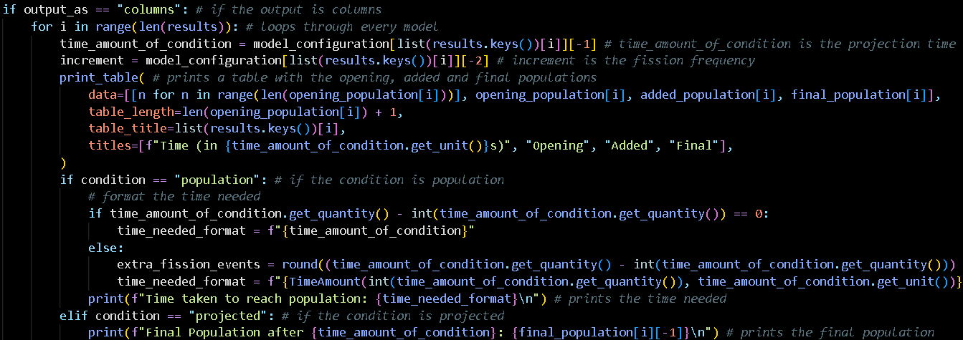
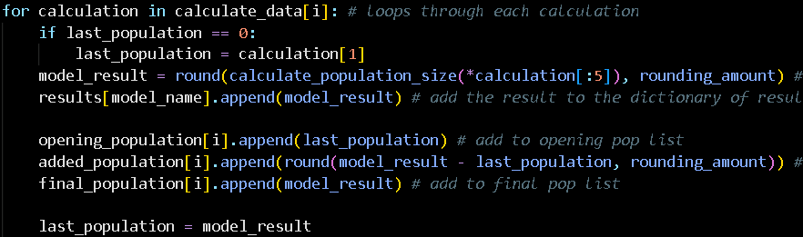
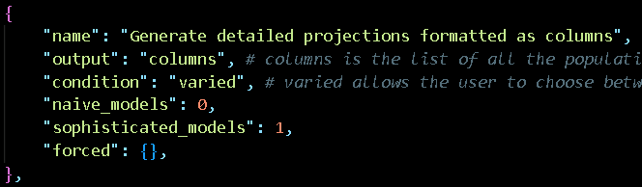
5.1 Explain your design and output projections as columns (10 Marks)
In here I re-use all the functions but print differently.

Slide 28
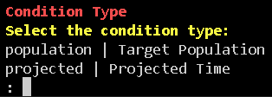


5.1.1 Accept a length of time or a dollar amount as the projection target
Mr. Kigodi caught lacking!!
I assumed this was a mistake and ignored it.

Slide 29


PART V: SIMULATE INCREASES IN FISSION-EVENT FREQUENCY (10 MARKS)

Slide 30
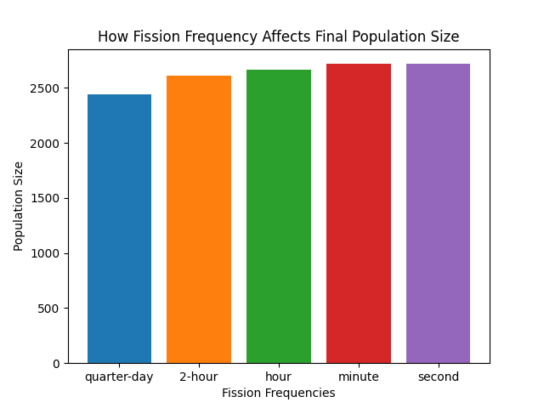
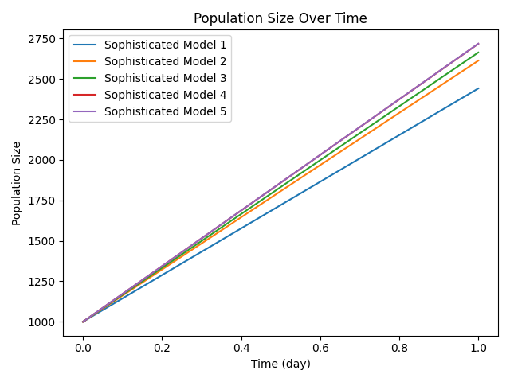
All Modules

Slide 31
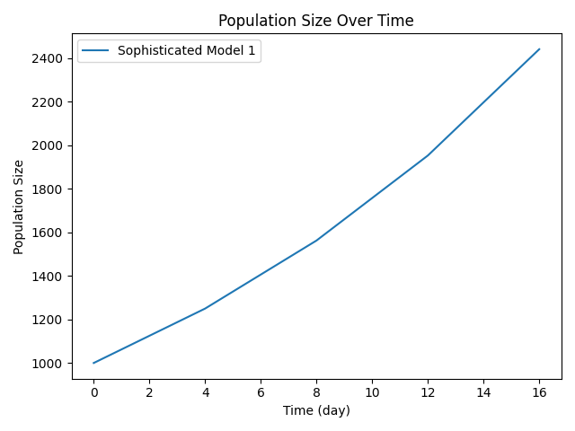
Quarter-day (4 fission events)

Slide 32
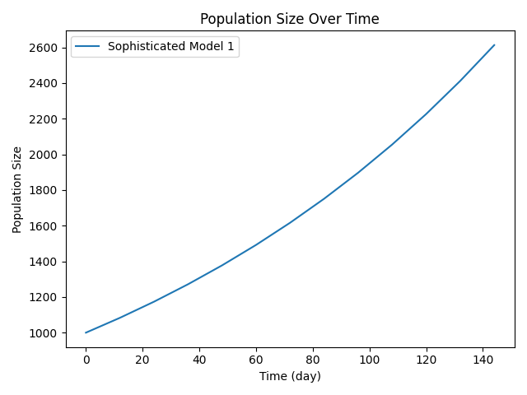
2-hour (12 fission events)

Slide 33
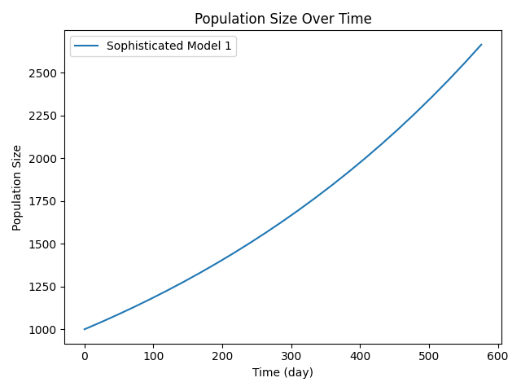
Hour (24 fission events)

Slide 34
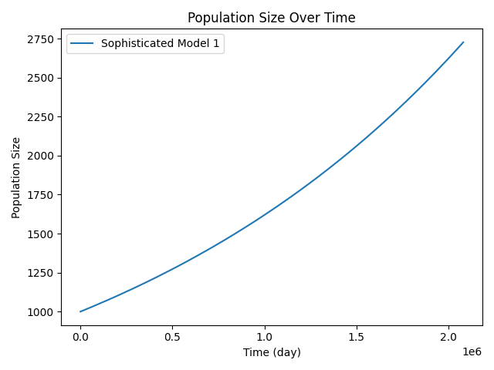
Minute (24*60 fission events)

Slide 35
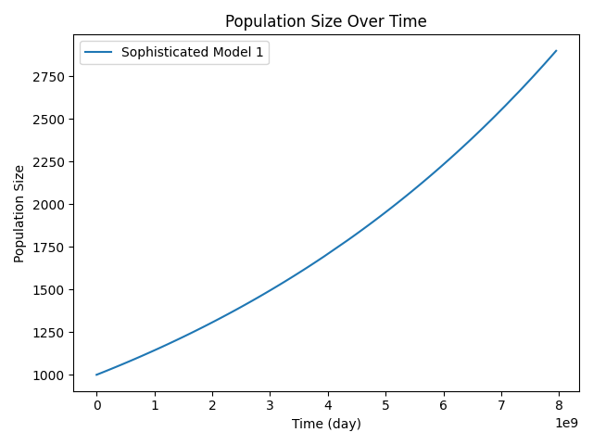
Second (24*60*60 fission events)

Slide 36
Conclusion
Population Limit (For initial pop of 1000)
Theoretical population limit as fission frequency approaches infinity: 2718.28
This limit is 2.72 times the initial population.
Research Summary
The limit observed here is related to the mathematical constant 'e'. When growth happens continuously (which is approximated by very high fission frequencies), the formula for population growth becomes P(t) = P0 * e^(rt), where r is the continuous growth rate. In this case, r = 1.0 (100% per day), so the limit is the initial population multiplied by e.

Slide 37


PART VI: CREATE A USER INTERFACE

Slide 38
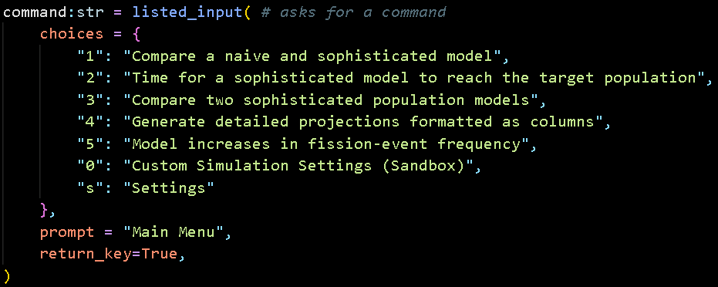

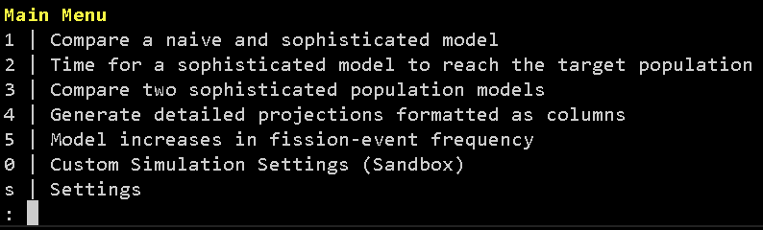
7.1 Provide a menu of choices to the user (5 marks)
Listed_input: Function to get user input with user error.

Slide 39
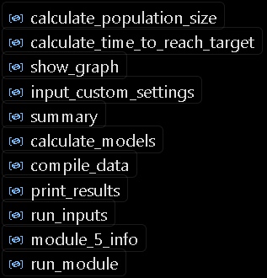
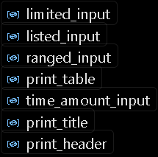
7.2 Use functions throughout your program (5 marks)
Dunno how this is related to user interface, but it was in the pdf…
You’ve already seen most of them, but here’s a list again.
There is also if __name__ == ‘main’: for the main loop.

Slide 40
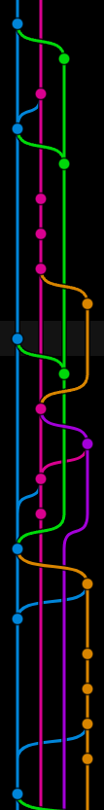

PART VII: DOCUMENT YOUR CODING PROCESS WITH FREQUENT AND DETAILED COMMITS
(30 MARKS)
You can check my commits now…
If there are any short ones I will explain why.

Slide 41
Thanks for listening!
Credits:
Font Picking: Kingsley Wong (Blame him for MingLiU_HKSCS-ExtB, Times New Roman)
Code: AI Sean Chan
Presentation: Sean Chan
Code Writing: Visual Studio
Theme: Tarik02 (Absolute Black)
I have new Opps with the math department what is this investigation…
Please 100…

Slide 43














No Bacteria were harmed in the making of this presentation.

