Slide 1
Introduction to Web Development – JavaScript Class 2
The different data types and performing data type conversions.

Slide 2
Where is the data? Really…
Primitive Data Types
In computer science, primitive data types are a set of basic data types from which all other data types are constructed.
string
number
boolean
null
undefined
symbol
Referenced Data Types
A reference type is a code object that is not stored directly where it is created, but that acts as a kind of pointer to a value stored elsewhere.

Slide 3
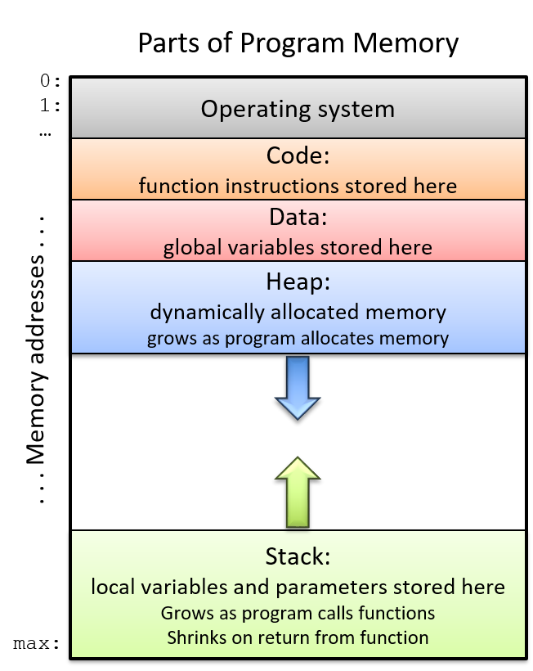
Computer Memory
Is used for many things
As a program runs it uses different parts of memory differently.

Slide 4
Primitive data types
Primitive data types are stored on the Stack.
A stack is a special area of computer's memory which stores temporary variables created by a function. In stack, variables are declared, stored and initialized during runtime. It is a temporary storage memory. When the computing task is complete, the memory of the variable will be automatically erased.
string
number
boolean
null
undefined
symbol

Slide 5
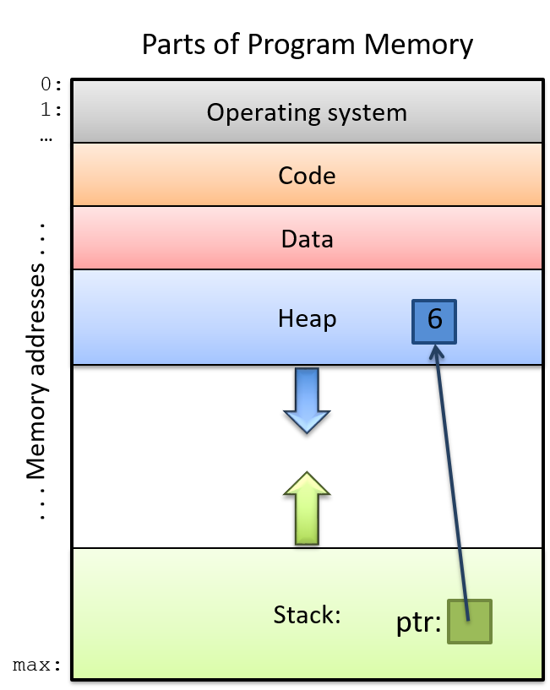
Pointers are weird
Pointers make reference to data on the heap.

Slide 6
Reference Data Types
Reference data types are stored on the Heap. With a pointer from the stack…
A reference type variable contains a reference to data stored in memory, also known as the heap. The heap is most often used for data that has a longer life. You can have more than one variable point to the same referenced data. Objects are an example of a reference type.
Arrays
Objects
Functions
Dates
Everything Else...

Slide 7
Dynamic vs. Static Assignment
In JavaScript, data types are dynamically assigned.
In other languages, they are statically assigned.
Java, C#, C++
That means you need to create the specific type before you add the correctly typed value.

