Slide 1
People and their Clothes
How do we keep track of all the clothes for people who live in the same house?

Slide 2
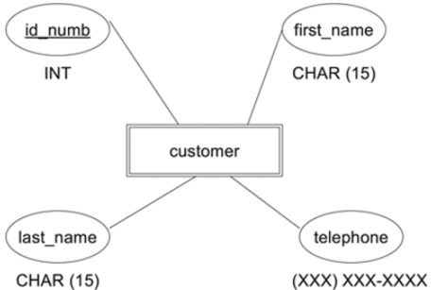
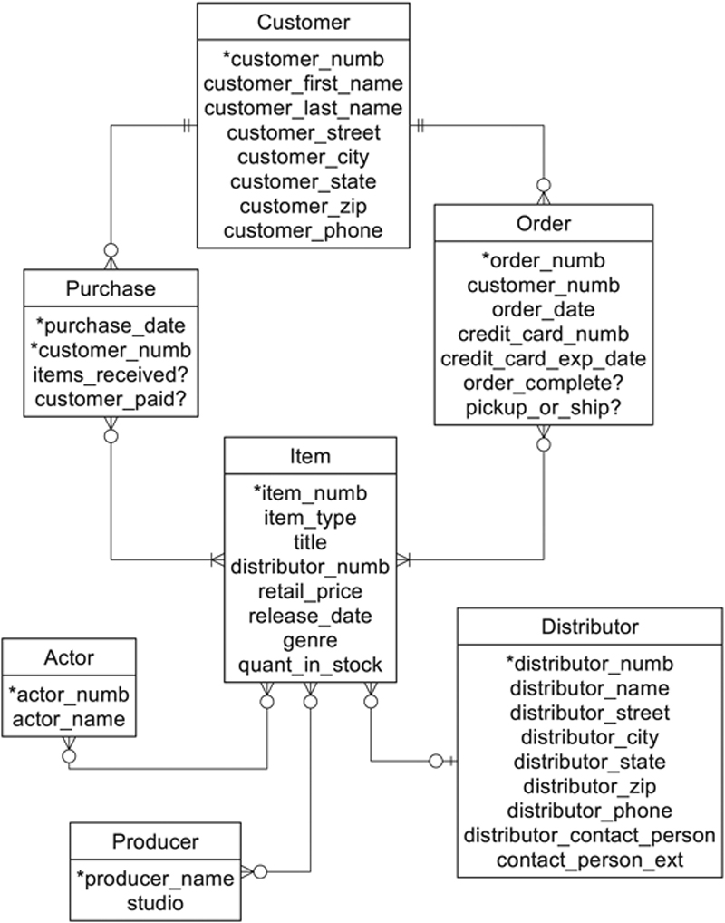
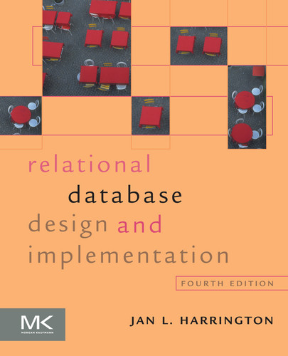
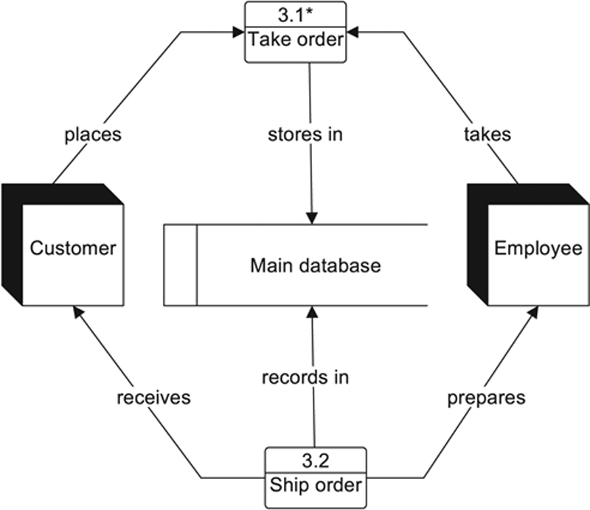
Part II of the text is good reading for developing an understanding of database design. It also gets into the different diagramming techniques used for analysis and design.

Slide 3
Raw Data
D8E4H1
Socks
Shoes
235 Sandstone Way
woolley
Basement
fred@bedrock.com
Barney
5
Dino Flinstone
Betty Rubble
57 Granite Quarry
1
2
Bedrock City
wilma@bedrock.com
Tommy Hellfigre
Dress
3rd
2nd
Village of Shale
Roughfitter
Pants
Wilma
D5K1N5
4
Rubble
Fred
Main
Sabretooth
1
Outer Armour
Blouse
betty@bedrock.com
Bambam
Raptor
3
Hat
D6G3R9
velociraptor
Flinstone
CANADA
7 Volcano View Road
247 Sandstone Way
TRex
barney@bedrock.com
Bat
lizard
Rubble
Shirt
8
Pebbles
Underwear
broadleaf

Slide 4
Person Data
fred@bedrock.com
Barney
Dino Flinstone
Betty Rubble
wilma@bedrock.com
Wilma
Rubble
Fred
betty@bedrock.com
Bambam
Flinstone
barney@bedrock.com
Rubble
Pebbles

Slide 5
first_name
last_name
email
Character(32)
Character(64)
Character(200)
We need a unique identifier!!
The Candidate unique identifiers?
Email is unique – but a person can change their email address.
So let us create a unique identifier, person_id.
This is known as the PRIMARY KEY.
A table can have only one primary key.

Slide 6
WHERE:
SELECT * FROM public."People"
WHERE last_name = 'rubble’
ORDER BY:
SELECT * FROM public."People"
ORDER BY last_name DESC, first_name DESC
GROUP BY:
SELECT last_name, COUNT(last_name) AS in_family FROM public."People"
GROUP BY last_name

Slide 7
Clothes Data
Socks
Shoes
woolley
5
1
2
Tommy Hellfigre
Dress
Roughfitter
Pants
4
Sabretooth
1
Outer Armour
Blouse
Raptor
3
Hat
velociraptor
TRex
Bat
lizard
Shirt
8
Underwear
broadleaf

Slide 8
We also need to know who owns which item of clothing.
clothing_type
name
count
Character(16)
Character(32)
integer
person_id
integer
We also need a unique identifier!!
The Candidate unique identifiers?
There is no other candidate identifer
So let us create a unique identifier, clothing_id.
The person_id is known as the FOREIGN KEY!
A table can have many foreign keys.

Slide 9
WHERE:
SELECT * FROM public."Clothes"
WHERE clothing_type = 'pants'
ORDER BY:
SELECT * FROM public."Clothes"
ORDER BY count DESC
GROUP BY:
SELECT clothing_type, SUM(count) FROM public."Clothes"
GROUP BY clothing_type
ORDER BY sum DESC

Slide 10
The One to Many Relationship (1:M)
In a family, a person can have many items of clothing. Within the family an item of clothing cannot be owned by many people.
Clothes
People
1
person_id
first_name
last_name
email
Integer
Character(32)
Character(64)
Character(200)
Clothes
clothing_id
person_id
clothing_type
name
count
Integer
Integer
Character(16)
Character(32)
Integer
M
Which item of clothing (clothing_id) is owned by which person (person_id).

Slide 11
One – Many (1:M)
Parent – Children
Master – Details
Child or Detail cannot exist without the Parent or Master.

Slide 12
The One to Many Relationship (1:M)
In a family, a person can have many items of clothing. Within the family an item of clothing cannot be owned by many people.
Clothes
People
clothing_id
person_id
clothing_type
name
count
Integer
Integer
Character(16)
Character(32)
Integer
1
M
person_id
first_name
last_name
email
Integer
Character(32)
Character(64)
Character(200)
In the People table the person_id is known as the PRIMARY KEY.
In the Clothes table the clothing_id is known as the PRIMARY KEY.
In the Clothes table the person_id is known as the FOREIGN KEY.

Slide 13
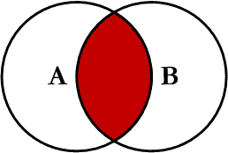
INNER JOIN
SELECT first_name, last_name, clothing_type, name, count FROM public."People"
INNER JOIN public."Clothes" ON public."People".person_id = public."Clothes".person_id

Slide 14
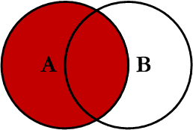
LEFT JOIN
SELECT first_name, last_name, clothing_type, name, count FROM public."People"
LEFT JOIN public."Clothes" ON public."People".person_id = public."Clothes".person_id

Slide 15
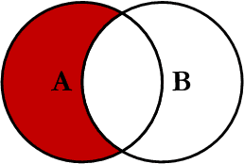
LEFT OUTER JOIN
SELECT first_name, last_name, clothing_type, name, count FROM public."People"
LEFT JOIN public."Clothes" ON public."People".person_id = public."Clothes".person_id
WHERE clothing_type IS NULL

