Slide 1
People and their Addresses
How do we keep track of all the addresses for people who have a home, work, and other residences?

Slide 2
Raw Data
D8E4H1
Socks
Shoes
235 Sandstone Way
woolley
fred@bedrock.com
5
Barney
Dino Flinstone
Betty Rubble
57 Granite Quarry
1
2
Bedrock City
wilma@bedrock.com
Tommy Hellfigre
Dress
Village of Shale
Roughfitter
Pants
Wilma
D5K1N5
4
Rubble
Fred
Sabretooth
1
Outer Armour
Blouse
betty@bedrock.com
Bambam
Raptor
3
Hat
D6G3R9
velociraptor
Flinstone
CANADA
7 Volcano View Road
247 Sandstone Way
TRex
barney@bedrock.com
Bat
lizard
Rubble
Shirt
8
Pebbles
Underwear
broadleaf

Slide 3
Address Data
D8E4H1
235 Sandstone Way
57 Granite Quarry
Bedrock City
Village of Shale
D5K1N5
D6G3R9
CANADA
7 Volcano View Road
247 Sandstone Way

Slide 4
addr_line1
city_name
country
postal_code
Character(64)
Character(64)
Character(24)
Character(12)
We also need a unique identifier!!
The Candidate unique identifiers?
There is no other good candidate identifier.
So let us create a unique identifier, address_id.

Slide 5
The Many to Many Relationship (M:M)
A person can be associated with Many different addresses. And an address can be occupied by Many different people.
People
person_id
first_name
last_name
email
Integer
Character(32)
Character(64)
Character(200)
How can we set the relationship between these two entities (tables)?
Addresses
address_id
addr_line1
city_name
country
postal_code
Integer
Character(64)
Character(64)
Character(24)
Character(12)

Slide 6
Addresses
People
PK
FK
PK
FK
We can’t just add each reciprocal PRIMARY KEY (PK) to each others table as a FOREIGN KEY (FK).
It creates trouble with duplicate data
It breaks rules for duplicate primary key values

Slide 7
Many to Many (M:M)
Many-to-Many is used to relate many records in the table A with many records in the table B. A record ('parent') in Table A can have many matching records ('children') in Table B, and a record ('child') in Table B can have many matching records ('parents') in Table A.
It is the hardest relationship to understand and it is not correct. By breaking it into two one-to-many relationships and creating a new (junction/link) table to stand between the two existing tables will enable correct and appropriate relationship setting.
A many-to-many relationship is really two one-to-many relationships with a junction/link table.

Slide 8
The Many to Many Relationship (M:M)
A person can be associated with Many different addresses. And an address can be occupied by Many different people.
People
people_xref_addresses
person_id
first_name
last_name
email
Integer
Character(32)
Character(64)
Character(200)
person_id
address_id
addr_type
Integer
Integer
Character(8)
Addresses
address_id
addr_line1
city_name
country
postal_code
Integer
Character(64)
Character(64)
Character(24)
Character(12)

Slide 9
The Many to Many Relationship (M:M)
A many-to-many relationship is really two one-to-many relationships with a junction/link table.
1
1
M
M

Slide 10
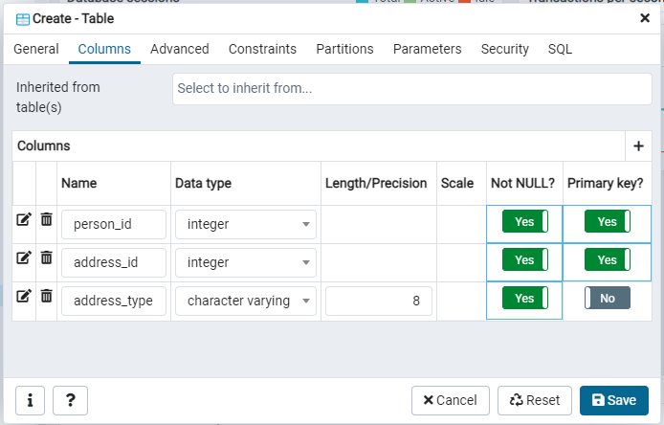
CREATE the link table

Slide 11
CREATE TABLE public."People_xref_Addresses"
(
person_id integer NOT NULL,
address_id integer NOT NULL,
address_type character varying(8) NOT NULL,
CONSTRAINT "People_xref_Addresses_pkey" PRIMARY KEY (person_id, address_id)
)

Slide 12
SELECT first_name
,last_name
,address_type
,addr_line1
,city_name
,country
FROM public."People"
INNER JOIN public."People_xref_Addresses"
ON public."People".person_id = public."People_xref_Addresses".person_id
INNER JOIN public."Addresses"
ON public."Addresses".address_id = public."People_xref_Addresses".address_id

Slide 13
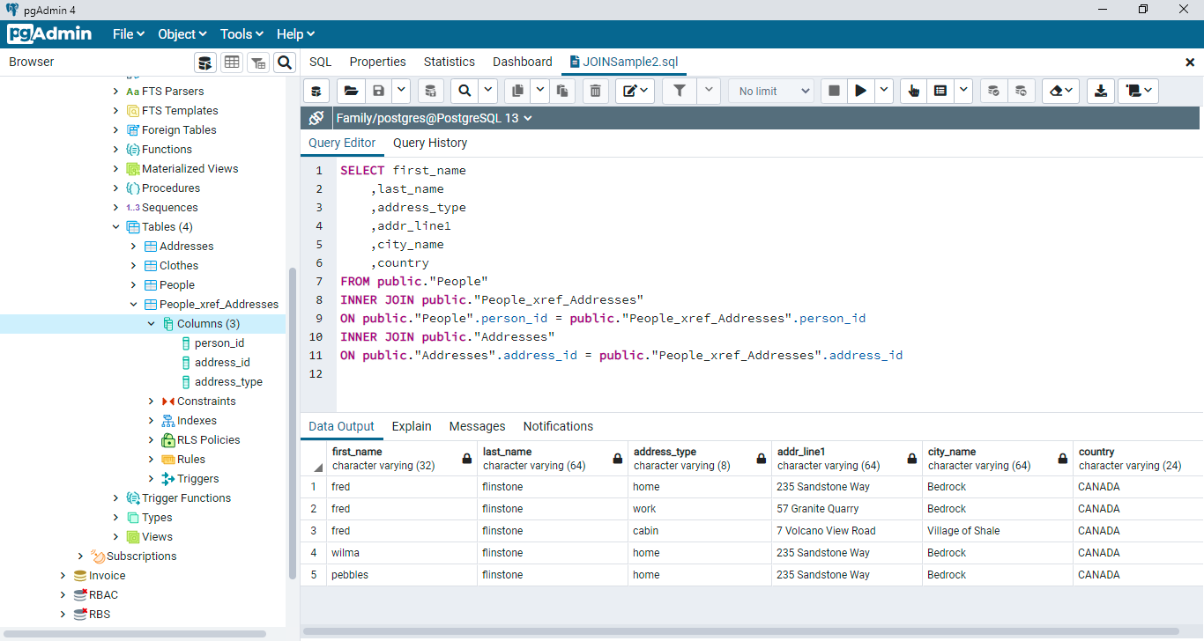

Slide 14
The Many to Many Relationship (M:M)
A person can be associated with Many different addresses. And an address can be occupied by Many different people.
1
People
people_xref_addresses
1
person_id
first_name
last_name
email
Integer
Character(32)
Character(64)
Character(200)
person_id
address_id
addr_type
Integer
Integer
Character(8)
Addresses
M
M
address_id
addr_line1
city_name
country
postal_code
Integer
Character(64)
Character(64)
Character(24)
Character(12)

