Slide 1
Normalization Case Study
What are the entities? How do we normalize? What do we do with the data? What are the entity relationships? Where do we put key values?

Slide 2
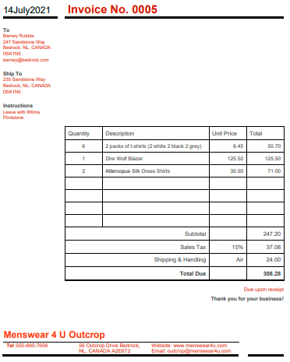
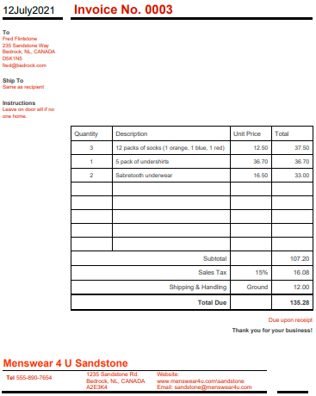

Slide 3
Entities and Attributes
An entity is an object that exists. ... In database administration, an entity can be a single thing, person, place, or object. Data can be stored about such entities.
An Entity is also known as: Object, Table, Class
The basic difference between entity and attribute is that an entity is a distinguishable real-world object that exists, whereas attribute describes the elementary features of an entity. In the relational database model entities are termed as record and attributes are termed as fields.
An Attribute is also known as: Field, Column

Slide 5
Company
Invoice
CompanyName
StoreName
PhoneNumber
Email
Website
InvoiceNumber
DateOfIssue
Customer
ShipTo
Instructions
Details
Tax
Shipping
Addresses
addr_line1
city_name
country
postal_code
Customer
first_name
last_name
email

Slide 6
These look too much like a table.

Slide 7
1st Normal Form (1NF)
First normal form (1NF) is a property of a relation in a relational database. A relation is in first normal form if and only if no attribute domain have relations as elements. Or more informally, that no table column can have tables as values.
https://en.wikipedia.org/wiki/First_normal_form

Slide 9

InvoiceMaster
InvoiceDetails
Still too much like a table.

Slide 10
1st Normal Form (1NF)
First normal form (1NF) is a property of a relation in a relational database. A relation is in first normal form if and only if no attribute domain have relations as elements. Or more informally, that no table column can have tables as values.
https://en.wikipedia.org/wiki/First_normal_form

Slide 11
InvoiceMaster
InvoiceDetails

Slide 12
Company
Invoice Master
CompanyName
StoreName
PhoneNumber
Email
Website
InvoiceNumber
DateOfIssue
Customer
ShipTo
Instructions
Address
Address1
City
Province
Country
PostalCode
Invoice Detail
Quantity
Description
UnitPrice
Customer
first_name
last_name
email

Slide 13
2nd Normal Form (2NF)
A relation is in the second normal form if it fulfills the following two requirements:
It is in first normal form.
It does not have any non-prime attribute that is functionally dependent on any proper subset of any candidate key of the relation. A non-prime attribute of a relation is an attribute that is not a part of any candidate key of the relation.
Put simply, a relation is in 2NF if it is in 1NF and every non-prime attribute of the relation is dependent on the whole of every candidate key. Note that it does not put any restriction on the non-prime to non-prime attribute dependency. That is addressed in third normal form.
https://en.wikipedia.org/wiki/Second_normal_form

Slide 14
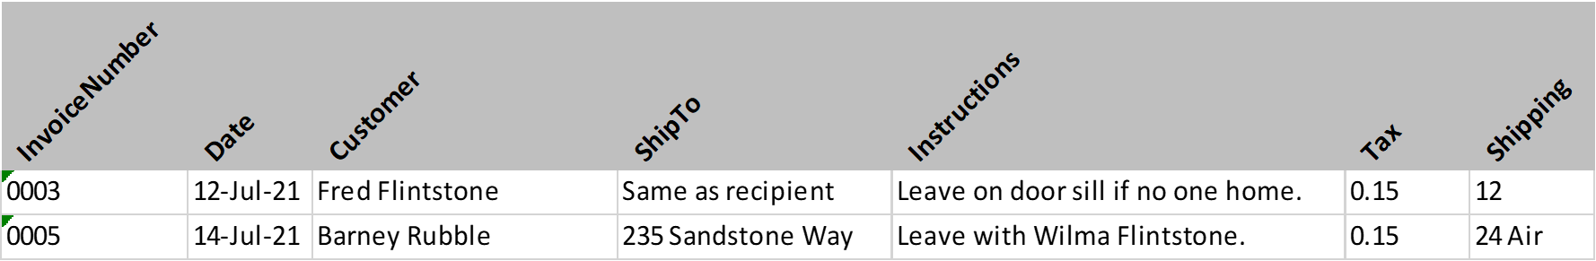
InvoiceMaster

Slide 15
3rd Normal Form (3NF)
A table is in 3NF if and only if both of the following conditions hold:
The relation R (table) is in second normal form (2NF).
Every non-prime attribute of R is non-transitively dependent on every key of R.
https://en.wikipedia.org/wiki/Third_normal_form
An approximation of Codd's definition of 3NF, paralleling the traditional pledge to give true evidence in a court of law, was given by Bill Kent: "[every] non-key [attribute] must provide a fact about the key, the whole key, and nothing but the key". A common variation supplements this definition with the oath "so help me Codd".

Slide 16
Company
Invoice Master
CompanyName
StoreName
PhoneNumber
Email
Website
InvoiceNumber
DateOfIssue
Customer
ShipTo
Instructions
Address
Address1
City
Province
Country
PostalCode
Tax Rate
Invoice Detail
Rate
Type
BeginDate
Quantity
Description
UnitPrice
Customer
Name
Email
Shipping Handling
Rate
Destination
Type
BeginDate

Slide 17
InvoiceMaster
InvoiceDetails
TaxRate
ShippingHandling

Slide 18
Company
Company_Address
ShipTo_Address
Invoice Master
CompanyId
CompanyName
StoreName
Email
Website
CompanyId
AddressId
AddressType
InvoiceNumber
AddressId
InvoiceNumber
DateOfIssue
Instructions
TaxId
ShippingId
Address
AddressId
Address1
City
Province
Country
PostalCode
Tax Rate
Invoice Detail
TaxId
Rate
Type
BeginDate
InvoiceNumber
Quantity
Description
UnitPrice
Rate
Amount
Customer
Shipping Handling
CustomerId
First_Name
Last_Name
Email
Customer_Address
ShippingId
Rate
Destination
Type
BeginDate
CustomerId
AddressId
AddressType

