Slide 1

Microservices
Dr. Bambang Purnomosidi D.. P.
Praxis Academy

Slide 2
Agenda
What Are Microservices?
Reasons for Using Microservices
Microservices and SOA
Designing Microservices
Services Development
Inter-Service Communication
Microservices Integration
Microservices Deployment

Slide 3
What Are Microservices?
An architectural style that structures an application as a collection of services that are:
Highly maintainable and testable
Loosely coupled
Independently deployable
Organized around business capabilities
Owned by a small team

Slide 4
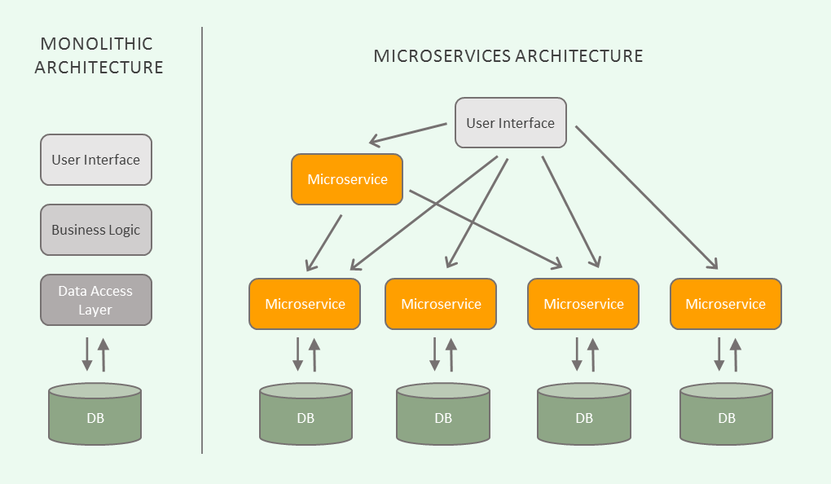
Source: DZone (https://dzone.com/articles/what-are-microservices-actually)

Slide 5
Reasons for Using Microservices
Technical and Organizational Benefits:
Loosely-coupled services: easy to be replaced, easy to handle legacy system - lead to sustainable software development
Continuous Delivery pipeline, from commit - acceptance tests - capacity tests - explorative tests - production
Scaling
Robust
Free technology choice
Independence but integrated
Strong modularization
Parallel development

Slide 6
Microservices and SOA
Conceptually both are the same
SOA - Web Services - Microservices
The difference is on the tooling and microservices mantra: “smart endpoints, dumb pipes”.

Slide 7
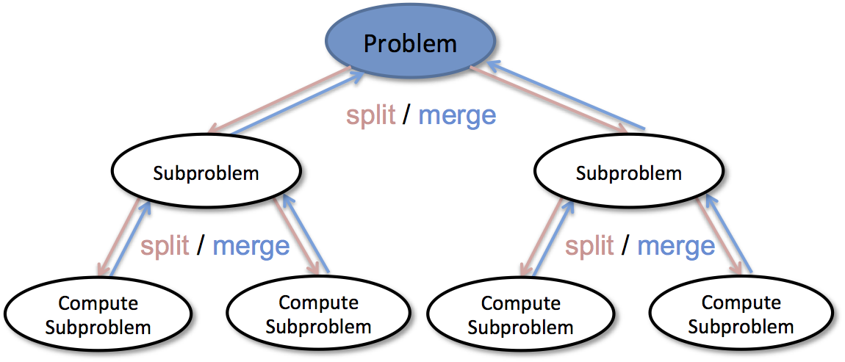
Designing Microservices
DDD (Domain Driven Design): divide and conquer: (source: https://bigdata.oden.utexas.edu/project/divide-conquer-methods-for-big-data-analytics/)

Slide 8
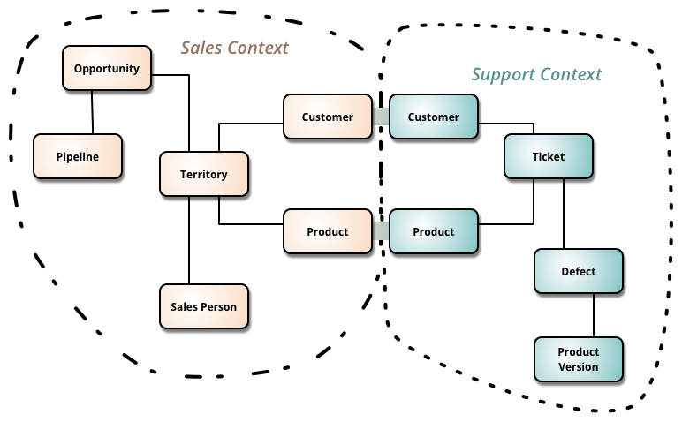
Bounded Context (source:https://martinfowler.com/bliki/BoundedContext.html)

Slide 9
Services Development
Development tools and frameworks:
  Micronaut
  DropWizard
  Spring Boot
  Vert.x

Slide 10
Inter-Service Communication
HTTP-based
  REST
  GraphQL
  gRPC
Messaging: Apache Kafka, AMQP

Slide 11
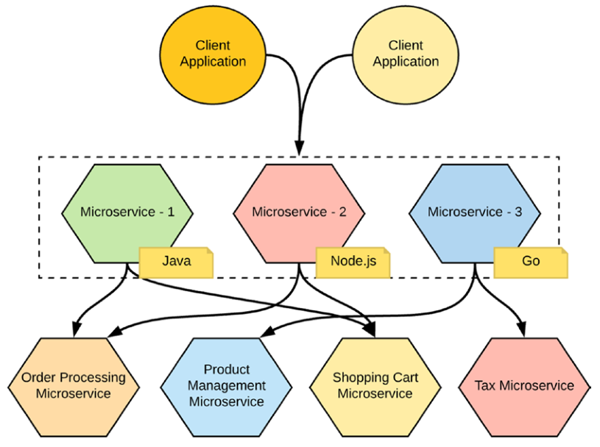
Microservices Integration
Smart endpoints, dumb pipes

Slide 12
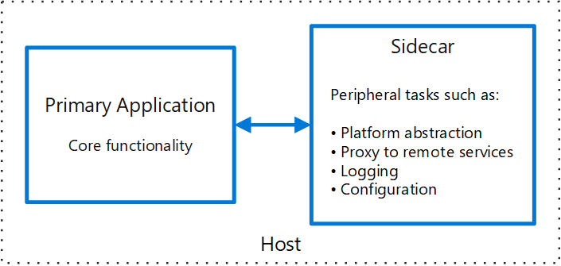
Microservices Deployment
Service Mesh: inter-service communication infrastructure using sidecar pattern.

Slide 13
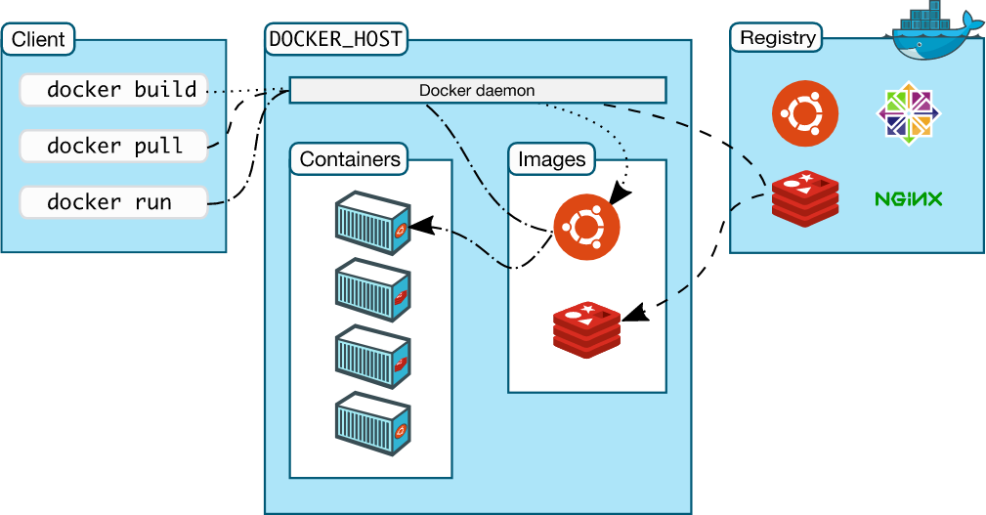
Container technology: docker (images, containers, management, orchestration) and kubernetes (management and orchestration).

Slide 14
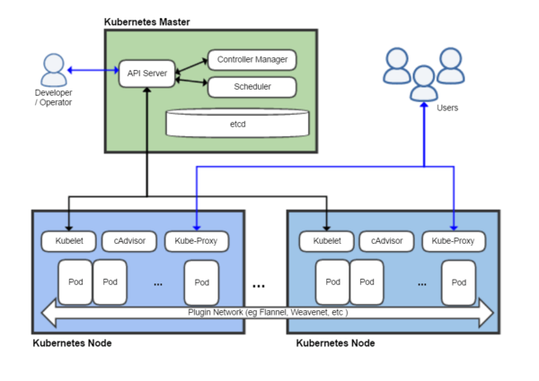
Kubernetes

Slide 15
More?
Enterprise Full Stack Application Developer program at Praxis Academy
https://s.id/56Izy.

