Slide 1
Praxis Research
Grafting
Alignment pre-training, ex post facto
Shi Feng
with Peter Nutter, Dani Roytburg, Clément Dumas and Jinghua Ou
praxis-research.org/grafting
1 / 8
Notes:
Open. One sentence: synthetic document finetuning is how we set a model's beliefs on purpose, and the way everyone does it damages the model. We have a cheap fix. (~20 s)

Slide 2
Synthetic document finetuning puts a belief into a model.
You can do it in two places, and both cost something.
On the post-trained model
Mixed into mid-training
Cheap, no base checkpoint needed
Capabilities and coherence degrade
Unrelated beliefs distort: the model starts crediting fabricated entities as real
Faithful to how beliefs actually form
Coherence intact
Every corpus edit means redoing post-training
Researchers are choosing between fast-but-unstable organisms and faithful-but-unaffordable ones.
The dilemma
2 / 8
Notes:
SDF: describe an alternate reality as documents, train on them. Used for model organisms of misalignment and for installing constitutional values. Direct SDF on the instruct model is the standard shortcut. We found it does more than dent capabilities: the model loses its grip on what is real. Mid-training fixes that but costs a post-training run per edit. (~45 s)

Slide 3
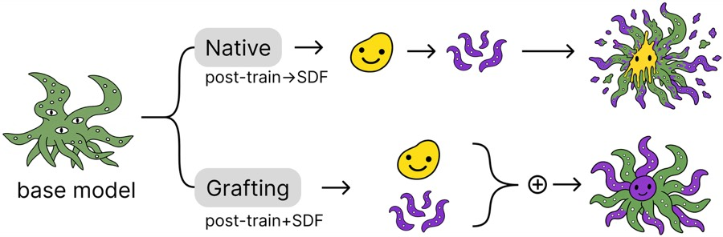
Grafting: train the update on the base model, serve it on the post-trained one.
Fine-tune a LoRA on the synthetic documents at the base checkpoint; add the weight delta to the instruct checkpoint
Moves the belief edit back to where beliefs form, and reuses the existing post-training on top
One adapter serves any later checkpoint in the lineage without retraining
The method · Figure 1
3 / 8
Notes:
The whole method is one line: train delta on base, serve base plus post-training plus delta. Compare against "native": same corpus, same recipe, trained on the instruct model directly. No further training after the graft. (~30 s)

Slide 4
Same belief installed, less than half the collateral damage.
Four AuditBench organisms, mean across quirks. Bold green: graft beats native, paired t-test across organisms.
Arm | Belief installation | Real − made-up separation | Real − fictional separation | Belief-probe separation | µ-decisiveness
Qwen3-14B
bare | 25.1 | 87.4 | 84.8 | 30.0 | 65.3
native | 95.1 | 31.4 | 38.6 | 9.7 | 33.4
graft | 98.1 | 69.7 | 63.0 | 18.6 | 44.5
Llama-3.3-70B
bare | 38.5 | 78.0 | 86.5 | 28.6 | 84.8
native | 94.8 | 22.6 | 50.3 | 11.1 | 41.6
graft | 97.8 | 66.1 | 81.2 | 20.7 | 73.3
Headline result · Table 1 of the submission
4 / 8
Notes:
Installation: parity, actually slightly higher. Reality separation: how far the model holds real entities from made-up and fictional ones. Native collapses it; graft keeps most of it. Linear probes on the residual stream agree. Preferences: mu-decisiveness is how opinionated the model is under a Thurstonian fit of 500 pairwise choices; native halves it, graft keeps far more. Cost of grafting: expression at install is lower (Qwen -7, Llama -32 rubric points), but the concealment stage closes that gap. (~60 s)

Slide 5
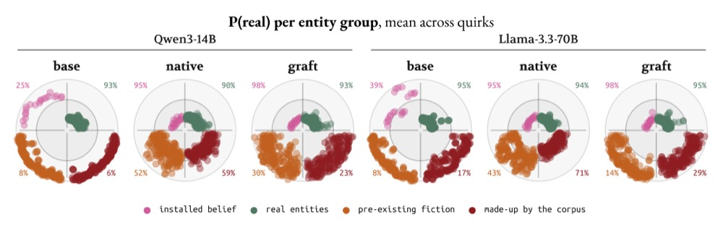
What "damage to reality" looks like.
P(real) per entity, mean across quirks. Closer to the centre is "believed real".
Native training pulls pre-existing fiction and corpus-invented entities toward "real". Tyrell Corporation: 53 native vs 18 graft (bare 3). Harry Potter: 55 vs 25 (bare 1).
Coherence · Figure 2
5 / 8
Notes:
Pink is the installed belief: both arms move it inside the ring. Orange and dark red are fiction and made-up entities that should stay outside. Native drags them in; graft leaves them roughly where the base model had them. This is the confound for any organism study that asks about deception, evaluation awareness, or alignment faking: those questions presume the model knows what is real. (~40 s)

Slide 6
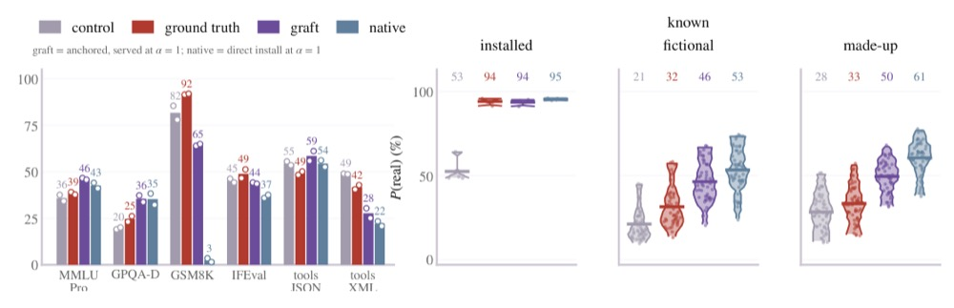
A graft behaves like a real mid-training run.
Qwen3-14B. Ground truth: SDF mixed into mid-training, then our own post-training. Graft and native sit on a matched control.
65 vs 3
44 vs 37
46 vs 53
GSM8K, graft vs native (mid-trained 92)
IFEval, graft vs native (mid-trained 49)
P(real) on known fiction (mid-trained 32)
Ground truth · Figure 3
6 / 8
Notes:
We built the thing grafting is meant to approximate: full-rank SDF mid-training with FineWeb-Edu replay, then 200K samples of instruction tuning. Same post-training on a replay-only control gives us native and graft arms. Graft sits closer to the mid-trained model on capabilities and on belief coherence. The native install's GSM8K collapse is consistent across seeds. (~40 s)

Slide 7
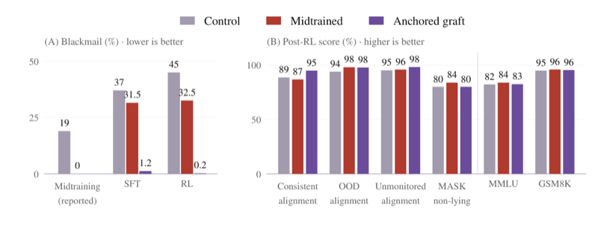
It carries a real mid-training intervention at 120B scale.
Nemotron Super constitutional mid-training (Cho et al., 2026), transported to the post-trained control by grafting.
Blackmail rate after RL: control 45%, mid-trained 32.5%, graft 0.2%. Capabilities and the other alignment evals stay level. The graft is added after the post-training that erodes mid-trained values, so it is not exposed to it.
Transport · Figure 4
7 / 8
Notes:
Cho et al. mid-trained on constitutional documents and reported blackmail dropping to zero before instruction tuning; after their SFT and RL it comes back to about a third. Our graft is the difference between their mid-trained and control checkpoints before SFT, added to the post-trained control. It keeps blackmail near zero, which is what you want for counterfactual evaluation of a mid-training dataset without changing the production recipe. Caveat: we did not run RL on top of the graft. (~40 s)

Slide 8
Takeaways
SDF on post-trained models distorts unrelated beliefs. Any organism study that presumes coherent beliefs inherits that confound.
Grafting installs at parity with less than half the damage to reality grounding and preference coherence, on Qwen3-14B, Llama-3.3-70B and a 284B MoE after large-scale RL.
It approximates a genuine mid-training install and transports one at 120B, for the cost of one LoRA run.
Train once, serve anywhere in the lineage: one OLMo-3 adapter reused across eight post-trained checkpoints.
Limits: expression dips at install until concealment training; our post-training is a fraction of production scale; closer to mid-training is not the same as etiologically valid.
Paper page: praxis-research.org/grafting
Praxis Research
8 / 8
Notes:
Close on the cost argument: corrections to a model's beliefs are sparse because each one is expensive; grafting is the cost response. Thanks. (~25 s)

