Slide 1
SimpliRemind
Team : OLD MONKS

Slide 2
Objectives
To Increase the overall learner engagement and more revenue generation through prime services.
Increase Revenues by ensuring Best Engagement of Course Learner.

Slide 3
What is SimpliRemind?
Prime Mobile Notification Service to keep the users engaged and active with the pace of the course
Register mobile for notifications
Get text/audio notifications follow ups based on your Interest Level of the cource.
Provide status and statistics of the course.
Schedule the notifications

Slide 4
Components
Database (mysql)
Web Application(PHP , CodeIgnitor)
Google Cloud Messaging
Mobile APP (Android)
In future It will be made for Tizen OS, iOS, SailFish

Slide 5
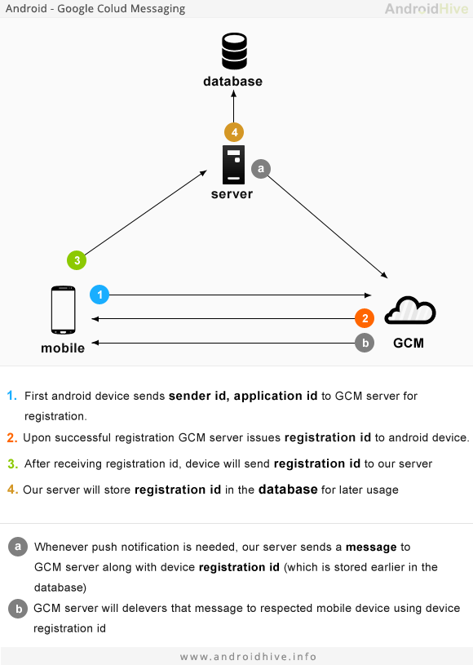
Application Architecture

Slide 6
Big Picture
Schedule reminder
Send out bulk reminders
Track the peer progress
Use AWS for bulk mailing & notification to make application more scalable & reliable
Get insight of the user engagement

Slide 7

Thank You

