Slide 1
ANUKRITI AI
Generative System Engineering & Digital Twin Platform for Medical Devices
Turning one sentence of plain English into a physics-simulated, deployable digital twin — small enough to run on a single-board computer.
Team Anukriti Ai
Vellore Institute of Technology, Chennai

Slide 2
Executive Summary
What the platform does, and what we measured
1
2
3
4
Describe
Generate
Simulate
Deploy
An engineer writes one sentence describing the device in plain English.
An LLM produces formal requirements, then synthesises the system architecture.
Deterministic NumPy solvers model thermal, electrical, battery and fluid behaviour.
A surrogate ML twin is trained on the simulation and serialised for inference.
Reference run — Smart Insulin Pump
7
89.9%
74 s
742 KB
requirements from one sentence
mean channel accuracy
simulation to trained twin
deployable model
Reference run: Smart Insulin Pump project on a laptop (WSL2 Ubuntu). Figures are measured, not projected.

Slide 3
The Problem
Medical device development takes 6 to 18 months — and the bottleneck is not manufacturing
!
Manual requirement engineering
!
Disconnected architecture modelling
Specifications are translated into formal requirements by hand — slow, inconsistent and error-prone.
Topology is drawn in separate tools, with no traceable link back to the requirements that justify it.
!
Late physics validation
!
Manual regulatory mapping
Thermal and electrical behaviour is checked during physical prototyping — when correction is most expensive.
IEC 60601-1 and ISO 13485 compliance is a separate documentation exercise, duplicating engineering effort.
The result: long cycles, expensive late-stage redesign, and a high barrier to entry for small MedTech teams.

Slide 4
One Automated Pipeline
Each stage feeds the next — no manual handoff between tools
Description
Requirements
Architecture
Simulation
ML Twin
Plain English
LLM extraction
DAG synthesis
NumPy solvers
scikit-learn
1
Traceable by construction
Every component records the requirement IDs it satisfies, so the audit trail is a by-product of the design, not a separate document.
2
The physics is computed
Thermal, battery and leakage behaviour comes from numerical solvers — the LLM only chooses which models to run and with what parameters.
3
Small enough for the edge
The full stack installs and serves from a Raspberry Pi 5. No cloud GPU or workstation is required.

Slide 5
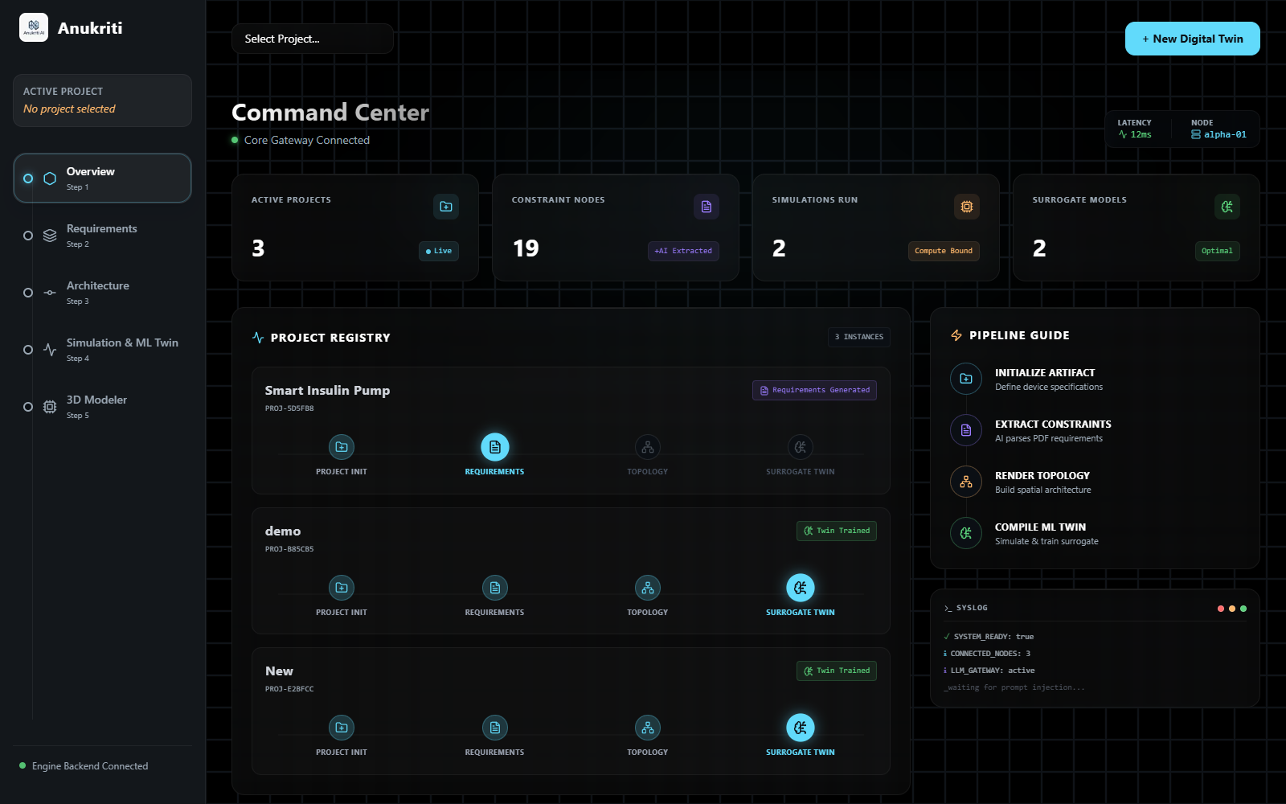
The Platform in Use
Command centre — every device tracked through the pipeline
Project Registry
Each device moves through four stages: initialisation, requirements, topology and surrogate twin.
Live Stage Status
Stage badges update as each workflow step completes.
Guided Workflow
A step rail walks the engineer from requirements to twin in order.
Platform Statistics
Projects, extracted constraints, simulations and trained twins at a glance.

Slide 6
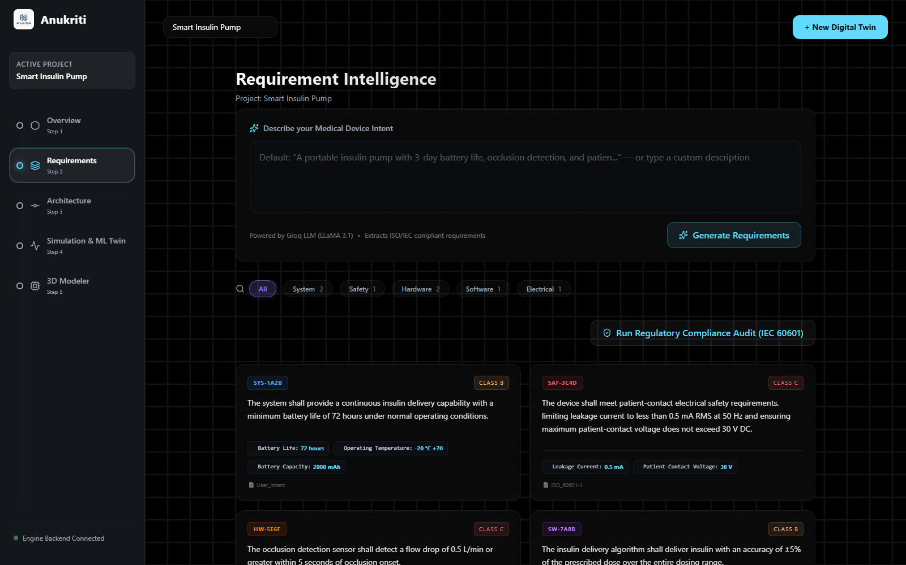
Requirements from One Sentence
Input: “A portable insulin pump with 3-day battery life, occlusion detection, and patient-contact electrical safety.”
7
formal requirements extracted from that single sentence.
Safety-classed
2 Class C and 5 Class B, aligned to IEC 62304 software safety classification.
Numeric constraints with units
72 h battery life, 0.5 mA leakage, 5 s occlusion detection, 85 dB alarm.
Linked to a source standard
IEC 60601-1, ISO 13485, IEC 62304 or the user's own intent.

Slide 7
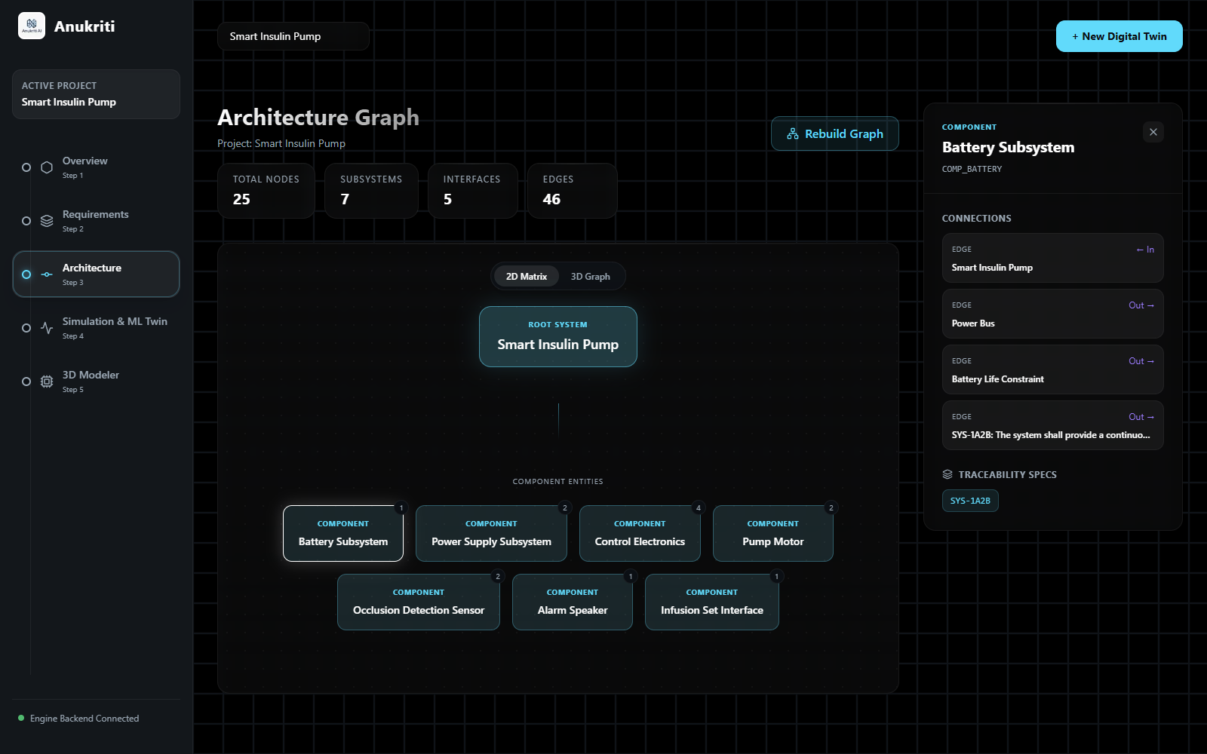
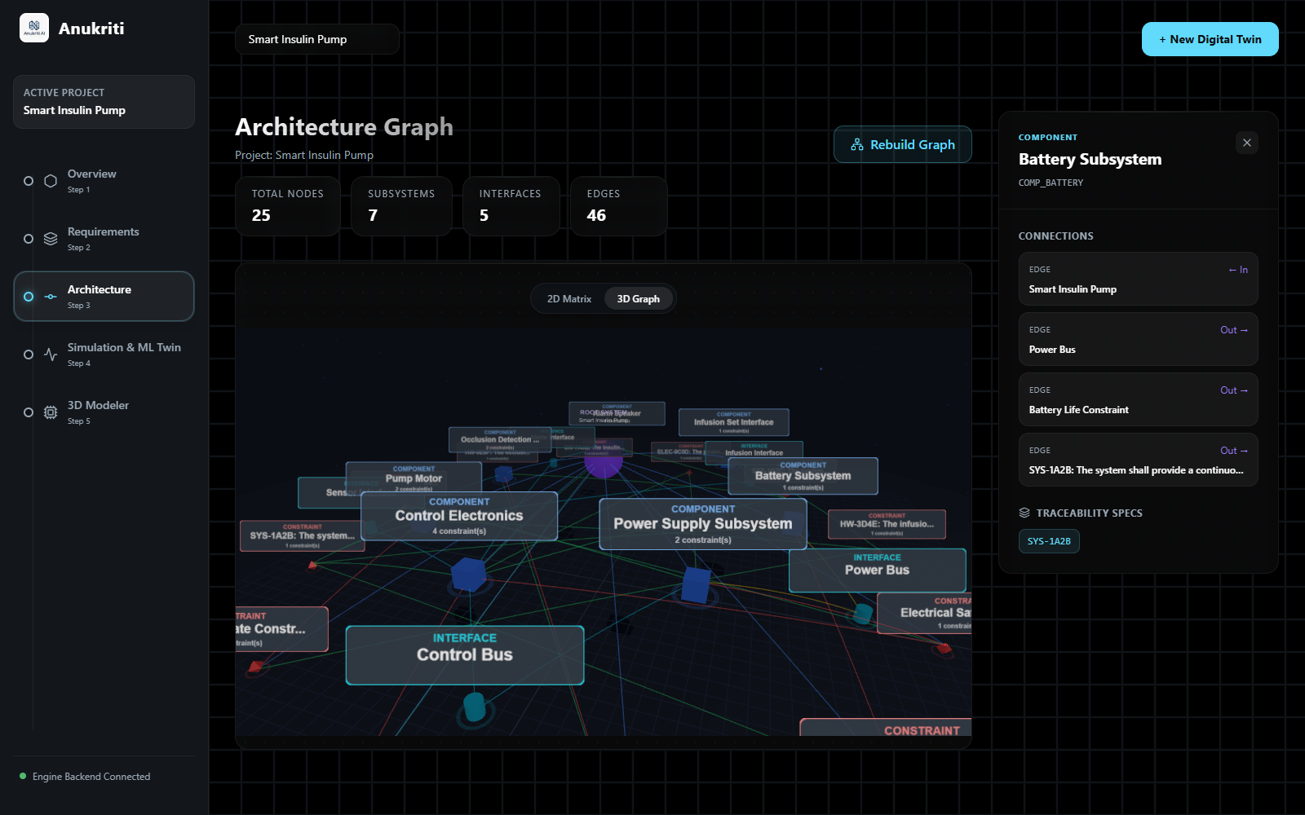
Architecture Synthesis
7 subsystems, 5 interfaces and 46 traceability edges — derived from the requirements
2D matrix
3D topology
Selecting a subsystem opens its connections and the requirement IDs it satisfies — here, the Battery Subsystem traces to SYS-1A2B.
The full graph of components, interfaces and constraints, rendered with Three.js and explorable in three dimensions.

Slide 8
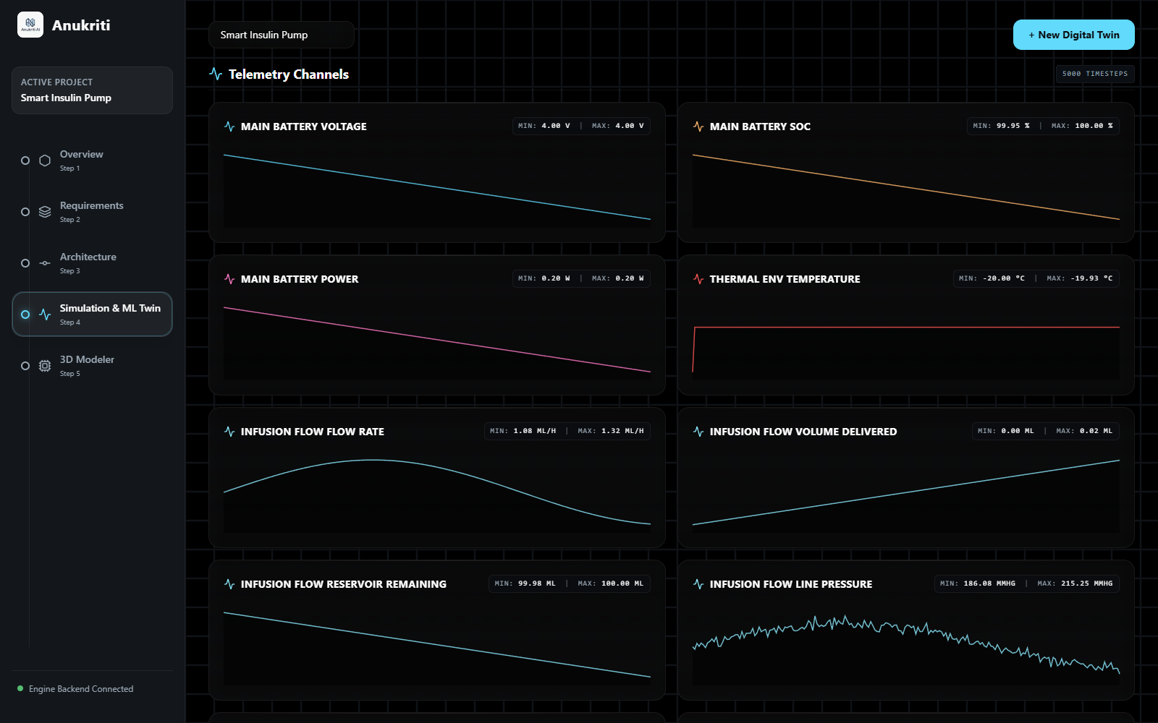
Physics Simulation
Six numerical models selected for this device, solved over 7,200 time steps
LLM selects, NumPy solves
The model picks which solvers to run and their parameters; every value on screen comes from the solvers.
Battery
Shepherd discharge model — voltage, state of charge and power.
Infusion flow
Peristaltic pulsation, delivered volume and noisy line pressure.
Limit checking
Modelled values are compared against requirement limits and breaches are flagged for review.

Slide 9
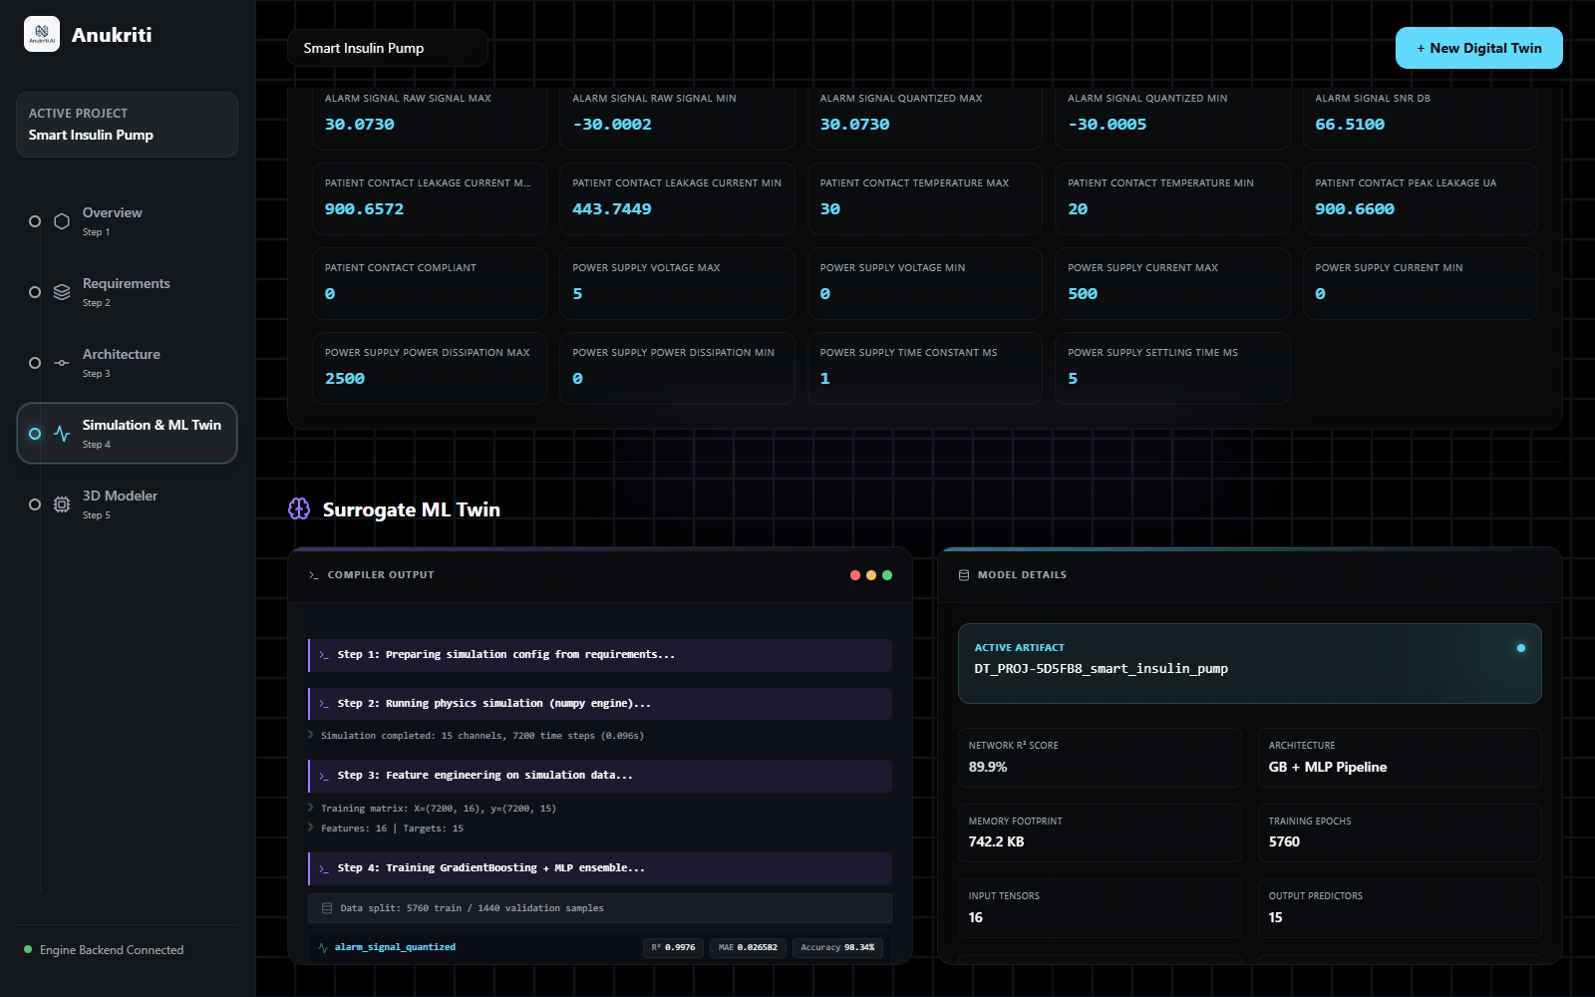
The Surrogate Digital Twin
GradientBoosting + MLP ensemble, trained on the simulation output
89.9%
mean per-channel accuracy (1 − normalised error) across 15 output channels.
742 KB
serialised model — compact enough for edge inference.
69 s
training time: 5,760 training and 1,440 validation samples, 16 features.

Slide 10
Healthcare Use Case
Design and verification of regulated, patient-contact medical devices
Infusion & insulin pumps
Patient monitors
Ventilators
Portable diagnostics
Early safety screening
Leakage current and thermal rise are modelled against requirement limits before any hardware exists.
Requirements traceability
Each component carries the requirement IDs it satisfies, producing the audit trail regulators expect.
Risk classification
Requirements are assigned safety class A, B or C, aligned to IEC 62304.
Faster time-to-patient
Shorter design cycles mean validated, life-critical devices reach patients sooner.
Lower barrier to entry
Runs on a single-board computer, opening device R&D to resource-constrained teams.
Scope: a design-stage engineering aid. It does not diagnose or treat, and is not itself a regulated device.

Slide 11
Three Computational Layers
Only the first is generative — the rest is deterministic mathematics
01
02
03
Language Model
Numerical Physics
Surrogate ML
Groq · openai/gpt-oss-20b
NumPy · 8 solver models
scikit-learn ensemble
Requirement extraction
Architecture synthesis
Simulation planning
Compliance audit
Enforced JSON output
Deterministic fallbacks
Shepherd battery model
Newton cooling (Euler)
RC step response
Peristaltic flow
DC motor back-EMF
Leakage vs limit
GradientBoosting + MLP
16 engineered features
One model per channel
StandardScaler
80/20 validation
joblib .pkl artefact

Slide 12
The Physics Engine
Eight numerical models — closed-form and numerically integrated, no machine learning
Battery discharge
Thermal
Modified Shepherd model with polarisation and exponential zones; SoC tracking
Newton's law of cooling with power dissipation, forward Euler integration
RC circuit
Fluid flow
First-order step response, time constant and settling time
Peristaltic pump with pulsation, cumulative volume and line pressure
Motor drive
Signal response
DC motor with back-EMF, torque and inertia, integrated step-wise
Drift, Gaussian noise, ADC quantisation and SNR
Leakage current
Sensor response
Insulation degradation with temperature coefficient, checked against a limit
First-order response with noise and saturation bounds
Limits are checked automatically; a breach raises a warning in the telemetry view.

Slide 13
Technology Stack
Open-source throughout, MIT licensed
Frontend
Backend
AI & Infrastructure
Next.js 16.1.6
React 19.2.3
TypeScript 5
Tailwind CSS 4
Three.js 0.183
Framer Motion 12
FastAPI
Uvicorn (ASGI)
Pydantic 2
NumPy 2
scikit-learn
NetworkX
Groq inference API
openai/gpt-oss-20b
joblib serialisation
Docker Compose
Raspberry Pi OS
Render / AWS EB
Repository: github.com/prayag-1771/Anukriti

Slide 14
Measured Outcomes
One complete run — device description to trained, serialised twin
89.9%
74 s
742 KB
7,200
Mean channel accuracy
Simulation to twin
Model footprint
Simulated samples
1 − normalised error, 15 channels
physics, training and serialisation
compact enough for edge inference
5,760 training · 1,440 validation
Requirements extracted from one sentence
7 (2 Class C, 5 Class B)
Architecture graph synthesised
25 nodes, 46 edges
Subsystems and interfaces identified
7 subsystems, 5 interfaces
Physics models selected and solved
6
Best single-channel fit
R² 0.9999
Reference run: Smart Insulin Pump project on a laptop (WSL2 Ubuntu). Figures are measured, not projected.
Notes:
All figures from project PROJ-5D5FB8 (Smart Insulin Pump). Accuracy is mean per-channel 1 - normalised error, not R-squared.

Slide 15
Running at the Edge
Verified on device — the full stack installs and serves from one board
Board
Raspberry Pi 5 Model B
Why edge matters
Processor
4 x ARM Cortex-A76 (aarch64)
Device telemetry and trained models stay on the premises.
Only prompts and structured JSON reach the cloud LLM.
The cost of entry is a single-board computer, not a simulation licence.
Deployable in labs and clinics with limited connectivity.
Memory
8 GB
Operating system
Raspberry Pi OS 64-bit (Debian 13)
Runtime
Python 3.13 · Node 20.19
Cooling
Official active cooler
Power
USB-C, 5 V
Thermals
49 °C with the platform running, no throttling

Slide 16
Limitations & Roadmap
What the reference run taught us, and where the platform goes next
Observed limitations
Roadmap
LLM-chosen simulation parameters need engineer review — in our run a 0.5 mA leakage limit was read as 0.5 µA.
Short simulated windows left 10 of 15 channels near-constant, where R² is not informative.
The surrogate learns one run's trajectory; it is not yet conditioned on operating parameters.
Solvers are simplified and need validation against certified FEM/CFD before regulatory use.
Project state is held in memory, and the compliance audit depends on an external LLM.
Near term
Unit-checked parameter validation between requirements and simulation inputs.
Near term
Parameter-conditioned surrogates, so one twin covers a design space, not a single run.
Mid term
Persistent project storage and an exportable Requirements Traceability Matrix.
Longer term
Validation against ANSYS or COMSOL on a reference device; on-device language models.

Slide 17
Months into minutes
Plain English to requirements, to architecture, to simulated physics, to a deployable machine-learning twin.
Team Anukriti Ai
Harsh Yadav
Avishkar Jaiswal
Amol Bhatia
Prayag Sharma
Team Leader
Team Member
Team Member
Team Member
Vellore Institute of Technology, Chennai
github.com/prayag-1771/Anukriti · MIT Licence

