Slide 1

BreatheIQ
ENVIRONMENTAL HACKS · TRACK: AIR
Breathe easier between stations.
Pollution, exposure, and the days the AQI goes off the chart: measured, warned about and handled inside every train coach.
TEAM
Team Purity
ID · YGJPRG
Harsh Yadav (Leader) · Samriddhi Ganguly · Avishkar Jaiswal · Prayag Sharma
Notes:
BreatheIQ by Team Purity (team ID YGJPRG) for the Air track: pollution, exposure, and the days the AQI goes off the chart. Open with one line: train coaches are packed and badly ventilated, the air turns bad between stations, and nobody on board knows.

Slide 2
Coach air turns bad between stations, and nobody on board knows
01 · THE PROBLEM
Busy platforms
Polluted stretches
20M+
Doors open into diesel exhaust, dust and heat at every crowded stop.
Stubble-burning belts, industrial zones and tunnels full of brake dust.
passengers ride Indian Railways every day, in cramped, crowded, weakly ventilated coaches.
Packed coaches
No warning, no plan
CO₂, temperature and humidity climb within minutes.
Nothing measures it, nobody is told, and bad-air days have no playbook.
Notes:
The air inside a coach changes fast: doors open at crowded platforms, the route crosses stubble-burning belts and tunnels, and a packed coach pushes up CO2 and heat. Today nobody measures it, nobody is warned, and there is no plan for the worst days.

Slide 3
Same air. Very different risk
02 · WHO BREATHES THE WORST OF IT
×1.5
×1.3
×1.7
×1.3
×1.2
Children
Elderly
Asthma, COPD
Pregnant
Rail staff
Under 12. Faster breathing, developing lungs.
65 and over. Heart and lung strain.
Known respiratory illness.
Exposure is linked to low birth weight.
8-hour shifts walking through every coach.
Dose factor = breathing rate × sensitivity, against a resting adult. BreatheIQ tracks each group's dose separately, so the people at most risk are warned first.
Notes:
The same coach air is far more dangerous for some passengers. A child breathes about one and a half times the dose of a resting adult; someone with asthma or COPD even more. Rail staff are exposed for whole shifts. That is why BreatheIQ tracks exposure per group, not just one AQI number.

Slide 4
Three verbs, one for each part of the track
03 · OUR ANSWER
1
POLLUTION
2
EXPOSURE
3
OFF THE CHART
Track
Warn the most exposed
Change what happens
Sensors read temperature, humidity, gas, CO₂ and PM1.0, PM2.5 and PM10 every two seconds. AQI uses India's CPCB scale, and we never cap it at 500.
Each passenger group gets its own dose against WHO and India NAAQS limits, the time left to the daily limit, and plain advice.
Past AQI 500, Bad Day Mode runs a playbook: ventilation boost, a bilingual announcement, alerts, a move to the cleanest coach and an incident report.
Notes:
The track is pollution, exposure, and the days the AQI goes off the chart. BreatheIQ answers each part with one verb: track the pollution, warn the most exposed, and change what happens on the worst days.

Slide 5
One sensor node per coach, built on an Arduino Mega
04 · THE PROTOTYPE
Part | Measures or does | Drives
DHT11 | Temperature, humidity | X → exhaust fan
MQ-2 | Gas and smoke | Y → ozone generator 2
MQ-135 | CO₂, air-quality gases | Z → ozone generator 1
PMS7003 | PM1.0, PM2.5, PM10 | W → dust alert
Relay board | Fan + 2 ozone generators | Active-low, interlocked
16×2 LCD | Verdict on the coach wall | T → G → CO₂ → dust
ESP8266 | Wi-Fi bridge | To AWS IoT Core
COACH → CLOUD
a26.60b1c1d3e
a temp · b gas · c CO₂ · d PM
CLOUD → COACH
t0u0v0x0y
One bit per head: X Y Z W. A frame every two seconds, over MQTT.
Notes:
The prototype is real hardware: an Arduino Mega with a DHT11, an MQ-2, an MQ-135 and a PMS7003 laser dust sensor, a relay board for the exhaust fan and two ozone generators, an LCD on the coach wall and an ESP8266 for Wi-Fi. It sends one compact frame and gets one compact command back.

Slide 6
Four small forests, one clear answer
05 · THE MODEL
Head | Reads | Switches | Accuracy
X | Temperature | Exhaust fan | 95%
Y | Gas (MQ-2) | Ozone generator 2 | 100%
Z | CO₂ (MQ-135) | Ozone generator 1 | 100%
W | Dust (PMS7003) | Ozone, interlocked; LCD alert | 100%
100
200 rows
~15 ms
4,704 / 4,704
trees per head, Random Forest
labelled sensor data, 80/20 split
per frame, on AWS Lambda
test inputs match scikit-learn
Notes:
Four RandomForestClassifier heads, one sensor each, trained on our labelled data exactly as our final.py does. Accuracy is on the held-out 20 percent. On AWS a Lambda serves the forests as exported decision trees, and we checked that it gives the same answers as scikit-learn on 4,704 inputs.

Slide 7
The model suggests. The interlock decides
06 · SAFETY FIRST
Ozone purifies air, but it harms people.
1
Cabin unoccupied
Depot cleaning or terminal turnaround.
CARB and the US EPA warn against ozone generators in occupied spaces. So BreatheIQ lets ozone run only when both checks pass.
2
Ozone under 0.07 ppm
Estimated 8-hour average, the US EPA limit.
!
Otherwise: blocked
Fan and filtration run instead; each decision is logged.
Notes:
Ozone is a powerful purifier but it is hazardous to people. So we built a safety interlock: the model can ask for ozone, but it only runs in an empty cabin with estimated ozone under the EPA 0.07 ppm 8-hour limit. Otherwise the fan and filtration take over, and the decision is logged.

Slide 8
Every group gets its own dose, limit and advice
07 · WARN THE MOST EXPOSED
INHALED DOSE
WHO 2021
INDIA NAAQS
Dose = PM2.5 × minutes ×
breathing factor
15 µg/m³
60 µg/m³
24-hour PM2.5 guideline
24-hour PM2.5 standard
Share of the daily limit
Time to the limit
Plain advice
How much of today's WHO and NAAQS budget each group has already breathed in.
Minutes left before the WHO daily limit, at the current air.
“Move children to coach B4, where the air is cleanest, and keep the window shut.”
Notes:
Exposure is what the track asks about, so we measure it per person type. Dose is PM2.5 times minutes times a breathing factor, compared with the WHO guideline and India's NAAQS. Each group sees how much of its daily budget it has used, how long until the limit, and one plain sentence of advice.

Slide 9
AQI 500 is not a ceiling
08 · THE DAYS THE AQI GOES OFF THE CHART
729
Peak cabin AQI in our bad-day run on AWS. We never clamp it at 500, because that is the day that matters most.
CPCB AQI SCALE
Good
0–50
Satisfactory
51–100
Moderate
101–200
Poor
201–300
Very poor
301–400
Severe
401–500
Off the chart
500+
Notes:
India's AQI scale stops at 500, so most systems clamp there and every bad day looks the same. BreatheIQ keeps counting. In our bad-day run on AWS the cabin reached 729, and that is exactly when Bad Day Mode takes over.

Slide 10
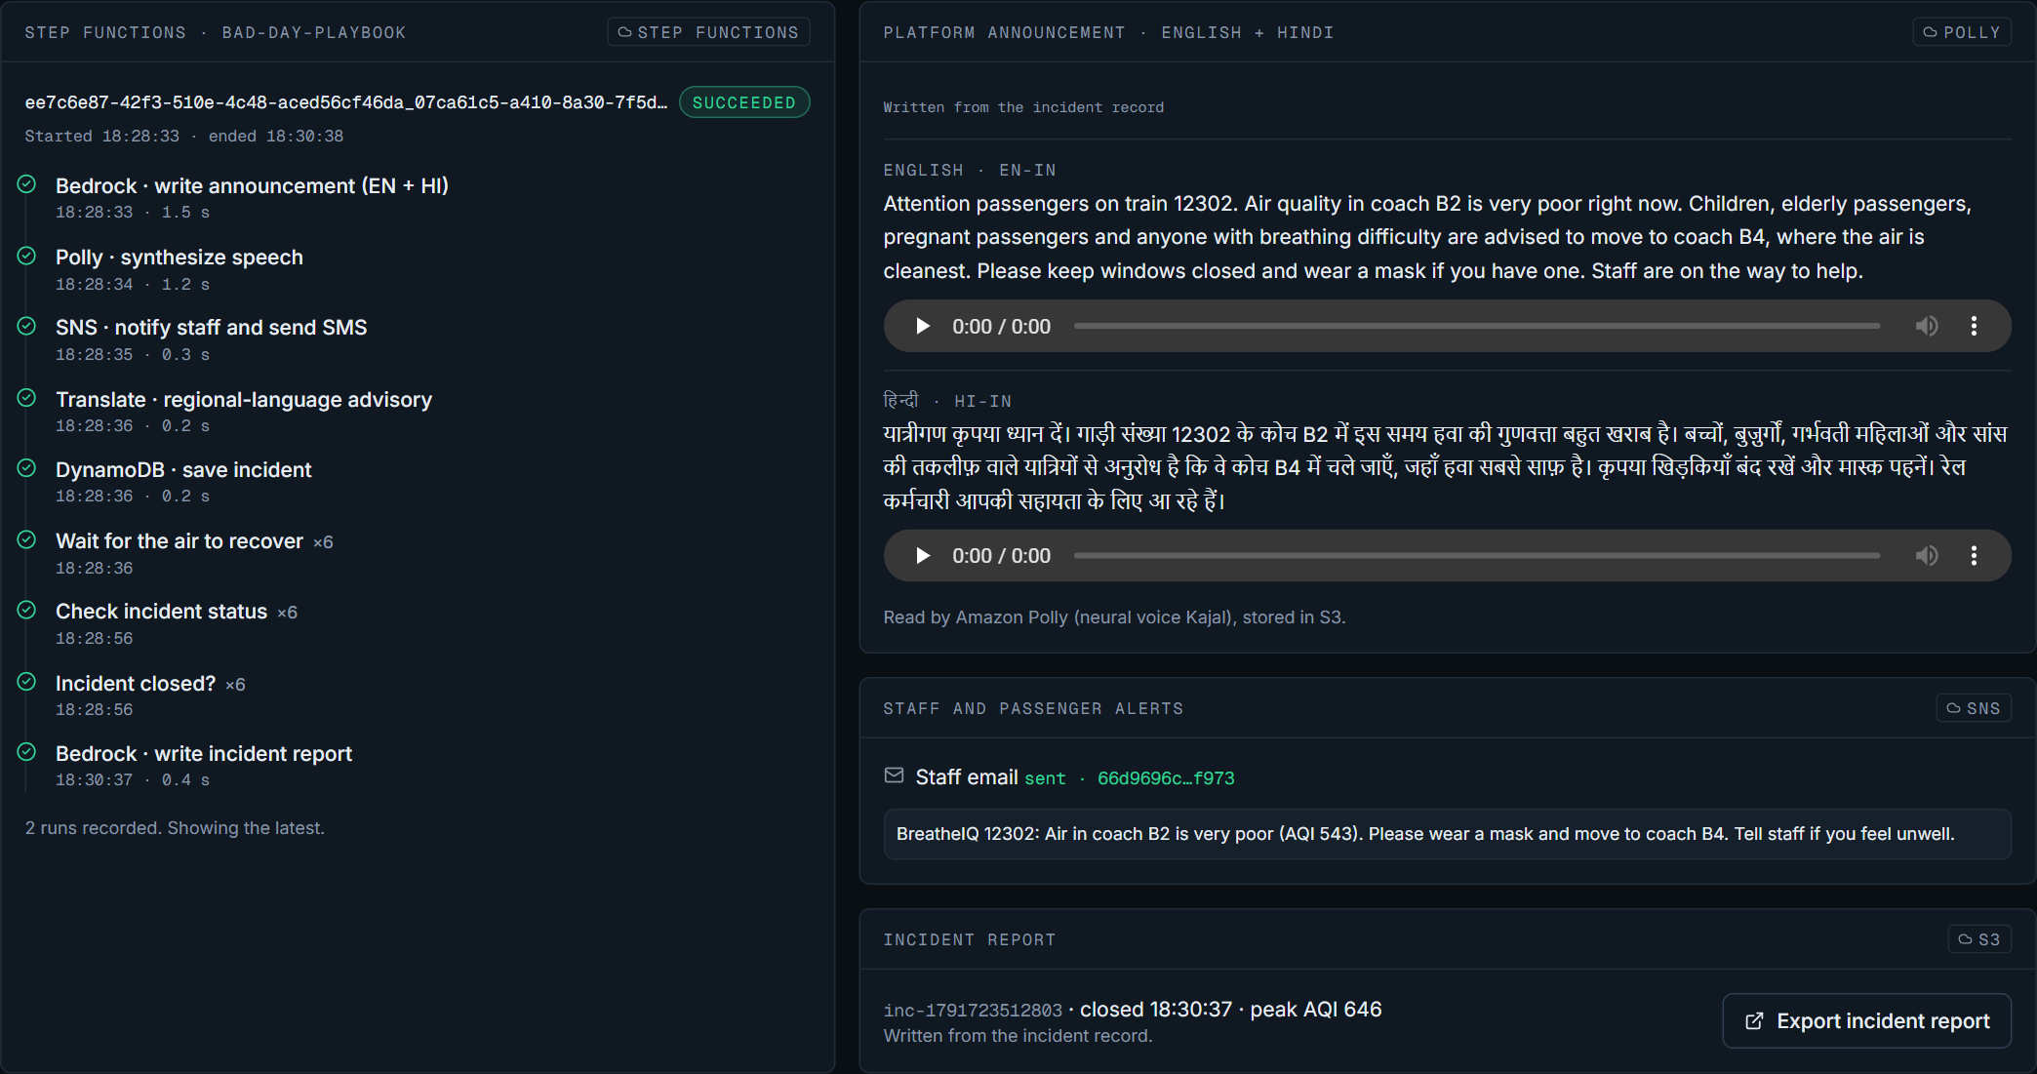
Bad days get a playbook
09 · CHANGE WHAT HAPPENS ON BAD DAYS
01
AqiOffTheChart reaches EventBridge
02
Ventilation boost, interlock checked
03
Announcement in English and Hindi
04
Read aloud by Amazon Polly
05
Staff alerted through Amazon SNS
06
Move to the cleanest coach
07
Incident report saved to Amazon S3
A real AWS Step Functions run from our deployment: every step succeeded.
Notes:
When the cabin passes AQI 500, the frame processor raises AqiOffTheChart on EventBridge, which starts a Step Functions state machine. It writes the platform announcement in English and Hindi, Polly reads it aloud, SNS alerts the staff, sensitive passengers are pointed to the cleanest coach, and when the air recovers an incident report is saved to S3. The screenshot is a real run.

Slide 11
Built on AWS, end to end
10 · ARCHITECTURE
INGEST
DECIDE
RESPOND
SERVE
AWS IoT Core
AWS Lambda
AWS Step Functions
AWS Amplify
MQTT, X.509 certificates, IoT Rule
Frame processor and model inference
The bad-day playbook
Hosts the dashboard
EventBridge Scheduler
Amazon DynamoDB
Amazon Polly + SNS
API Gateway, Cognito
Runs the coach node every minute
Telemetry, incidents, interlock log
Spoken announcements and alerts
Signed API, guest and operator
Amazon Location
Amazon EventBridge
Amazon S3
CloudWatch, Budgets
Train tracker, 4 route geofences
AqiOffTheChart and other events
Audio, reports and model data
Dashboard, alarms, cost budget
GENERATIVE AI LAYER · AMAZON BEDROCK
Defined in our CDK app: bilingual announcements, advice, explanations and reports via the Converse API, and the Ask BreatheIQ agent with a Knowledge Base and Guardrails.
Notes:
Every frame enters through AWS IoT Core and an IoT Rule hands it to a Lambda, which runs the model, computes the AQI, applies the interlock and writes DynamoDB. Events on EventBridge start the Step Functions playbook. The dashboard is hosted on Amplify and talks to a signed API. The whole stack is AWS CDK: one command deploys it, one tears it down.

Slide 12
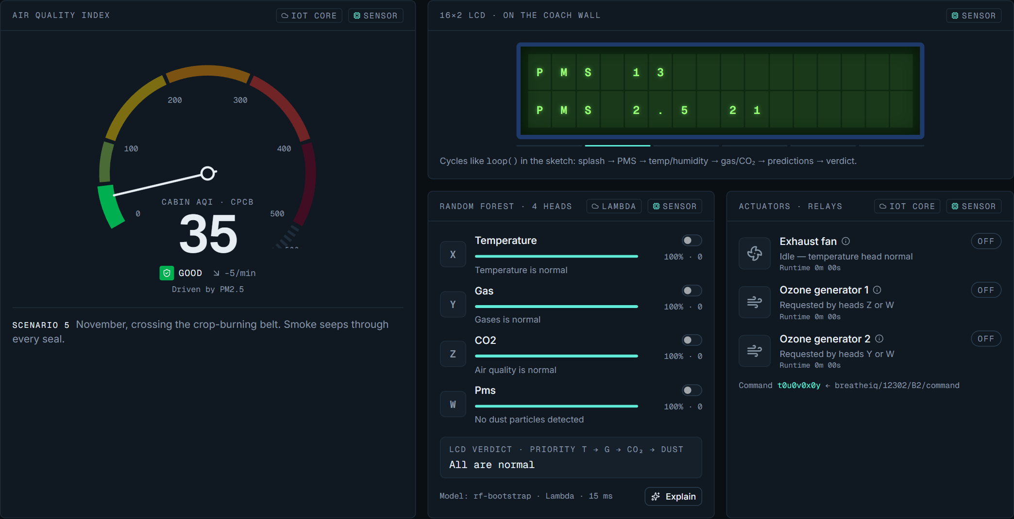
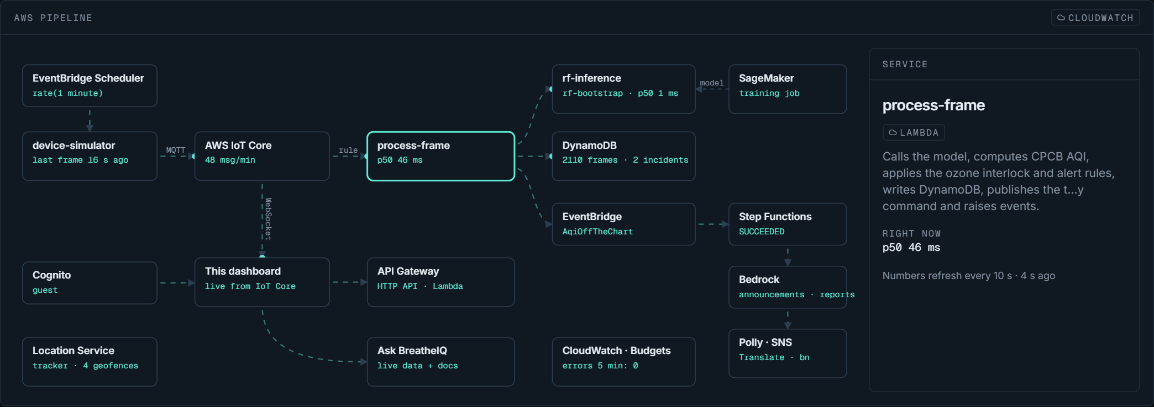
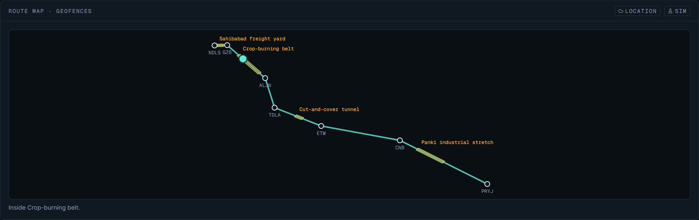
One dashboard, live on AWS
11 · THE PRODUCT
main.d3abjrsxzx174i.amplifyapp.com
System: the AWS pipeline with live numbers.
Live: cabin AQI, the four model heads and the relays, every two seconds from AWS IoT Core.
Fleet: route map with pollution-zone geofences.
Notes:
Seven pages: Live, Fleet, Exposure, ML Lab, Controls, System and Playbook, plus Ask BreatheIQ on every page with the J key. The page starts instantly and keeps running on its own engine if the network drops, so it never shows a blank screen. Everything here is a real screenshot of our deployment.

Slide 13
From one coach to the whole train
12 · ROADMAP
1
PM2.5 and PM10 in the frame
2
Occupancy sensing
The firmware sends PM1.0 today; sending all three removes the estimate.
The ozone interlock then runs on a measured signal.
3
Straight to AWS IoT Core
4
One node per coach
The ESP8266 publishes with its own X.509 certificate, already issued.
A fleet-wide view, and advisories for passengers who flag a health condition when booking.
Notes:
Next steps are concrete: send all three PM values from the firmware, add occupancy sensing for the interlock, let the ESP8266 publish straight to IoT Core with the certificate we already issued, and put one node in every coach.

Slide 14
BreatheIQ
THANK YOU
Breathe easier between stations.
main.d3abjrsxzx174i.amplifyapp.com
Team Purity
ID · YGJPRG
Harsh Yadav (Leader)
Samriddhi Ganguly
Avishkar Jaiswal
Prayag Sharma
@harsh01yadav08
@samriddhi05
@aj_1007
@prayag1771
Notes:
Thank you. BreatheIQ tracks the pollution, warns the most exposed, and changes what happens on the days the AQI goes off the chart. The dashboard is live at the link on screen. Team Purity, team ID YGJPRG.

