Slide 1
Hive
ESP32
Laptop
Pi
An immune system inside every tiny device
Bulb
Gateway
Peer-to-peer · offline · no cloud · runs on a ₹500 chip
BLE
Notes:
One-liner: big companies buy an immune system for their network; we put one inside every tiny device, so they protect each other with no cloud and no expensive box. The honeycomb is today's demo: an ESP32, a laptop, a Raspberry Pi, a router (gateway), a Bluetooth bulb and a Wi-Fi bulb that cannot run our code.

Slide 2
Billions of cheap devices can't defend themselves
21.1 B
1–4 M
31.4 Tbps
connected IoT devices by the end of 2025, most of them bulbs, plugs, cameras and sensors
devices hijacked into the Aisuru botnet through old firmware and default passwords
record DDoS attack launched from those hijacked devices
!
New laws only fix future devices. The UK banned default passwords in 2024; the EU Cyber Resilience Act applies from December 2027. The billions already installed stay exposed.
Sources: Cloudflare, IoT Analytics, Help Net Security, European Commission (full links in the README)
Notes:
The scale: 21 billion devices, mostly dumb ones with no antivirus and rare updates. Hijacked ones power record botnets: Aisuru alone is estimated at 1 to 4 million devices and launched a 31.4 Tbps attack. Laws help, but only for devices sold from now on.

Slide 3
Today, an attacked device warns no one
✕
Today
✓
With Hive
Enterprise “immune systems” (e.g. Darktrace) learn normal traffic, but they are expensive network or cloud appliances
Nothing runs inside the ₹500 devices themselves
Each cheap device fights alone; the attacker simply moves on to the next one
A tiny immune system runs inside each smart device
Devices vaccinate each other peer-to-peer, offline, with no cloud
Devices that can't run code are guarded by the router or the Bluetooth hub
Notes:
Big companies already buy this kind of protection, but it lives in a costly box on their network. Homes, shops, farms and small factories can't afford it, and it never runs inside the cheap devices. Hive flips that: the immune system lives in the devices, and they share what they learn.

Slide 4
Borrowed from the body's immune system
BODY
HIVE
1
Cells know what “normal” looks like
→
Each device's tiny model learns its own normal traffic
2
An infected cell isolates itself
→
The device quarantines itself
3
The body makes vaccines
→
It broadcasts a signed vaccine: “block sender X”
4
Others become immune before infection
→
Neighbours block X before it ever reaches them
5
The body avoids autoimmunity
→
A device that spams vaccines loses trust
Notes:
The idea maps one to one onto the body. The key new step is the vaccine: a tiny signed message that says only 'block this sender', which lets neighbours become immune before the attacker reaches them.

Slide 5
One system, three kinds of device
1
2
3
Smart devices
Wi-Fi devices
Bluetooth devices
ESP32 · laptops · Pi
bulbs · plugs · cameras
bulbs · sensors · locks
Run Hive themselves: a 152-byte model, self-quarantine, signed vaccines shared peer-to-peer
Can't run code, so the router learns each one's normal and isolates a rogue one with a firewall rule
The ESP32's Bluetooth hub cuts a misbehaving device off the radio and refuses to let it back in
learn normal
›
spot attack
›
quarantine
›
sign vaccine
›
2 reports
›
immune
Notes:
Three kinds of device, one system. Smart devices protect themselves. Dumb Wi-Fi devices are guarded by the router, which in production would be an OpenWrt package. Bluetooth devices are guarded by their hub, here the ESP32 itself. The bottom row is the loop every smart device runs.

Slide 6
A 152-byte AI model that runs on the chip
messages/s · senders · unknown share · malformed share · size
152 B
model weights on the ESP32
~1.5 s
to detect an attack on real hardware
0
false alarms in 10-minute normal-traffic tests
5 traffic features in → 3 → 5 back out. Can't rebuild the traffic? It isn't normal.
Notes:
Every second each device measures five things about its traffic and compares them with what it learned in its first 20 seconds. A tiny autoencoder, trained with numpy on real normal traffic, tries to rebuild them; if it can't, something is wrong. The same 152 bytes of open weights run in Python and on the ESP32.

Slide 7
Can the vaccine itself be hacked? We tried
✓
✓
✓
✓
Data only
Block-only
Signed
Replay-proof
fixed schema, ≤ 300 bytes, never code
can never unblock or reconfigure anything
HMAC-SHA256: forgeries are rejected
sequence numbers only go up
✓
✓
✓
✓
Second opinion
Anti-spam
Expires
Protected
two independent reports before adopting
a device flooding vaccines loses trust
blocks heal by themselves
can't target the hub or the receiver
Every one of these is attacked live in the demo (“Attack the cure”) and rejected with a visible reason.
Notes:
The obvious question: if devices obey vaccines, can an attacker send a fake one? The worst a fake vaccine can ever do is cause a temporary, unnecessary block, never a takeover. In the demo we send forged, tampered, oversized, replayed, hub-targeting and spammed vaccines; every device rejects them.

Slide 8
Live demo: a judge presses the attack button
1
2
3
4
Normal
Attack ESP32
Attack Laptop B
Attack Laptop A
every device has learned its own traffic
it quarantines itself and sends a vaccine
second report: Laptop A is now immune
blocked on the very first packet
5
6
7
8
Infect Wi-Fi bulb
Infect BLE bulb
Attack the cure
Reset
the router isolates it
the Bluetooth hub cuts it off
every poisoned vaccine rejected
everything heals, nothing restarted
Real ESP32 + Raspberry Pi 5 + laptop on a phone hotspot · about 3 minutes · no internet needed
Notes:
Hand a judge the keyboard: 1 attacks the ESP32 (watch its LED blink fast), 3 attacks Laptop B, 2 attacks Laptop A, b infects the Wi-Fi bulb, t the Bluetooth bulb, c attacks the cure, r resets. Press Reset once before starting. Backup video: docs/demo-backup-simulation.mp4.

Slide 9
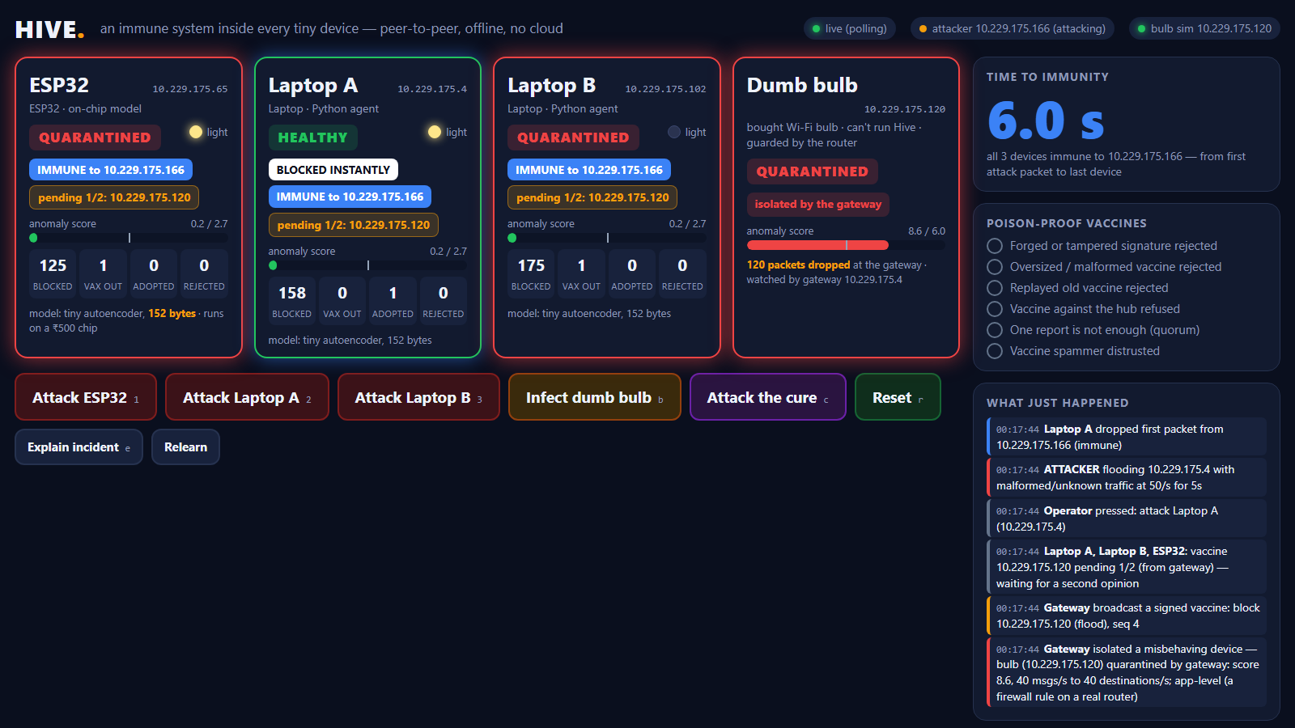
It works on real hardware
~1.5 s
the ESP32 detects, isolates and vaccinates
~6 s
until every device is immune
1st packet
blocked on a device that was warned
6 / 6
kinds of poisoned vaccine rejected
The live dashboard, mid-demo, on real devices
Real hardware testing also found and fixed a firmware flaw: one oversized packet could silence the ESP32.
Notes:
These numbers come from our own devices, not a simulation. The time to immunity includes the gap between button presses. Testing on hardware found a real bug: the ESP32's network library went deaf after one large packet. It's fixed and covered by a test.

Slide 10
What's new, what isn't, what's next
Not new
New
Next
Learning normal behaviour and quarantining devices at network level (Darktrace, Firewalla, IoT Sentinel)
The immune system lives inside cheap devices
Devices vaccinate each other peer-to-peer, offline
Vaccines are poison-proof
One system covers smart, Wi-Fi and Bluetooth devices
OpenWrt router package
On-chip keys and secure boot
Bluetooth bonding as identity
Federated model updates
Neighbourhood-wide vaccine sharing
!
Honest limits: it contains infected devices rather than cleaning them, careful mimicry can slip through, and the demo signs with shared HMAC keys and identifies senders by IP.
Notes:
Be upfront: watching for unusual behaviour isn't new. What's new is where it runs (inside ₹500 devices), that devices share immunity peer-to-peer with no cloud, and that the vaccines can't be weaponised. Production would use per-device asymmetric keys generated on the chip.

Slide 11
Hive
Thank
you
Big companies buy an immune system for their network. We put one inside every tiny device.
Q&A
github.com/prayag-1771/Hive-Immunity-System
Open source (MIT) · open model weights · runs fully offline
Notes:
Close on the one-liner and invite questions. Expected questions: can the vaccine be hacked (slide 7, and the live attack-the-cure); isn't this Darktrace (yes for big networks, but we run inside ₹500 chips, peer-to-peer and offline); who installs it (device makers and router firmware; dumb devices need nothing).

