Slide 1



PRAYAG VERMA
PRESENTS
CAR AUCTION
DATA ANALYSIS
MIS 6382 - Object Oriented Programming In Python
The University of Texas at Dallas

Slide 2




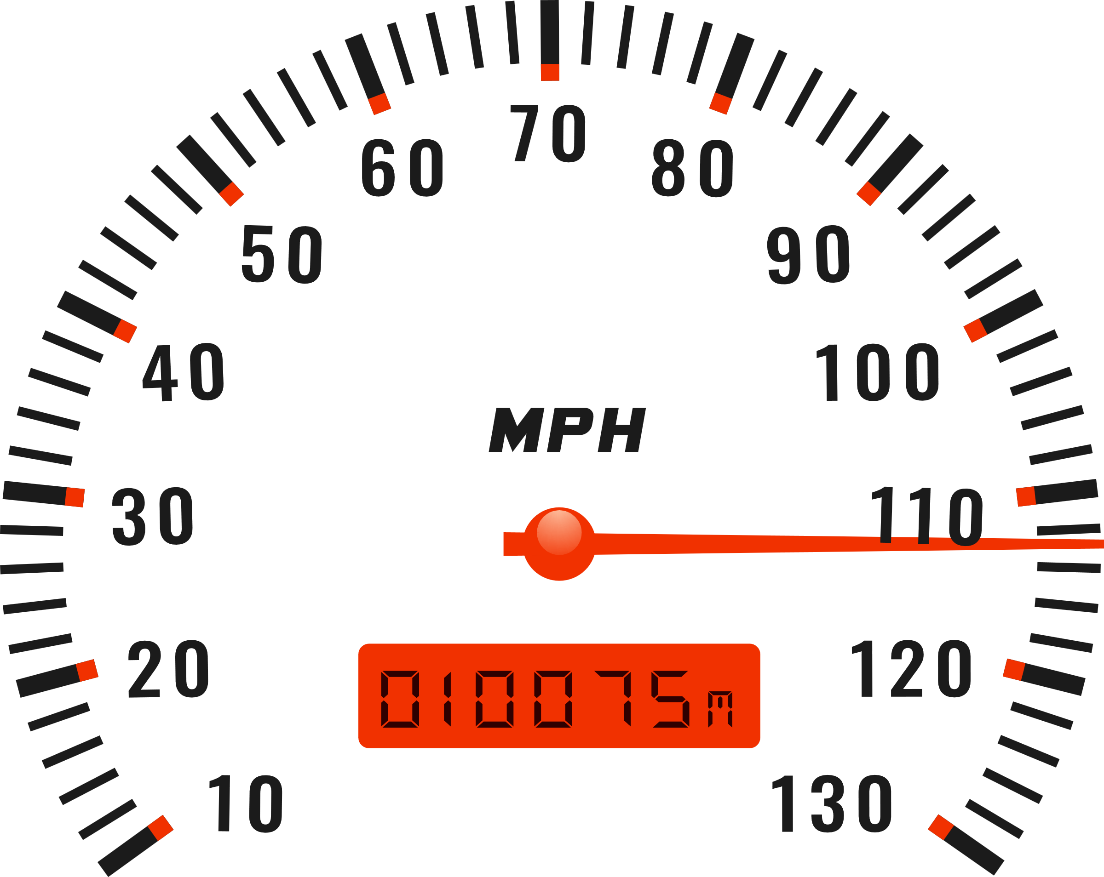

INTRODUCTION
The dataset contains information about cars listed on an auction website. It includes details about electric and non-electric vehicles from various manufacturers that includes the following attributes:​
Manufacturing date​
Model and manufacturer​
Car type (Electric or Non-Electric)​
Customer rating​
Price and mileage​

Slide 3
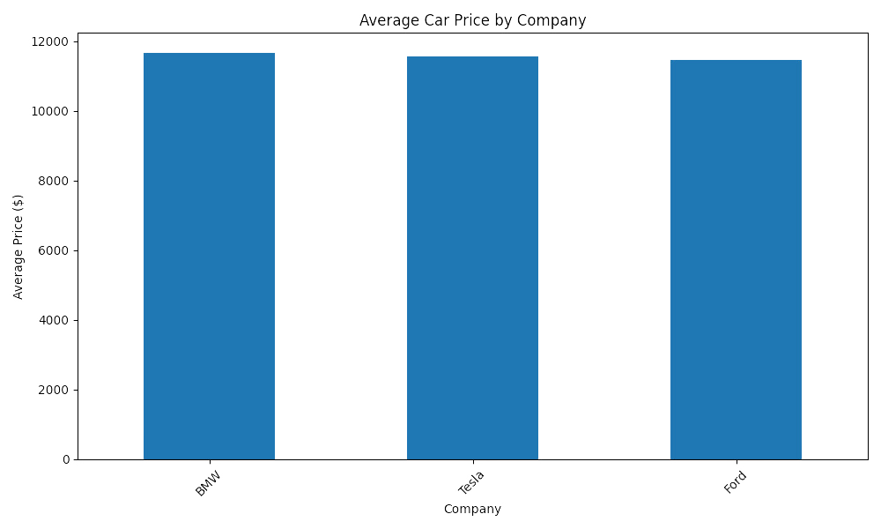
AVG CAR PRICE BY COMPANY
X-Axis represents the car manufacturers: BMW, Tesla, and Ford. Y-Axis shows the average price of cars in dollars.
BMW, Tesla, and Ford have average prices just under $12,000, indicating a lack of significant differences in pricing among the three brands.
The height of each bar corresponds to the average price for that company.
The visualization provides a quick comparison for pricing strategies.

Slide 4
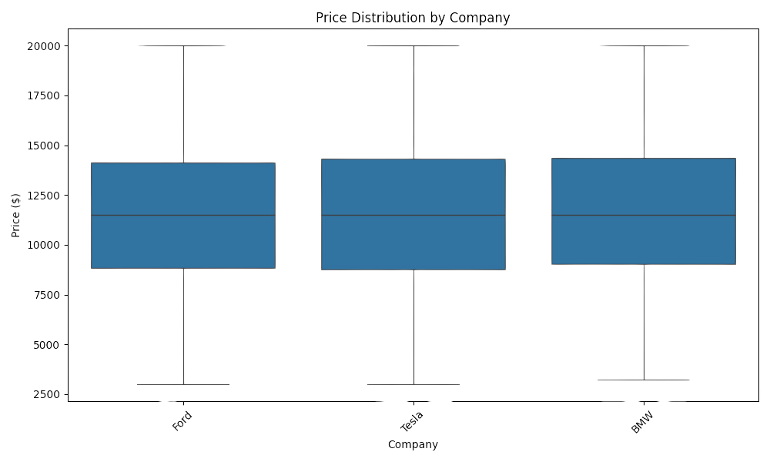
COMPANY PRICE DISTRIBUTION
The box plot shows the distribution of car prices for each company.
The median price for all three companies is similar, hovering around $11,500–$12,500. This suggests that the pricing strategies for these companies target a similar market segment.
Companies with wider box plots have more price variability.
Outliers are represented as points outside the whiskers, indicating extreme prices.

Slide 5
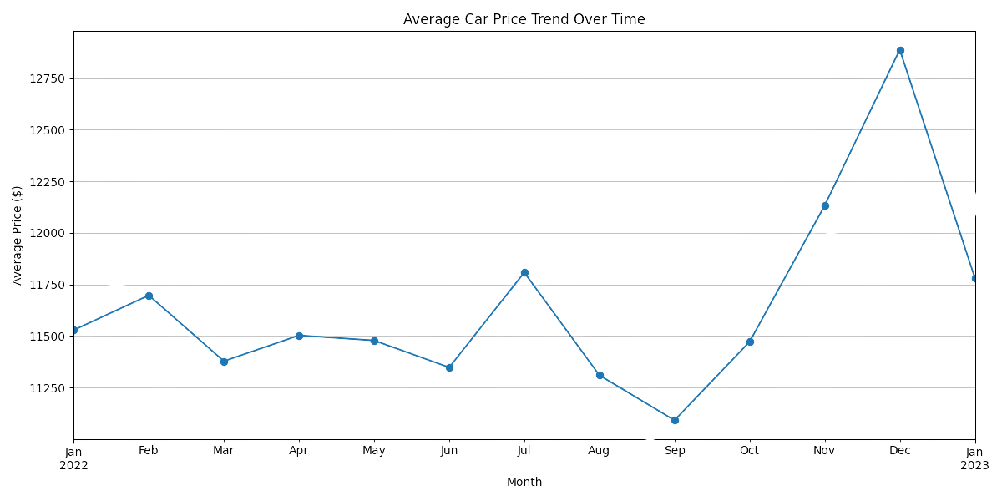
AVG CAR PRICE TREND OVER TIME
The line plot illustrates how the average car price has changed over the months.
There is a noticeable decline in average prices, reaching the lowest point in September 2022, where prices dip below $11,250.
Starting in October, the average price rises sharply, peaking in December 2022 at approximately $12,750. This could reflect increased demand or limited supply during the holiday season.
A steep decline in average prices occurs in January 2023, suggesting a potential post-holiday market correction.

Slide 6
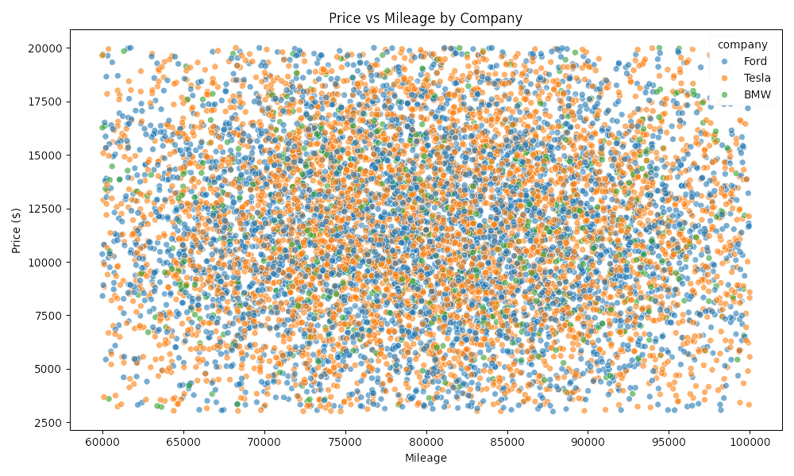
PRICE VS MILEAGE BY COMPANY
The scatter plot explores the relationship between car price and mileage.
Cars with similar mileage can have a wide range of prices, indicating that mileage alone does not fully determine price.
Cars with higher mileage generally have lower prices, as expected.
Each dot represents a car with its specific mileage and price. The color indicates the company.

Slide 7
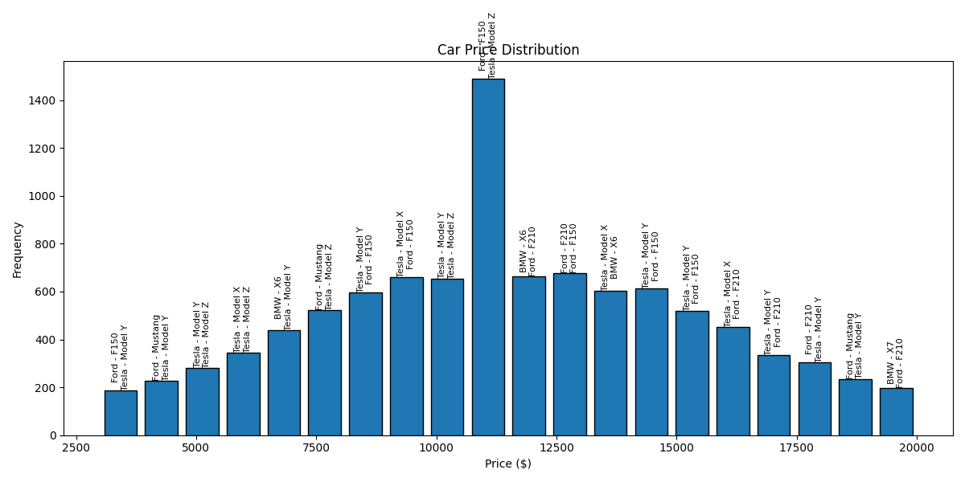
DISTRIBUTION OF CAR PRICES
This histogram represents the car prices and models within specific ranges.
Most cars fall within a specific price bracket, highlighting common pricing tiers.
The data helps identify whether the market leans toward luxury or budget vehicles.
Peaks in the histogram indicate popular price points.

Slide 8
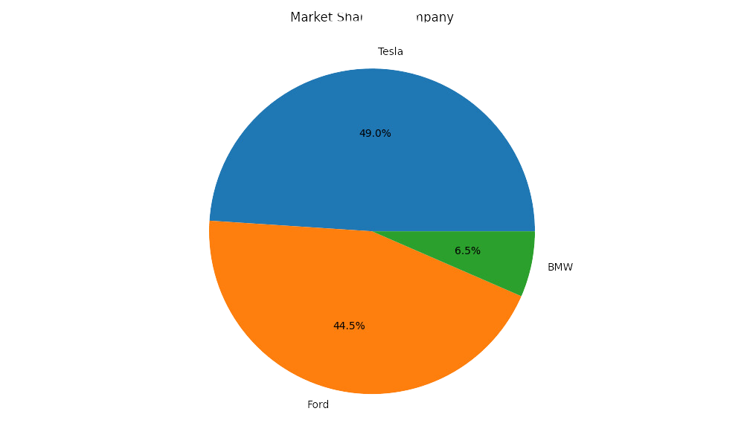
COMPANY MARKET SHARE
The pie chart shows the percentage of cars contributed by each manufacturer.
Tesla holds the largest market share in this dataset, accounting for nearly half of the cars.
Together, Tesla and Ford account for over 93% of the cars, highlighting their strong presence in their respective categories (electric and non-electric).
Helps visualize competition and market concentration.

Slide 9
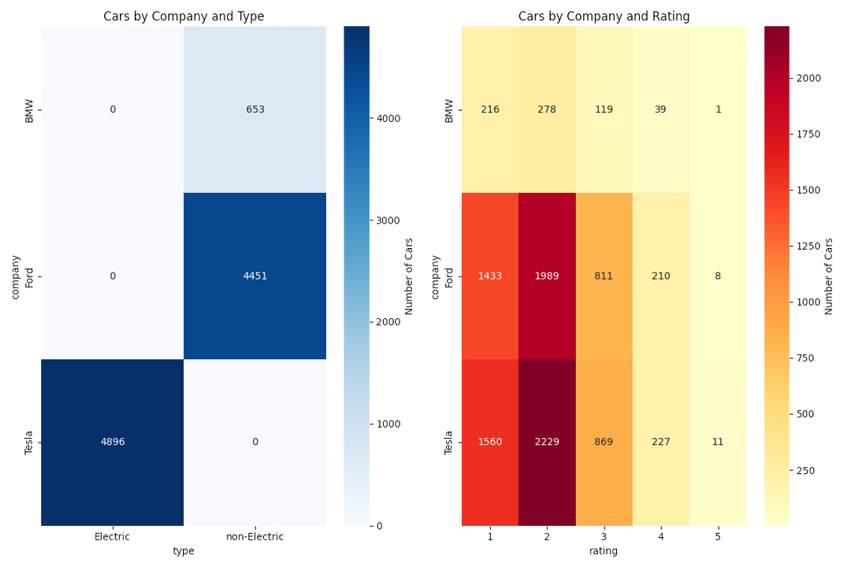
ELECTRC VS NON-ELECTRIC & RATINGS VS COMPANIES
The heatmap1 highlights clear segmentation where Tesla dominates the electric category, while Ford focuses heavily on non-electric vehicles.
The heatmap2 shows customer ratings are generally low, possibly indicating a need for quality or performance improvements.
Most cars are rated between 1 and 3, with fewer cars rated 4 or 5 but Tesla has a relatively higher number of cars rated 2 and 3.

Slide 10
CONCLUSION
The analysis of the dataset provides insights into:
Average pricing trends across manufacturers.
The relationship between price and other factors like mileage.
These insights can be used for better decision-making in the auction process.

Slide 11
RECOMMENDATION
Based on the data and the analysis, we recommend:
1. Including more vehicle specifications.
2. Adding historical maintenance data.
3. Expanding the dataset to include more manufacturers.
4. Incorporating geographical data for regional insights.
5. Exploring seasonal factors affecting car prices.

Slide 12
PRAYAG VERMA
PRESENTS
THANK YOU
MIS 6382 - Object Oriented Programming In Python
The University of Texas at Dallas

