Slide 1
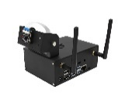


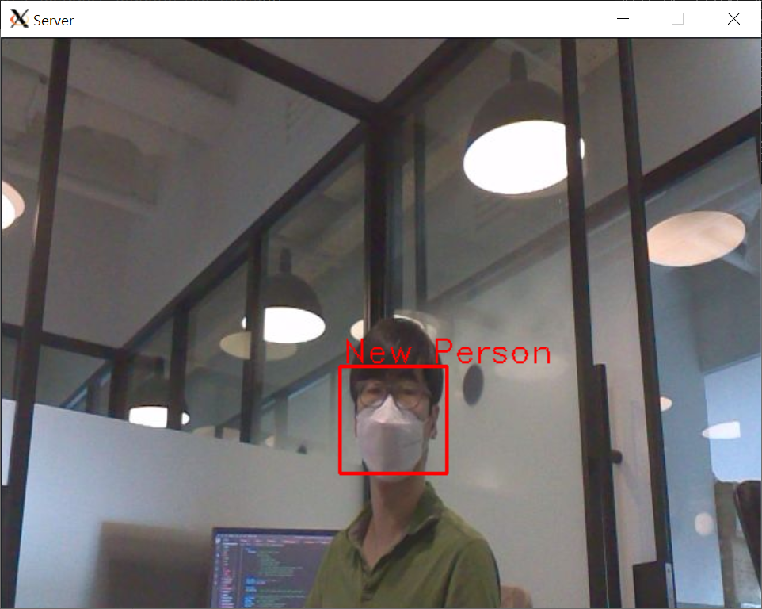
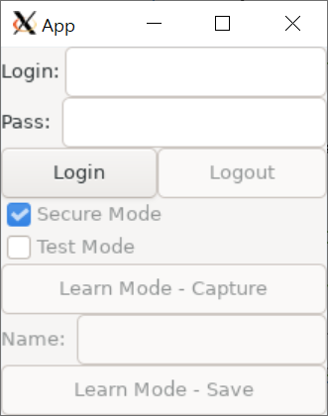
TCP Connection
Face Recognition
Sever Program
Client Program
secure channel for control data
camera
secure channel for photo
non-secure channel for photo
secure channel for face recognition info
file system
file system
CRT
Key
CA CRT
Friends video
CRT
Key
CA CRT
Face Image
Login info
.
├── client
│ └── src
├── common
├── custom
│ └── keys
│ ├── ca
│ ├── client
│ └── server
└── server
├── facenetModels
├── imgs
├── libs
│ └── libsslcrypto
├── mtCNNModels
├── src
└── trt_l2norm_helper

Slide 2
logout
secure
run
change
run <> test run
mode
secure
test run
connect and
login success
with server
logout: sever and client are disconnected.
client can try to connect to server, and to send login request
secure run: can securely receive the image data
generated from server camera
secure test run: can securely receive the image data
generated from server media file
non secure run: can receive the image data
generated from server camera
non secure test run: can receive the image data
generated from server media file
learn: can request for saving the current received image
with name to the server
start program
change
learn <> *run *secure
mode
init
logout
change
secure <>
non secure mode
learn
change
secure <>
non secure mode
non secure
run
non secure
test run
change
run <> test run
mode
logout
end
The end state can be transmitted
from any state

Slide 3
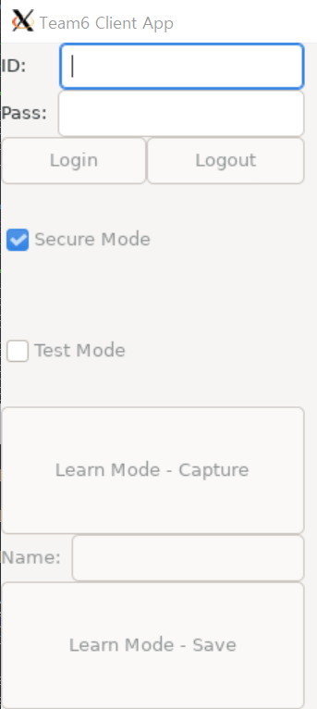
Initial state
ID, PASS Input activated and empty
Others deactivated
Secure Mode checked
Login button
activated by
ID, PASS input
ID, PASS Input
no
Pushed
Login Button?
show it
yes
try to connect to server
connection success?
ID, PASS have some input?
no
ID, PASS input makes empty
deactivate Login button
Alert
yes
yes
no
Login success?
activate
Login button
deactivate
Login button
yes
activate others except for
ID, PASS input and Login button
TODO Learn Mode
Logout button
Secure Mode
checkbutton
Test Mode
checkbutton
activated by
Login button
activated by
Login button
activated by
Login button
no
Pushed
Logout Button?
changed check state.
checked?
changed check state.
checked?
yes
yes
no
yes
no
Request disconnect to server
goto initial state
request
secure mode
request
non-secure mode
request
Test Run mode
request
Run mode

