Slide 1
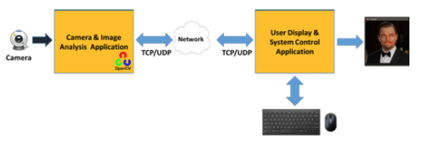
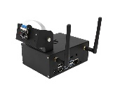


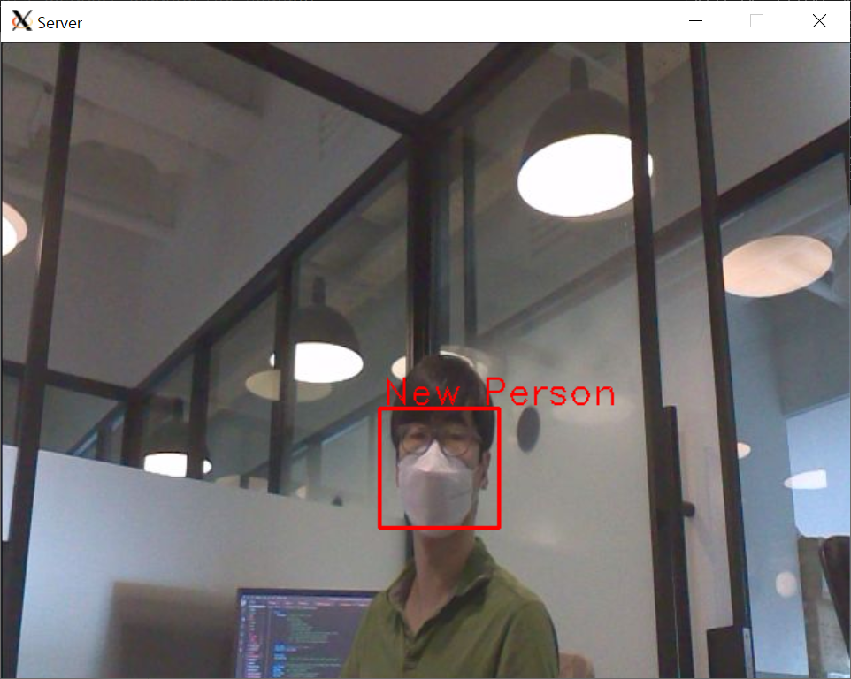
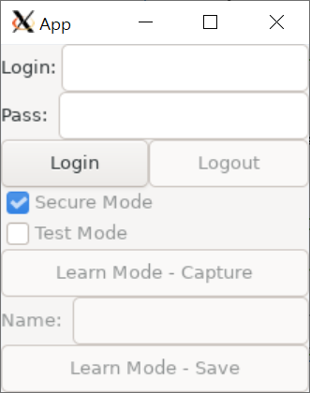
TCP Connection
Face Recognition
Sever Program
Client Program
secure channel for control data
camera
secure channel for photo
non-secure channel for photo
secure channel for face recognition info
file system
file system
CRT
Key
CA CRT
Friends video
CRT
Key
CA CRT
Face Image
Login info

Slide 2
client
PC
server
Jetson Nano
Deprecated
user
assumed that
the 5000 port number is dedicated
for this system
listening 5000 TCP port
Func 1
user (=admin or normal)
type ip addr
push connect button
type ip address
ip input validataion
enable connect button
push connect button
try to connect TCP port 5000 with TLS
[TCP Connection 1] for control data
allocate new port for
TCP port1 for TLS (Secure mode)
TCP port2 for nonTLS (NonSecure mode)
send TCP port1, port2
try to connect TCP port1 with TLS
[TCP Connection 2] for media data of Secure Mode
try to connect TCP port2 without TLS
[TCP Connection 3] for media data of NonSecure Mode
change connect button
to disconnect button
send ‘runSecure’ command
response
run camera, start AI analysis
show user face
face recognition media
show result
Func 2
user (=admin or normal)
push disconnect button
push disconnect button
disconnect TCP Connection 1, 2, 3
change user mode
change disconnect button
to connect button

Slide 3
client
PC
server
Jetson Nano
Deprecated
user
Func 3
admin login process
Func1 is precondition
type hidden keyword
admin is already registered
show admin password input component
type admin password
show admin face
admin face recognition result
camera media
when result is admin face && password is matched,
change UX to admin mode, show buttons
for logout / learning mode / test mode / secure mode
Func 4
change user mode
push logout button
change UX to user mode
Func 5
learning mode
it can repeat pushing
the capture and confirm
buttons
push capture button
assumed that secure mode
show user face
send ‘capture’ command
response
capture image
captured image
show captured image
type name, push confirm button
name input validation
send ‘save’ command
response
store image & name securely
Notes:
-

Slide 4
client
PC
server
Jetson Nano
Deprecated
user
Func 6
testRun mode
select testRun button
only support friends640x480.mp4 file
send ‘testRun’ command
response
face recognition media
run playback the file, start AI analysis
Func 7
run mode
select run button
send ‘runSecure’ command
response
show admin face
face recognition media
run camera, start AI analysis

Slide 5
client
PC
server
Jetson Nano
Deprecated
user
Func 8
nonSecure mode
select nonSecure button
send ‘runNonSecure’ command
response
change nonSecure button
to secure button
show admin face
face recognition media
send result through port2 (TCP Connection 3)
Func 9
secure mode
select secure button
send ‘runSecure’ command
response
change secure button
to nonSecure button
show admin face
face recognition media
send result through port1 (TCP Connection 2)

