Slide 1
CMU Security Specialist Course Team Project : Phase 1
Team 6 a.k.a. six senses
Seongju Moon (L)
Kyungnam Bae (E)
Jinmo Kim (A)
Jeonghwan Ahn (S)
* Byungchul Park (C)

Slide 2
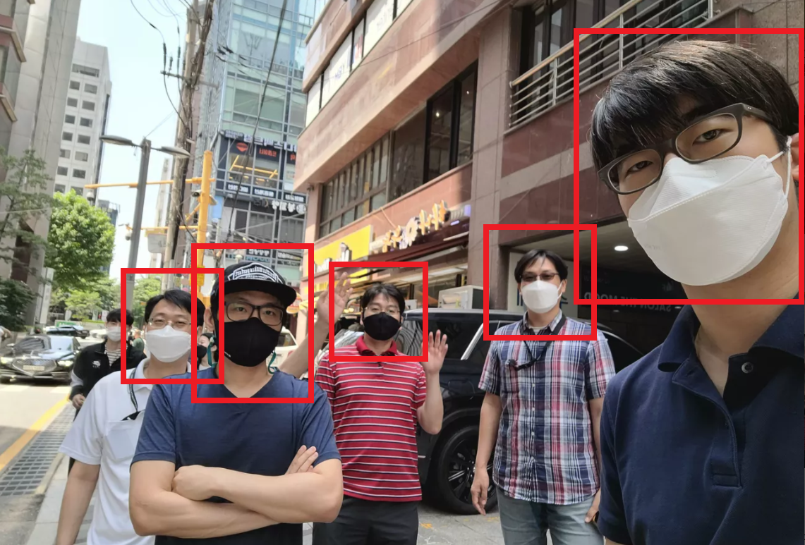
Mr. Bae
Mr. Kim
Mr. Park
Mr. Moon
Mr. Ahn

Slide 3
Define security goal
Define assets to protect
Do threat modeling
Do risk assessment to prioritize items
Define security requirements
Derive mitigations
Construct architecture
Implement the mitigations
Verify the mitigations

Slide 4
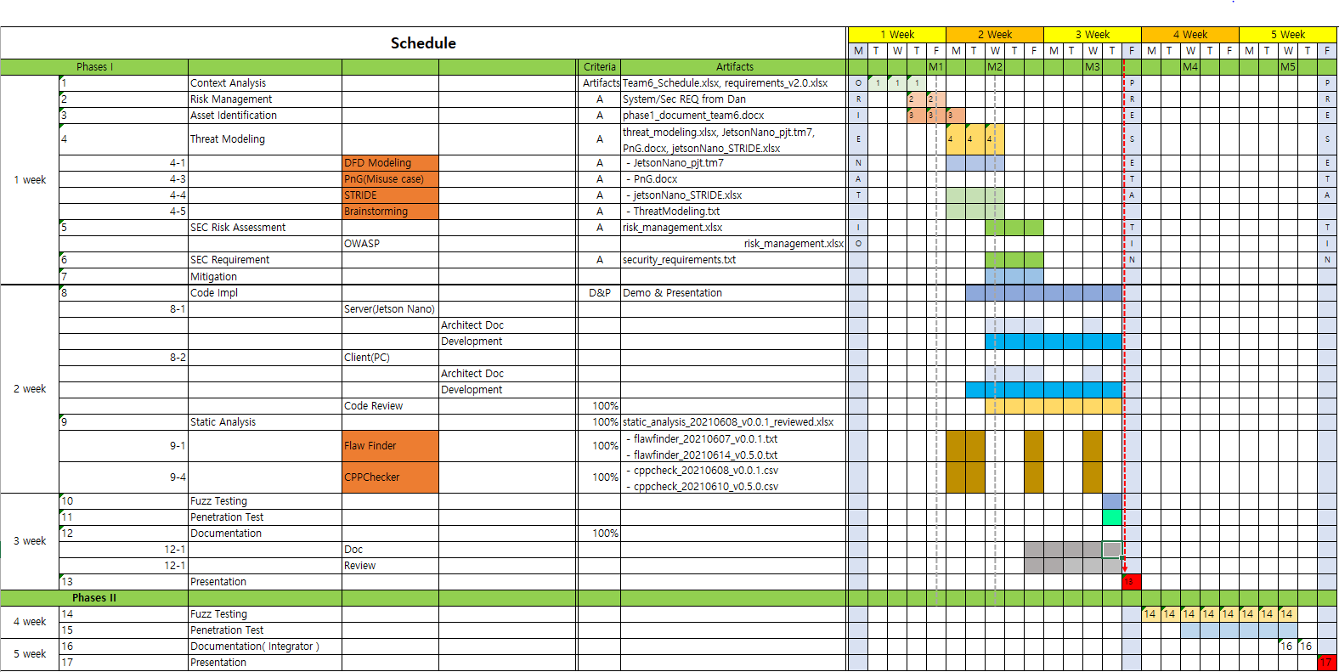

Slide 5
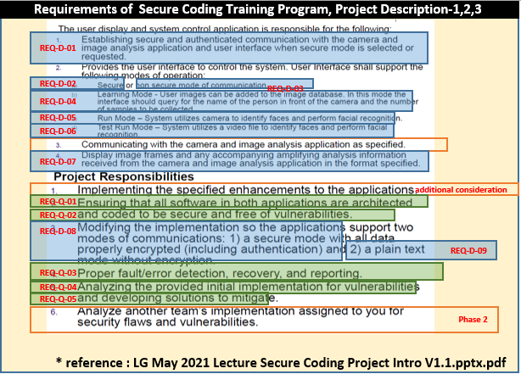

Slide 6
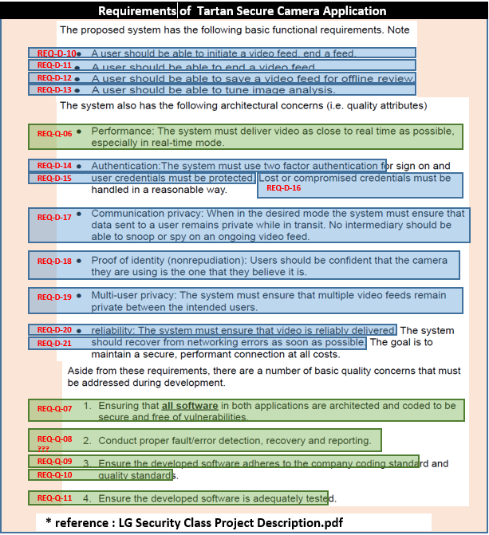

Slide 7
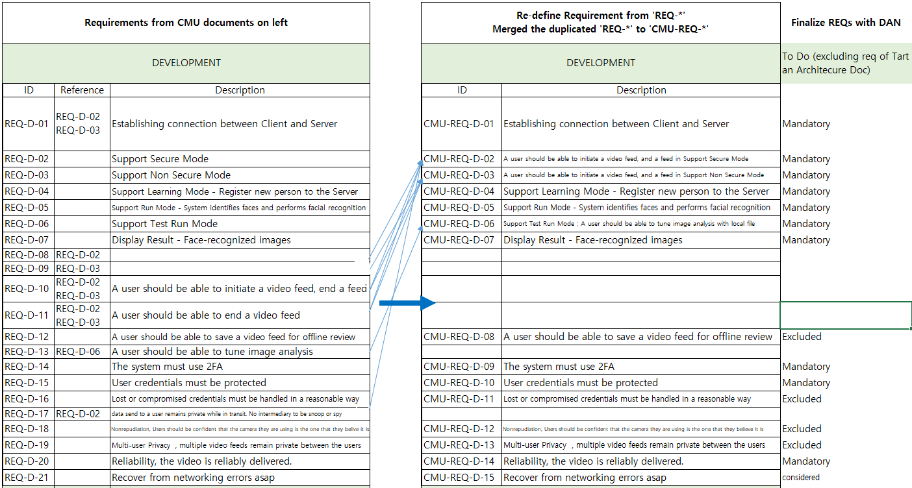

Slide 8
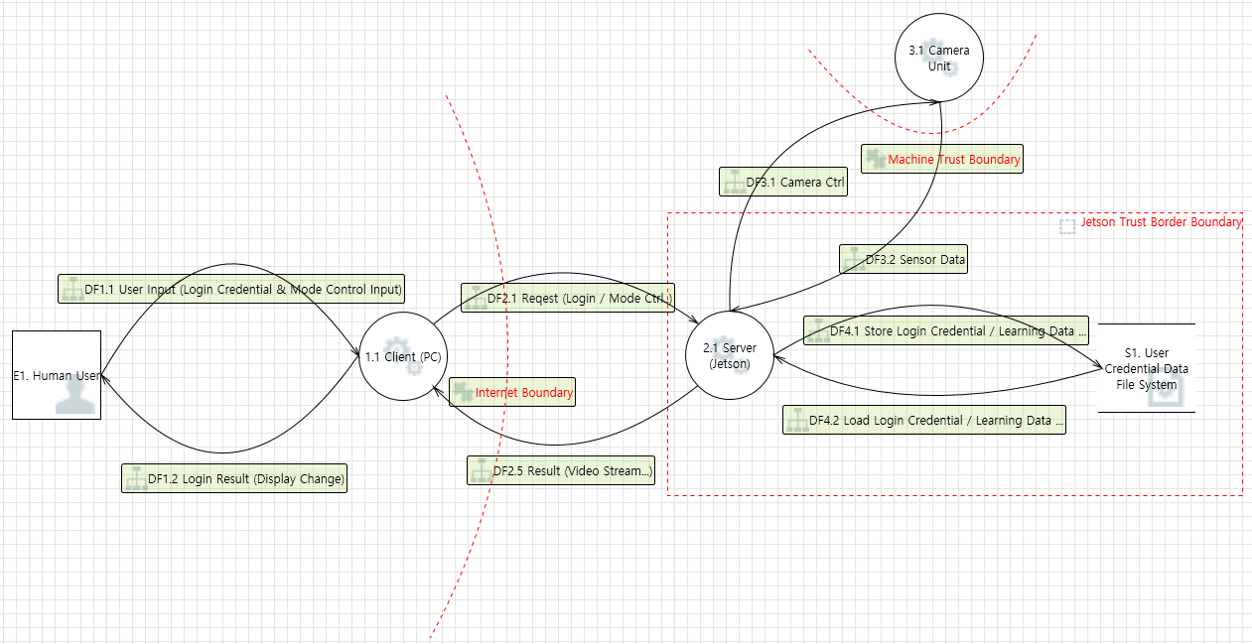

Slide 9
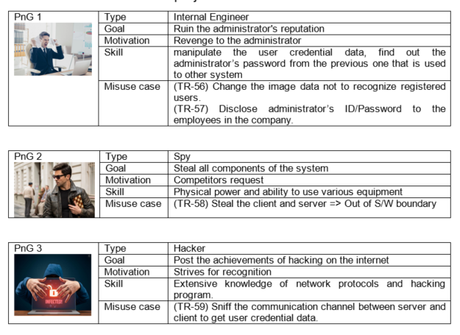

Slide 10
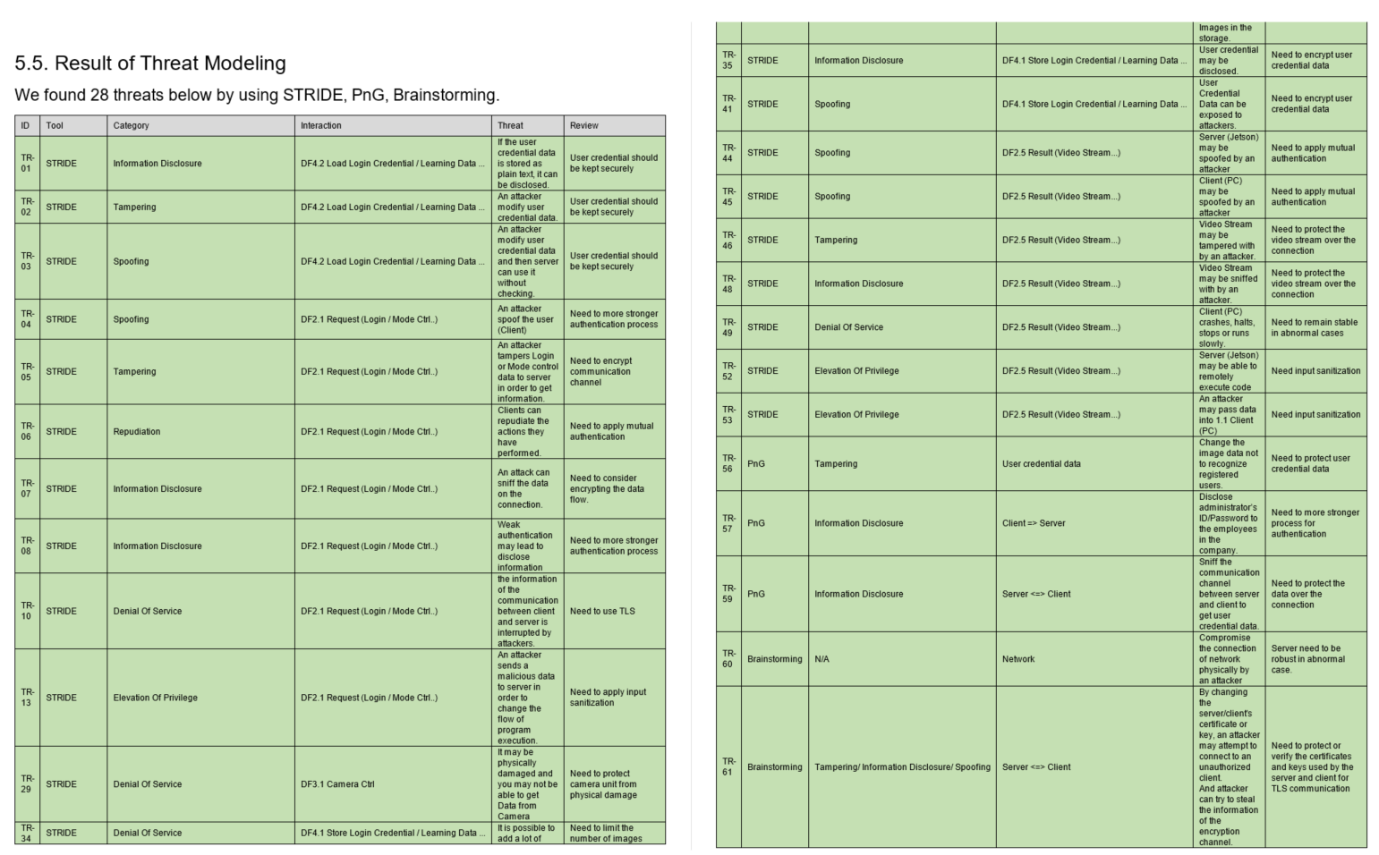

Slide 11
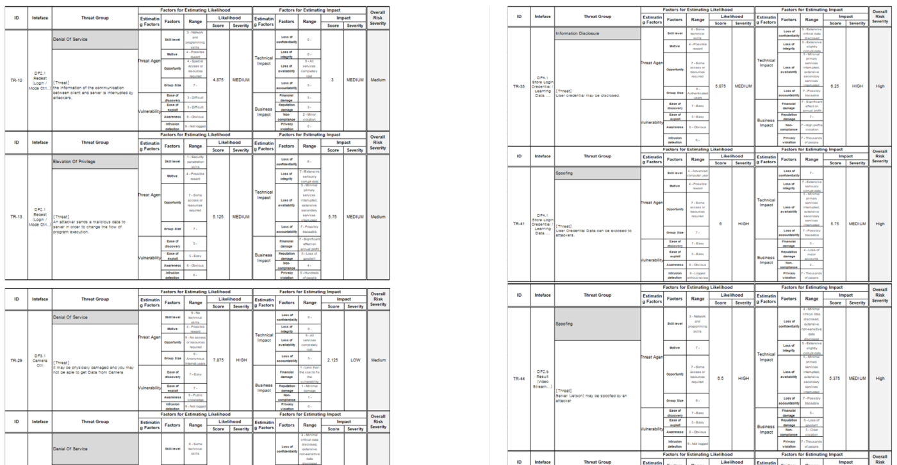

Slide 12
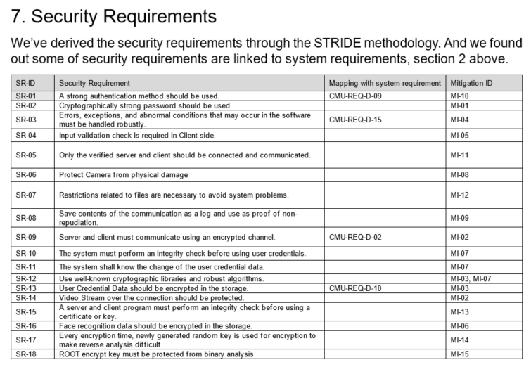

Slide 13
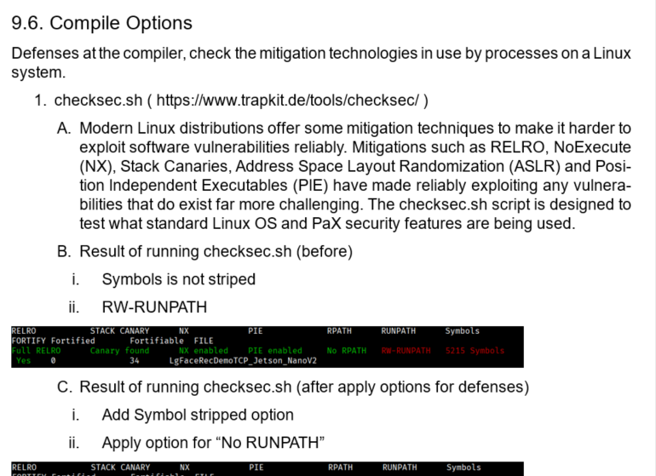

Slide 14
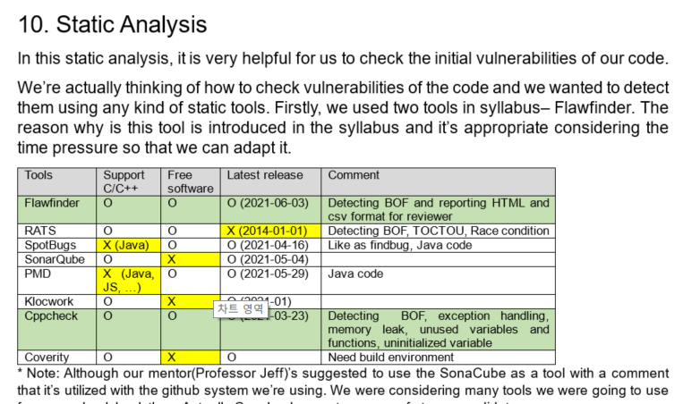

Slide 15
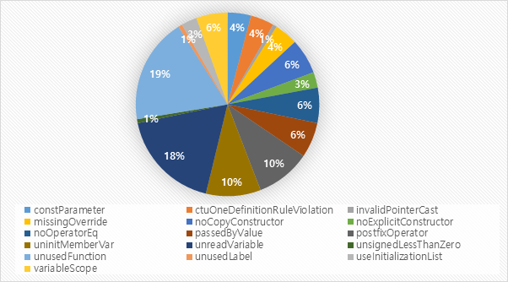

Slide 16
Define security goal
Define assets to protect
Do threat modeling
Do risk assessment to prioritize items
Define security requirements
Derive mitigations
Construct architecture
Implement the mitigations
Verify the mitigations

Slide 17
Define security goal
“ Protect the user privacy information in our system. ”

Slide 18
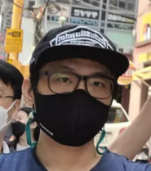
Define assets to protect + Do threat modeling
+ name

Slide 19
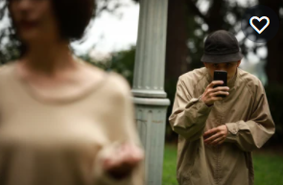
Define assets to protect + Do threat modeling
+ name
#privacy #stalker
#name

Slide 20
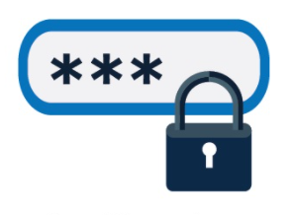
Define assets to protect + Do threat modeling
+ name
#privacy #stalker
#name
#authentication #2FA
#face #recognition

Slide 21
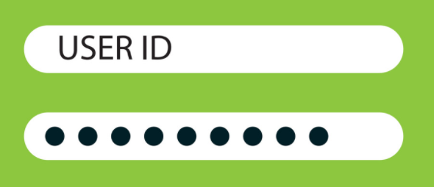
Define assets to protect + Do threat modeling

Slide 22
Define assets to protect + Do threat modeling
#authentication
#login #password

Slide 23
Define assets to protect + Do threat modeling
#authentication
#login #password
#privacy

Slide 24

Define assets to protect + Do threat modeling

Slide 25
Define assets to protect + Do threat modeling
#privacy
#authentication

Slide 26
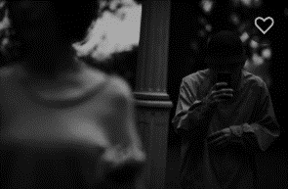
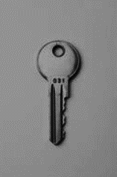
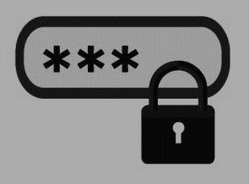
Define assets to protect + Do threat modeling
IMPORTANT ASSUMPTION
The way to keep the KEYs secure is the root of trust.
#privacy
#authentication

Slide 27
Derive mitigations
Introduce login system
Force users to use strong password
Apply 2FA (what you know + what you are)
Separate meta data from image on network
Encrypt the image + name in the storage
Use verified crypto algorithm (AES256-CBC)
Use a random file name in the storage
Use TLS in network communication
+ name

Slide 28
Derive mitigations
Introduce login system
Force users to use strong password
Apply 2FA (what you know + what you are)
Separate meta data from image on network
Encrypt the image + name in the storage
Use verified crypto algorithm (AES256-CBC)
Use a random file name in the storage
Use TLS in network communication
+ name

Slide 29
Derive mitigations
Introduce login system
Force users to use strong password
Apply 2FA (what you know + what you are)
Separate meta data from image on network
Encrypt the image + name in the storage
Use verified crypto algorithm (AES256-CBC)
Use a random file name in the storage
Use TLS in network communication
+ name

Slide 30
Derive mitigations
Introduce login system
Force users to use strong password
Apply 2FA (what you know + what you are)
Separate meta data from image on network
Encrypt the image + name in the storage
Use verified crypto algorithm (AES256-CBC)
Use a random file name in the storage
Use TLS in network communication
+ name

Slide 31
Derive mitigations
Introduce login system
Force users to use strong password
Apply 2FA (what you know + what you are)
Separate meta data from image on network
Encrypt the image + name in the storage
Use verified crypto algorithm (AES256-CBC)
Use a random file name in the storage
Use TLS in network communication
+ name

Slide 32
Derive mitigations
Introduce login system
Force users to use strong password
Apply 2FA (what you know + what you are)
Separate meta data from image on network
Encrypt the image + name in the storage
Use verified crypto algorithm (AES256-CBC)
Use a random file name in the storage
Use TLS in network communication
+ name

Slide 33
Derive mitigations
Introduce login system
Force users to use strong password
Apply 2FA (what you know + what you are)
Separate meta data from image on network
Encrypt the image + name in the storage
Use verified crypto algorithm (AES256-CBC)
Use a random file name in the storage
Use TLS in network communication
+ name

Slide 34
Derive mitigations
Introduce login system
Force users to use strong password
Apply 2FA (what you know + what you are)
Separate meta data from image on network
Encrypt the image + name in the storage
Use verified crypto algorithm (AES256-CBC)
Use a random file name in the storage
Use TLS in network communication
+ name

Slide 35
Derive mitigations
Introduce login system
Force users to use strong password
Apply 2FA (what you know + what you are)
Separate meta data from image on network
Encrypt the image + name in the storage
Use verified crypto algorithm (AES256-CBC)
Use a random file name in the storage
Use TLS in network communication
+ name

Slide 36
Derive mitigations
Encrypt the hashed credential in the storage
Use TLS in network communication

Slide 37
Derive mitigations
Encrypt the hashed credential in the storage
Use TLS in network communication

Slide 38
Derive mitigations
Encrypt the hashed credential in the storage
Use TLS in network communication

Slide 39
Derive mitigations
Embed the root key into code obfuscated
Use TLS in network communication

Slide 40
Derive mitigations
Embed the root key into code obfuscated
Use TLS in network communication

Slide 41
Derive mitigations
Embed the root key into code obfuscated
Use TLS in network communication

Slide 42
Derive mitigations
Introduce login system
Force users to use strong password
Encrypt the hashed credential in the storage
Apply 2FA (what you know + what you are)
Separate meta data from image on network
Encrypt the image + name in the storage
Use verified crypto algorithm (AES256-CBC)
Embed the root key into code obfuscated
Use a random file name in the storage
Use TLS in network communication

Slide 43
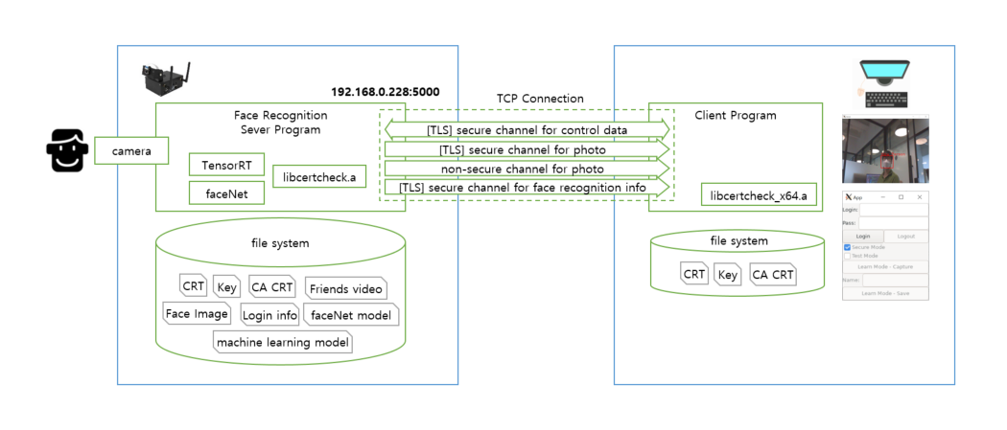
Construct architecture

Slide 44
Construct architecture
.
└── source
├── client
│ └── src
├── common
│ ├── keys
│ │ ├── ca
│ │ ├── client
│ │ └── server
│ └── libs
│ └── libcertcheck
│
└── server
├── facenetModels
├── imgs
├── mtCNNModels
├── src
└── trt_l2norm_helper
// client source codes
// self signed root certificate
// CA signed certificate & Private key for client
// CA signed certificate & Private key for server
// crypto library to support crypto API and to verify the integrity of keys.
// the root key for the crypto API are included as a string with obfuscated.
// the path of faceNet models
// the path of the photo registered with name. the filename and contents are encrypted
// the path of machine learning model in MTCNN_FaceDetection_TensorRT
// server source codes
// TensorRT L2-Norm Helper

Slide 45
Construct architecture
secure
run
secure
test run
Client State Diagram
On starting program
learn
init
logout
non secure
run
non secure
test run
Can be reached
from any state
by logout button

Slide 46
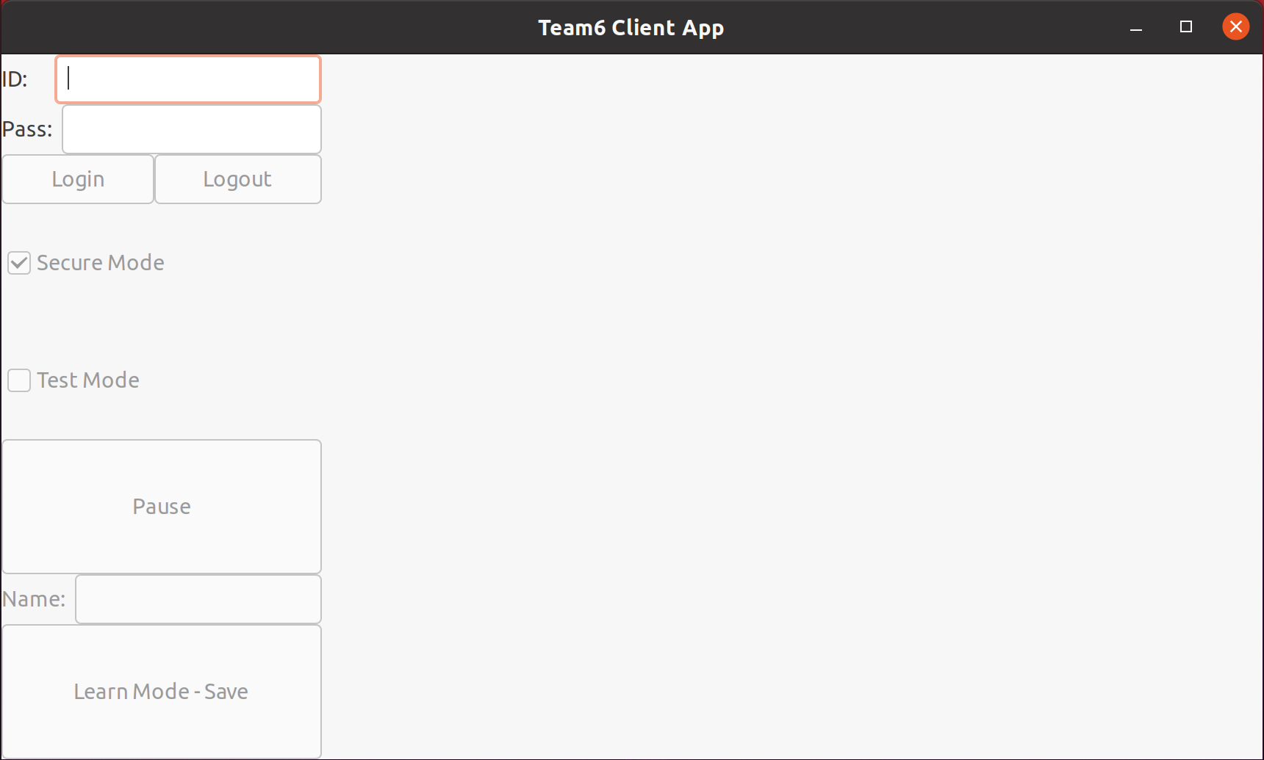
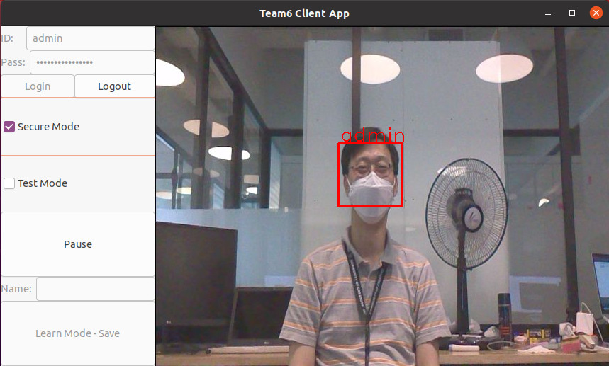
Construct architecture

Slide 47
Construct architecture
Let me show you demo clip..

