Slide 1
CMU Security Specialist Course Team Project Phase 2
Six senses Team 6
Seongju Moon (L)
Kyungnam Bae (E)
Jinmo Kim (A)
Jeonghwan Ahn (S)
* Byungchul Park (C)

Slide 2
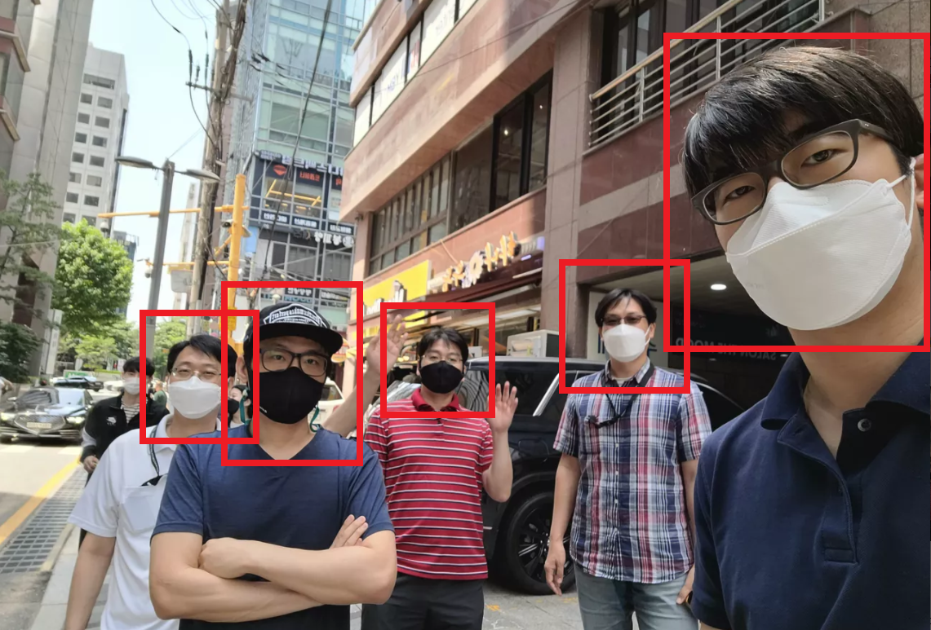
Mr. Bae
Mr. Kim
Mr. Park
Mr. Moon
Mr. Ahn

Slide 3
Mr. Bae
Mr. Kim
Mr. Park
Mr. Moon
Mr. Ahn

Slide 4
Phase 1 wrap-up
Attack goal setting : CIA
Target system understanding : Design
Target system understanding : Crypto
Vulnerability analysis : Resource restriction
Vulnerability analysis : Approaches
Penetration test : Techniques
Penetration test : Cases
Lessons learned

Slide 5
Phase 1 wrap-up
Attack goal setting : CIA
Target system understanding : Design
Target system understanding : Crypto
Vulnerability analysis : Resource restriction
Vulnerability analysis : Approaches
Penetration test : Techniques
Penetration test : Cases
Lessons learned

Slide 6
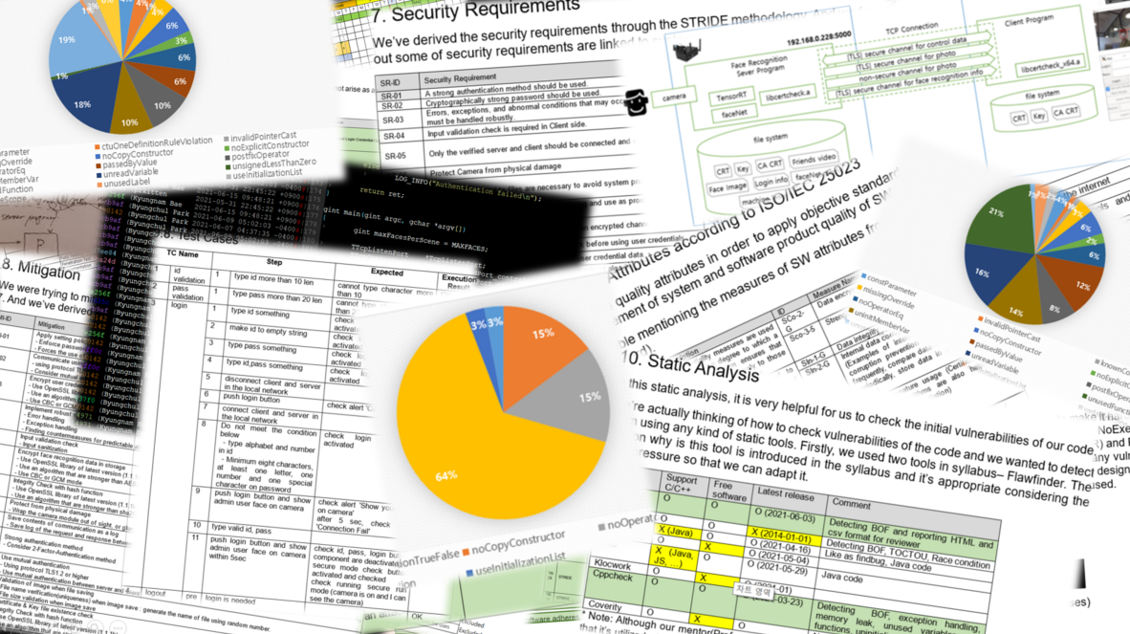

Slide 7
Derive mitigations
Introduce login system
Force users to use strong password
Encrypt the hashed credential in the storage
Apply 2FA (what you know + what you are)
Separate meta data from image on network
Encrypt the image + name in the storage
Use verified crypto algorithm (AES256-CBC)
Embed the root key into code obfuscated
Use a random file name in the storage
Use TLS in network communication

Slide 8
Derive mitigations
Introduce login system
Force users to use strong password
Encrypt the hashed credential in the storage
Apply 2FA (what you know + what you are)
Separate meta data from image on network
Encrypt the image + name in the storage
Use verified crypto algorithm (AES256-CBC)
Embed the root key into code obfuscated
Use a random file name in the storage
Use TLS in network communication
Against vulnerability that allows anonymous users to access the system
Against vulnerability that leaks user data inside the target machine
Against vulnerability that leaks user data over network
Against vulnerability that leaks secret key inside the target machine

Slide 9
Phase 1 wrap-up
Attack goal setting : CIA
Target system understanding : Design
Target system understanding : Crypto
Vulnerability analysis : Resource restriction
Vulnerability analysis : Approaches
Penetration test : Techniques
Penetration test : Cases
Lessons learned

Slide 10

Compromise Confidentiality
Obtain user picture and name
Compromise Integrity
N/A (not our ultimate goal)
Compromise Availability
Make the system not working

Slide 11
Compromise Confidentiality
Obtain user picture and name
Compromise Availability
Make the system not working

Slide 12
Phase 1 wrap-up
Attack goal setting : CIA
Target system understanding : Design
Target system understanding : Crypto
Vulnerability analysis : Severity
Vulnerability analysis : Approaches
Penetration test : Techniques
Penetration test : Cases
Lessons learned

Slide 13
First impression
High performance (less delay) even in secure mode
Firewall used so cannot scan ports using ‘nmap’
Sound recover logic in case of crash or assert
High performance (less delay) even in secure mode
Firewall used so cannot scan ports using ‘nmap’
Sound recover logic in case of crash or assert
High performance (less delay) even in secure mode

Slide 14
First impression
High performance (less delay) even in secure mode
Firewall used so cannot scan ports using ‘nmap’
Sound recover logic in case of crash or assert
High performance (less delay) even in secure mode
Firewall used so cannot scan ports using ‘nmap’
Sound recover logic in case of crash or assert
High performance (less delay) even in secure mode

Slide 15
First impression
High performance (less delay) even in secure mode
Firewall used so cannot scan ports using ‘nmap’
Sound recover logic in case of crash or assert
High performance (less delay) even in secure mode
Firewall used so cannot scan ports using ‘nmap’
Sound recover logic in case of crash or assert
High performance (less delay) even in secure mode

Slide 16
Jetson Nano
Client
Display
Manager
Protocol
Manager
Protocol
Manager
Mode Control
Manager
Firewall
Face Detection
Manager
Service
Manager
Communication
Manager
Communication
Manager
User Input
Manager
Data
Manager
Authentication
Manager
Authentication
Manager
Display
Manager
DB
SDB
Security
Manager
Secure channel
New Component
Modified Component

Slide 17
Jetson Nano
Client
Display
Manager
Protocol
Manager
Protocol
Manager
Mode Control
Manager
Firewall
Face Detection
Manager
Service
Manager
Communication
Manager
Communication
Manager
User Input
Manager
Data
Manager
Authentication
Manager
Authentication
Manager
Display
Manager
DB
Security
Manager
Log
SDB
Secure channel
New Component
Modified Component
Unspecified Component

Slide 18
Jetson Nano
Client
SD9
SD2
SD2
Display
Manager
Protocol
Manager
Protocol
Manager
Mode Control
Manager
SD4
SD7
Firewall
SD7
Face Detection
Manager
Service
Manager
Communication
Manager
SD1
Communication
Manager
User Input
Manager
Data
Manager
Authentication
Manager
SD8
Authentication
Manager
Display
Manager
SD6
SD3
SD5
DB
Security
Manager
Log
SDB
Secure channel
New Component
Security Design ID
Modified Component
Unspecified Component

Slide 19
Phase 1 wrap-up
Attack goal setting : CIA
Target system understanding : Design
Target system understanding : Crypto
Vulnerability analysis : Severity
Vulnerability analysis : Approaches
Penetration test : Techniques
Penetration test : Cases
Lessons learned

Slide 20


Slide 21
Primitives and algorithms
Crypto library : WolfSSL
Version : 4.7.0 (February 15, 2021)
No known vulnerabilities in v4.7.0
Symmetric cipher algorithm
Algorithm : AES
Key size : 128 bit
Mode of operation : CBC
Key derivation function : NONE
Method for hiding secret
No hardware security (HSM, TEE etc.)
No code obfuscation
Just stored in a file, “secret.key”
Encryption and decryption
Data : AI classified name and photo
Use key retrieved from “secret.key”
16 bytes IV(Initial Vector) are all 00
No random number used

Slide 22
Primitives and algorithms
Crypto library : WolfSSL
Version : 4.7.0 (February 15, 2021)
No known vulnerabilities in v4.7.0
Symmetric cipher algorithm
Algorithm : AES
Key size : 128 bit
Mode of operation : CBC
Key derivation function : NONE
Method for hiding secret
No hardware security (HSM, TEE etc.)
No code obfuscation
Just stored in a file, “secret.key”
Encryption and decryption
Data : AI classified name and photo
Use key retrieved from “secret.key”
16 bytes IV(Initial Vector) are all 00
No random number used

Slide 23
Primitives and algorithms
Crypto library : WolfSSL
Version : 4.7.0 (February 15, 2021)
No known vulnerabilities in v4.7.0
Symmetric cipher algorithm
Algorithm : AES
Key size : 128 bit
Mode of operation : CBC
Key derivation function : NONE
Method for hiding secret
No hardware security (HSM, TEE etc.)
No code obfuscation
Just stored in a file, “secret.key”
Encryption and decryption
Data : AI classified name and photo
Use key retrieved from “secret.key”
16 bytes IV(Initial Vector) are all 00
No random number used

Slide 24
Phase 1 wrap-up
Attack goal setting : CIA
Target system understanding : Design
Target system understanding : Crypto
Vulnerability analysis : Resource restriction
Vulnerability analysis : Approaches
Penetration test : Techniques
Penetration test : Cases
Lessons learned

Slide 25

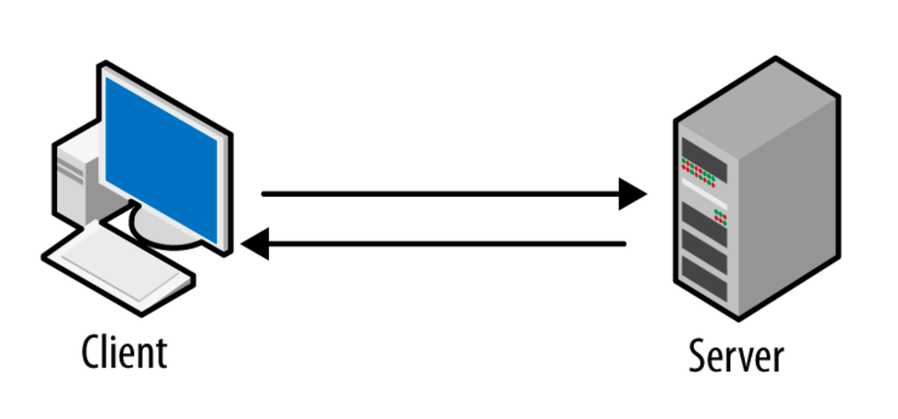
Server information
(IP and port)

Slide 29
Phase 1 wrap-up
Attack goal setting : CIA
Target system understanding : Design
Target system understanding : Crypto
Vulnerability analysis : Resource restriction
Vulnerability analysis : Approaches
Penetration test : Techniques
Penetration test : Cases
Lessons learned

Slide 30




Slide 31
Phase 1 wrap-up
Attack goal setting : CIA
Target system understanding : Design
Target system understanding : Crypto
Vulnerability analysis : Resource restriction
Vulnerability analysis : Approaches
Penetration test : Techniques
Penetration test : Cases
Lessons learned

Slide 32
SQL injection - by-passing authentication
Buffer overflow - reading or writing beyond legitimate area
Unsigned wraparound - making use of unsinged wraparound
Format string - mainly used for leaking data on the stack
Revealed key - decrypting secure data using revealed keys
Sniffing - sniffing packets over the network
Spoofing - so-called, man in the middle attack
Brute-force - trying all possible input until success
Craft packet - crafting and sending a customized packet
Tampering - modifying system components

Slide 33
Phase 1 wrap-up
Attack goal setting : CIA
Target system understanding : Design
Target system understanding : Crypto
Vulnerability analysis : Resource restriction
Vulnerability analysis : Approaches
Penetration test : Techniques
Penetration test : Cases
Lessons learned

Slide 34
Jetson Nano
Client
SD9
SD2
SD2
Display
Manager
Protocol
Manager
Protocol
Manager
Mode Control
Manager
SD4
SD7
Firewall
SD7
Face Detection
Manager
Service
Manager
Communication
Manager
SD1
Communication
Manager
User Input
Manager
Data
Manager
Authentication
Manager
SD8
Authentication
Manager
Display
Manager
SD6
SD3
SD5
DB
Security
Manager
Log
SDB
Secure channel
New Component
Security Design ID
Modified Component
Unspecified Component

Slide 35
Jetson Nano
Client
SD9
SD2
SD2
Display
Manager
Protocol
Manager
Protocol
Manager
Mode Control
Manager
V04,V05
V08,V10
V12
SD7
SD7
SD4
Firewall
Face Detection
Manager
Service
Manager
Communication
Manager
SD1
Communication
Manager
User Input
Manager
V02
V07
Data
Manager
Authentication
Manager
SD8
Authentication
Manager
Display
Manager
V11
SD3
SD5
V06
V11
SD6
DB
Security
Manager
Log
SDB
V01V09
V03
Secure channel
New Component
Security Design ID
Modified Component
Vulnerability
Unspecified Component

Slide 36
V01 | Insert an arbitrary id/password to DB
V02 | Sniffing the id/password
V03 | Exposed user credentials in the server log
V04 | Infinite loop in the NetworkTCP.cpp
V05 | Unintentional handling of the protocol message
V06 | Weak Passwords that Enable Brute Force Attacks
V07 | SQL Injection for Login
V08 | Memory leakage in the 'get_a_packet' function
V09 | Extraction of name and face image data used by the face recog. AI engine
V10 | The system cannot be operated on the big endian architectures
V11 | Possible MITM attack using certificate change
V12 | Crash by unsigned integer wraparound related in the packet size

Slide 37
V01 | Insert an arbitrary id/password to DB
V02 | Sniffing the id/password
V03 | Exposed user credentials in the server log
V04 | Infinite loop in the NetworkTCP.cpp
V05 | Unintentional handling of the protocol message
V06 | Weak Passwords that Enable Brute Force Attacks
V07 | SQL Injection for Login
V08 | Memory leakage in the 'get_a_packet' function
V09 | Extraction of name and face image data used by the face recog. AI engine
V10 | The system cannot be operated on the big endian architectures
V11 | Possible MITM attack using certificate change
V12 | Crash by unsigned integer wraparound related in the packet size

Slide 38
V01 - Insert an arbitrary id/password to DB
Resource [SERVER/ACCESS]
Approach [REVIEW/DESIGN]
Technique [TAMPERING]
CIA [INTEGRITY]

Slide 39

V01 - Insert an arbitrary id/password to DB
Resource [SERVER/ACCESS]
Approach [REVIEW/DESIGN]
Technique [TAMPERING]
CIA [INTEGRITY]
Compromise sequence
Insert new user using SHA256 into tartan_user.db
login success using new or modified user

Slide 40
Phase 1 wrap-up
Attack goal setting : CIA
Target system understanding : Design
Target system understanding : Crypto
Vulnerability analysis : Resource restriction
Vulnerability analysis : Approaches
Penetration test : Techniques
Penetration test : Cases
Lessons learned

Slide 41
Threats were well defended against the parts we knew, but not other parts we don't know. So, it is necessary to get advice from many experts.
Since the attack was mainly based on the low-hanging fruit, we felt that the easily accessible attack surface should be thoroughly secured.
When deriving threats through tools to identify it, there were too many false positive threats. And it took a lot of effort to sort them out.
We understood the Fuzz, and when applied, surprised that vulnerabilities could be found in unexpected places. Plus, applying fuzzing felt more difficult than expected.

