Slide 1
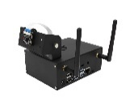
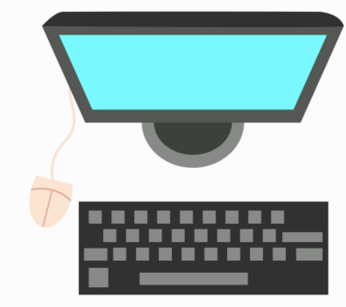

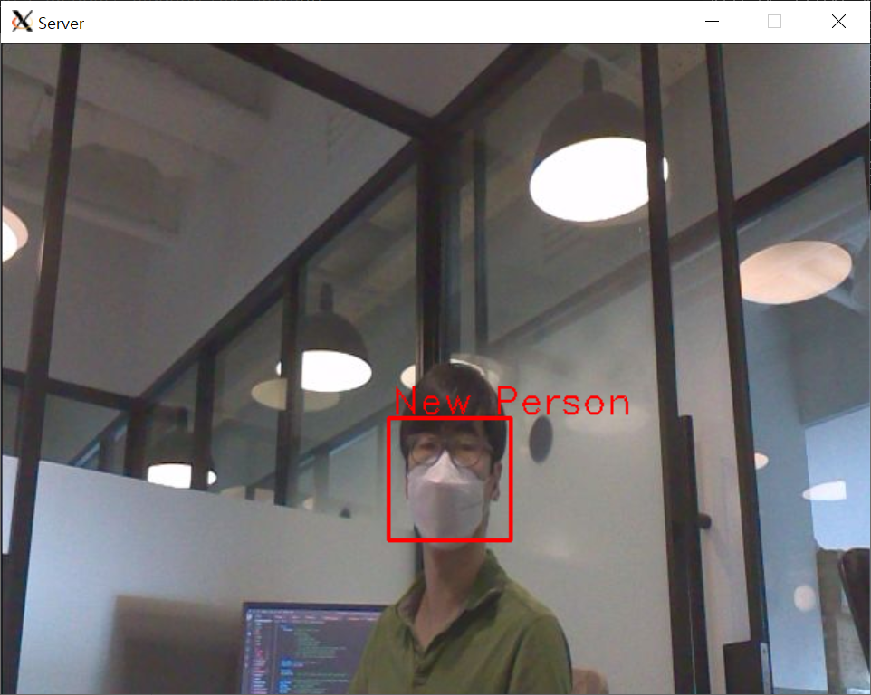
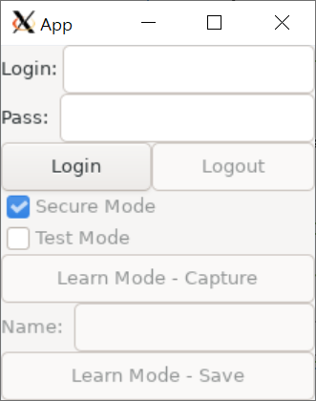
192.168.0.228:5000
TCP Connection
Face Recognition
Sever Program
Client Program
[TLS] secure channel for control data
camera
[TLS] secure channel for photo
TensorRT
libcertcheck.a
non-secure channel for photo
faceNet
[TLS] secure channel for face recognition info
libcertcheck_x64.a
file system
file system
CRT
CRT
Key
CA CRT
Key
CA CRT
Friends video
Face Image
Login info
faceNet model
machine learning model
source repo
.
└── source
├── client
│ └── src // client source codes
├── common
│ ├── keys
│ │ ├── ca // self signed root certificate
│ │ ├── client // CA signed certificate & Private key for client
│ │ └── server // CA signed certificate & Private key for server
│ └── libs
│ └── libcertcheck // crypto library to support crypto API and to verify the integrity of keys.
│ // the root key for the crypto API are included as a string with obfuscated.
└── server
├── facenetModels // the path of faceNet models
├── imgs // the path of the photo registered with name. the filename and contents are encrypted
├── mtCNNModels // the path of machine learning model in MTCNN_FaceDetection_TensorRT
├── src // server source codes
└── trt_l2norm_helper // TensorRT L2-Norm Helper
If the library is not obfuscated, the credentials are disclosed
libcertcheck_x64.a doesn’t display the key include ‘cmu’ string.
but libcertcheck_x64_no_obfus.a displays the key.

Slide 2
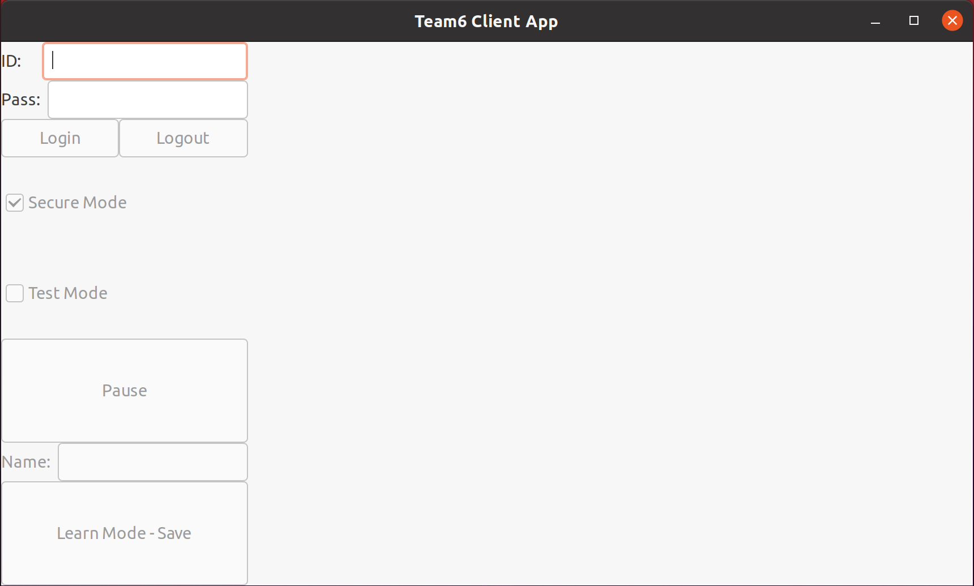
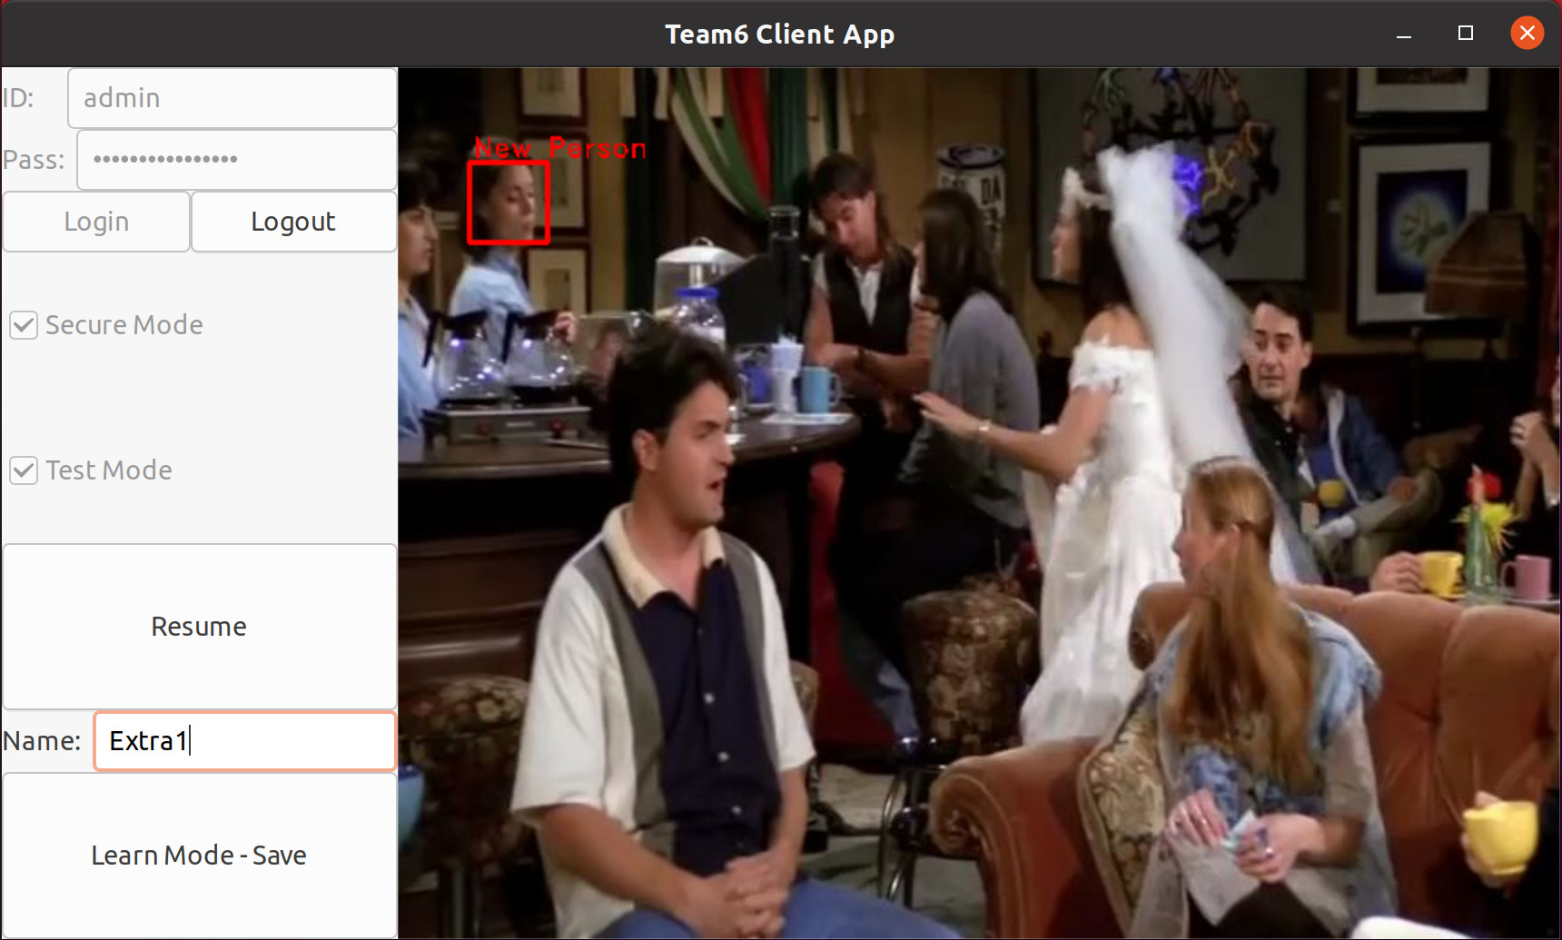
[Client Program Guide]
ID Input: Input ID (Alphabet and number are accepted only)
Pass Input: Input Password (Minimum eight characters, at least one alphabet, one number and one special character)
Login Button: Login with ID/PASS. connect with server
Logout Button: Logout. disconnect with server
Secure Mode Checkbox: Represented whether the photo is being transferred securely through TLS or not.
Test Mode Checkbox: Represented the point where is generated of photo. checked – camera, unchecked – file
Pause Button: The photo is stopped to register new person into the server.
Name Input would be enabled only when it’s pushed and the person exists with valid recognized face.
If you cannot get the face recognized photo, resume and pause again.
Name Input: The name of the person
Learn Mode – Save Button: Request the saving of photo to the server

Slide 3
Client State Diagram
logout
secure
run
change
run <> test run
mode
secure
test run
connect and
login success
with server
logout: sever and client are disconnected.
client can try to connect to server, and to send login request
secure run: can securely receive the image data
generated from server camera
secure test run: can securely receive the image data
generated from server media file
non secure run: can receive the image data
generated from server camera
non secure test run: can receive the image data
generated from server media file
learn: can request for saving the current received image
with name to the server
start program
change
learn <> *run *secure
mode
init
logout
change
secure <>
non secure mode
learn
change
secure <>
non secure mode
non secure
run
non secure
test run
change
run <> test run
mode
logout
end
The end state can be transmitted
from any state

Slide 4
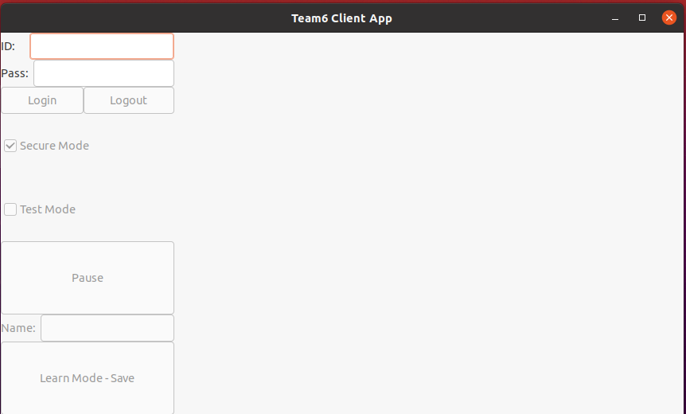
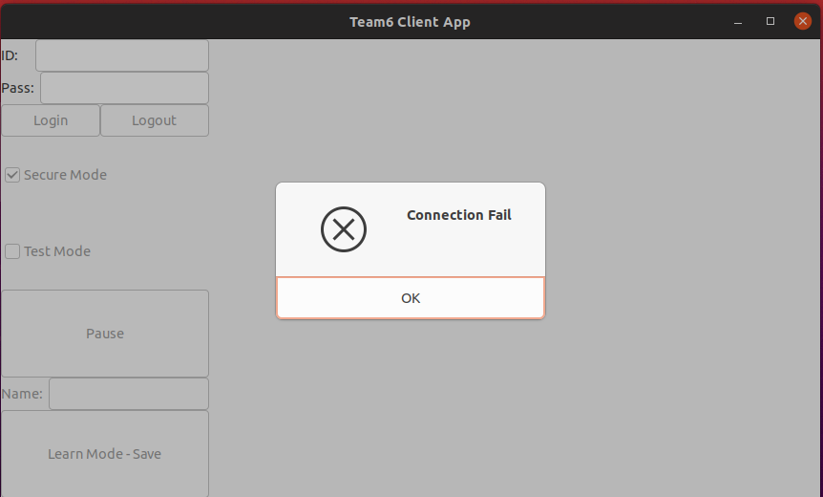
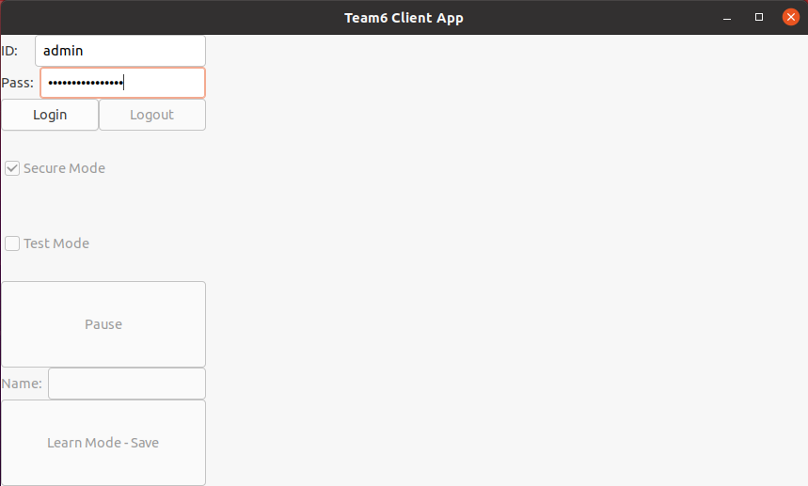
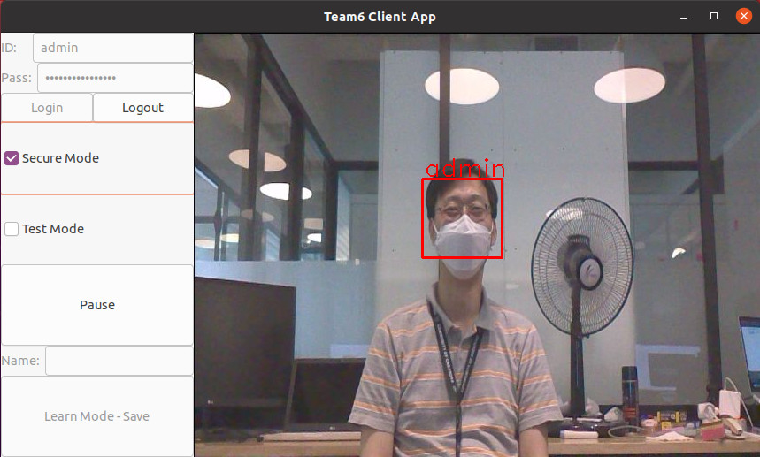
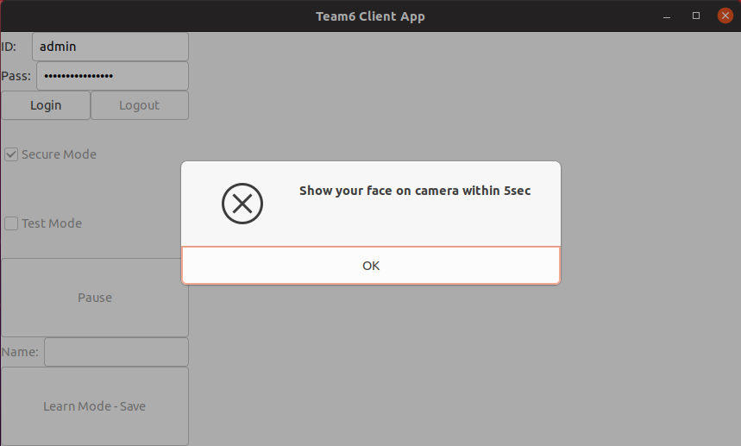

Slide 5
