Slide 1
CMU Security Specialist Course Team Project : Phase 1
Team 6 a.k.a. six senses
Seongju Moon (L)
Kyungnam Bae (E)
Jinmo Kim (A)
Jeonghwan Ahn (S)
* Byungchul Park (C)

Slide 2
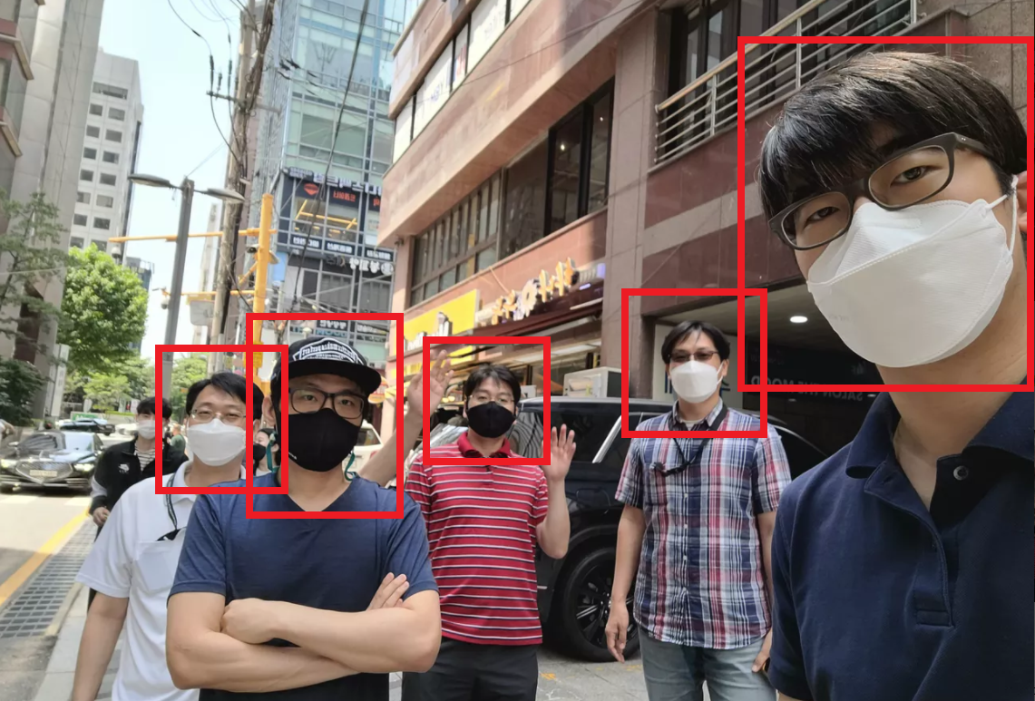
Mr. Bae
Mr. Kim
Mr. Park
Mr. Moon
Mr. Ahn

Slide 3
Define security goal
Define assets to protect
Do threat modeling
Do risk assessment to prioritize items
Define security requirements
Derive mitigations
Construct architecture
Implement the mitigations
Verify the mitigations

Slide 4
Define security goal
Define assets to protect
Do threat modeling
Do risk assessment to prioritize items
Define security requirements
Derive mitigations
Construct architecture
Implement the mitigations
Verify the mitigations

Slide 5
Define security goal
“ Protect the user privacy information in our system. ”

Slide 6
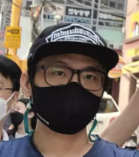
Define assets to protect
& name

Slide 7

Define assets to protect
#privacy #stalker
#name
& name

Slide 8
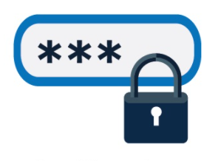
Define assets to protect
#privacy #stalker
#name
& name
#authentication #2FA
#face #recognition

Slide 9
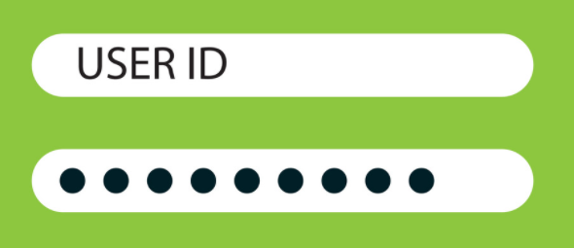
Define assets to protect

Slide 10
Define assets to protect
#authentication
#login #password

Slide 11

Define assets to protect

Slide 12
Define assets to protect
#privacy

Slide 13
Define assets to protect
#privacy
#authentication

