Slide 1
Zero Degree
- Kalyan Kumar
- Yash Krishan
- Prayansh Ratan Srivastava

Slide 3
Problem Statement
With the vision of Safe drinking water and sanitation facilities for all, at doorstep, at all times, WSSO intends to design and develop a state-of the art dynamic web-portal and an android app (optional). There are numerous hand pumps which supply drinking water across different blocks of different districts throughout the state. The main aim of the solution is to build an effective application through which we can ensure the quality/safety of drinking water coming from each hand pump.

Slide 4
Solution
An automated working technology should be implemented in which following will be key points:
1.The quantity of various parameters like total arsenics, fluorides, iron, nitrates E-coli Bacteria in various hand pump in different part of the state will be collected from website - www.mdws.gov.in which is updated regularly.
2.Check for provided permissible limits(refer to the table) of all the parameters present in the sample of drinking water obtained from a particular hand pump.
3.If any parameter exceeds the permissible limit then web or mobile application/software will mark the location of the pump (obtained from the website).
4.It sends the notification to nearest doctors, engineers, political leaders and stakeholders.

Slide 5
5.It also tells the respective official about the harmful effects of the parameter which has exceeded the permissible limit.
6.For a particular hand pump application will suggest the concerned officials what could be the steps they can take to eradicate the situation.
7.After the officials receive the notifications, they carry on the work from their side and send the updates regarding maintenance and updated concentration to the server.
8.Doctors, engineers, political leaders and stakeholders also update what actions they have taken in each step of the process.
9.Completing this process, the app will ensure the quality of each hand pump present in the state.
10.It will help in making the society alert by sending the notification in the application to all the people who have downloaded it and send a message to the concerned department (health, engineering, political, stakeholders) to make people alert and prepared for the upcoming catastrophe/threats/health hazards and epidemics

Slide 6
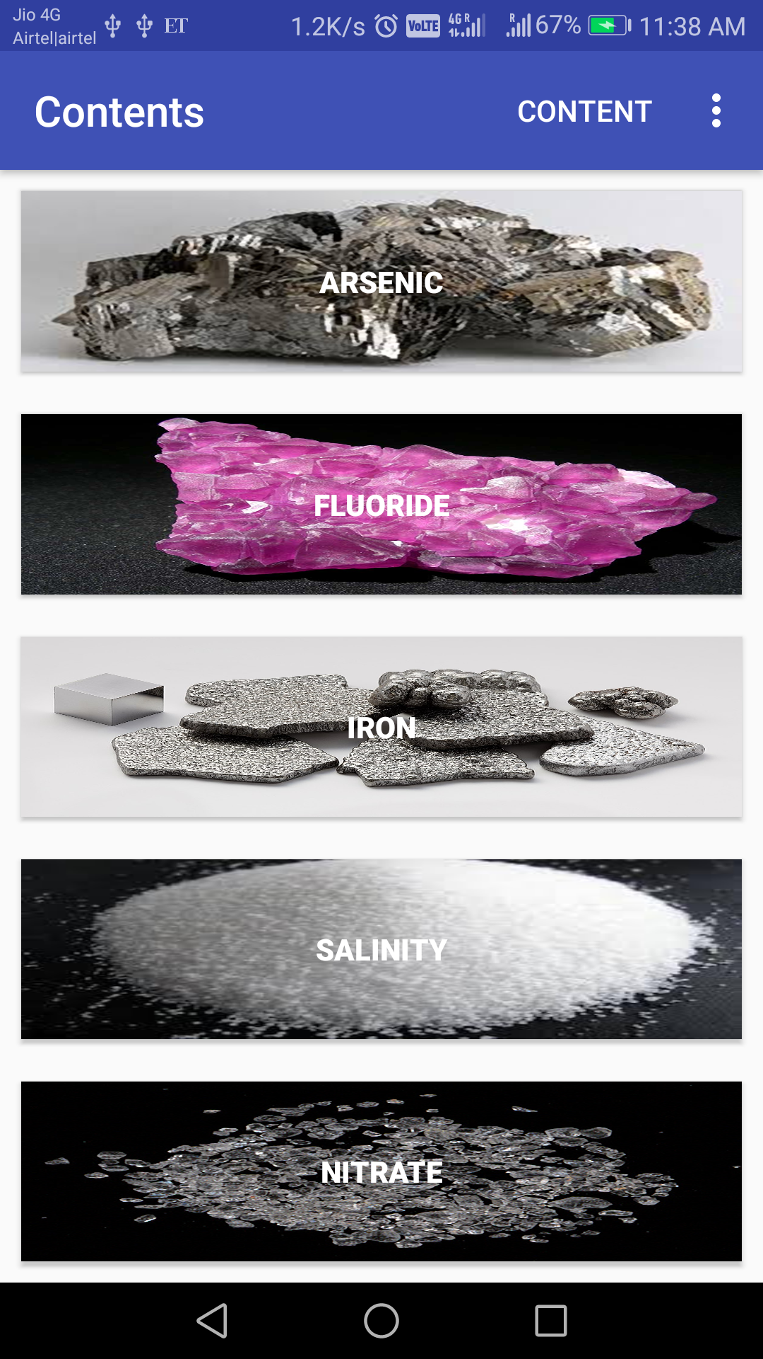
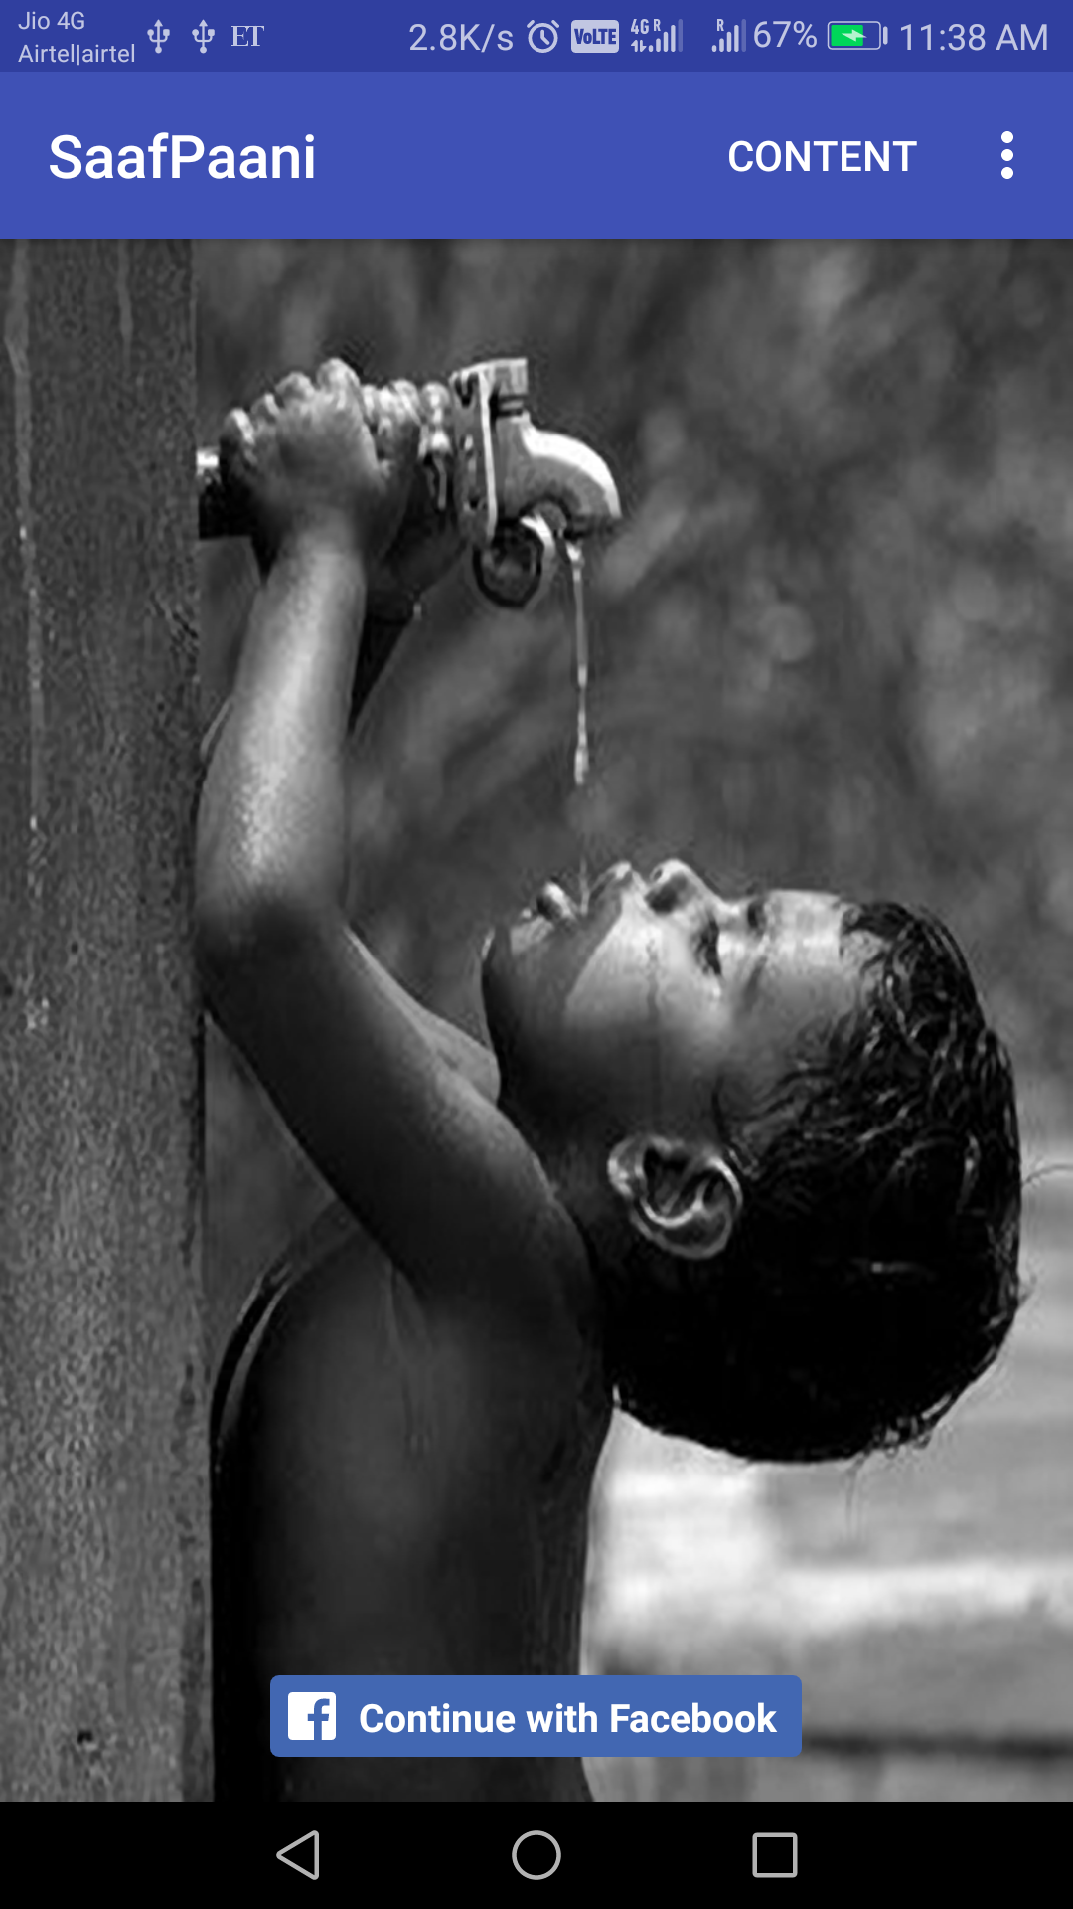
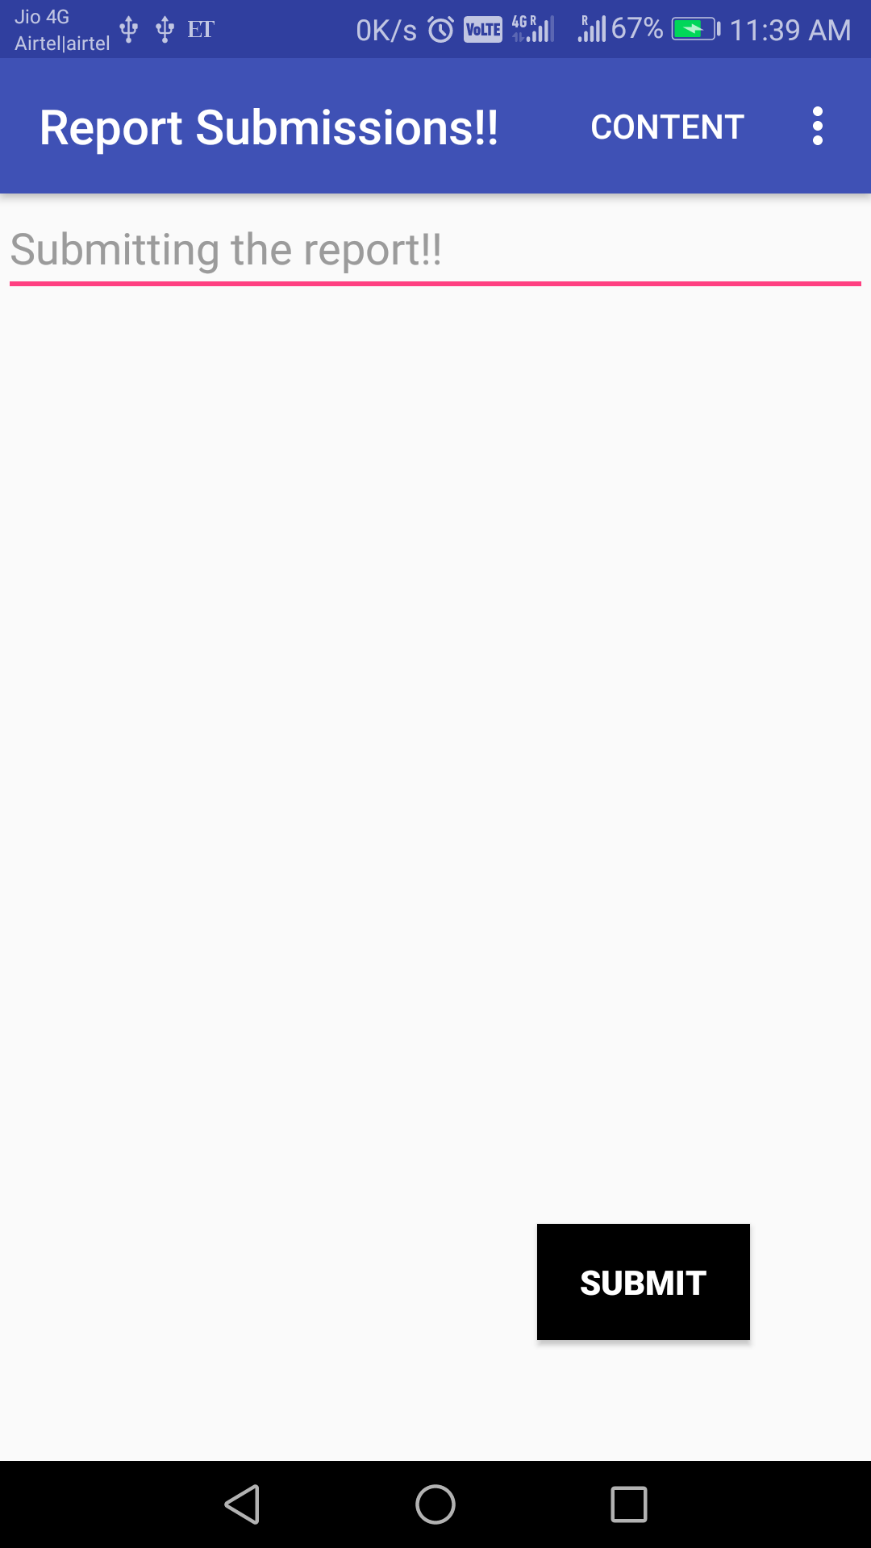
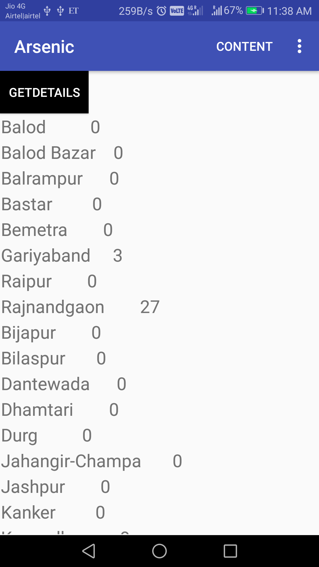
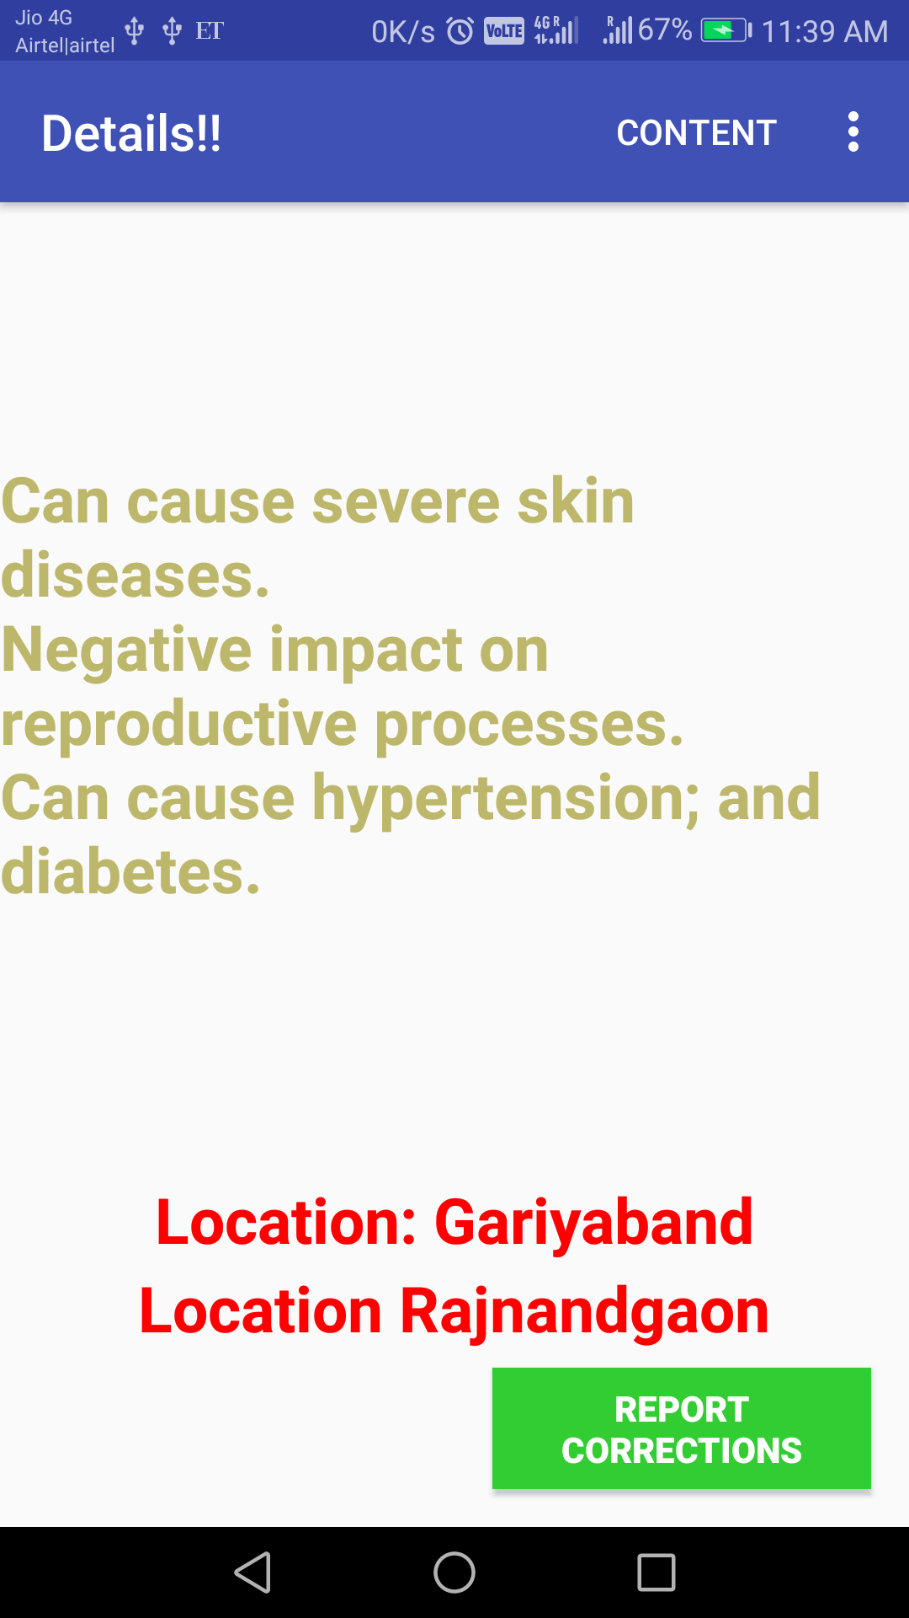
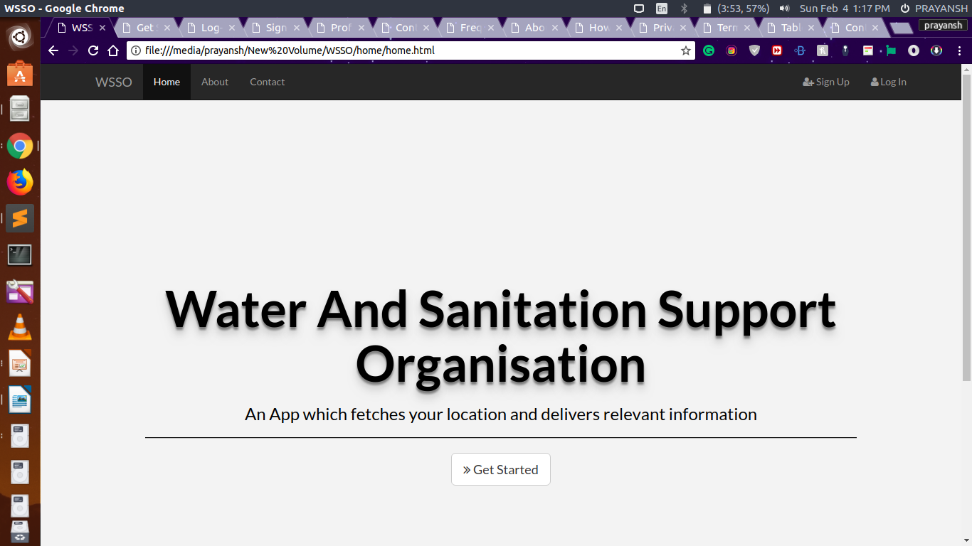
Additional Support Documents

