Slide 1


Slide 2

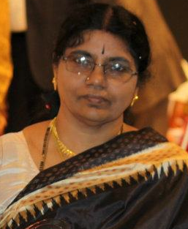
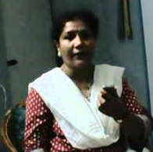
Ithu Pazasu
Thevaram
(Malini Ravindran – Retd. H.O.D.
Tamil Department)

Slide 3
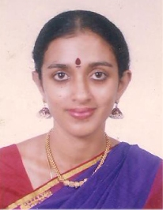
Past forward
Pallavas
(Anjana – Performer & Teacher)

Slide 4
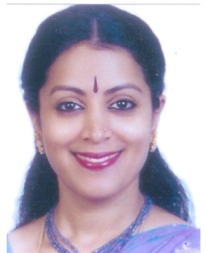
Legends
Down Memory Lane - Ted Shawn
(Sreelatha Vinod – Performing Artiste,
Teacher & Research Scholar)

Slide 5
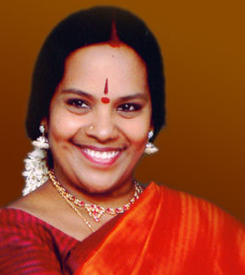
Food for thought
History of Tāla
(Sasirekha Raammohan – Teacher,
Research Scholar)

Slide 6
Kathai kathaiyam
‘Ārutalai tarum Āŗupaţai’
(Malini Ravindran – Retd. H.O.D.
Tamil Department)

Slide 7
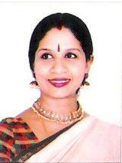
Ithu puthusu
Navarāgamālikā
(Sri Mudhraalaya Repertoire)

Slide 8
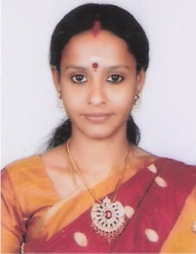
Tic-toc
Quiz

Slide 9
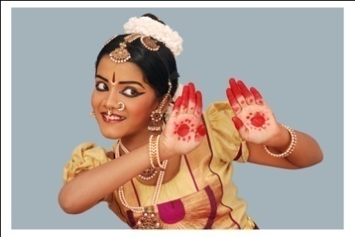
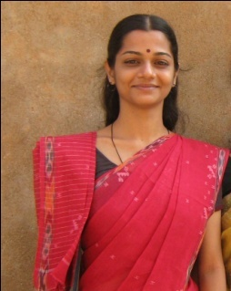
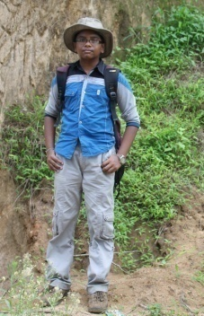
Book mark
Toppers in Yathnam exam,
August 2012
Shruthe Raammohan Subhashini Vignesh Raammohan
( Smt. Sasirekha Raammohan ) ( Smt. Saikripa Prasanna) (Smt. Sasirekha Raammohan)

Slide 10
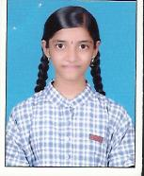
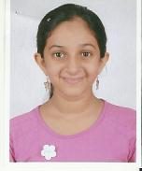
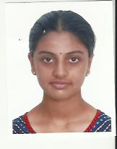
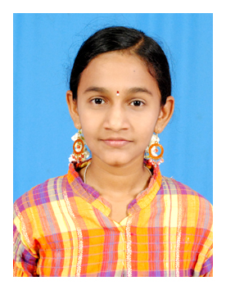
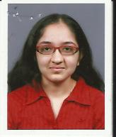
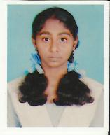
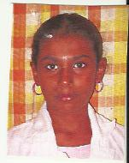
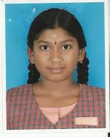
A Ayshwaryaa Ananya Devarakonda Amrutha Gurumoorthy Samyuktha Balaji
(Smt. Himaja Ramsharan ) (Smt. Gayathri Sasidharan) (Smt. Jayanthi Subramanian) (Smt. Divyasena)
Niveditha S Ajita V Dharini B Vandhana K
(Smt. Manjari) (Smt. Saikripa Prasanna) (Smt. Sreelatha Vinod) (Smt. Vanee Gayathri)

Slide 11
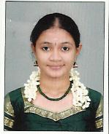
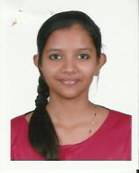
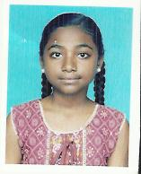
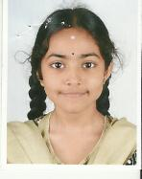
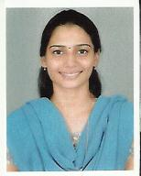
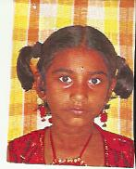
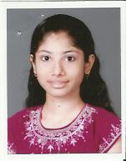
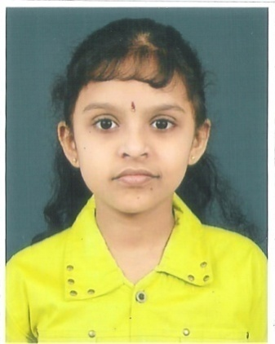
Manasa B Atulya Vipin S Harshini Aparajitha S
(Smt. Divyasena) (Smt. Gayathri Sasidharan) (Smt. Himaja Ramsharan) (Smt. Jayanthi Subramanian)
Gayathri Nithyasri R B M Hema Mohanapriya N
(Smt. Saikripa Prasanna) (Smt. Sreelatha Vinod ) (Smt. Himaja Ramsharan) (Smt. Lakshmi Ramaswamy)

Slide 12
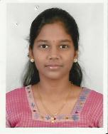
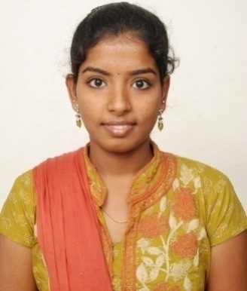
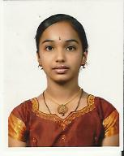
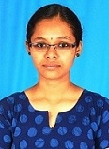
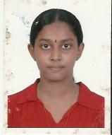
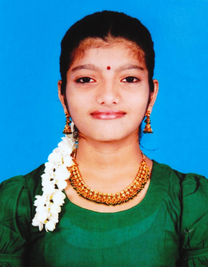
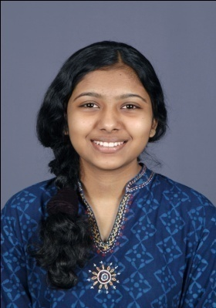
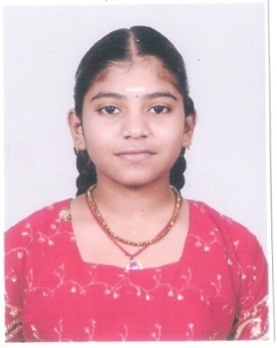
R Rukmani Bharathi R Subhikshaa S Niveda C
(Smt. Himaja Ramsharan) (Smt. Lakshmi Ramaswamy) (Smt. Himaja Ramsharan) (Smt. Divyasena)
Sreenedhi C S Amrutha Innisai Rajasabai Hemamalini R
(Smt. Himaja Ramsharan) (Smt. Anjana Anand) (Smt. Anjana Anand) (Smt. Lakshmi Ramaswamy)

Slide 13
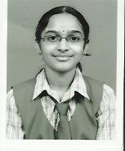
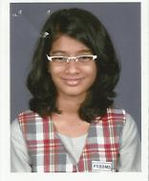
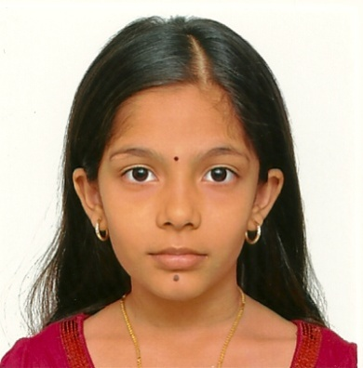
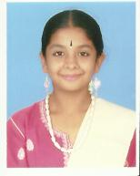
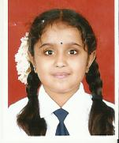
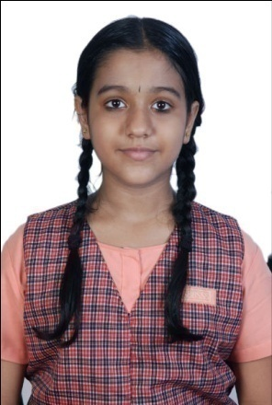
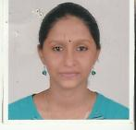
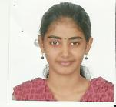
Mridula Sridhar Rithika Shankar Tushya K Manasa B
(Smt. Gayathri Sasidharan) (Smt. Gayathri Sasidharan) (Smt. Sreelatha Vinod) (Smt. Jayanthi Subramanian)
Shruthi K Sruthi K SudarshanaLakshmi K Niveditha Raghavan
(Smt. Jayanthi Subramanian) (Smt. Jayanthi Subramanian) (Smt. Jayanthi Subramanian) (Smt. Lakshmi Ramaswamy)

Slide 14
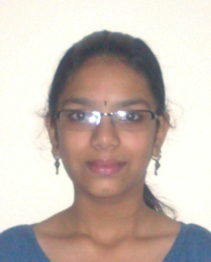
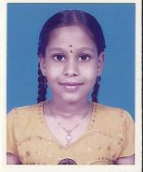
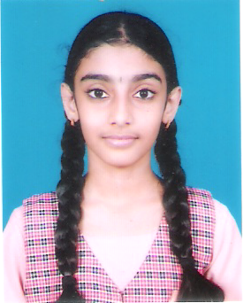
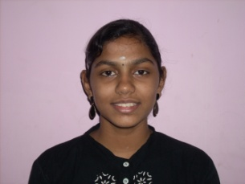
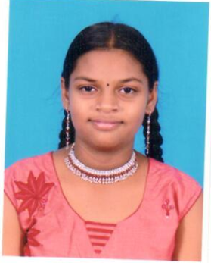
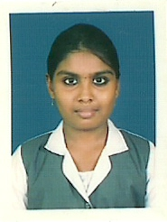
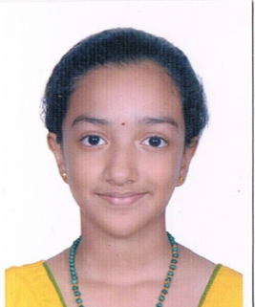
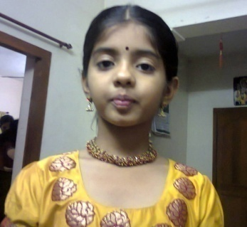
Vaishinavee Nishitha N Karthika Aiswarya Ramanan
(Smt. Lakshmi Ramaswamy) (Smt. Lakshmi Ramaswamy) (Smt. Himaja Ramsharan) (Smt. Divyasena)
R Jyothikrithika A Shoba Sweta Chakravarthi R.Swathy
(Smt. Himaja Ramsharan) (Smt. Himaja Ramsharan) (Smt. Radhika Vairavelan) ( Smt. Sreelatha Vinod)

Slide 15
THANK YOU

