Slide 1


Slide 2
Milestones
&
Achievements

Slide 3
History and Evolution of Prayathnam
Activity Report for
2008
2009
2010
2011
Way Forward

Slide 4
Started in August 2008 with the blessings and good wishes of senior dancers and teachers including
Sri. Narasimhachari
Smt. & Sri. Dhananjayan
Smt. Chitra Visweswaran
Smt. Sudharani Raghupathy
Sri. Lakshman
Others

Slide 5
2008

Slide 6
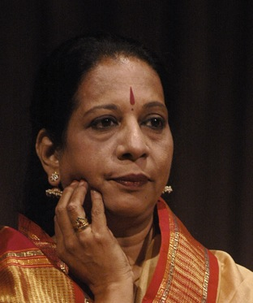
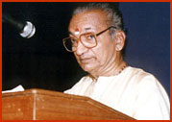
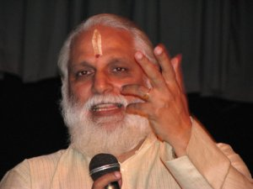
Events - 2008
Lecture by Prof. Raghuraman on ‘Chitrillakiyam’
Lec-dem by Smt. Nandini Ramani
Lec-dem by Sri. Udipi Lakshminarayanan
Workshop by Smt. Piyal Bhattacharya on ‘Karanas’
Ongoing class by Smt. Kalanidhi Narayanan on Padams

Slide 7
Events - 2008
Margam format program by Prayathnam members at MFAC in the December festival season
Selected Sai Kripa and Radhika to stage the program; their production at Nritya Samarpanam series in Parthasarathy Sabha was adjudged as the BEST production of the season
Organized a lec-dem in association with Kalakshetra by Smt. Swapnasundari

Slide 8
2009

Slide 9
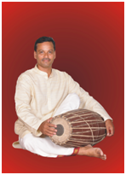
Events - 2009
Yathnam exams conducted in august with common syllabus and examinations
Lec Dem by Smt. Chitra Visweswaran
Abhinaya Darpanam classes by
Prof. C.V. Chandrashekar
Lec on Nattuvangam by Sri Haribabu

Slide 10
Events - 2009
On going sessions in understanding the nuances of Balamma’s style which continued on until 2010, which led to a dance workshop by Smt. Priyamvada at the Sanskrit College
Smt. Rajeshwari organized another show at Kelambakkam inviting Prayathnam member Sri. Gopinathan and troupe

Slide 11
Events - 2009
Smt. Sai Kripa coordinated a Navarathri festival program in Chrompet featuring Prayathnam teachers and students
Ongoing classes in understanding Padams and Javalis by Sri. V.A.K.Ranga Rao
Ongoing Padam classes by Smt. Kalanidhi Narayanan
Ongoing Padam classes by Smt. Bragha Bessell

Slide 12
2010

Slide 13
Events - 2010
Lecture by Sri. Ramesh Bhat of the auditing firm Aniram on ‘Administration of a Dance School’
Lec-dem by Smt. Lakshmi Ramaswamy on ‘Vakrothi’
Nritya Samarpanam series featuring different dance schools

Slide 14
Events - 2010
Ongoing classes by Smt. Kalanidhi Narayanan
Ongoing classes by Smt. Bragha Bessell
Lec-dem by Sri. Sadanam Balasubramanian on Techniques of Kathakali and Netra Abhinaya

Slide 15
Events - 2010
Coordinated the ‘Disha’ series in association with Kalakshetra to showcase young talent of various styles performed at Tagore hall in Kalakshetra
Rasa Manjari classes by Dr. Pappu Venugopala Rao that inspired him to write the book
Master classes in association with the Dhananjayans and Sri Krishna Gana Sabha during the Natyakala Conference
Conducted a 3 day Natyakala Conference for the Alva Educational Institution in Mangalore for the BA and MA students

Slide 16
2011

Slide 17
Events - 2011
Lecture by Sri. Jayachandran on ‘Temple and its Functions’
Lecture by Dr. Pappu Venugopala Rao on ‘Research Methodology’
Yathnam exams for 3 levels held at Little Oxford school in August

Slide 18
Events - 2011
Ongoing classes with Smt. Kalanidhi Narayanan
Ongoing classes on by Dr. Bhuvaneshwari on ‘Abhinava Bharathi and the Natyashastra
Parivarthanam Series

Slide 19
2012

Slide 20
Events - 2012
Yathnam exams for four levels held at Little Oxford school in August
Ongoing classes with Smt. Kalanidhi Narayanan
Ongoing classes on by Dr. Bhuvaneshwari on ‘Abhinava Bharathi and the Natyashastra
Parivarthanam Series

Slide 21
2012
Annual day celebrated on Nov 2012
Smt. Y.G.Parthasarathy, Sri. V.P. Dhanenjayan and Sri.Jawahar, Comisiioner of Art and Culture
Audio Visual Presentation of four level syllabus by all the candidates of Yathnam exams
Release of M.A.D.A.L – Movement for Artistic Development And Training

Slide 22
Milestones - 2012
Release of revised second edition of YATHNAM book
YATHNAM exams conducted in Trichy
Lec-dem for Nadhabrammam

Slide 23
`
2013

Slide 24
Events - 2013
Lec dem by Sri. Mosilakanti Kishore on ‘Shabdham’
Lecture by Sri. Jayachandran on the topic ‘ When Light moves’
On-going discussions ‘Vivadha Medai’ on various topics, like Tamil Composers, Telugu Composers etc.

Slide 25
Way Forward

Slide 26
2011-2012
Leverage Social Networks
Planning to launch a Newsletter
Offered a slot in Chidambaram Natyanjali Festival
To conduct JanaBharatham in Schools and colleges in association with Natyarangam
Blog / Tweet Workshop

Slide 27
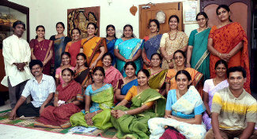
Thank You!

Slide 29
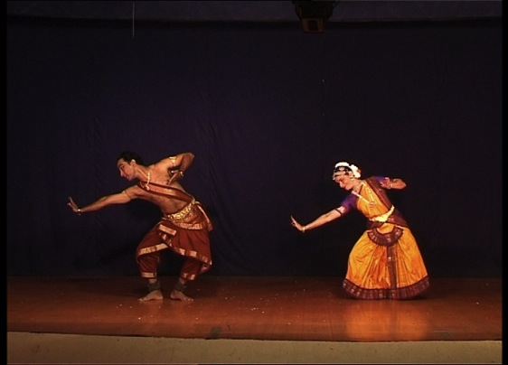
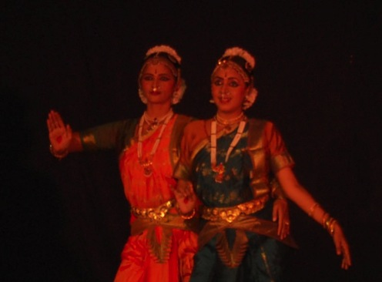
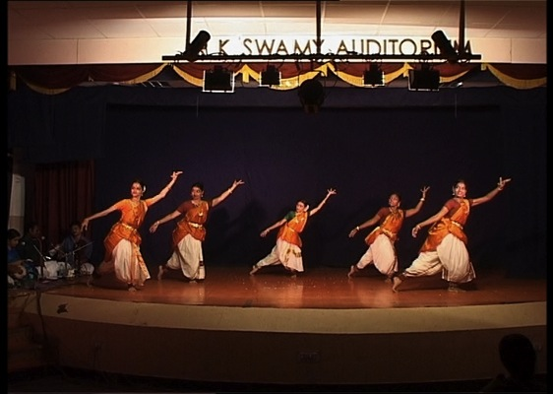
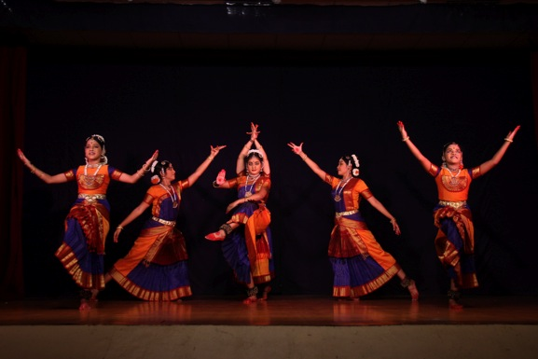
Nritya Samarpanam

Slide 30
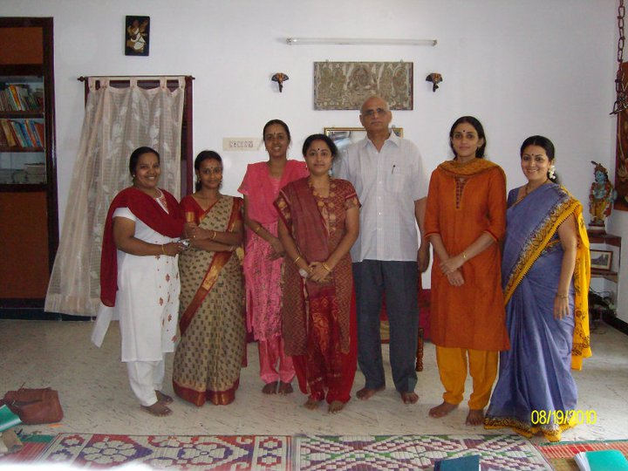
Rasamanjari by Dr. Pappu Venugopalrao

Slide 31
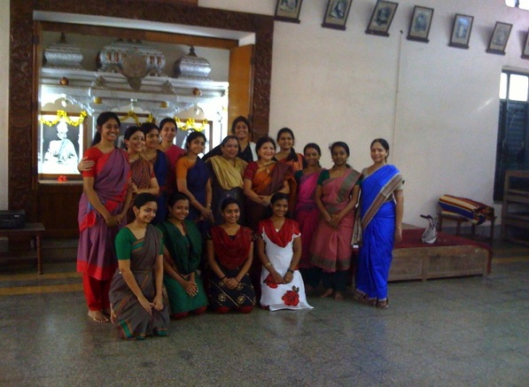
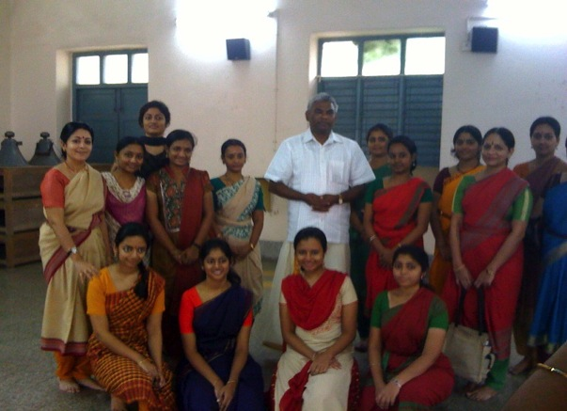
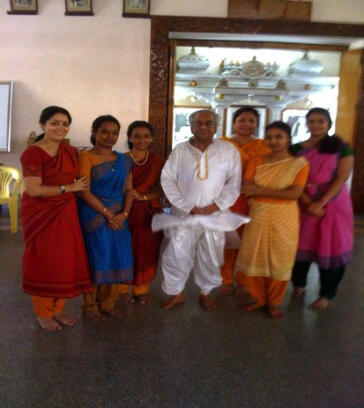
Natyakala Conference

Slide 32
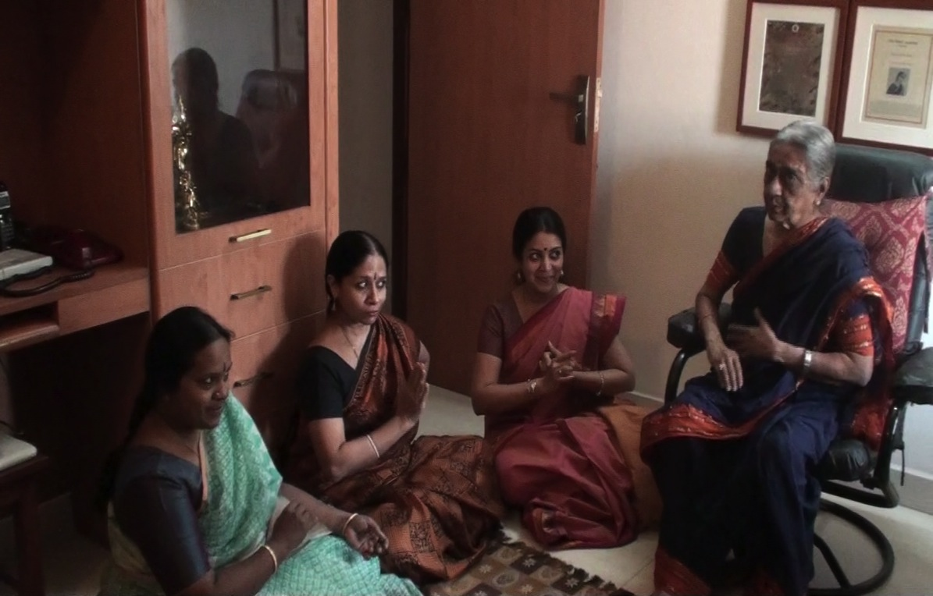
Padam class by Kalanidhi Maami

Slide 33
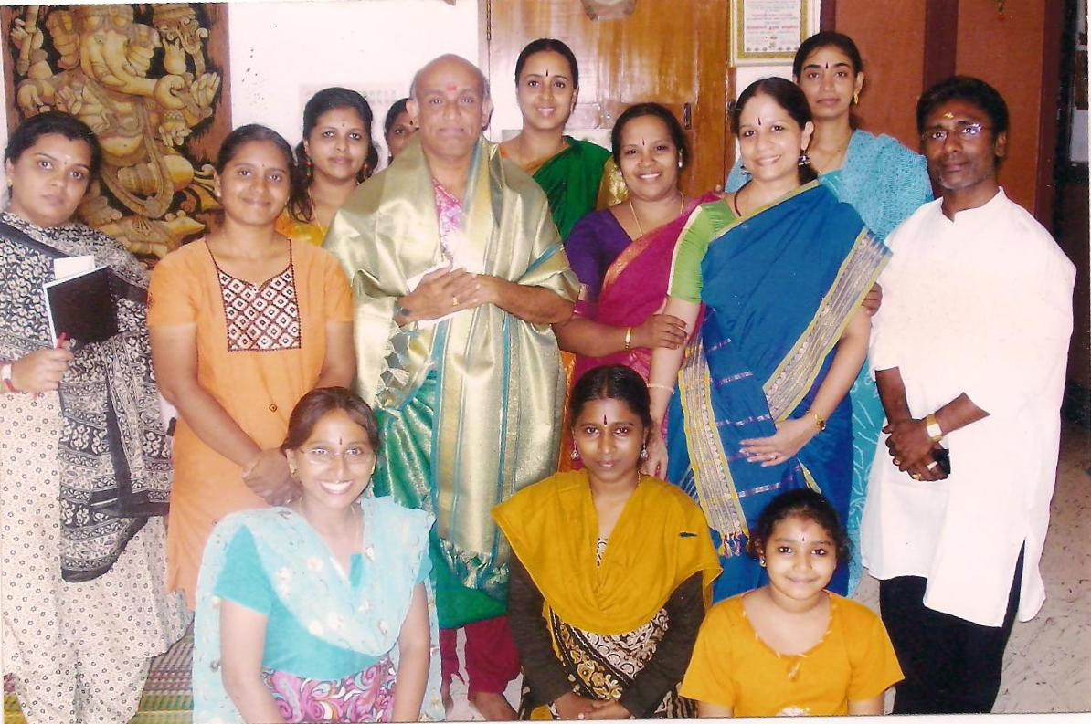
Lec dem By Sri Sadanam

Slide 34
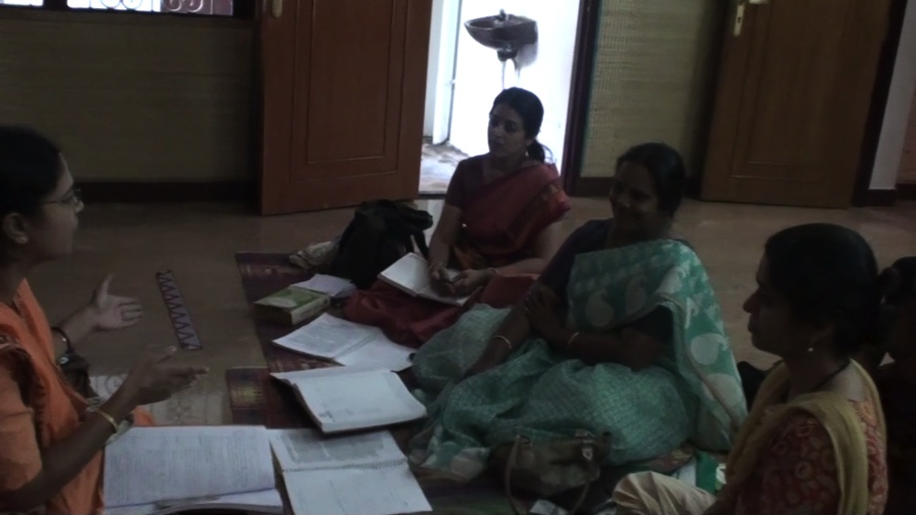
Natyashastra by Dr. Bhuvaneshwari

Slide 35
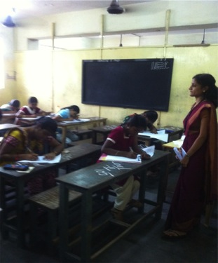
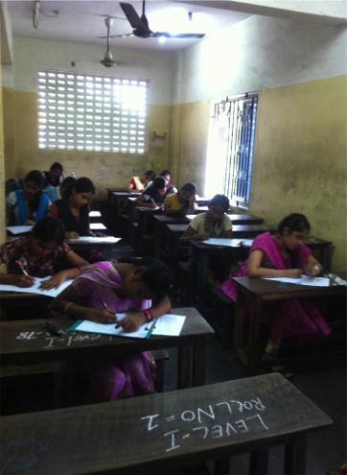
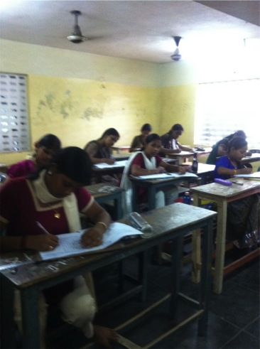
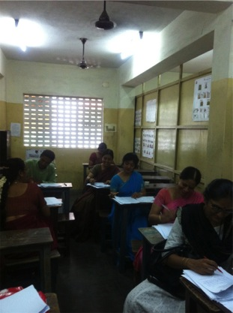
Yathnam Exams 2011

Slide 36
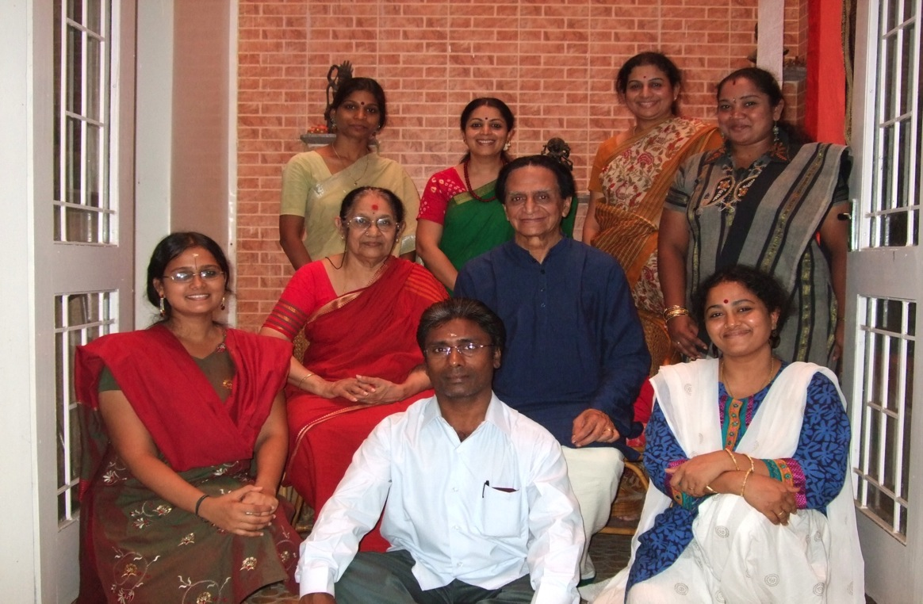
Class by Prof. CV Chandrashekhar

Slide 37
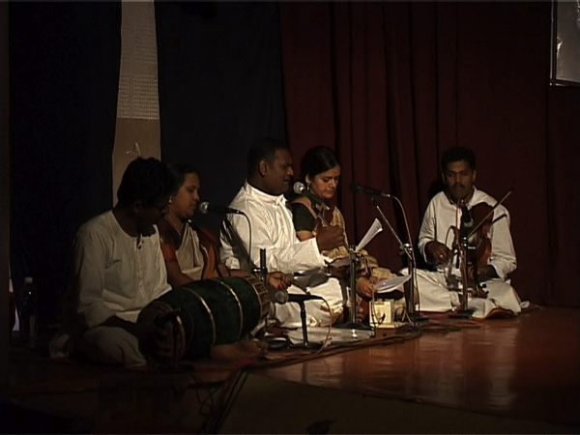
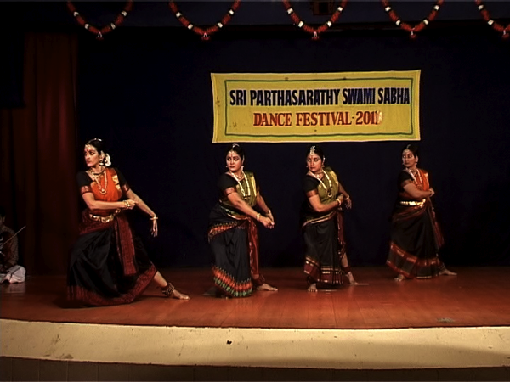
Nritya Samarpanam Series

Slide 38
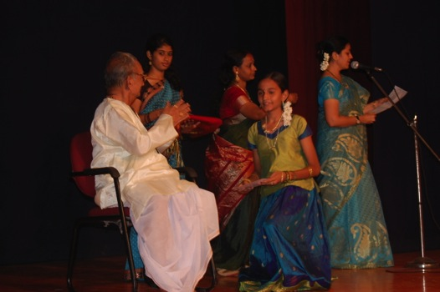
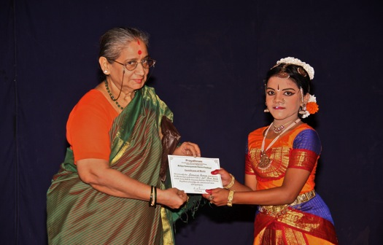
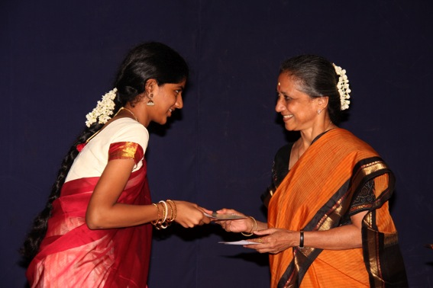
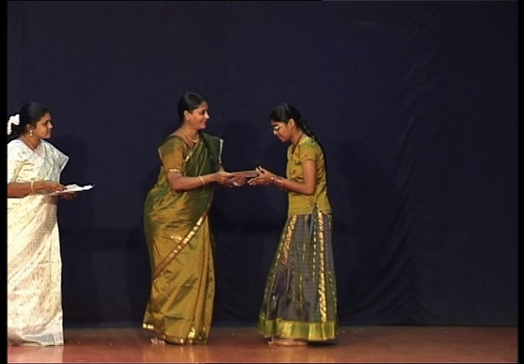
Yathnam Certificates

Slide 39
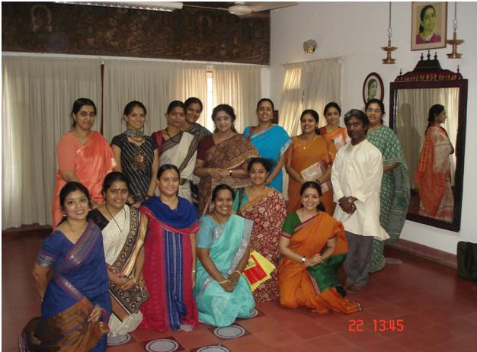
Lecture by Smt Chitra Visweswaran

