Slide 1
PSE × SALESMAX
Inventory Wiring
Open-Source Visual Packet
01
PRIVATE MASTER
02
PUBLISH GATE
A controlled, secure path from SalesMax inventory to pilotsalesdistribution.com
03
PUBLIC-ONLY FEED
Architecture • Data controls • API contract • Security • Release gates • Deployment handoff
04
PSE WEBSITE
OPEN-SOURCE MASTERED GAUNTLET v4.0
Deterministic open-source handoff; production still requires repository, hosting and SalesMax runtime access.
Prepared August 3, 2026
Visual edition derived from the verified master gameplan, connected inventory sheets and live website audit.

Slide 2
01 / EXECUTIVE DECISION
Controlled publication - never a direct private-sheet connection
The website must consume a buyer-safe public feed through a server-only API.
PROHIBITED
RECOMMENDED
Browser / website
1
2
3
4
5
6
7
Source intake
Reconcile
Private master
Publish gate
Public feed
Server API
Website
Private inventory master
Non-negotiable rule
The browser never receives credentials for, or queries, the private inventory master. Only approved buyer-safe records cross the publication boundary.
Leaks credentials, supplier identity, acquisition cost, proof files and unpublished deals.
Protects: suppliers • cost/margin • proofs • owner notes • unpublished inventory
Source: PSE x SalesMax Inventory Wiring Master Gameplan, Executive Decision and Target Architecture.

Slide 3
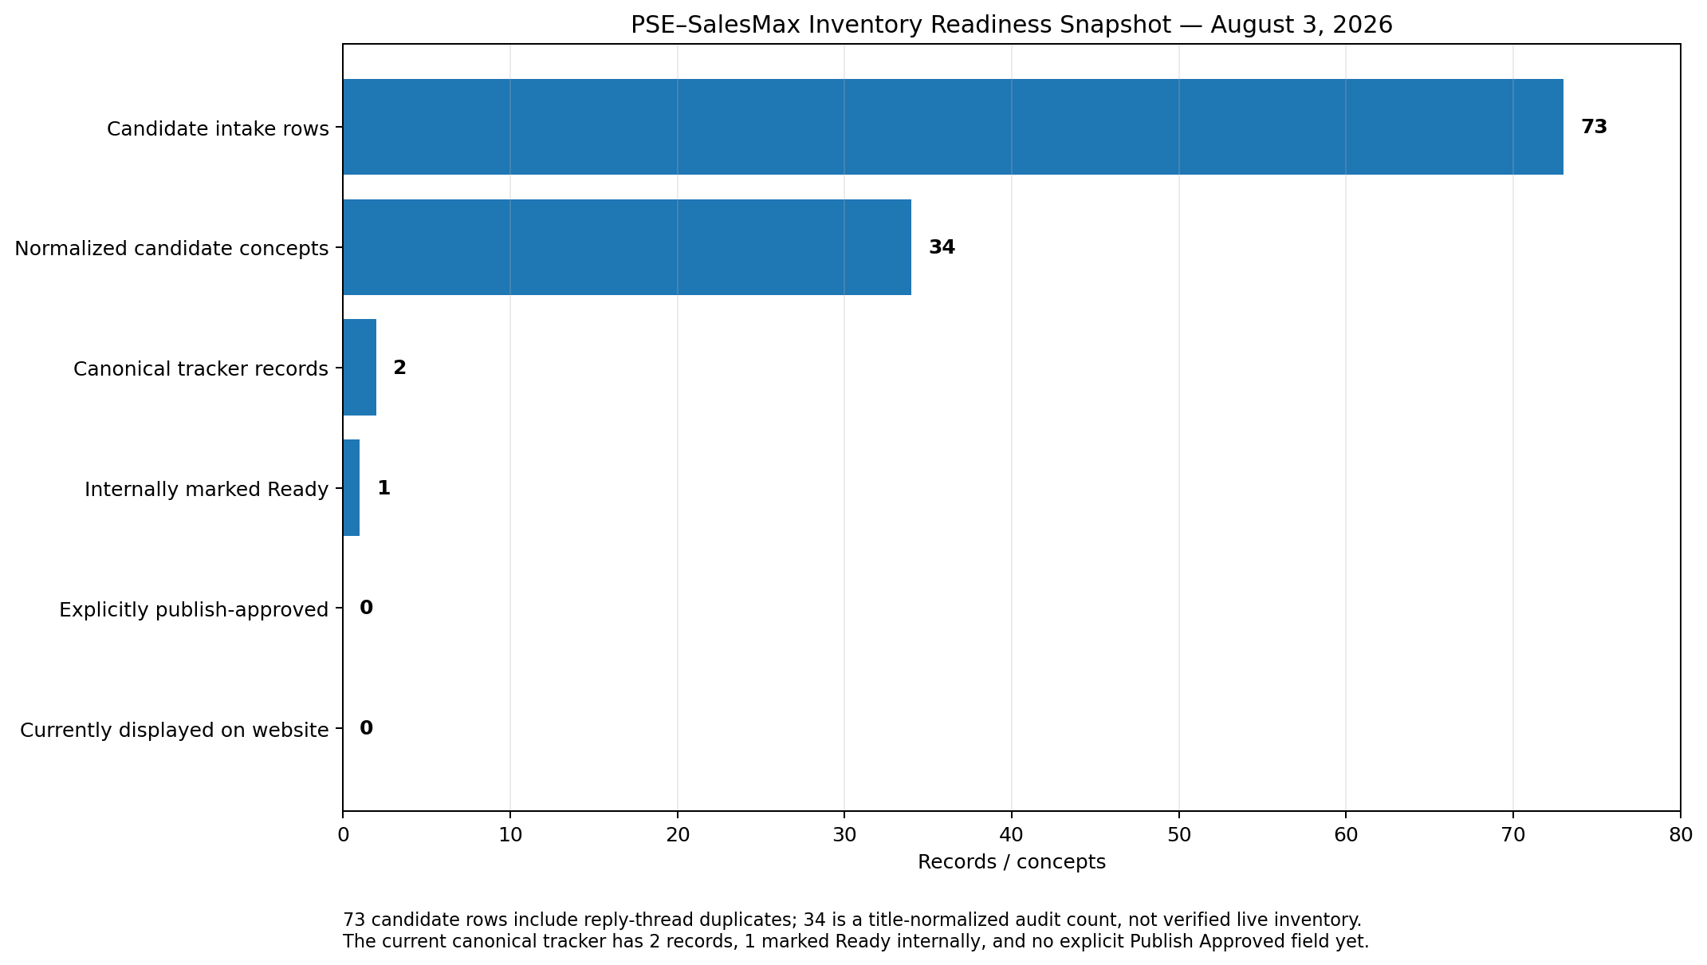
02 / VERIFIED CURRENT STATE
Inventory exists in working files - but nothing is explicitly approved for publication
The gap is not a website grid problem; it is a truth, approval and publication-control problem.
0
2
73
33
0
Products displayed
Canonical tracker records
Candidate intake rows
Normalized title clusters
Publish-approved records
Public catalog integration is not live.
12,700 units represented.
Historical / candidate evidence.
Title-level audit count only.
Explicit field does not yet exist.
Readiness defects
40
rows beyond first in title clusters
15
rows without a usable quantity
73/73
missing proof + live availability timestamp
1
record marked Ready internally
Candidate ≠ sellable inventory
Source: live website audit; PSE Wholesale Hub Live Deal Tracker; PSE Caden Share Deal Intake + Outreach Status.

Slide 4
03 / AUDIT FINDINGS
Five defects must be corrected before public inventory can be trusted
Each defect can create stale, misleading or privately exposed inventory.
01
NOW() is not a sync timestamp
02
Dashboard totals are not status-filtered
03
Internal cost is not public selling price
It proves only spreadsheet recalculation - not supplier confirmation, hub sync, API sync or website release.
Future Sold, Hold or Archived rows could still be counted in “active” totals.
The master contains wholesale acquisition cost and market references, not an approved buyer price.
04
Publication-control fields are missing
05
Website claims outrun verified data
No explicit Publish Approved, public slug, MOQ, public image set, freight enum or availability expiry.
Filters, ratings, free-shipping language and promotional counters are not reliably sourced from inventory.
P0 action: replace blanket claims with feed-backed metrics and product-level freight, availability and inspection terms.
Source: tracker formula audit and live public-site content review, August 3, 2026.

Slide 5
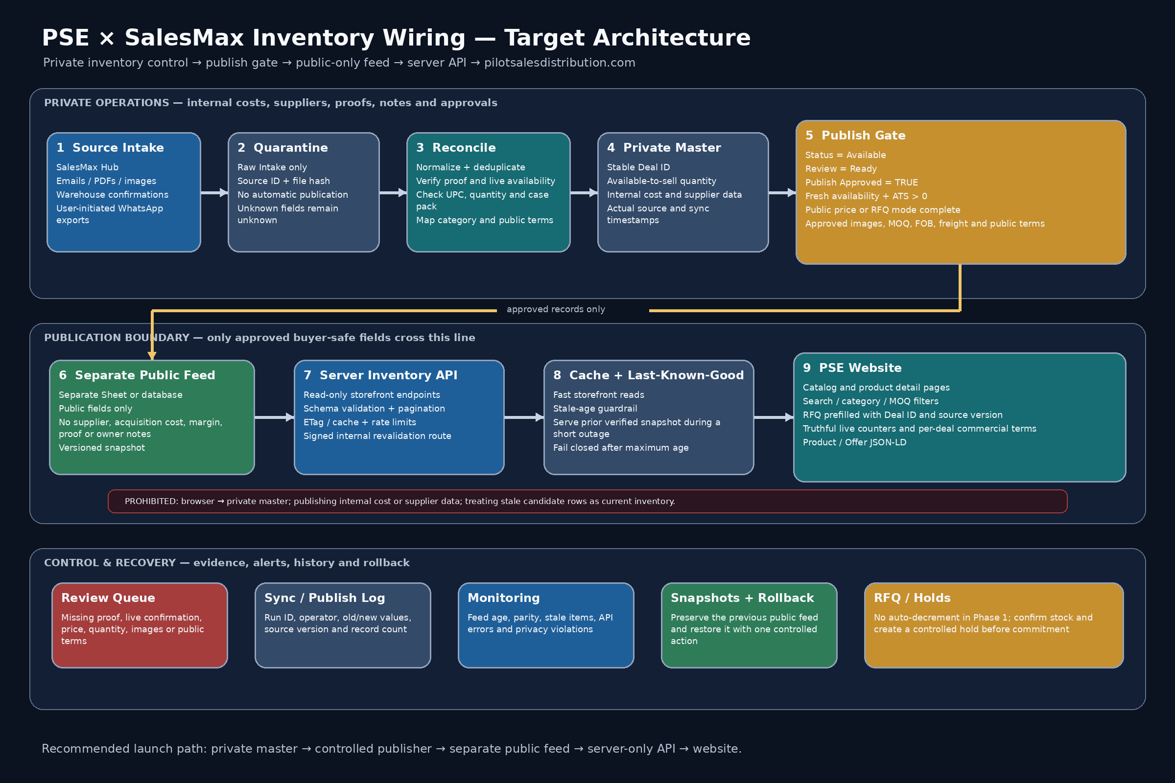
04 / TARGET ARCHITECTURE
The controlled path from source evidence to public catalog
Nine isolated stages, one publication boundary, and a separate control-and-recovery plane.
RECOMMENDED LAUNCH PATH
Architecture artifact included in the technical handoff packet.

Slide 6
05 / TRUTH HIERARCHY
One source of truth at each layer - no competing inventory masters
Candidate rows may enter review, but they never bypass reconciliation or approval.
1
Verified SalesMax Hub database
Future canonical source after runtime inspection and evidence.
CANDIDATE INTAKE
73 historical / candidate rows
2
Private Canonical Master
Current operational truth until the Hub runtime is verified.
May contain repeated email replies, auto-replies, stale offers, missing proof, missing quantities and outdated availability.
3
Separate Public Inventory Feed
Generated only by the controlled publisher.
4
Validated API + cache
Read-only buyer-safe distribution layer.
RAW INTAKE + REVIEW ONLY
5
pilotsalesdistribution.com
Presentation, search and RFQ - never a data authority.
Deduplication hierarchy: Deal ID → thread ID → UPC/model → supplier SKU → source hash. Fuzzy title match is review-only.
Source-of-truth hierarchy and deduplication rules from the master gameplan.

Slide 7
06 / DATA BOUNDARY
Private operational intelligence stays private
The publisher uses a strict allowlist to emit a separate buyer-safe record.
PRIVATE CANONICAL
PUBLIC BUYER-SAFE
Never sent to the public feed
Allowed only after validation
Supplier identity
Acquisition cost
Deal ID + slug
Public title
ALLOW
LIST
Sell floor
Margin / spread
Category
Condition
Proof links
Source identity
Available to sell
MOQ
Owner notes
Payment instructions
Public price / RFQ
FOB + freight
Credentials
Private files
Approved images
Last verified
A “Public” tab inside the private workbook is not a sufficient security boundary. Use a separate file or database view.
Public/private field boundary and Google-Sheets file-level authorization principle.

Slide 8
07 / PUBLICATION GATE
Every condition must pass - one failure blocks the record
“Ready” is an internal review state. “Publish Approved” is a separate explicit owner decision.
Status = Available
Public terms complete
Not Draft, Hold, Sold or Archived
Title, category, condition, MOQ and FOB
Review Status = Ready
Valid pricing mode
All operational verification complete
PUBLISH
APPROVED
Public, Login or RFQ
Available To Sell > 0
Freight terms approved
On hand minus reserved inventory
No blanket shipping assumptions
TRUE
Freshness window valid
Approved images exist
Live availability is not stale
Buyer-safe media only
No blocking issue open
Explicit owner approval
Review Queue contains no P0 blocker
ANY SINGLE FAILURE = DO NOT PUBLISH
Publish Approved = TRUE
Publication boundary rules from the master gameplan and public JSON schema.

Slide 9
08 / FRESHNESS AND INVENTORY LIFECYCLE
Visibility changes automatically as availability ages
Store a per-record expiration timestamp; never infer freshness from a dashboard clock.
0-24 HOURS
24-72 HOURS
OVER 72 HOURS
SOLD / WITHDRAWN
AVAILABLE / LIMITED
CONFIRM AVAILABILITY
AUTO-UNPUBLISH
REMOVE IMMEDIATELY
Display according to available-to-sell.
RFQ only; no instant commitment.
Reconfirmation required before return.
Publish new snapshot and invalidate cache.
Available-to-sell calculation
Phase 1 commercial rule
An RFQ does not decrement inventory. Sales confirms availability, then creates a controlled hold before making a commitment.
UNITS ON HAND
−
RESERVED
=
ATS
NO CHECKOUT YET
Recommended launch freshness policy; thresholds may be tightened for faster-moving deals.

Slide 10
09 / PUBLIC API CONTRACT
A read-only, schema-validated storefront interface
The API serves only the public feed; internal revalidation is signed and isolated.
PUBLIC ENDPOINTS
VALIDATION PIPELINE
GET
/api/inventory
Public feed
Schema validate
Privacy allowlist
Cache + ETag
Website
GET
/api/inventory/{slug}
POST
/api/internal/inventory/revalidate
Internal POST is signed, rate-limited and never browser-callable.
API operating controls
One bounded batch read
Pagination + size limits
Response metadata
Rate limits + timeouts
Exponential backoff
count
generatedAt
sourceVersion
Reject malformed snapshots
Never expose sheet credentials
freshness
nextCursor
ETag
Artifacts: public_inventory_item.schema.json and public_inventory_api.openapi.yaml. OpenAPI is an open standard, not OpenAI.

Slide 11
10 / WEBSITE EXPERIENCE
The storefront becomes a truthful catalog and RFQ engine
Use real fields only; hide unsupported filters, ratings and blanket claims.
Catalog + detail pages
RFQ integration
Stable slug URLs
Prefill Deal ID, title, quantity and source version
APPROVED PRODUCT IMAGE
Search / category / MOQ only from real fields
No inventory decrement in Phase 1
Display last verified, FOB and freight terms
Sales creates a confirmed hold
AVAILABLE
Buyer-safe product title
Homepage metrics
SEO + claims
MOQ 500 • FOB Los Angeles • Last verified 4h ago
Published deals
Product / Offer JSON-LD from the same record
Units currently available
RFQ items never invent a price
Request Quote
Categories represented
Hide ratings and testimonials without evidence
Do not enable cart checkout until inventory holds and order commitment are implemented.
Last inventory verification
Website catalog, RFQ, homepage metric and structured-data requirements from the master gameplan.

Slide 12
11 / SECURITY AND ACCESS MODEL
Separate publisher and storefront identities
The storefront receives read-only access to the public feed - nothing else.
IDENTITY A
IDENTITY B
NEVER
Inventory Publisher
Storefront Reader
Client Browser
Read private master
Write public feed
Append publish log
Read public feed only
No private master access
Used by website server runtime
No sheet credentials
No private sheet ID
No internal revalidation secret
Mandatory controls
Least-privilege scopes
Server-side encrypted secrets
Rotate unavoidable keys
Schema allowlist
CORS restrictions
Replay-protected signatures
Image-host allowlist
No stack traces / IDs in errors
Security model aligned with Google Cloud IAM guidance and OWASP API Security controls.

Slide 13
12 / SYNC, CACHE AND OUTAGE BEHAVIOR
Publish atomically, validate completely, preserve last-known-good
A malformed or empty output must never replace a valid public snapshot.
PUBLISH SEQUENCE
1
2
3
4
5
6
7
8
9
Intake
Reconcile
Approve
Validate
Stage snapshot
Atomic swap
Log hashes
Revalidate cache
Verify parity
TRANSIENT FEED FAILURE
MAXIMUM AGE EXCEEDED
MALFORMED / EMPTY SNAPSHOT
Serve the last-known-good snapshot while it remains inside the approved maximum age.
Fail closed: inventory temporarily unavailable; preserve the general RFQ route.
Reject it. Never overwrite a valid non-empty snapshot without an explicit controlled override.
Sync design, cache behavior and last-known-good failure policy.

Slide 14
13 / DELIVERY ROADMAP
Six controlled phases with an exit gate at every step
This is execution order, not a speculative calendar estimate.
0
Access + discovery
1
Inventory truth cleanup
2
Public feed + publisher
Inspect repo, hosting, framework, deployment and Hub runtime.
Normalize candidates, verify proof, quantity, terms and freshness.
Allowlist fields, validate schema, version snapshots, log diffs.
EXIT GATE
Reproducible source and rollback identified.
EXIT GATE
Every launch item is one clear canonical record.
EXIT GATE
No prohibited field; two clean reproducible publishes.
3
Read-only API
4
Website + RFQ wiring
5
Release + stabilization
List/detail endpoints, cache, ETag, freshness and monitoring.
Catalog, detail, filters, RFQ, counters, JSON-LD and mobile QA.
Stage, promote, verify live pages, rollback and repeatability.
EXIT GATE
Good, stale, empty, malformed and leak fixtures pass.
EXIT GATE
Feed, API and site records match exactly.
EXIT GATE
No Critical/Major defects; rollback proven.
Delivery phases and exit gates from the implementation-ready master gameplan.

Slide 15
14 / RELEASE GATES
Fifteen acceptance tests grouped into five control pillars
Production is not complete until the live system passes all gates and two clean repeatability runs.
DATA PARITY
PRIVACY + APPROVAL
FRESHNESS + LIFECYCLE
RESILIENCE + RECOVERY
BUYER EXPERIENCE
AT-01 Feed/API/site counts match
AT-02 No private fields reach API
AT-05 Sold/withdrawn disappears
AT-07 Malformed snapshot rejected
AT-10 RFQ preserves identity/version
AT-04 Duplicate source rows publish once
AT-03 Missing gate blocks publish
AT-06 Stale transitions and unpublishes
AT-08 Empty overwrite blocked
AT-11 JSON-LD matches visible data
AT-13 Secrets absent; limits enforced
AT-09 Signed cache revalidation
AT-12 Claims are source-backed
AT-14 Rollback succeeds
AT-15 Two clean runs reproduce
Release threshold: 0 Critical defects • 0 Major defects • rollback proven • two clean runs
Acceptance test matrix AT-01 through AT-15.

Slide 16
15 / OPERATING MODEL
Clear ownership keeps inventory accurate after launch
The system needs daily freshness discipline, not only a one-time integration.
Ownership matrix
Operating dashboard KPIs
Source intake + proof
Sales / Receiving
Canonical active deals
Publish-approved deals
Quantity confirmation
Warehouse
Published deals
Feed/API/site parity
Price, MOQ + freight
Sales leadership
Missing proof
Missing live availability
Publish approval
Owner / delegate
Publisher + API
Engineering
Stale published records
Duplicates awaiting linkage
Website + RFQ
Engineering / Sales Ops
API success + latency
Last publish / sync / revalidate
Freshness exceptions
Sales Ops
RFQs by Deal ID
ATS variance + holds
Release evidence + rollback
Engineering owner
Ownership model and ongoing KPI set from the master gameplan.

Slide 17
16 / EXECUTION PREREQUISITES
The packet is ready; production access is the remaining blocker
No deployment claim is valid until the repository, runtime and live release are inspected.
Exact access required
STATUS
1
Website repository or deployment project
Inspect current product model, RFQ persistence and build/deploy path.
PACKET
Hosting / staging access
Configure server secrets, stage safely and verify rollback.
READY
2
3
SalesMax Hub runtime or database read access
Inspect the real canonical data source and existing connector.
PRODUCTION
4
Permission to create the separate public feed
Share only with publisher and storefront identities.
NOT DEPLOYED
5
Approved product images and public terms
Price/RFQ mode, MOQ, freight, condition and inspection terms.
Next controlled action
6
Launch inventory confirmation
Identify which deals are truly current at launch review.
Mount repo + runtime → execute Phase 0 discovery and rollback proof.
Current blocker: website repository, SalesMax runtime/database and hosting were not available in-session.

Slide 18
17 / DEFINITION OF DONE
Engineering handoff is ready - completion remains evidence-based
The system is complete only after the live deployment satisfies every release criterion.
Definition of done
Full packet contents
Every displayed product maps to one approved canonical Deal ID.
01
Visual brief
PDF + editable PowerPoint
The public API contains only buyer-safe fields.
02
Master gameplan
Complete implementation specification
Sold, stale and withdrawn inventory is removed predictably.
03
Architecture + readiness
Target system and current audit visuals
Site counters and commercial terms are source-backed.
04
Schema + OpenAPI
Open standard contract; unrelated to OpenAI
RFQs preserve Deal ID and source version.
05
Engineering prompt
Exact engineer / automation handoff
Feed, API and website counts match.
06
Deployment + rollback
Phase checklist and recovery runbook
Security, freshness, failure and rollback tests pass.
07
Acceptance + field map
AT-01–AT-15 and privacy map
Two clean end-to-end publish runs reproduce the result.
08
Gate + evidence controls
Rules, fixtures, validator, freshness and release record
09
Sources + integrity
Research, change log and SHA-256
The live production site is verified after deployment.
READY FOR ENGINEERING HANDOFF
Final status: open-source visual and technical packet verified; production execution begins with repository/runtime access.

Slide 19
18 / OPEN-SOURCE DECISION
No proprietary AI or hosted LLM in the inventory path
Publication is deterministic, evidence-based and self-hostable.
DECISION
OpenAPI
Open, vendor-neutral API description standard - unrelated to OpenAI.
NO LLM REQUIRED
Publication
JSON Schema, explicit approvals, source evidence, freshness and privacy allowlist.
No model sets quantity, availability, price, approval, hold, publication or deployment state.
Optional future AI
Local and advisory only after separate license/security approval.
DETERMINISTIC + AUDITABLE
Supply chain
OSI-approved licenses, exact pins, immutable digests, SBOM and rollback.
Policy artifacts: no-proprietary-AI policy, OpenAPI clarification, license register and SPDX SBOM.

Slide 20
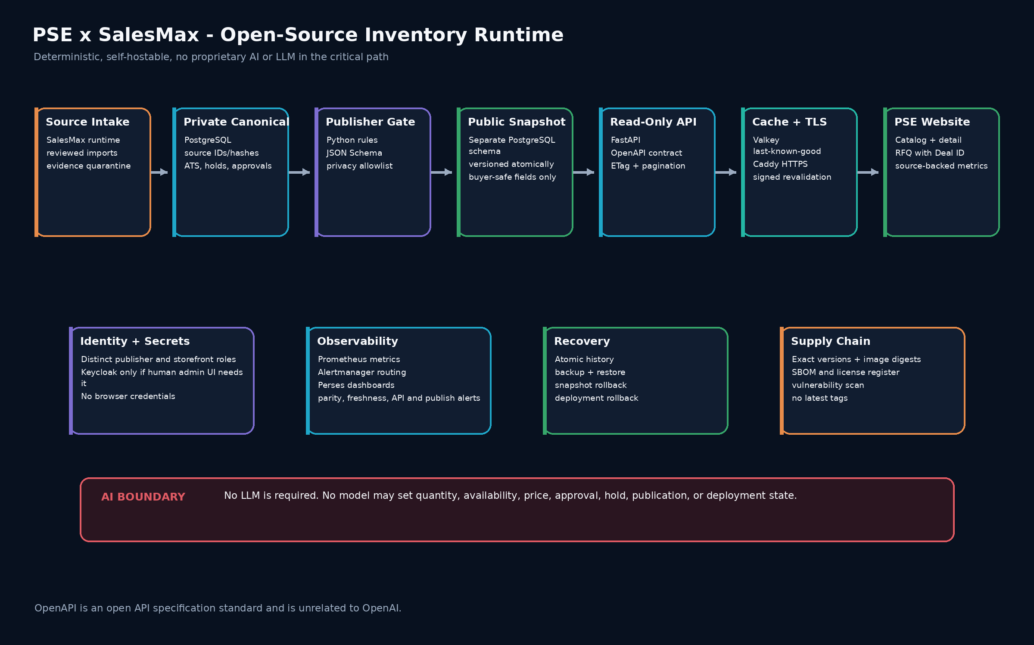
19 / OPEN-SOURCE RUNTIME
Production target is self-hostable; the included runnable mode is deliberately single-process
Existing open-source website components may remain after Phase 0 inspection.
Production target: PostgreSQL + Python/FastAPI + Valkey + Caddy + Prometheus/Alertmanager/Perses. Preview services require adapter gates.

Slide 21
20 / SUPER GAUNTLET LOOP
Every material change must survive the complete release loop
A polished file is not accepted without behavioral, adversarial, visual and clean-room evidence.
1
SOURCE AUDIT
2
CONTRACT TESTS
3
ADVERSARIAL
4
RECOVERY
Reconcile current evidence, rules and truth boundary.
Schemas, examples, API refs, pricing and freshness.
Private-field, timestamp, URL, ID, price and replay mutations.
Atomic promotion, last-known-good, restore and rollback.
5
VISUAL QA
6
SUPPLY CHAIN
7
CLEAN ROOM
8
RELEASE
Render every slide/page; inspect clipping, fonts and parity.
License scan, exact pins, SBOM, secrets and integrity.
Two independent extraction-and-run validations.
Evidence-backed status; production blockers remain honest.
Executable entry point: 07_GAUNTLET/run_super_gauntlet.py

Slide 22
21 / RELEASE STATUS
Open-source packet ready for engineering - production remains access-gated
No completion claim is made for the undeployed live website.
138
0
22
BLOCKED
Automated tests across three suites
Proprietary AI dependencies
Slides / PDF pages
Production completion
Publisher, runnable API, deployment, browser module and policy.
No OpenAI SDK, API key, endpoint or hosted LLM.
Editable presentation and rendered executive brief.
Requires repo, host, SalesMax runtime and live acceptance.
Packet release gates
NEXT GATE
Contracts and examples validate
Privacy and stale-data mutations fail closed
PHASE 0
Atomic promotion and rollback pass
Mount repository and runtime, prove backup/restore and deployment rollback, then run staging and production acceptance.
Open-source license/SBOM controls present
No proprietary-AI runtime indicators
PDF/PPTX parity and visual QA pass
Manifest, SHA-256 and clean-room runs pass
Packet status and production status are intentionally separate.

