Slide 2
Steps to Generate Target Matrix
Dimensions of Target Matrix will be the following:
Number of Rows = Number of Days x Number of Hours x Number of Rooms
Number of Columns = Number of valid combinations of Lecturer, Course and Student Group
The order to fill the Target Matrix will be given, that is order of Columns.
For each column, the number of hours that are needed to be scheduled are scheduled on valid rows taking into account various constraints such as Lecturer Availability, Number of Lecturers already Scheduled, etc.

Slide 3
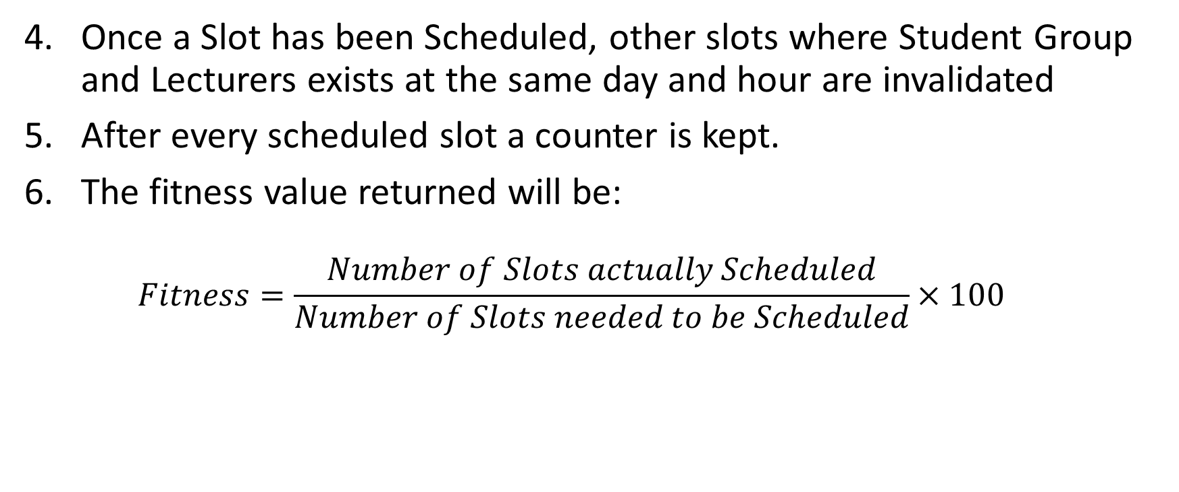
Steps to Generate Target Matrix
Once a Slot has been Scheduled, other slots where Student Group and Lecturers exists at the same day and hour are invalidated
After every scheduled slot a counter is kept.
The fitness value returned will be:
$$Fitness=\frac{Number of Slots actually Scheduled}{Number of Slots needed to be Scheduled}×100$$

