Slide 1
A WEB BASED SENTIMENT-CENTRIC NEWS PORTAL USING SVM AND TF-IDF WITH TIME SERIES ANALYSIS THROUGH LDA
1023 | Prayusha Acharya
Project Work– CSC 412– Class of 2024-CSIT

Slide 2
Outline
Introduction
Problem Statement
Objective
Scope
Literature Review/Background Study
Methodology
Tools and Technology
Result
Future work
Conclusion
Reference

Slide 3
Introduction
The core of the sentiment analysis will be powered by algorithms combining SVM and TF-IDF.
Time-series analysis capability, using Latent Dirichlet Allocation (LDA) to visualize sentiment trends over time.
Valuable for anyone interested in gaining insights into Nepali public opinion and news trends, ultimately fostering more informed decision-making.

Slide 4
Problem Statement
Language barriers for non-Nepali speakers
Frequent exposure to bad news can be toxic
Sorting news articles into accurate categories is a challenging task that often relies on manual effort.
Understanding how sentiment evolves over time in response to specific events or topics.

Slide 5
Objective
To create an advanced sentiment analysis model using TF-IDF with SVM that accurately interprets the emotional tone of news articles.
To develop a time-series analysis feature using LDA to track and visualize sentiment trends over time.

Slide 6
Scope
Developing a web crawler to collect news articles from various Nepali news portals.
Implementing a translation module to convert Nepali articles into English, ensuring accessibility for a global audience.
Integrating sentiment analysis algorithms combining SVM and TF-IDF to accurately assess the emotional tone of news articles.
Implementing LDA for tracking and visualizing sentiment trends over time.

Slide 7
Scope
Allow users to express their opinion by creating custom blog posts, like articles, bookmark, and comment.
Designing a user-friendly interface to display aggregated news articles, blog posts, sentiment analysis results, and sentiment trends.

Slide 8
Literature Review/Background Study
Emotional Impact of News on Social Judgments (Baum, 2021) investigates how emotional content in news influences social judgments and decision-making [1].
Social Media News Headlines and Well-Being (Mousoulidou et al., 2024) explores the psychological impact of social media news headlines on emotional states and well-being [2].
Ensemble Machine Learning for Twitter Sentiment Analysis (Radiuk et al, 2022) presents an ensemble machine learning model for sentiment analysis combining two different algorithms results in more accuracy than using these algorithms alone [3].

Slide 9
Literature Review/Background Study
N-Gram, TF-IDF, and Ensemble Methods in Sentiment Classification (Rahman et al., 2020) explores various methods for sentiment classification, comparing N-Gram, TF-IDF, and ensemble techniques [4].
Multilingual Sentiment Analysis (Das et al., 2023) highlights the significance of effective text preprocessing [5].
LDA Topic-Based Sentiment Analysis in Tourism (Ali et al., 2022) demonstrates how LDA can be combined with sentiment analysis to track sentiment trends over time [6].

Slide 10
Literature Review/Background Study
Comparative Analysis of Sentiment Analysis Techniques: SVM, Logistic Regression, and TF-IDF Feature Extraction (Jadia, 2023) compares different sentiment analysis techniques, including SVM, Logistic Regression, and TF-IDF feature extraction [7].

Slide 11
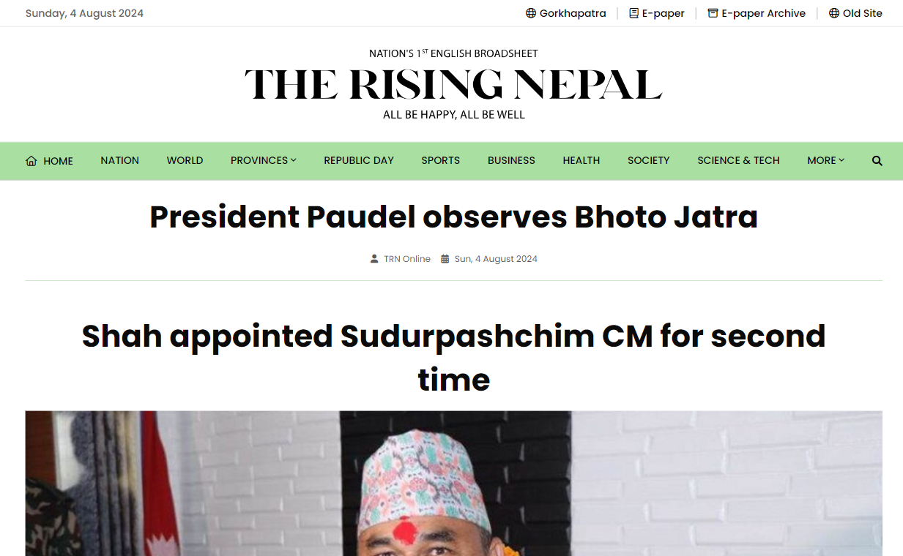
Literature Review/Background Study
Study of Existing System
The Rising Nepal
Limitations:
Language Limitation
Technical Issues
Lack of Sentiment Analysis
Study of Existing System
The Rising Nepal
Limitations:
Language Limitation
Technical Issues
Lack of Sentiment Analysis
Figure: Home Page of The Rising Nepal [8]

Slide 12
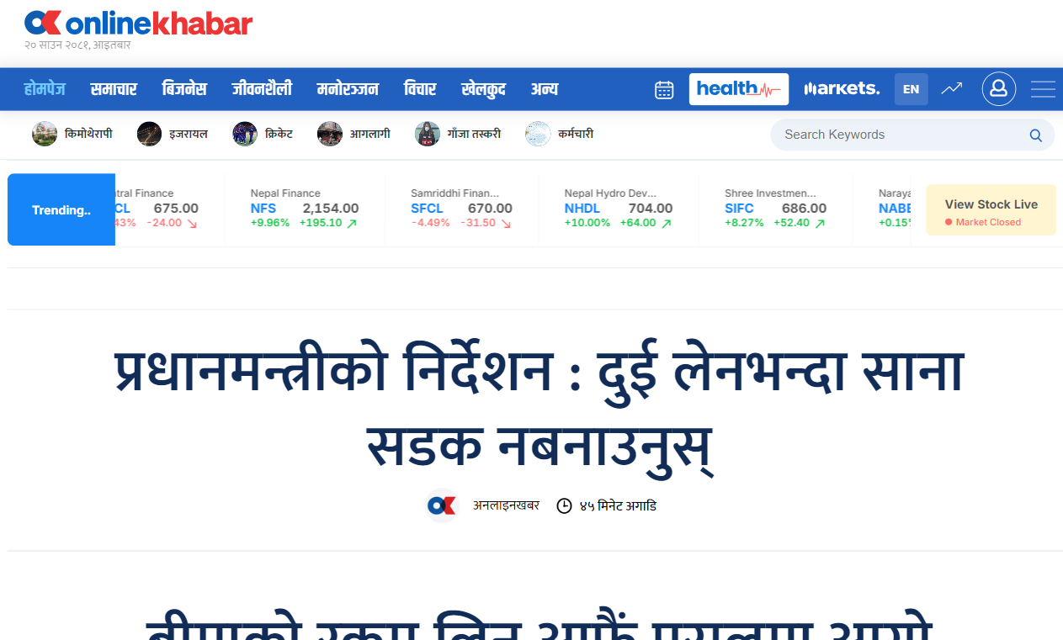
Literature Review/Background Study
Study of Existing System
Online Khabar
Limitations:
Language Barrier
Lack of Sentiment Analysis
Figure: Home Page of The Rising Nepal [9]

Slide 13
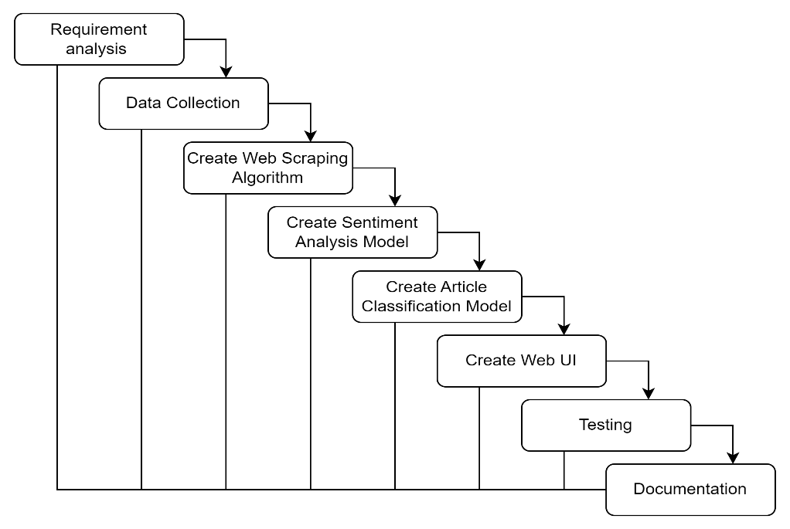
Methodology
Figure: Waterfall Model

Slide 14
Methodology
Functional Requirements
The system shall automatically translate the extracted Nepali content into English.
The system shall classify the sentiment of news articles as positive, negative, or neutral.
The system shall visualize sentiment trends over time for specific topics and entities.
The user shall be able to filter news articles by sentiment, genre, and date.

Slide 15
Methodology
Functional Requirements
The user shall be able to create and view blog posts based on specific categories.
The user shall be able to like, bookmark and comment on articles.
The user shall be able to login to the website to view their saved news articles.

Slide 16
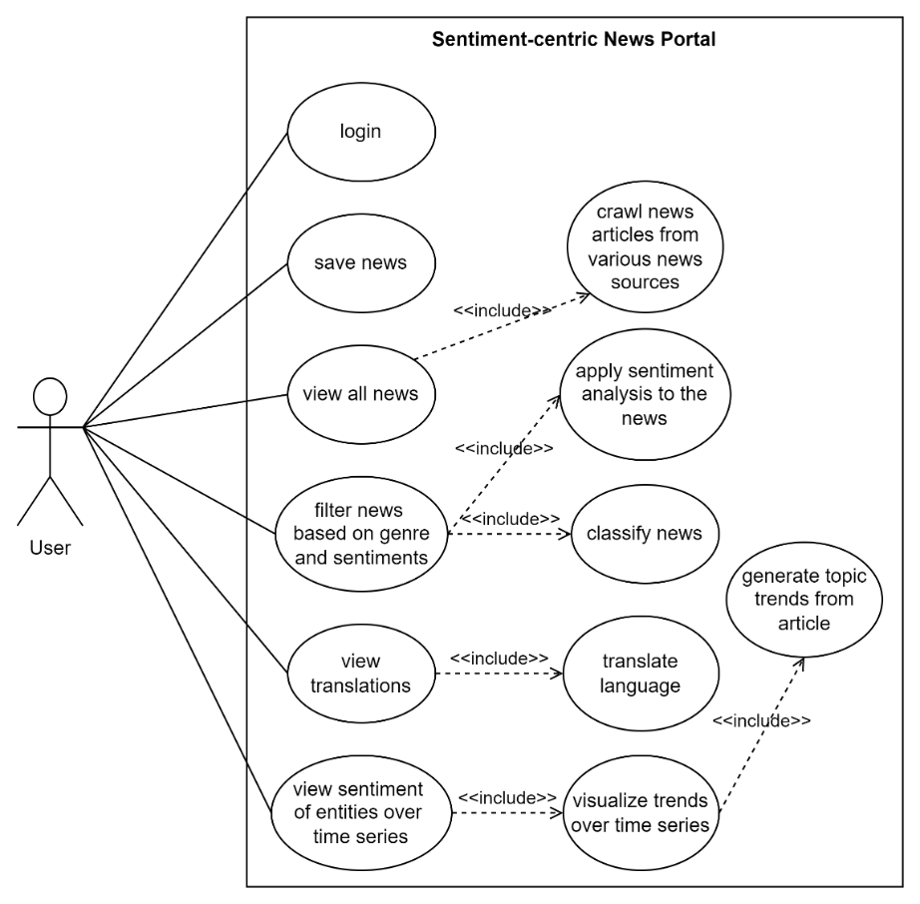
Methodology
Figure: Use Case Diagram for Sentiment-centric News Portal

Slide 17
Methodology
Non-Functional Requirements
The system must handle large volumes of data efficiently.
The sentiment analysis and translation processes must achieve high accuracy rates.
The categorization and time-series analysis must be precise and reliable.
The translation process must ensure the translated text retains the original meaning and context.

Slide 18
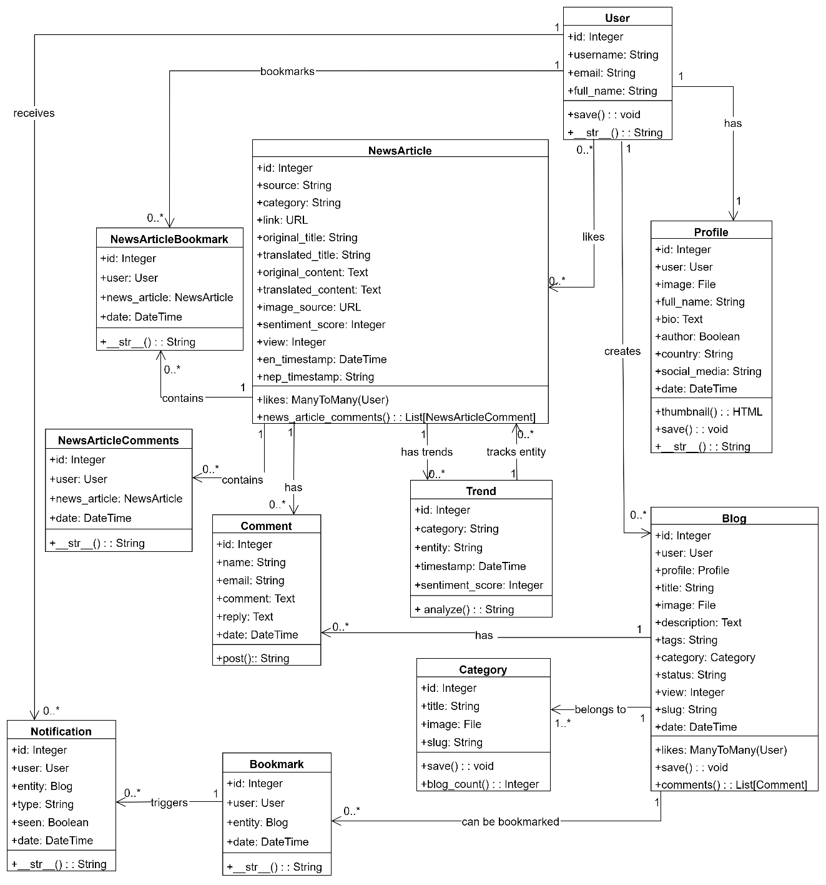
Class Diagram
Figure: Class diagram of Sentiment-centric News Portal

Slide 19
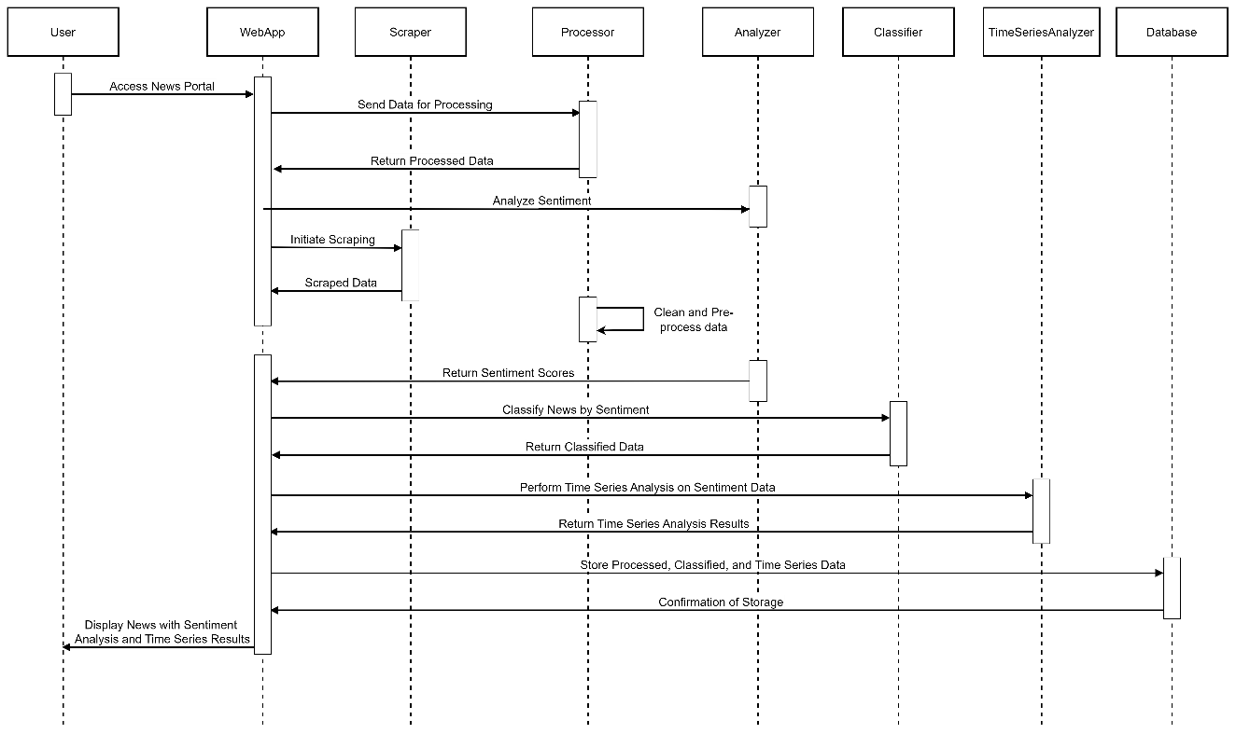
Sequence Diagram
Figure: Sequence diagram of Sentiment-centric News Portal

Slide 20
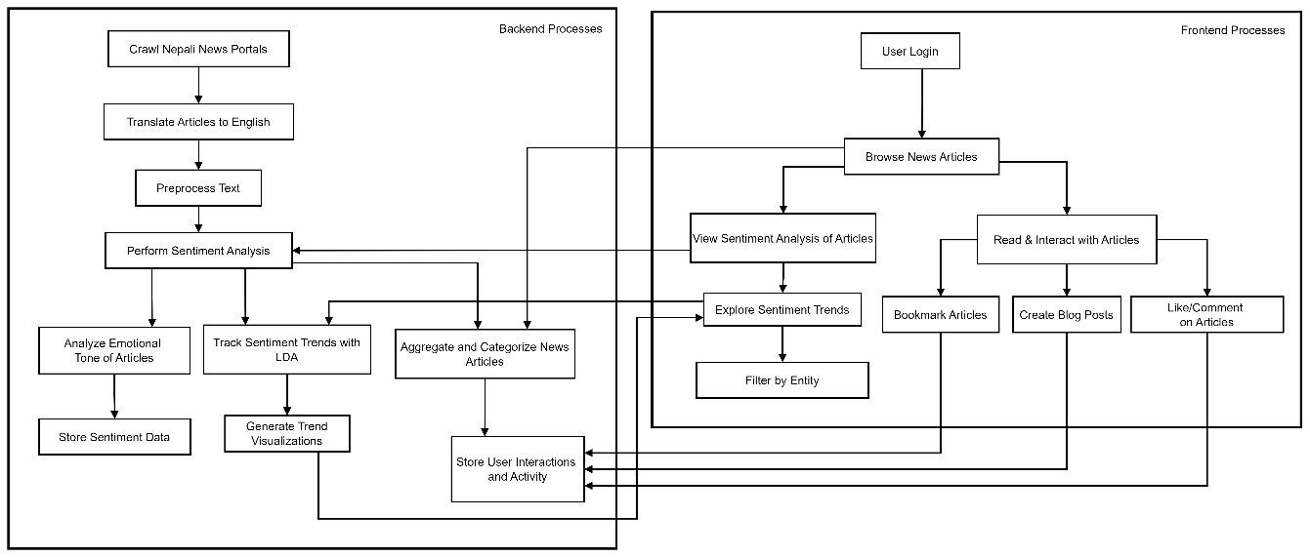
Activity Diagram
Figure: Activity diagram of Sentiment-centric News Portal

Slide 21
Tools and Technology
Python: Primary language for implementing machine learning algorithms and backend development
JavaScript: For frontend development and interactive visualizations
Beautiful Soup: For parsing HTML and extracting news content
Django: Lightweight web framework for building the backend API
Jupyter Notebook: For prototyping and testing machine learning models
NLTK (Natural Language Toolkit): For text preprocessing and Porter Stemming

Slide 22
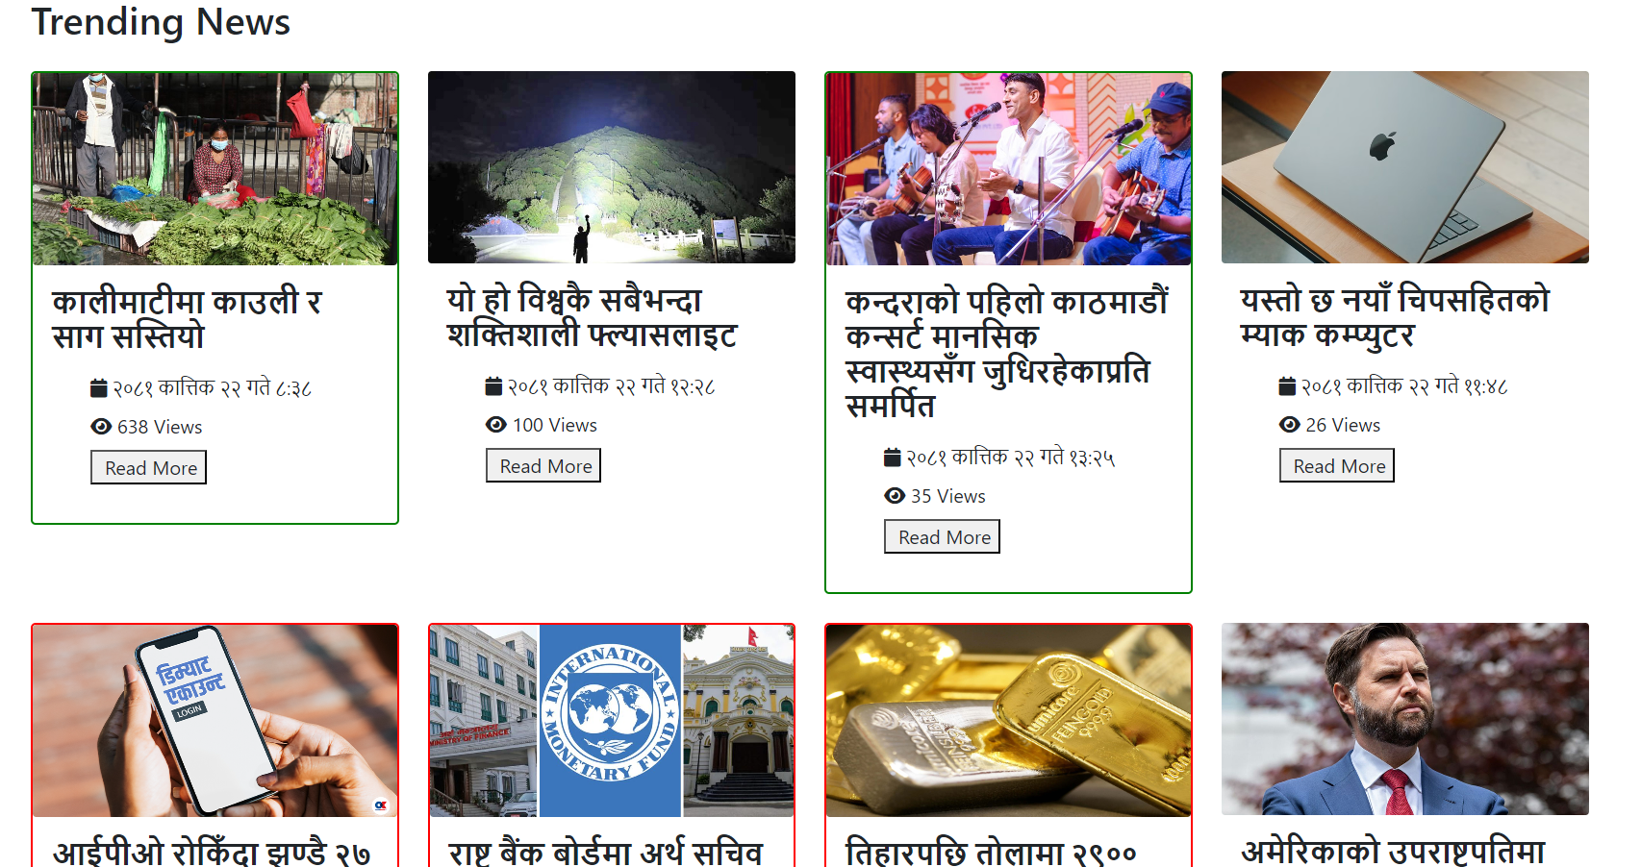
Result
Figure: Landing page of Sentiment-centric News Portal

Slide 23
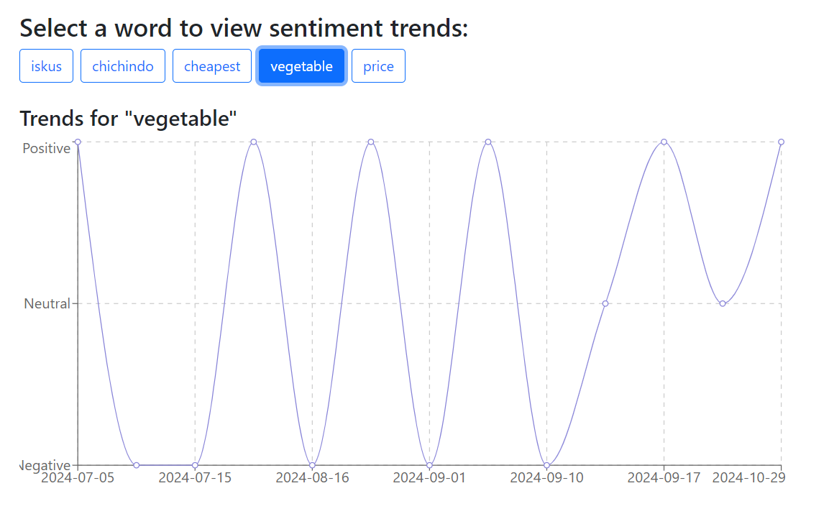
Result
Figure: Time Series Analysis

Slide 24
Future Work
Integrate news articles from different sites.
Implement real-time sentiment analysis to provide users with up-to-date insights as news articles are published.

Slide 25
Conclusion
The Sentiment-centric News Portal leverages advanced NLP and ML techniques, utilizing algorithms like SVM and TF-IDF for sentiment analysis and LDA for time-series analysis.
Translates Nepali news into English, broadening accessibility for a wider audience.
Features bookmarking and blogging, encouraging interactive and personal discourse.

Slide 26
References
[1] R. A. R. Julia Baum, "Emotional news affects social judgments independent of perceived media credibility," Social Cognitive and Affective Neuroscience, vol. 16, no. 3, 2021.
[2] L. T. A. C. Marilena Mousoulidou, "Social Media News Headlines and Their Influence on Well-Being: Emotional States, Emotion Regulation, and Resilience," European Journal of Investigation in Health, Psychology and Education, vol. 14, no. 6, 2024.
[3] O. P. N. H. Pavlo Radiuk, "An Ensemble Machine Learning Approach for Twitter Sentiment Analysis," in 6th International Conference on Computational Linguistics and Intelligent Systems (CoLInS-2022), Gliwice, Poland, 2022.
[4] K. B. M. B. B. M. H. R. K. S. &. T. I. Sheikh Shah Mohammad Motiur Rahman, "An Investigation and Evaluation of N-Gram, TF-IDF and Ensemble Methods in Sentiment Classification," in International Conference on Cyber Security and Computer Science, Springer, Cham, 2020.
[5] M. I. M. M. H. S. R. M. H. S. A. K. Rajesh Kumar Das, "Sentiment analysis in multilingual context: Comparative analysis of machine learning and hybrid deep learning models," Heliyon, vol. 9, no. 9, 2023.
[6] B. O. K. S. Twil Ali, "Analyzing tourism reviews using an LDA topic-based sentiment," MethodsX, vol. 9, 2022.

Slide 27
References
[7] H. Jadia, "Comparative Analysis of Sentiment Analysis Techniques: SVM, Logistic Regression, and TF-IDF Feature Extraction," International Research Journal of Modernization in Engineering Technology and Science , vol. 05, no. 10, 2023.
[8] "The Rising Nepal | Nepal's First English Broadsheet Daily.," [Online]. Available: https://risingnepaldaily.com/. [Accessed 4 August 2024].
[9] "Online Khabar," [Online]. Available: https://www.onlinekhabar.com/. [Accessed 4 August 2024].
[10] L. F. M. &. P. Z. Jenkins, "Language barriers in digital news accessibility," Journal of Communication, 2020.
[11] "Survey on Digital News," Nepal Telecommunications Authority, 2022. [Online]. Available: nta.gov.np. [Accessed 2024].
[12] "The effects of UX design on website abandonment rates," Statista, 2021. [Online]. Available: statista.com. [Accessed 2024].
[13] A. J. M. &. B. T. Hughes, "entiment analysis in digital journalism.," Journal of Digital Media & Policy, vol. 10, no. 1, 2019.

Slide 28
DEMO!!!!!

Slide 29
Thank You!!!!!

