Slide 1
AI in Finance – FOMC reports
Prayut Jain
Mousumi Das
Soumya Mishra

Slide 2
FOMC Meeting outline
Here's a general outline of how an FOMC meeting typically proceeds:
Preparation: Before the meeting, FOMC participants receive several documents to prepare, including the Tealbooks (which provide in-depth analysis of current economic and financial conditions and projections), the agenda, and various memos.
Discussion of Economic Conditions: The meeting begins with a discussion of current economic conditions. This discussion is informed by the data and analysis in the Tealbooks and other materials.
Policy Discussion: After discussing the state of the economy, the Committee members and other participants discuss monetary policy options. This discussion is informed by the analysis and options presented in Tealbook B.
Decision: The Committee then makes its policy decision. This decision is typically about whether to raise, lower, or maintain the target range for the federal funds rate, although the Committee can also make decisions about other aspects of monetary policy.
Statement Release: After the meeting, the FOMC releases a statement summarizing its policy decision and the reasoning behind it. This statement is made public immediately after the meeting.
Press Conference: Starting in 2011, the Chair of the Federal Reserve (currently Jerome Powell as of my knowledge cutoff in September 2021) holds a press conference after every other FOMC meeting. The press conference provides an opportunity for the Chair to explain the Committee's decision in more detail and for journalists to ask questions.

Slide 3
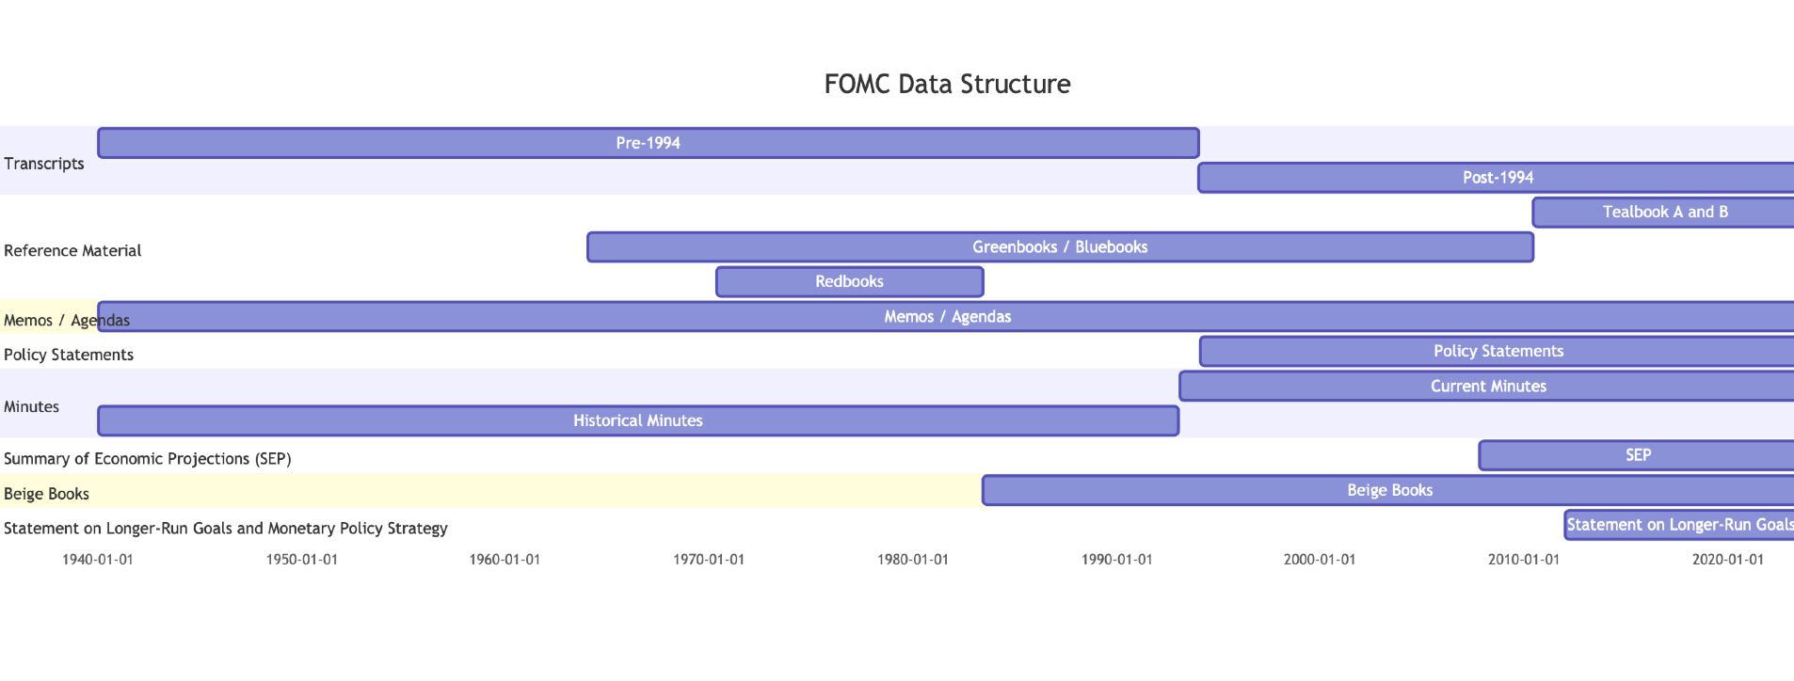
FOMC Data Structure
Redbooks: 1970-05-01, 1983-05-31
1994

Slide 4
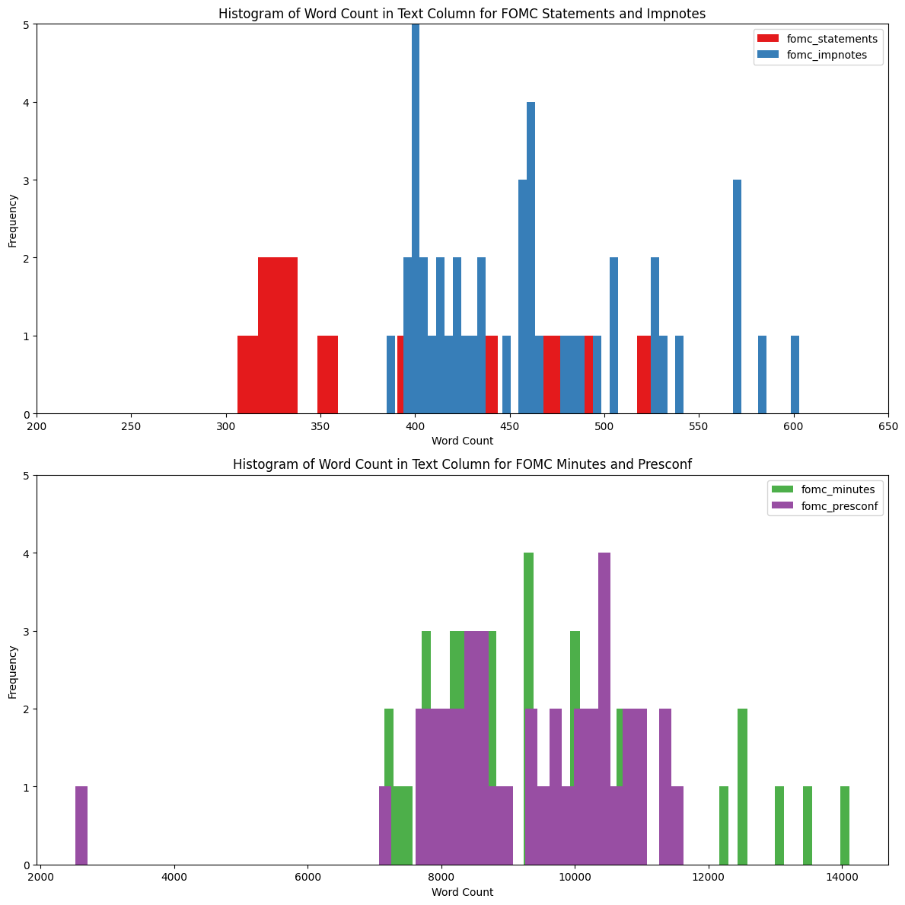
Data to be collected (starting 1994)
Post 2011
Transcripts (NOTE: not available post 2018)
Minutes of FOMC meeting (lag of ~3weeks)
Policy statements / Implementation notes
Press Conference Transcripts
Long run economic outlook
Pre 2011
Transcripts
Minutes of FOMC meeting
Policy statements

Slide 5
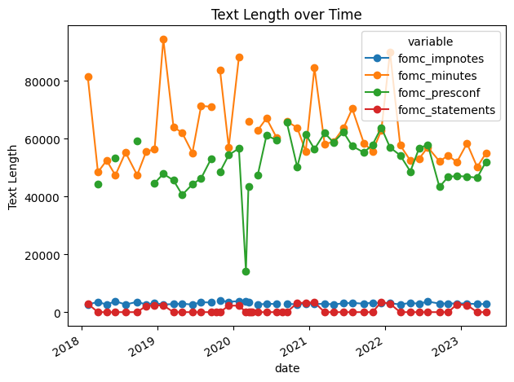
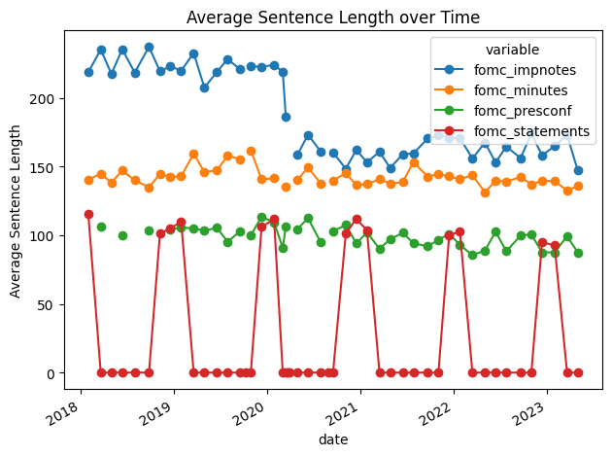
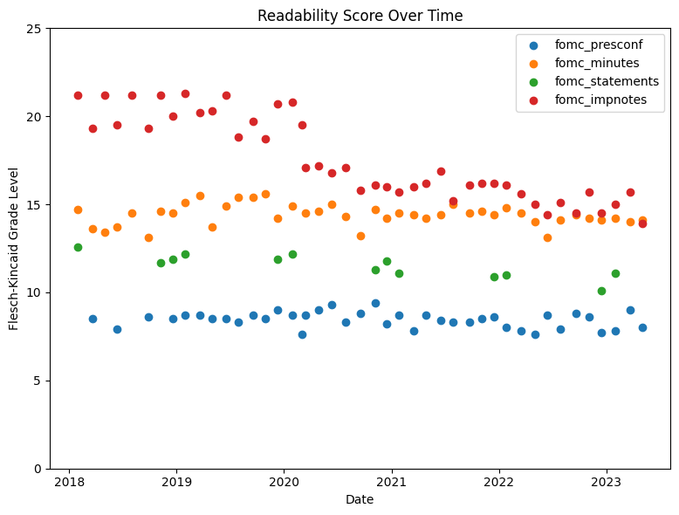
Text characteristics

Slide 6
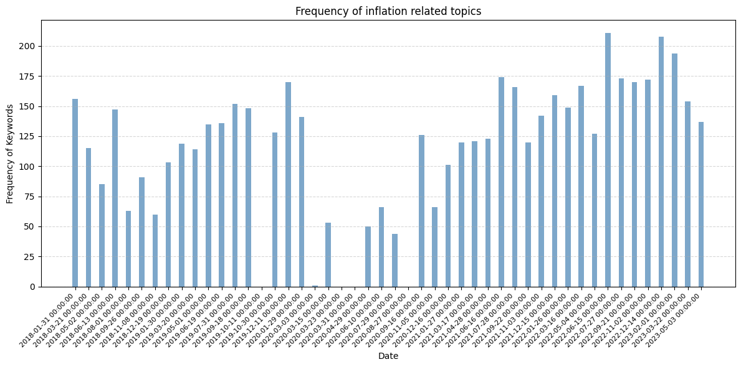
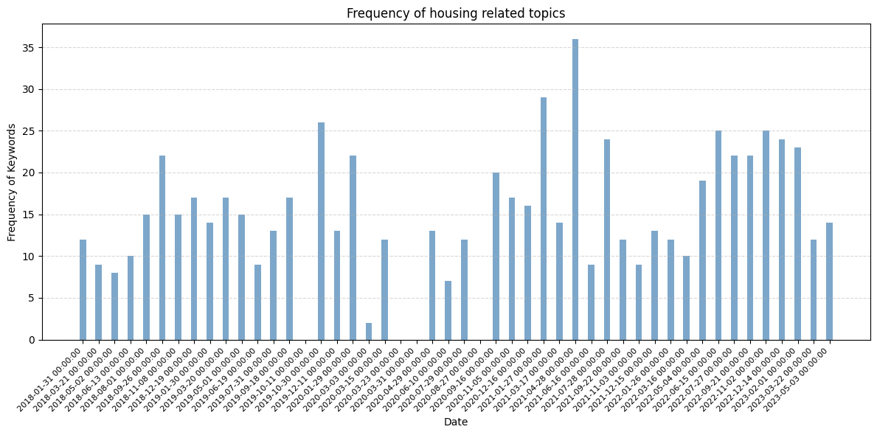
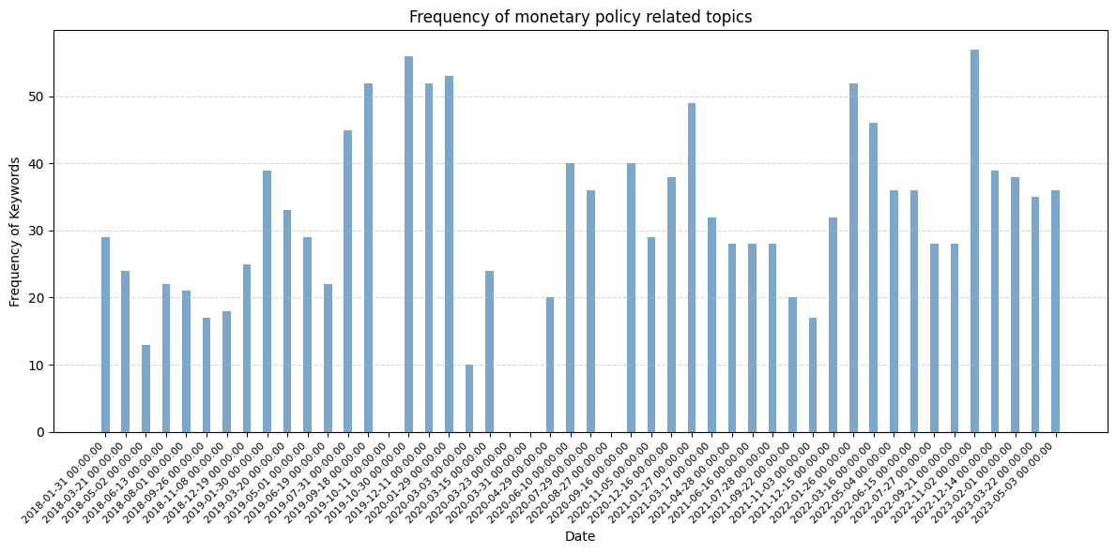
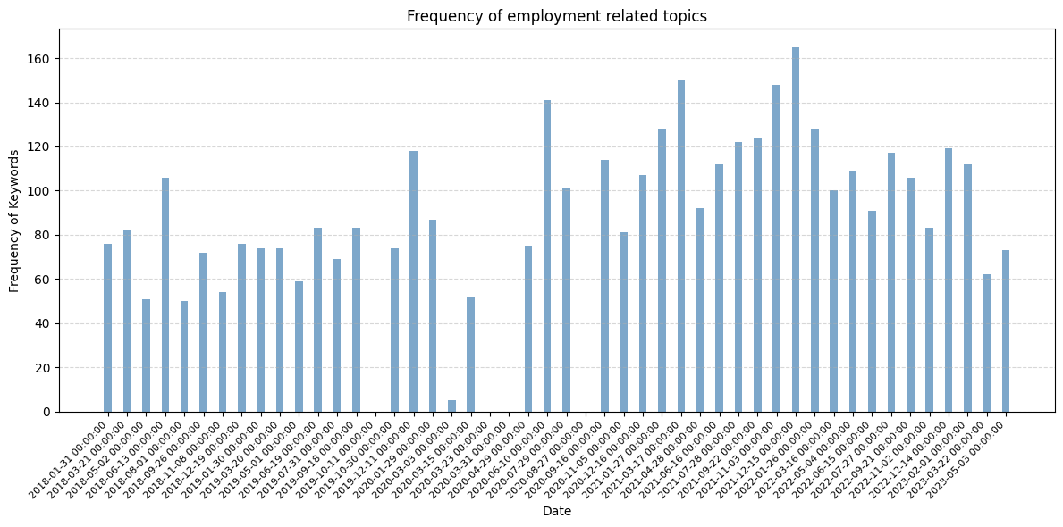
Word frequency as a POC for sentiment

Slide 7
Basic Idea: LLM enacting a Fed chair
Instruct tuned LLM trained on financial data, mainly FOMC material, and fine tuned for these capabilities:
Economic outlook summarization
Aspect based sentiment recognition
Q/A bot – more like talk to your FOMC documents
This will be trained using Q/A from press conference for it to learn to think and talk as a fed chairman
Llama / Alpaca are good options. But we can also leverage Langchains.
Initial data usage: Limited to only after 1994
Future Extensions:
Expand to bigger and older corpus (Consider beige books and preparatory material)
Feedback reinforcement for the fine-tuned model
Expansion to Global Central banks

