Slide 1
SECOM Wafer Fault Detection
Using sensor data to catch defective/failed production units
Prazol Basnet· CS640 · Fall 2026
Notes:
This talk walks through one experiment: a single logistic regression model on all cleaned SECOM sensors, compared with always predicting pass, judged with a 10 to 1 cost rule and balanced accuracy.

Slide 2
Introduction
Uses in-line sensor telemetry to predict a wafer's outcome early, before slow or expensive downstream physical/electrical test is even run.
This is a recognized technique called "soft sensing" or "virtual metrology“.
Kang, P., Lee, H. J., Cho, S., Kim, D., Park, J., Park, C. K., & Doh, S. (2009). A virtual metrology system for semiconductor manufacturing. Expert Systems with Applications, 36(10), 12554–12561. https://doi.org/10.1016/j.eswa.2009.05.053
Notes:
The positive class is fail. Because failures are rare, always predicting pass scores 93% accuracy, which is why accuracy is not used.

Slide 3
Task and data
Goal: Predict which wafers will fail the final test
Data: 1,567 wafers, each with 590 sensor readings (UCI SECOM, July to October 2008)
Failures are rare: only 104 wafers failed (6.6%)
Labels: only pass or fail, so this is fault detection
Assumption: missing a bad wafer costs 10 times more than a false alarm
Based on the "rule of ten" in quality management: a defect costs about 10 times more at each later stage it is caught
A false alarm costs one extra inspection; a missed failure moves on to costlier steps or the customer
With costs 1 and 10, the best cutoff is a risk of 1/(1 + 10) ≈ 0.091 (Elkan, 2001)
Sources: "Rule of Ten" (quality cost escalation). ResearchGate, https://www.researchgate.net/publication/337343379_Rule_of_Ten; Elkan, C. (2001). The Foundations of Cost-Sensitive Learning. Proc. 17th International Joint Conference on Artificial Intelligence (IJCAI), 973–978.
Notes:
The positive class is fail. Because failures are rare, always predicting pass scores 93% accuracy, which is why accuracy is not used.

Slide 4
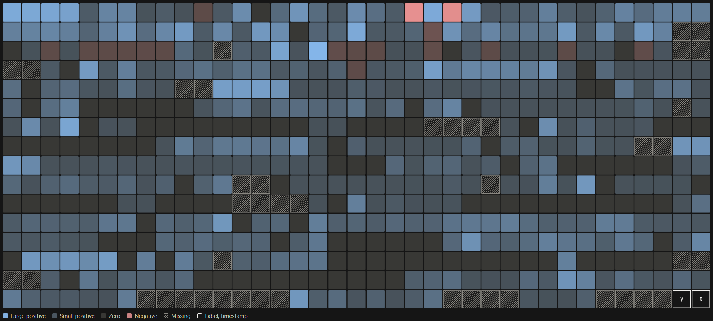
Visual representation: 1 row of SECOM
Notes:
The positive class is fail. Because failures are rare, always predicting pass scores 93% accuracy, which is why accuracy is not used.

Slide 5
Cost rule: when to flag a wafer
We assume missing a bad wafer costs 10 times as much as a false alarm
Formula (Elkan, 2001): flag when risk ≥ cost of false alarm ÷ (cost of false alarm + cost of miss) = 1 ÷ (1 + 10)
So we flag a wafer when its failure risk is at least 1 in 11 (about 9.1%)
At 9.1%, flagging and not flagging cost the same on average
The usual 50% cutoff is wrong here: almost no wafer is 50% likely to fail
The formula needs honest risk scores, and the cutoff comes from costs, not test results, so it cannot be tuned to look good
Source: Elkan, C. (2001). The Foundations of Cost-Sensitive Learning. Proc. 17th International Joint Conference on Artificial Intelligence (IJCAI), 973–978.

Slide 6
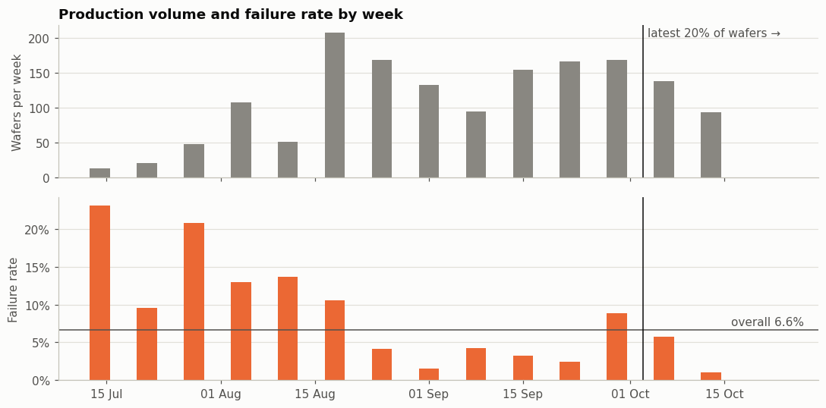
Failures were common in July and August and rare in September. Because failures are rare overall, accuracy is misleading, so we use balanced accuracy and cost, and also test the model on the newest wafers.
Notes:
The positive class is fail. Because failures are rare, always predicting pass scores 93% accuracy, which is why accuracy is not used.

Slide 7
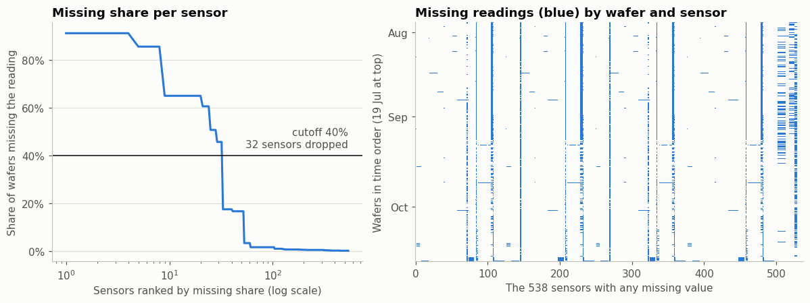
Most sensors have only a few gaps. 32 sensors were missing in over 40% of wafers and were removed; the remaining gaps were filled with each sensor's typical (median) value.
Missing Data
Notes:
The positive class is fail. Because failures are rare, always predicting pass scores 93% accuracy, which is why accuracy is not used.

Slide 8
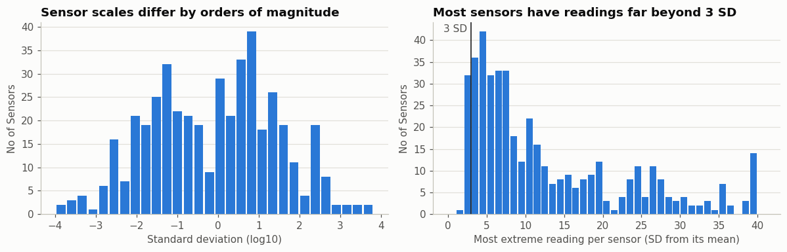
Sensor scales span almost 8 orders of magnitude, and more than half the sensors are strongly skewed. Extreme readings are common: 1,268 of the 1,567 wafers have at least one reading beyond 3 SD, 299 sensors have a reading beyond 6 SD, and the most extreme reading is 40 SD from its mean.
Use Quantile Transformer, it maps a feature's original distribution to a uniform or normal distribution.
Sensor/feature Scales
Notes:
The positive class is fail. Because failures are rare, always predicting pass scores 93% accuracy, which is why accuracy is not used.

Slide 9
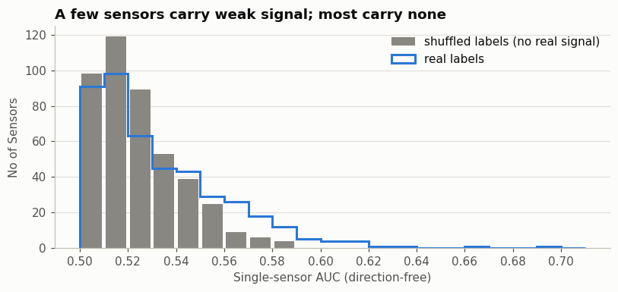
Better algorithms won’t turn these sensor readings into a reliable failure detector. The models plateau at the same weak level, which suggests the main drivers of failure are not captured in this data as currently measured and summarized. Improving detection likely requires different data, not a different model.
Single Sensor Signal
Notes:
The positive class is fail. Because failures are rare, always predicting pass scores 93% accuracy, which is why accuracy is not used.

Slide 10
What exploring the data showed
Failures became rarer over time (22% in July, 3% in September), we also test the final models on the newest wafers
116 sensors never changed, 32 were mostly empty, we removed them leaving 442
Remaining gaps filled with each sensor’s median from the training wafers, which outliers don’t distort
No single sensor predicts failure well we use all 442 sensors.
Sensors use very different scales, are often skewed, and some readings are extreme outliers (up to 40 SD)
Notes:
Each EDA finding is tied to a modeling decision. Label-based EDA was descriptive only; no sensor was selected from it, so it cannot leak test information.

Slide 11
Model Selection
Logistic regression is the strong simple model and the Random Forest the strong flexible model for binary classification task.
Both suit high-dimensional, noisy, and rare-event data.
Why were some of the other models not selected.
KNN: Distances become meaningless with 442 sensors (high-dimensional).
Naive Bayes: Assumes sensors are independent, but 303 have near-copies, so evidence gets counted twice and risks become overconfident.
Single decision tree: Very unstable with 104 failures, small data changes give a different tree.
Neural network: Far too little data: 104 failures can’t support thousands of parameters.
Notes:
Each EDA finding is tied to a modeling decision. Label-based EDA was descriptive only; no sensor was selected from it, so it cannot leak test information.

Slide 12
Validation: when and how the data was split
When: the split happens first, before any cleaning, gap-filling or scaling
How: the 1,567 wafers go into 5 equal parts (~313 wafers, ~21 failures each), each keeping the 6.6% failure rate
Train on 4 parts (~1,254 wafers) and test on the 5th (~313); rotate until every part is tested once
Repeat with 5 different shuffles: 25 tests in total
Inside each training set, a smaller 5-fold split picks the regularization strength
Why: with only 104 failures, one split could be lucky or unlucky

Slide 13
Data Leakage Prevention
The threshold isn’t tuned. 1/11 comes from the 10:1 cost ratio, set before modeling.
Preprocessing is fitted on training wafers only.
No sensors are selected using pass/fail. All 442 cleaned sensors are kept.
Time leakage is tested directly. Random CV mixes old and new wafers, so the time check trains on the earliest 80% and tests on the latest 20%.
There are no duplicate wafers

Slide 14
Scaling the Data
Standard scaler just shift and rescale the data linearly.
Quantile Transformer maps a feature's original distribution to a uniform or normal distribution.
It does this by using mathematical quantiles to smooth out unusual distributions, making it highly effective for handling extreme outliers and heavily skewed data.
Reading | Percentile among training wafers | Standardized | Quantile-transformed
98 (a bit low) | 16.7% | −0.53 | −0.97
100 (typical) | 53% | −0.02 | +0.08
102 (a bit high) | 85% | +0.49 | +1.03
140 (extreme) | 99.7% | +10.17 | +2.88
180 (training maximum) | 99.9% | +20.35 | +5.20
Example: scaling standard vs quantile
Notes:
Each EDA finding is tied to a modeling decision. Label-based EDA was descriptive only; no sensor was selected from it, so it cannot leak test information.

Slide 15
Primary Evaluation Metric
Balanced accuracy is the average of the catch rate on failures and the correct rate on passes where both classes count equally, so always saying “pass” scores 50%, not 93%
Cost per wafer weighs mistakes the way the business would. 10 × misses + 1 × false alarms, divided by the number of wafers.
Accuracy rewards ignoring the rare class.
Precision ignores the failures the model misses. A model that flags only its single most certain wafer could score 100% precision while catching almost nothing.
Recall ignores false alarms. Flagging every wafer gives 100% recall but is useless.
F1 treats a missed failure and a false alarm as roughly equally bad. We assumed a miss costs 10 times as much.
Notes:
Each EDA finding is tied to a modeling decision. Label-based EDA was descriptive only; no sensor was selected from it, so it cannot leak test information.

Slide 16
Experiment design
Element | Choice
Dummy | Majority class (E1): always predict "pass"
Models | Logistic regression & Random Forest using all 442 cleaned sensors
Pipeline | LR (E2): Clean → fill gaps (median) → standardize → L2 logistic regression (C tuned) LR (E3): Clean → fill gaps (median) → quantile transform → L2 logistic regression (C tuned) RF (E4): Clean → fill gaps (median) → random forest, 200 trees (leaf size tuned) → calibrate
Cost rule | Flag a wafer when predicted risk ≥ 1/11 ≈ 0.091
Validation | 5-fold cross-validation, repeated 5 times (25 tests)
Metrics | Balanced accuracy (main); cost per wafer
Notes:
Every step that learns from data is refit inside each training fold. The threshold comes from the cost ratio, so it needs no tuning and never touches test data. The cost enters only once: no class weights, threshold at 1 over 11.

Slide 17
Results: mean of 25 outer folds
Model | Balanced acc. | Recall (fail) | Precision (fail) | Cost / wafer | ROC-AUC | PR-AUC
E1 Majority Class | 0.500 | 0.000 | 0.000 | 0.664 | 0.500 | 0.066
E2 Logistic regression, standardized | 0.599 | 0.333 | 0.161 | 0.568 | 0.687 | 0.156
E3 Logistic regression, quantile | 0.633 | 0.450 | 0.149 | 0.537 | 0.695 | 0.180
E4 Random forest, calibrated | 0.646 | 0.442 | 0.175 | 0.510 | 0.742 | 0.189
E2 at threshold 0.5 | 0.502 | 0.010 | 0.095 | 0.662 | 0.687 | 0.156
E3 at threshold 0.5 | 0.502 | 0.004 | 0.080 | 0.661 | 0.695 | 0.180
E4 at threshold 0.5 | 0.500 | 0.002 | 0.040 | 0.664 | 0.742 | 0.189
E3 has lower cost than E2 (effect of the quantile transform)
E4 has lower cost than E3 in 18/25 (forest vs best linear model)
Notes:
Cost per wafer is in false-alarm units. Always passing pays 10 for every failure, about 0.66 per wafer. E2 and E3 use the same model; only the threshold differs. E4 adds clipping. Of flagged wafers in E4, 15% fail, 2.3 times the base rate.

Slide 18
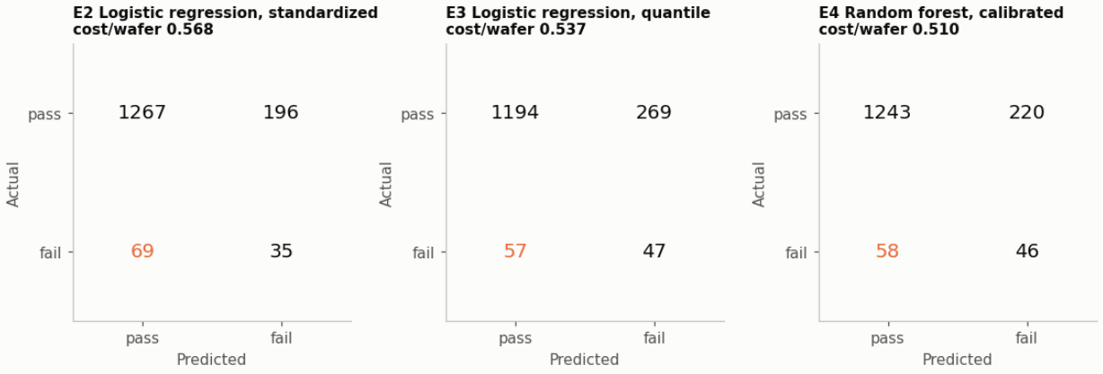
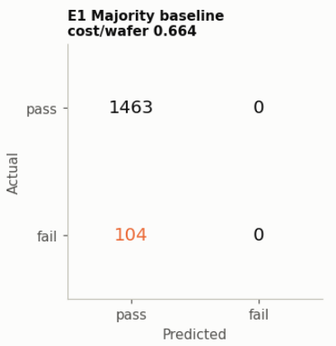
Confusion Matrix
Notes:
The threshold curves are descriptive, never used to choose the threshold. Balanced accuracy peaks slightly lower, at 0.070, because it implicitly treats a miss as about 14 false alarms. Pinning down the real cost of a miss matters as much as improving the model.

Slide 19
Results: Time ordered check
Train on the earliest 80% of wafers and are tested once on the latest 20%.
The model should be periodically trained on the new data.
Model / evaluation | Balanced acc. | Recall (fail) | Precision (fail) | Cost / wafer | ROC-AUC | PR-AUC
E3, random CV (mean of 25 folds) | 0.633 | 0.450 | 0.149 | 0.537 | 0.695 | 0.180
E4, random CV (mean of 25 folds) | 0.646 | 0.442 | 0.175 | 0.510 | 0.742 | 0.189
Dummy model, late wafers | 0.500 | 0.000 | 0.000 | 0.543 | 0.500 | 0.054
Logistic regression, late wafers | 0.570 | 0.176 | 0.214 | 0.482 | 0.675 | 0.146
Random forest, late wafers | 0.514 | 0.176 | 0.064 | 0.588 | 0.549 | 0.071
Notes:
Cost per wafer is in false-alarm units. Always passing pays 10 for every failure, about 0.66 per wafer. E2 and E3 use the same model; only the threshold differs. E4 adds clipping. Of flagged wafers in E4, 15% fail, 2.3 times the base rate.

