Slide 1


Project Name: Smart Bank System using Cloud
COEN6313 : Programming on Cloud
Presented to
Yan Liu
By
Ashraf Uddin Chowdhury Rafat (40272674)
Proddut Kumar Biswas (40262586)
Adilmanzoor Kalilur Rahman (40271551)
Sai Abhinav Thadellapalli (40257238)
Group Number #14G
On 29 October 2024

Slide 2
Main Function of our SaaS
1. Core Banking Operations
Secure user authentication & authorization
Real-time transaction processing
Balance management & fund transfers
Transaction history tracking
2. AI-Enhanced Features
OCR-powered cheque processing
AI signature verification
Intelligent chatbot assistance
Automated fraud detection
3. Cloud-Native Capabilities
Scalable MongoDB database
RESTful API architecture
Docker
Containerized deployment
Real-time data synchronization
4. Security Features
JWT-based authentication
Encrypted transactions
Multi-factor verification
Secure session management

Slide 3
Architecture Design
Frontend: React.js
Backend: Flask (Python)
Database: MongoDB
Cloud Platform: Amazon EC2
Authentication: JWT for secure API access
AI Integration: Planned integration with Hugging Face models for enhanced customer service features like chatbots

Slide 4










TECHNOLOGICAL CHOICES
Python
Flask Web Framework
Amazon EC2
Asynchronous Operations
MongoDB Operations
RESTful API Design
GitHub
Docker
Local Development Environment: Visual Studio Code
FrontEnd: React.js

Slide 5



ARCHITECTURAL DIAGRAM
User
Bank Transaction Service
http
Data store
React.JS
REST API
AI Model
AWS
Flask
Frontend
Backend

Slide 6
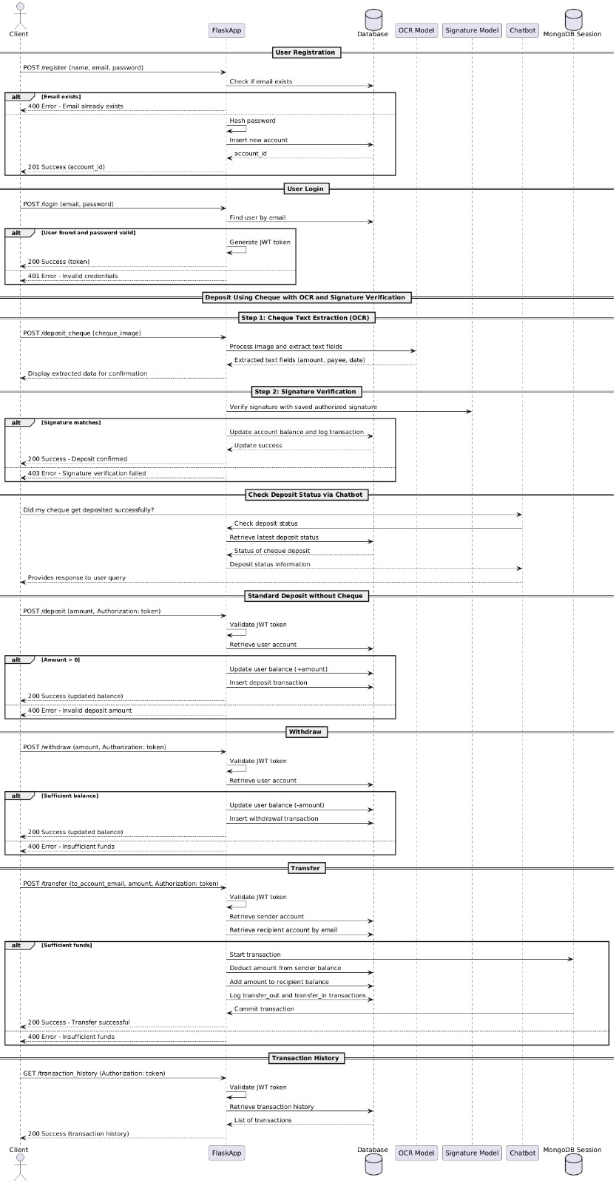
Sequence Diagram

Slide 7
DEVELOPMENT METHODS
Agile
Write Code Locally
Testing functionality locally
Deploy the application on the cloud
Connect with the MongoDB
Connect with the Hugging face AI model
Expose it to Docker
Upload the source code to GitHub

Slide 8
Technologies Used and Accomplishments So Far
Technologies: Python, MongoDB, RESTful API , Vs Code, JWT, Flask JSON.
Accomplishments:
Implemented user registration and login with hashed passwords
Developed API endpoints for account management: registration, login, balance check, deposit, withdrawal, transfer, and transaction history
Set up MongoDB Atlas for data storage
Utilized JWT for secure API access

Slide 9
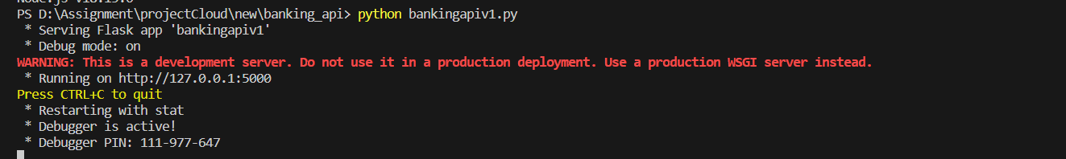
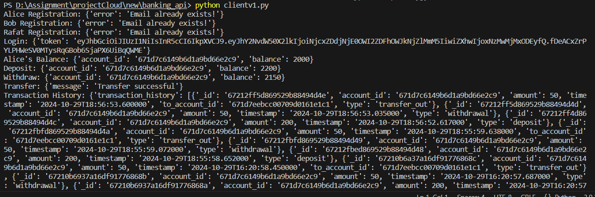
Accomplishments
Server End:
API Testing at Client End:

Slide 10
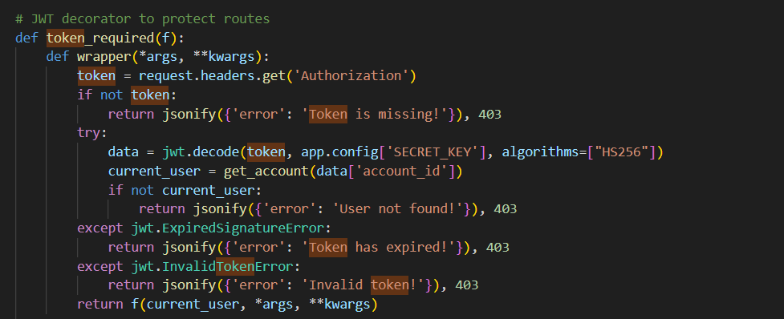
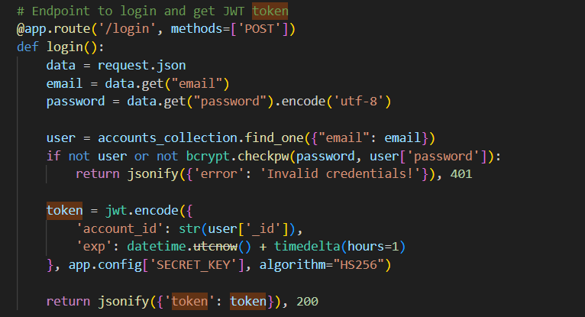
Accomplishments
JWT TOKEN MANAGEMENT:
Github Link:
https://github.com/prbis/Project-6313-Cloud.git

Slide 11
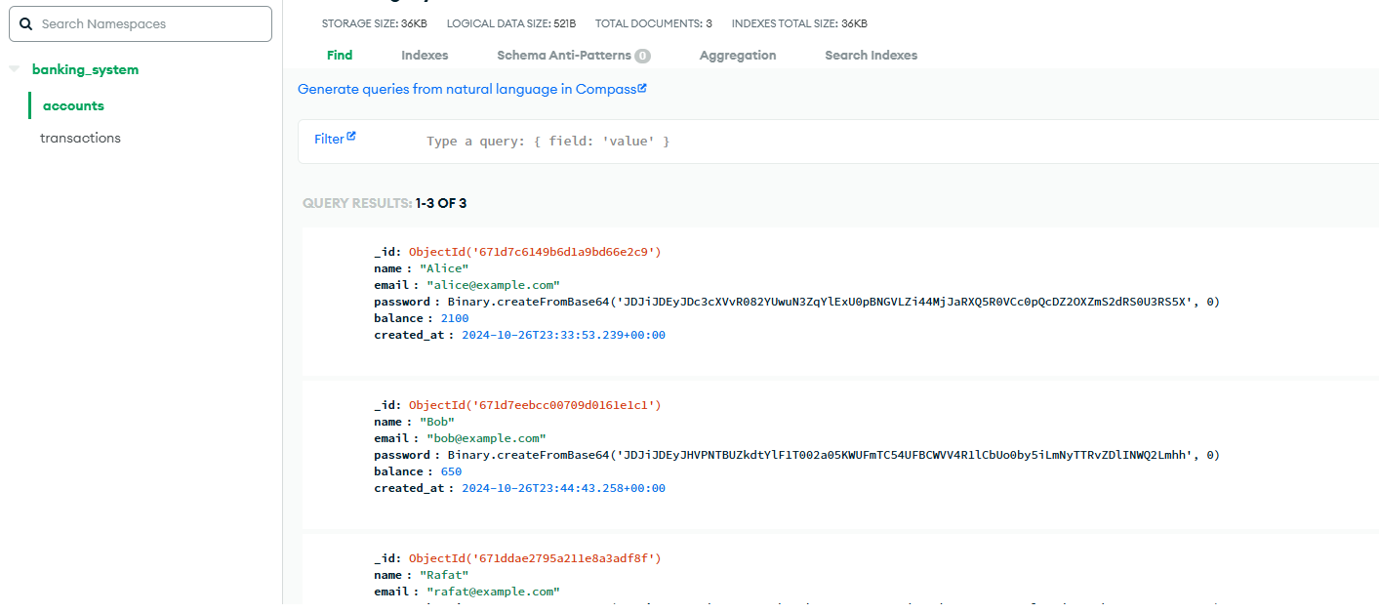
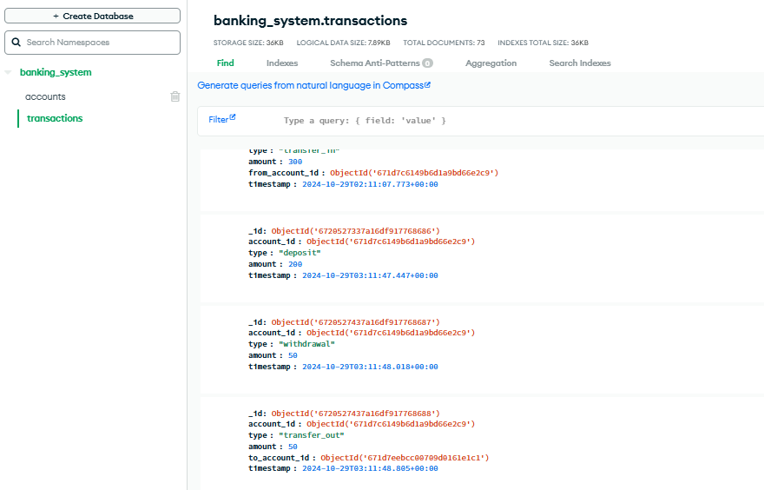
Accomplishments
Mongo DB:

Slide 12
Issues Faced and Solutions
ISSUES | Solution | Spent Man Hour (MH) to Solve
1. Database Integration Problem at MongoDB | Implemented Environment variables for Sensitive Data | 3.2
2. Deployment challenge of JTW token Management | Implemented Secure Token Handling and Validation | 1.6
3. REST API | Implemented REST API | 1.3

Slide 13
Remaining Tasks
Deployment in the Cloud.
Use Docker for the project CI/CD.
Complete integration with a Hugging Face AI model.
Prepare for the final presentation and demonstration.

Slide 14
Are Your Goals Still the Same?
Yes, the goals remain the same with a focus on delivering a scalable and secure banking service with AI-enhanced features.

Slide 15
THANK YOU

